Slide 1
Skeletal System
Pupils at home!
Work through the powerpoint and complete any task that is in a yellow box using the powerpoint
Progress indicators
Good Progress: Be able to explain functions of the skeletal system
Outstanding Progress: Be able to link the structure and functions of the skeletal system, providing a sporting example

Slide 2
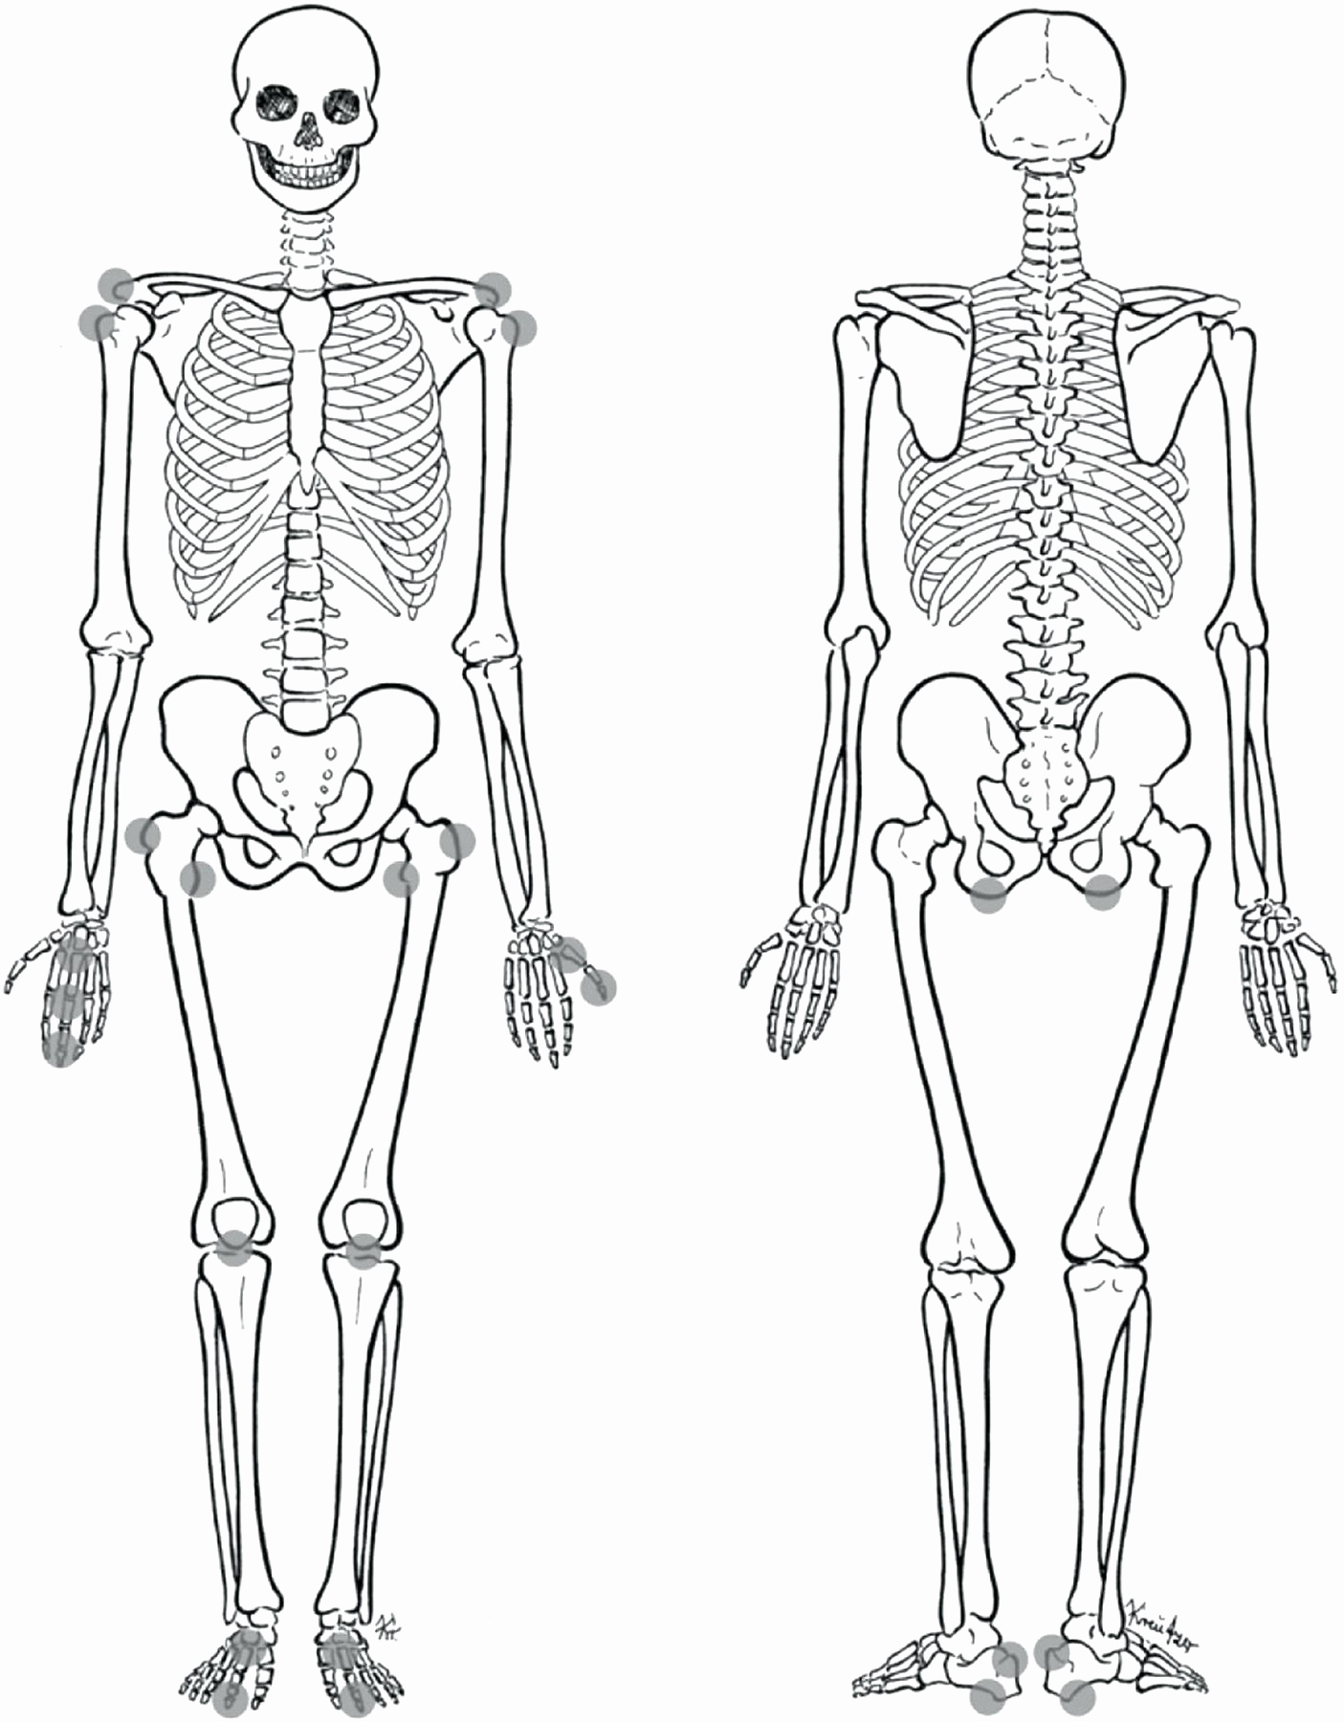
DNA
Name:
Task
Label the skeleton components using the next slide as guidance (add text boxes)
Delete this box once complete

Slide 3
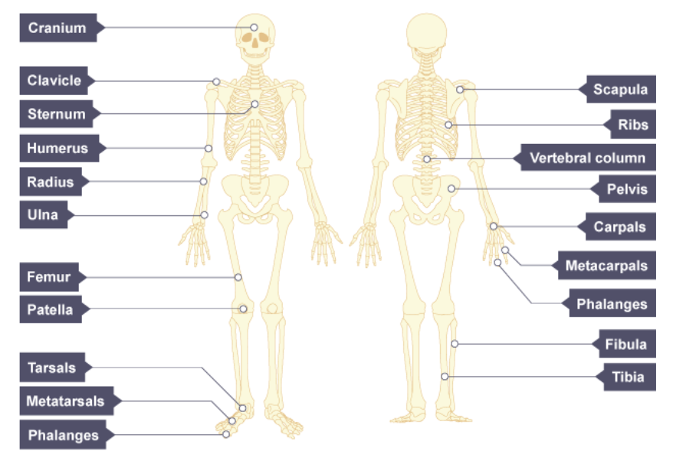
Fix it!

Slide 4
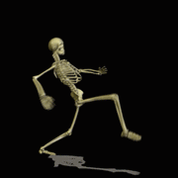
What actually do I need to know about the skeletal system?
Functions
Structure
(where SOME bones are)
Classification
(types)

Slide 5
Functions of the Skeleton

Slide 6
Task
Fill in the boxes using the following slides as guidance, you must translate this into your own words!
Blood cell production
Movement
Protection
Functions
of the Skeleton
Mineral storage
Muscle Attachment

Slide 7
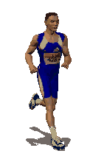
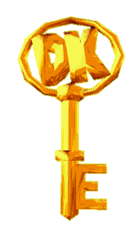
Movement:
As muscles contract the bone is moved causing movement
This joint is where movement takes place
SE (AO2) When running hamstring contracts flexion occurs at the knee, the tibia and fibula at the knee raising the lower leg.
You just need to be able to explain an example of movement linked to bones!

Slide 8
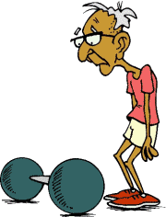
Muscle Attachment:
Muscles only PULL, they are attached to the joints by Tendons.
As a muscle contracts it pulls the bone and flexes or extends the joint.
SE (AO2) E.g when the bicep contracts the elbow flexes, then tendon is connects the bicep to the radius/ulna.

Slide 9
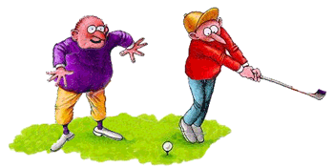
Protection:
The skeleton protects the vital organs
SE - The ribs protect the heart and lungs).
Tell your partner your own sporting example of a bone that protects a vital organ in sporting context.
For example…….

Slide 10
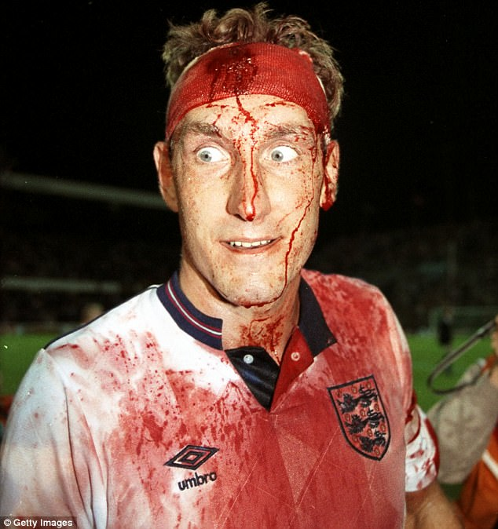
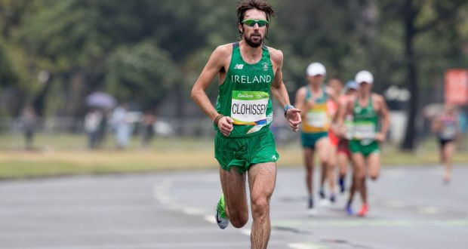
Blood Cell Production (Red, white and platelets)
Blood is formed in larger (long) bones therefore more o2 can be sent to the working muscles via red blood cells
White blood cells (to protect against infection)
Platelets (clot the blood)

Slide 11
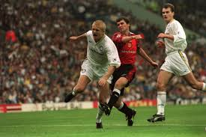
Mineral Storage Storage of calcium and Phosphorus:
Calcium and phosphorus are minerals
Stored in your bones to strengthen them
Gives the skeletal structure strength to
support your body and withstand powerful
stresses particularly during sport.
This makes athletes less prone to injury and able to cope with the demands on the body.

Slide 12
DEMONSTRATE
Task
Add a text box for each section and complete the exam question

Slide 13
Classification of bones
Short Bones | Long Bones | Flat Bones | Irregular Bones
Weight bearing and provide support E.G. Carpels Tarsals | Aid movement by working as levers Cell production E.G Humerus Femur | Provide protection to essential areas E.G Cranium Ribs | Irregular bones provide protection and a place fro muscle attachment E.G Vertebrae

Slide 14
Extension task
1) Name 4 bones that are used a lot when playing sport
Can you name the muscles that work with these bones antagonistically?
2) Explain the role of 2 bone classifications and their impact in a healthy active lifestyle (4 marks)
Task
Add a text box for each section and complete the exam question

Slide 15
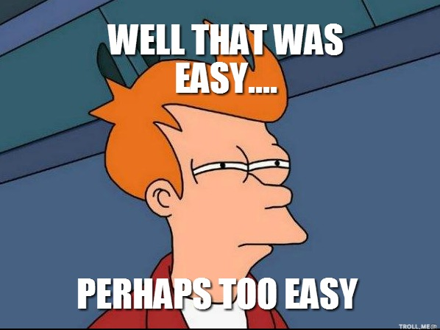
Classification of joints
Movement Possible at joints
Tendons, ligaments and cartilage
PROGRESS INDICATORS
 | Good Progress | Outstanding Progress
3-5 | To be able to identify different types of joints, Movements AND different connective tissues | …And show some knowledge of how they help sporting movements
6-9 | …And describe how they help sporting movements | Explaining and JUSTIFY how they help increase sports performance

Slide 16
Task
Fill in the boxes using the following slides as guidance, you must translate this into your own words!
TYPE OF BONE | JOB | EXAMPLES
F – Flat:
I – Irregular:
L – Long:
S- Short:

Slide 17
F – Flat:
I – Irregular:
L – Long:
S- Short:
These protect the internal organs e.g. ….
attachment of muscles to help movement
Provide shape, protection
Movement - to generate strength and speed
Shock absorption - spreading load

Slide 18
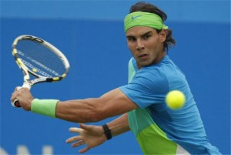
There are 4 Types of Synovial Joints
JOINTS
A joint is where two bones come together. They are known as synovial joints!
Ball and Socket
Hinge
Pivot
Condyloid

Slide 19
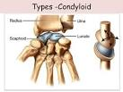
Type of Synovial Joint: | Notes
Ball and socket
Hinge
Pivot
Condyloid
Task
Fill in the boxes using the following slides as guidance, you must translate this into your own words!
Shape =
Examples =
Movement available =
Shape =
Examples =
Movement available =
Shape =
Examples =
Movement available =
Shape =
Examples =
Movement available =

Slide 20
Type of Synovial Joint: | Notes
Ball and socket
Hinge
Pivot
Condyloid
Shape =
Examples =
Movement available =
One bone has a bulge like a ball at the end. This fits into a socket in the other bone
ALL Types of movement
--YOU DO:--
Hip and Shoulder
Shape =
Examples =
Movement available =
This works like a hinge on a door. It fits into a hollow in the other. The joint will open until it’s straight, but no further.
Flexion and Extension
Elbow and Knee
Shape =
Examples =
Movement available =
This fits into a ring or notch on the other bone.
rotation
WE DO:
the joint between the atlas and axis (the top two vertebrae)
the joint between the radius and ulna, below the elbow
Shape =
Examples =
Movement available =
A rounded bump on one bone sits in a hollow formed by another bone or bones.
Flexion and Extension
Adduction and abduction
I DO:
Circumduction
• the joint at the wrist between the radius and carpals
• the joint between the base of the skull and the top vertebra (atlas)

Slide 21
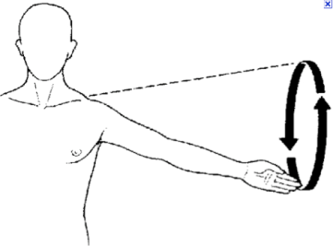
Types of Movement
Extension
Flexion
Adduction
Abduction
Opening a joint
Closing a joint
Moving towards the center line
Moving away the center line
Rotation
Circumduction
Plantar-Flexion
Dorsi-flexion
Clockwise or anticlockwise movement
Movement of a circular motion
Extension of the ankle
P = pointing
Flexion of the ankle

Slide 22
Movement | Sporting Example
Flexion
Extension
Adduction
Abduction
Rotation
Circumduction
Plantar flexion
Dorsi flexion
Task
Use the internet to give a sporting example of each type of movement, use these images for guidance from the previous slide!

Slide 23
Synovial joints AND movement
Type | Example | Flexion and Extension | Adduction and Abduction | Rotation | Circumduction
Ball and Socket
Hinge
Condyloid
Pivot
I do:
Hip and Shoulder
Knee, ankle, elbow
We do:
Wrist
You do:
Neck (atlas and axis)

Slide 24
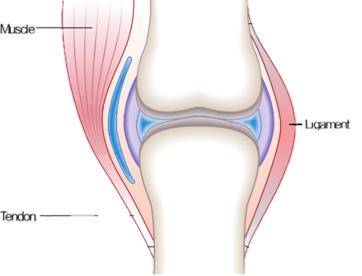
Tendons
Connective Tissue
TASK: List what you know about each.
Ligaments
A Ligament is a fibrous tissue which connects bone to bone in a joint.
A Ligament is strong and flexible.
A Ligament keeps a joint stable and holds structures together.
Like to Like
Bone - Bone
GfG: Add what you did not have
Muscle – Bone
A tendon is a fibrous tissue which connects the muscle to bone.
Tendons are strong and flexible.
A tendon aides movement.
Cartilage
Cartilage
Cartilage (which is smooth) prevents bones from rubbing together and reduces friction
Care

Slide 25
Task
Research and explain the function of ligaments, tendons and cartilage (what they do)
Ligaments -
Tendons -
Cartilage -

