Slide 1
CwK
Thursday, 24 September 2020
Work Done and Energy Transfer
Do Now Activity
Define centre of mass

Slide 2
Self Assess
The point in an object where mass is thought to be concentrated.

Slide 3
Progress Indicators
Good Progress
Recall and apply W=Fs
Describe energy transfers when work is done
Outstanding Progress
Explain why work done can cause a rise in temperature

Slide 4
Word Consciousness
Work is a transfer in energy

Slide 5
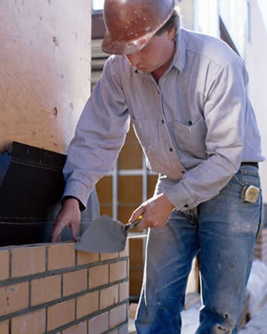
Which of these people does the most work?

Slide 6
If you apply a force over a given distance then you have done work.
Therefore we can use a calculation to find work done:
Work done ( J ) = Force (N) x Distance (m)
Work done is measured in Joules.
Joules is equivalent to Newton Meters, but you will not get a mark for Nm in the exam.

Slide 7
If an objects kinetic or gravitational potential energy changes – then work has been done.
Work = change in energy
So Work done is measured in joules (J).
Remember capital J.

Slide 8
A boy lifts a 300N weight 2M above his head.
How much work has he done?
300N x 2M= 600J

Slide 9
A 50N owl sits on a 10N book.
How much work is done?
Zero work is done as the owl is not moving !

Slide 10
Two main types of work can be done- work done against a force and work done in heating
http://www.youtube.com/watch?feature=fvwp&v=y2Q4OpGCfME&NR=1

Slide 11
Questions
A builder pushed a wheelbarrow a distance of 5M across flat ground with a force of 50N. Calculate the work done.
A car is brought to a standstill when the driver applies the brakes. Explain why the brakes get warm
The car travelled 20M after the brakes were applied. The braking force on the car was 7000N, calculate the work done by the braking force.
Calculate work done when
A force of 20N makes an object move 4.8M
An object of weight 80N is raised to a height of 1.2M

Slide 12
Answers
50N x 5M= 250J
Friction between the brake pads and the wheel discs make the pads and the discs get hot
7000N x 20M= 140000J
20N x 4.8M= 96J
80N x 1.2=96J

Slide 13
Plenary

