Slide 1











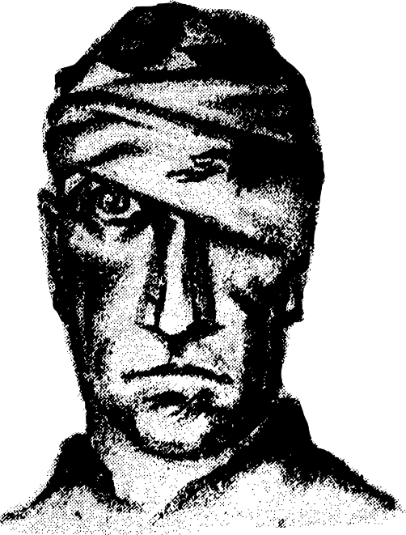

English GCSE Literature Paper 2
Power and conflict
poetry
Revision Guide
Detailed notes on every poem including language, structure and context analysis
Makes sense of the mark scheme
Revision activities to help make meaningful comparisons between poems

Slide 2

Introduction
There are fifteen poems that you will have studied in preparation for the poetry section of your GCSE English Literature Paper 2 exam. They are as follows:
The Prelude
Storm on the Island
Exposure
The Charge of the Light Brigade
Bayonet Charge
Remains
Poppies
War Photographer
Kamikaze
Ozymandias
London
My Last Duchess
The Émigrée
Checking Out Me History
Tissue
In Section A of your exam you will be given one of these poems which will be included in full in the exam booklet.
However, you will also need to compare this given poem to one other in the collection based around a theme that will be given to you. Here is an example:
Compare the ways the poets present ideas about anger in ‘Checking Out Me History’ and one other poem from ‘Power and Conflict’
In order to do this you will need to think carefully about which poems fit into which particular themes or ideas.

Slide 3
Analysing the mark scheme
AO | Jargon-free criteria:
AO1 (12 marks) | Understand and create responses to the Power and Conflict poems. In your answer to any essay question you should: Create a style of writing that is able to critique the text, is informed but also personal to you. Include textual references which may be quotations so that they back up and support your ideas and interpretations. Make comparisons between the poems and how the writers approach a common theme in similar or different ways.
AO2 (12 marks) | Analyse how language, structure and form may have been used by the writers to create effects on an audience and create meaning for them, referring to subject key terms and terminology to support ideas.
AO3 (6 marks) | Establish links between the poems and the worlds in which they were set and written.
AO4 | Not applicable in the Power and Conflict question.
Challenge: Highlight all the important words in the AOs. Write down five things you will need to include in your Power and Conflict answer to make sure you get a good mark.
Extra Challenge: In your own words, write down exactly what skills and knowledge the examiners are looking for in your Power and Conflict answer.
Mega Challenge: How would you plan your essay to ensure you meet ALL these AOs?

Slide 4
AO | Jargon-free criteria:
AO1 | Understand and create responses to Power and Conflict poetry. In your answer to any essay question you should: Create a style of writing that is able to critique the text, is informed but also personal to you. Include textual references which may be quotations so that they back up and support your ideas and interpretations. Make comparisons between the poems and how the writers approach a common theme in similar or different ways.
AO2 | Analyse how language, structure and form may have been used by the poets to create effects on readers and create meaning for them, referring to subject key terms and terminology to support ideas.
AO3 | Establish links between the poems and the worlds in which they were written and set.
AO4 | Vocabulary, sentence structures, spelling and punctuation that all help to make your ideas clear.
So you’ve got to show you know the poems inside out, that’s obvious.
However, you’ve also got to make an essay that shows you can pull apart the play and write a response that sounds like you! Show your interest, your enthusiasm, your understanding.
You’ve got to put quotations and references in to back up your ideas and show how they back them up.
Finally, the Power and Conflict question is all about comparing the two poems you are writing about and the writers’ perspectives on a common theme, for example war or the effects conflict can have on people. How do they approach this theme similarly or differently? Why?
AO3 is about showing how the poems link to the world they were written in, but also when they are set. Being aware of contexts can alter our understanding and interpretations of a poem. AO3 is about showing your awareness of the world the poets lived in and wrote in and how this may have impacted on their writing.
AO2 is all about analysing language, structure and form, so all those techniques we’ve been talking about and how they affect readers. We’re talking about a writer’s toolbox and what they use at specific times to really get their readers on board and engaged.

Slide 5
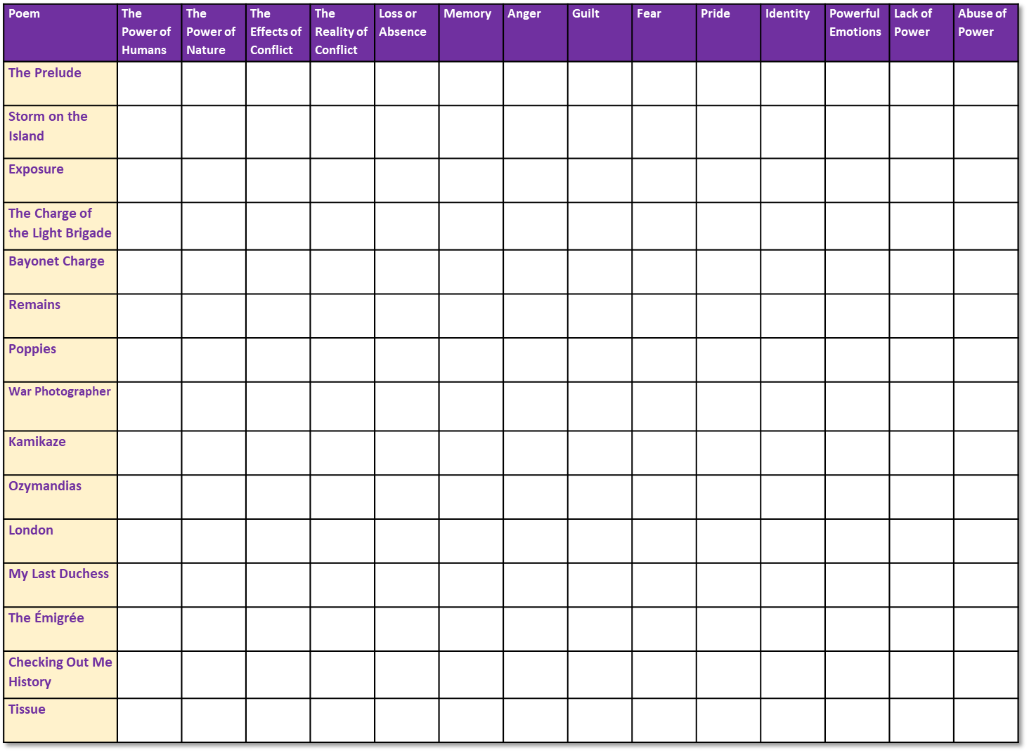

Revision Activity: Comparing Poems
Use your knowledge of the 15 anthology poems to tick off every theme you think each poem fits into. This should help you see which poems would work best together in the exam.
Complete the table, ticking off all the relevant boxes for exam poem.
Which poems would be best to compare with Checking Out Me History on the theme of anger? Make notes on how anger is shown in the two poems you choose and how it is similar or different to Checking Out Me History.
Begin writing out an answer to this exam question and think about how you are showing your comparisons in your answer.

Slide 6
Poem | The Power of Humans | The Power of Nature | The Effects of Conflict | The Reality of Conflict | Loss or Absence | Memory | Anger | Guilt | Fear | Pride | Identity | Powerful Emotions | Lack of Power | Abuse of Power
The Prelude
Storm on the Island
Exposure
The Charge of the Light Brigade
Bayonet Charge
Remains
Poppies
War Photographer
Kamikaze
Ozymandias
London
My Last Duchess
The Émigrée
Checking Out Me History
Tissue

Slide 7


Now that you’ve thought about how you will link the poems together, it would be a good idea to recap every poem in detail.
Over the next 15 pages you will find detailed information and analysis on each poem, plus ways of helping you make notes on every poem in the collection.

Slide 8
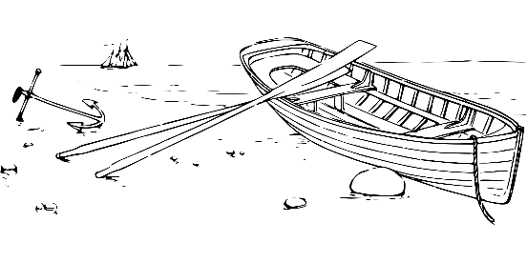






The Prelude by William Wordsworth
Language: This can be quite a difficult poem for students to get their heads around; this is because Wordsworth is being very metaphorical. The nature that surrounds him is a representation of his state of mind: at first he is confident, self-assured and ultimately happy, but later his mood completely alters. He becomes anxious, fearful and scared. It is about a man finding his own identity and how he fits into the world around him.
What happens in the poem? The speaker is out walking in the Lake District, an area of England that is known for its stunning natural beauty (mountains, trees, plants, and flowers – essentially, beautiful countryside). When out walking the speaker finds a boat and steals it.
During his journey he describes the natural world around him and seems full of admiration and happiness, but then his mood change as he encounters an enormous, black mountain. This fills him with fear and dread. The speaker then decides to head home, but his whole view of nature has been fundamentally altered.
Context: William Wordsworth belonged to a group of poets known as the Romantics. The Romantics were a group of writers, artists and musicians from the late 18th century into the early 19th century.
The Romantics had a very clear political philosophy and they wanted to stop the exploitation of the poor by the wealthy. Rather than following the rules of society, the Romantics believed every person should follow their own ideals.
They felt it very important that people only express their personal feelings. They also felt a sense of responsibility to everyone in society: they felt it was their duty to use their work to change society.
Structure: The extract from The Prelude is written in blank verse, or unrhyming lines of iambic pentameter (ten syllables a line: 5 bars, 2 beats per bar). Iambic pentameter is the type of meter that best mimics natural speech and presents a realistic representation of the speaker’s thoughts and feelings.
At times the poem employs enjambment (where lines carry on into each other) to represent an overflowing of emotions.
Revision activities:
Go through the poem and using highlighters or coloured pens:
Highlight all the parts of the poem which show a positivity to nature
Highlight all the parts of the poem which show a negativity towards nature
Highlight all the examples of the speaker personifying nature and explain why the speaker does this.
The speaker uses the pronoun ‘her’ on a number of occasions in this extract. Why does he do this? Who might ‘her’ be? Which is it feminine?
What do you notice about positivity and negativity within this poem? What does this tell you about the speaker’s thoughts?

Slide 9



Storm on the Island by Seamus Heaney
Language: Like many of Heaney’s other poems, this one is packed with images of nature. He describes the work the people of the community are doing to ensure they are protected from the oncoming storm; the speaker also describes the power of the storm through very military-like imagery and shows the growing strength of it, but ultimately this is a ‘huge nothing’ that they fear- which is the wind.
What happens in the poem? An isolated community is preparing itself for the onslaught of a severe storm. The speaker describes the preparations, his thoughts and feelings about the storm, the storm itself and how it affects him.
Context: Seamus Heaney grew up in rural Northern Ireland, where his father was a farmer. Much of Heaney’s poetry focuses on the countryside of his childhood and his descriptions of nature can often act as metaphors for human behaviour – in many ways this is similar to Wordsworth’s ‘The Prelude’. Heaney spent much of his life living and teaching in Northern Ireland and devoted himself to his writing.
Structure: The poem is presented in one stanza, which could be used to represent the isolation of the island within the storm.
Both enjambment and caesuras are used at times throughout the poem to emphasise the preparations of the people on the island and the ferocious power of the storm.
Moreover, the poem is presented in blank verse: 19 lines of unrhyming iambic pentameter. Again, like ‘The Prelude’, iambic pentameter is used as it best represents the natural way of speaking. When you couple this with the at times informal language of the speaker (“you know what I mean”) it feels as if the speaker is addressing us directly.
Revision activities:
Highlight all the parts of the poem which shows the people on the island are well prepared and are safe.
Highlight all the parts of the poem which show the power of the storm.
Find all the military images used within in the poem. What do you think is the conflict within the poem? What do you think is the speaker’s attitude towards the storm? Why?
At which points is the poem at its most tense? When is it least tense? Why do you think Heaney constructed his poem like this?

Slide 10


Exposure by Wilfred Owen
Language: Owen was disgusted by the war and what he perceived as the utterly futile or pointless nature of it. Thousands of young men seemed to be losing their lives in horrifying ways for no reason. In this poem, Owen turns his focus to the weather and how it too becomes an enemy to the soldiers. By using a range of metaphors and similes, Owen is able to bring to life the weather that surrounds the soldiers and transforms it into their most deadly enemy.
What happens in the poem? A group of soldiers during the First World War are waiting around in the trenches before they are given orders to ‘go over the top’ and fight. During this time, the speaker describes the horrendous weather conditions that surround the soldiers and threaten to kill them: they are shown to be another type of enemy. Indeed, many soldiers did perish because of the appalling conditions rather than because of the fighting itself. The speaker mentions about soldiers remembering being back home, but ultimately ‘nothing happens’ in this poem.
Context: Wilfred Owen fought during the First World War and was killed just before the war ended. He used his writing abilities to create deeply cynical and angry poems about the War and the reasons why it had happened. Owen’s works were very unusual at a time when most writing about the war had been deeply patriotic.
Structure: This poem is divided up into eight stanzas of five lines each (using iambic hexameter – lines of eight syllables), with each final line being indented and shorter than the rest. These shorter lines help to provide a type of final idea to each stanza that emphasises the speaker’s thoughts and feelings regarding the war. They are often framed as rhetorical questions, asking the reader question the point of these men being exposed to these conditions.
Revision activities:
Highlight all the words which show existing in these conditions was incredibly tough.
Find all the words which show the speaker is not the only one who is suffering in these conditions.
Find the examples of negative imagery being used in the poem. How is the weather described? Why do you think the speaker chose to personify the weather in this way?
Which lines in the poem do you think are the most tragic and desperate? How does Owen use language in the poem to emphasise just how awful these conditions were?

Slide 11




The Charge of the Light Brigade by Alfred, Lord Tennyson
Language: Although the soldiers were killed because of a stupid mistake, the speaker tries to refocus the outcry that this generated and instead asks the reader to remember the soldiers’ bravery and nobility rather than anything else. He describes the actions of the soldiers in detail, focusing on their bravery rather than their deaths. Repetition and refrains (see structure notes) are used to reinforce the emphasis on bravery, nobility and honour rather than sadness or anger.
What happens in the poem? The speaker pleads with the reader to picture the six hundred soldiers that formed the Light Brigade to see them as brave and to be respected, even though their deaths were tragic and because someone ‘blundered’ or made a huge mistake. The soldiers charge into certain death and bravely fight on against impossible odds with those remaining alive returning at the end.
Context: This poem is based around an infamous conflict during the Battle of Balaclava in the Crime an War, which took place between 1853 and 1856. Britain was at the time fighting with Russia. A miscommunication meant the soldiers in the Light Brigade were sent on the wrong mission, and ultimately many of those men were killed. The soldiers were sent into a valley that was surrounded by enemy soldiers with guns, whereas the Light Brigade only had swords on them.
Alfred, Lord Tennyson read about these events during 1854 and decided – in his position as Poet Laureate – to write his piece to praise the soldiers despite the error that led to their deaths.
Tennyson was one of the most famous and celebrated poets of the Victorian era and therefore a man of considerable influence.
Structure: The poem is divided up into six stanzas, with the first being 8 lines long, the next two have 9 lines, the fourth stanza is 12 lines long, the fifth 11 and the final stanza only 6 lines long. The structure in this poem is driven by the refrain that appears at the end of each stanza and begins ‘Rode the six hundred’. This line changes slightly depending on the message of each stanza, but the repetition of it focus the reader on the bravery of these men. They continue to ride on despite the horrors they face.
The poem also features repetition heavily, suggesting an unrelenting rhythm that mimics the fast pace of the soldiers and the horses as they rode into battle. This is further emphasised with the use of rhyming triplets and couplets throughout the poem, including at times the use of half rhyme.
Revision activities:
Highlight all the words which show the speaker thinks the soldiers are brave.
Highlight all the words which show the speaker thinks these soldiers should be respected.
Look at the refrain at the end of each stanza. How does Tennyson use this in each stanza to emphasise the message of his poem?
Look at Tennyson’s use of imperative sentences within the poem. How do they help Tennyson to influence his reader?

Slide 12


Bayonet Charge by Ted Hughes
Language: The speaker explains how a soldier begins the war full of patriotism and pride in fighting for his country, but halfway across on his journey his feelings change and he gets a sense of ‘bewilderment’ or realisation of where he is and what he is doing. The inclusion of the yellow hare could be literal or it could be metaphorical, representing the cowardly side of the soldier wanting to escape the situation he now finds himself in. By the end of the poem he is desperate to escape. This poem contrasts particularly well with ‘Charge of the Light Brigade’ in terms of attitudes towards war and bravery.
What happens in the poem? A soldier during the First World War is sent ‘over the top’ to charge across no man’s land with a bayonet or knife fixed to the end of his rifle. As he moves his thoughts and feelings begin to change. The soldier loses his sense of raw patriotism and this is replaced with overwhelming fear and terror. By the end of the poem the soldier can only think of trying to find a way out of his situation.
Context: Ted Hughes once served if the RAF and studied Archaeology and Anthropology at university, so he was already thinking deeply about history and mythology by the time he came to his writing.
Hughes grew up in the 1930s and so could see the impact of the First World War on the world he lived in, but soon saw the reality of the Second World War kick in, too. Hughes' brother Gerald would leave home to join the RAF (Royal Air Force) and his father fought in the First World War as well.
Structure: The poem begins with the soldier already running – he finds himself running across the battlefield, as if he is detached from what is happening.
The poem is broken up into three stanzas: the first explains the soldier’s initial actions and the patriotism he had at the beginning: “The patriotic tear that had brimmed in his eye /
Sweating like molten iron from the centre of his chest”.
The second stanza shows a significant change in tone with the soldier experiencing ‘bewilderment’ and a level of self-awareness: “In what cold clockwork of the stars and the nations /
Was he the hand pointing that second?” It is a kind of existential experience for the soldier as he begins to question exactly what he is doing.
The third stanza sees the soldier ‘awaken’ again and find a way to keep moving, to get out of “blue crackling air”, but the yellow hare is included potentially as a form of metaphor to represent cowardice.
The use of caesuras and enjambment creates lines of differing lines which could represent the uneven running of the man through the mud.
Revision activities:
Find all the words in the first stanza which represent bravery and patriotism.
Find all the words in the second stanza which question those ideas of bravery.
Find all the words in the final stanza which suggest panic and fear.
Find three language techniques being used in this poem. For each one, explain how the technique gets across the writer’s ideas to the reader.
Choose three examples of enjambment and caesuras and evaluate how they impact on the reader.

Slide 13


Remains by Simon Armitage
Language:
The title has multiple meanings: It can mean ‘remains’ as in what remains of a body after a person has been killed, it can refer to what ‘remains’ in the soldier’s head after the event and finally what remains of the soldier now that his life has been turned upside down. The first-person perspective provides a kind of monologue and the use of no particular rhyme scheme and examples of enjambment make the poem sound like natural speech, as if the speaker is talking directly to us.
What happens in the poem? A soldier recalls the memories he has of killing a man who was running from a bank raid he was a part of. The soldier describes the memory of killing him in great detail and explains his feelings about it afterwards. It is not something he can just forget about and the images of the man keep going around and around his head – this is something called ‘Post-Traumatic Stress Disorder’.
Context: Simon Armitage is a very famous British poet and wrote a collection of poems called ‘The Not Dead’ based on the experiences of soldiers in the Gulf, Bosnian and Malayan Wars – those that happened after the Second World War.
Remains itself is based on the real life experiences of Guardsman Rob Tromans who served in Iraq in 2003 as a machine gunner. There is a link to Tromans retelling his story here but please be prepared for an account that is difficult to listen to: https://www.youtube.com/watch?v=2DHWqppktFo
Structure: The poem is made up of eight stanzas, with the first seven made up of mostly unrhymed quatrains (four line stanzas). However, the last stanza is only two lines long acting as a kind of summary of the soldier’s feelings about the experience. Ultimately, he cannot get the image of the dead man out of his head.
The title has multiple meanings: It can mean ‘remains’ as in what remains of a body after a person has been killed, it can refer to what ‘remains’ in the soldier’s head after the event and finally what remains of the soldier now that his life has been turned upside down.
The first person perspective provides a kind of monologue and the use of no particular rhyme scheme and examples of enjambment make the poem sound like natural speech, as if the speaker is talking directly to us.
Revision activities:
Find all the words which describe the killing of the man.
Find all the words which show the soldier keeps remembering the event.
Find all the words which show he cannot forget about what has happened.
Find three language techniques being used in this poem. For each one, explain how the technique gets across the writer’s ideas to the reader.
How do the perspectives of the other soldiers mentioned in the poem differ to those of the speaker? What does this tell us about war?

Slide 14


Poppies by Jane Weir
Language:
As a mother prepares to say goodbye to her son who is leaving to go to war, she remembers the experiences she had with her son when he was a child, how she feels now that he is going and her fears of what will happen in the future. The speaker employs military imagery to always link her son to war. Throughout the poem a military motif is used to provide constant reminders of war and conflict and echoes the speaker’s own feelings as she keeps thinking of her son going off to fight. Images such as “blockade”, “spasms”, “bandaged” and “reinforcements” all allude to the threat of war throughout the entire piece.
What happens in the poem? A mother describes her thoughts and feelings as her son is leaving home to join the army. As a mother prepares to say goodbye to her son who is leaving to go to war, she remembers the experiences she had with her son when he was a child, how she feels now that he is going and her fears of what will happen in the future. Like some of the other poems in the ‘Power and Conflict’ collection, Weir’s Poppies deals with the feelings of absence and loss.
Context: Jane Weir is of English and Italian heritage, and grew up in both Manchester and Italy. As an adult she spent time living in Belfast but now resides in England. The poem ‘Poppies’ was commissioned as part of a collection of modern war poetry by Carol Ann Duffy in 2009.
The poem uses military imagery throughout but seems to point to modern warfare and how this impacts on the lives of family at home.
Structure: The poem has four clear stanzas, the opening and closing stanzas with six lines, the second with 11 and the third 12.
The heavy use of caesuras suggests a person unsure about themselves and how they feel. Whilst the mother gives the outward appearance of confidence and certainty to her son, inside we can see through her thoughts that she is struggling to come to terms with the loss of her son as he leaves.
As the poem moves along we see it is moving across time as well: “Three days before”, “Before you left”, “After you’d gone”, “later” and “this is where it led me”. Throughout the poem the mother returns to her past with her child as she remembers their experiences together.
The memorial in the final stanza acts as a visual metaphor for the past as the speaker stands in the present looking to the future. Like some of the other poems in the ‘Power and Conflict’ collection, Poppies focuses on the idea of time and the power it has.
Revision activities:
Highlight all the words in the poem that show the role of a mum or mother.
For each word or phrase highlighted, explain how the speaker is feeling.
Using the quote on the left hand side and your own interpretation of the poem, what message was Weir trying to send to her readers? Why?
Jane Weir on Poppies:
"I wanted to write a poem from the point of view of a mother and her relationship with her son, a child who was loved cherished and protected... and it had led to this.... heightened and absolute fear that parents experience in letting their children go, the anxiety and ultimately the pain of loss... I hoped to somehow channel all this, convey it into something concise and contemporary, but also historically classic, in terms of universal experience."

Slide 15



War Photographer by Carol Ann Duffy
Language:
Duffy uses her poem to not only explain the difficult role of being a war photographer, but to ask the reader to look at themselves and ask why they have become desensitised to images of war. It also seems like the war photographer is finding it increasingly difficult to find comfort in his own world but also forget about the events he has seen – he is emotionally and mentally torn. The religious imagery in the first stanza allows the photographer to detach himself from the process of developing the photos and being affected by the suffering he has witnessed. It has become a process he must go through without emotional response in order for him to complete it. However, we know he is affected by it as his hands ; which did not tremble then though seem to now’. The sibilance of ‘spools of suffering’ again seems to dehumanize or desensitize the photographer and the reader to the violence of war.
What happens in the poem? This poem focuses on the experiences of someone who goes to war zones to take pictures for national newspapers back in the UK. In his darkroom (where he develops his photos) at the start of the poem, he develops the pictures he’s taken. Being back at home in the UK presents a very different world to the ones he has visited in the midst of war. Like in ‘Remains’, the photographer remembers the experiences he went through and the ‘ghosts’ that are in his thoughts.
Context: Carol Ann Duffy was friends with a war photographer herself and was intrigued by the idea of people who go to war zones to record what is happening there without being able to get directly involved themselves. The poem mentions several war zones like Belfast and Phnom Penh. The photographer lives in rural England and this acts as a contrast to the war zones.
Structure: The poem is divided up into four regular six line stanzas and each one ends with a rhyming couplet. Unlike some of the other poems in the ‘Power and Conflict’ collection, War Photographer is rigidly structured. Could this mirror the photographer’s determination to find some sort of order in the chaos he finds himself in? He does put the ‘spools of suffering’ into ‘ordered rows’ after all. Moreover, a war photographer must be detached and distant from his work in order to do his job. The regular structure to the poem seems to reflect this.
The final lines “From the aeroplane he stares impassively at where / he earns his living and they do not care” suggest the people he takes photos for do not care about the people he takes photos of, and the war photographer is off to his next assignment to earn his living and feels ‘impassive’ or without care about having to do it once more.
Revision activities:
Highlight all the words which show the war photographer is trying to detach himself from the experiences he has been through.
Highlight all the words which show the true horrors of war.
Find the quotes which show the people back at home do not really care about the war photos they see. How does Duffy use language to emphasise this lack of feeling towards others?
How does Duffy use language to make clear to the reader how the war photographer is struggling to exist within the two worlds that he finds himself trapped between? How is this similar or different to one of the other poems in the collection?

Slide 16

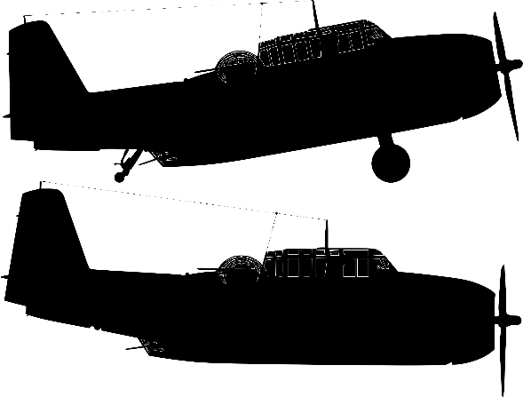
Kamikaze by Beatrice Garland
Language:
Beatrice Garland uses this poem to question the attitudes surrounding Kamikaze pilots and how the pilot is treated when he returns. The way the fish are described in the sea emphasises how beautiful they were to the father, and the way speaker talks of her father suggests she can understand why he did what he did.
The pilot has a dichotomy to choose between: a physical death and an emotional death. If he completes his mission, he loves his physical life. If he does not, he loses any emotional connection with his family and friends. Throughout the poem similes (“strung out like bunting”) adjectives (“green-blue translucent sea”) and powerful imagery (“flashing silver as their bellies swivelled towards the sun”) are used to show the power of the pilot’s childhood memories to make him what to return home.
What happens in the poem? A kamikaze pilot sets off on his mission but halfway on his journey he changes his mind. Kamikaze pilots were trained to go on suicide missions, or to crash their planes into enemy boats. The pilot’s daughter tries to explain to the reader why she thinks he turned back: because he loved the beauty of nature around him and because he remembered the wonderful days of his childhood. It was a great honour to become a kamikaze pilot in Japanese culture at the time and to not complete your mission would be viewed as cowardice and a great dishonour to your family. The pilot’s wife and family shun and isolate and slowly his children learn to do so too.
Context: Kamikaze pilots were used more and more during the final stages of the Second World War as the Japanese war leaders become increasingly desperate. It was seen in Japanese society as a great honour to die for your country and Kamikaze pilots were highly respected – but to refuse to complete your mission left you isolated and ostracised, as we see in this poem.
Structure: The poem is set out in seven, six-line stanzas and although there isn’t a regular rhyming pattern to the piece, most lines have a similar length and number of syllables to them, providing a calmness, neutrality and regularity to the poem. The speaker tells the reader the story, and the reader can then make up their own minds about the events that have taken place.
There is a shift in perspective halfway through the poem. Initially, the poem is told in third person (“her father, “she thought”), but this changes to first person (“my mother never spoke again”) which changes our understanding of the poem and of the pilot. Finally, we are told that the speaker’s mother thinks the father probably felt about would have been the better way to die. We are provided with three perspectives throughout the poem and it is up to the reader to interpret the events.
Revision activities:
Find three quotes which show the speaker understands why her father did what he did.
Find all the quotes which show the family shunned the pilot.
How do you interpret the poem? Do you think the pilot was right to turn back? Why? Why not? Use quotes from the poem to support your interpretation.
Choose three language techniques the writer has included in her poem. How does each one influence the reader in terms of their interpretation of the pilot’s actions?

Slide 17



Ozymandias by Percy Bysshe Shelley
Language:
Ozymandias was once the ruler of a great civilisation, but now virtually nothing exists of the city he presided over. It can be argued that the poem ‘Ozymandias’ is not just about Ramesses but about the abuse of power generally and how those with power can perceive themselves to be invincible or undefeatable.
The adjectives ‘vast’ and trunkless’ provide the perfect juxtaposition to describe Ozymandias and his legacy: A vast statue was created of him, but it lacks a torso and so the intention of the statue to provoke fear and respect from everyone is now redundant. The repetition of ‘King of Kings’ highlights Ozymandias’ ridiculous sense of self-importance, and the oxymoron of ‘colossal wreck’ again brings together the ideas of power mixed with being powerless.
What happens in the poem? The speaker meets a traveller who explains to him about a broken statue he saw standing in the middle of a desert. We find out the statue was of a former pharaoh or king known as Ozymandias. The statue’s base contains an inscription which shows that Ozymandias is boasting of his immense power, but around the statue is nothing but wasteland.
Context: Written by English poet Percy Bysshe Shelley in 1818, it focuses in on Egyptian pharaoh Ramesses II who ruled from 1279 BCE to 1213 BCE (66 years!) Ozymandias was another name for Ramesses. Ramesses II had hundreds of statues and temples built in his name, which would have used slave labour to build them.
Shelley was born into a wealthy family and was set to inherit his father’s fortune. However, Shelley began writing on controversial topics – including atheism (not believing in God) – which meant his father disowned him.
Structure: The poem has a rhyme scheme of ABABACDCEDEFEF. It is a mixture of a Petrachan sonnet (a traditional way of structuring a sonnet) and a Shakespearean sonnet which came later. There is a 'volta' or twist in the poem on the ninth line ("And on the pedestal, these words appear"), which again is traditional within a sonnet. A sonnet is a very specific, very rigid form of poetry, so why does Shelley use it for his poem? Well, it seems almost fitting that a man of such immense power and arrogance like Ozymandias should have his entire legacy reduced down to 14 lines and to be controlled by the writer, not himself. Instead of an epic poem that might have been expected for a great pharaoh, he is boxed in to this very rigid pattern. It almost seems inevitable that power will corrupt and be destroyed eventually as well.
Revision activities:
Structure:
How does the rhyme of ‘stand’ and ‘sand’ give the image extra power?
Why does Shelley rhyme ‘decay’ and ‘away’ and ‘despair’ and ‘bare’ at the end of the poem?
Most of the poem is written as a quote from the traveller. Why does Shelley choose to do this?
Language:
Highlight all the negative ideas within the poem. Choose three and explain what they mean.
Highlight in one colour the description of the statue and in another the description of Ozymandias as a person. What do you notice about the two descriptions?
Label all the language techniques you can find being used in the poem. How do they help to emphasise the meaning or message of the poem?

Slide 18



London by William Blake
Language:
Blake wanted to bring change to his own country and hated seeing the suffering around him. In his poem he uses imagery to emphasise just how awful life is for most people in the city and how those with power simply ignore what is happening around them. Throughout the poem the writer takes advantage of the use of sound to create a cacophony of pain and sadness through the cries and curses of all the people of London.
What happens in the poem? The speaker describes a walk around the city of London during the 18th century. Everywhere he looks the speaker sees poverty, misery and despair. No one escapes it, except perhaps those who live behind the palace walls and the Church – who seem to do nothing about the inequality that surrounds them.
Context: Blake lived at time of huge change in Europe: France had gone through a revolution where the ordinary people had risen up against the wealthy ruling classes. It inspired Blake to look to his own country and see the suffering all around him.
Blake lost faith in his religion and so began to question the role of Christianity and the Church in society, something which he alludes to in the poem ‘London’.
England itself was going through the Industrial Revolution which itself was bringing enormous changes to life for the people of the country.
Structure: The structure is simple and regular – the poem is presented in four stanzas of four lines (quatrains) with a regular ABAB rhyme scheme. This allows Blake to create regular snapshots of all the misery taking place in London, but also may imply that such suffering is firmly established and normalised in 18th century London.
At the centre of the poem lies the Church and the palace – both home to the centres of power in 18th century England. This is symbolic and significant – surrounding the places of power in this society is great suffering.
Revision activities:
Find three powerful images of the suffering of ordinary people in London.
Find three powerful images of the people with power doing nothing to help those suffering.
Why does Blake speak of ‘charter’d street’ and ‘charter’d Thames’? ‘Charter’d’ means privately owned. What does it suggest about life in 18th century London?
Why does Blake use the oxymoron ‘marriage hearse’ at the end of the poem? What does it suggest about the futures of the poor in London?

Slide 19



My Last Duchess by Robert Browning
Language:
The poem is critical of the pride and vanity of the Duke, whose jealously and suspicious nature seems him lose his wife – potentially because he had her murdered. He is presented as a sinister and unlikeable character who judges things by its appearance rather than having any substance. Look at how he refers to his wife as ‘my’ Duchess – as if he owns her. When he alludes to his wife he speaks of “A heart—how shall I say?— too soon made glad” with the dashes suggesting the Duke is considering his words very carefully but also may suggest he is angry and furious at what happened, highlighting his jealousy at his wife delighting in others’ gifts and suggesting she may have had affairs behind his back. The line “I gave commands; Then all smiles stopped together” is particularly sinister as the noun ‘commands’ suggest the Duke had his wife killed and the sibilance of “smiles stopped” hints at his delight at what happened.
What happens in the poem? The poem is a type of dramatic monologue and ‘Ferrera’ is the character saying it. It is believed Ferrera is based on Alfonso II d'Este, the fifth Duke of Ferrara (1533–1598), who, aged 25, married Lucrezia di Cosimo de' Medici, the 14-year-old daughter of Cosimo I de' Medici, Grand Duke of Tuscany, and Eleonora di Toledo.
The Duke is presenting a painting of his ex-wife to a visitor to his home. The Duke explains that he was angered by his wife’s behaviour towards him and other people: she treated him like anyone else and she seemed to enjoy simple gifts from others just as much as any he gave her. It is hinted at in the poem that the Duke may have had the Duchess murdered. By the end of the poem it is made clear he is moving on to a potential new wife. The old Duchess was simply his ‘last’ Duchess.
Context: Robert Browning was a 19th century poet and born into a wealthy family. He later moved to Italy and married his wife Elizabeth Barrett – one reason that they moved was to escape her over-protective father. These experiences meant Browning knew all too well about over-controlling patriarchs or leading male family members. It is believed Ferrera is based on Alfonso II d'Este, the fifth Duke of Ferrara (1533–1598), a well-known aristocrat.
Structure: The poem is presented in lines of iambic pentameter (five bars of two beats = 10 syllables per line) and in rhyming couplets. However, although rhyming couplets would normally help make a poem easy to remember, the Duke employs lots of enjambment and caesuras throughout the poem, with caesuras showing he is being very controlling in what he says, but enjambment showing he is very keen to show off his wealth and power to his visitor, or presents the anger and jealously he feels about his wife’s behaviour.
Like some of the other poems in the ‘Power and Conflict’ collection, this poem is presented as a dramatic monologue meaning we only ever hear from one perspective; in this case it is only the Duke’s. He is controlling the conversation in this poem and it symbolises his over-protective nature.
Revision activities:
Highlight all the words that suggest the Duke is a proud man.
Circle all the parts of the poem that suggest the Duke was suspicious of his wife.
What is the Duke proud of? What might this suggest to us about him as a character?
In what ways does Browning portray the Duke? What message might the writer be presenting to his reader?
Although not told directly, the reader can begin to understand how the Duke and Duchess’ relationship deteriorated. How do we see this?

Slide 20
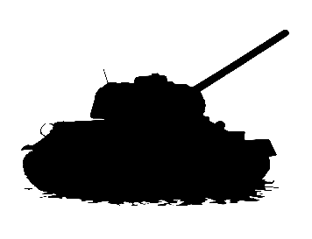


The Emigrée by Carol Rumens
Language:
Throughout the poem there is a contrast between the light of the positive memories of the speaker’s childhood home and the darkness of the negative memories of her home being destroyed by war and conflict. A light motif is shown in contrast and even in conflict with the darkness motif, with the speaker personifying both ideas and acting as a guardian to the positive memories, protecting them from the darkness of the negative effects of conflict.
What happens in the poem? The speaker is a young girl who was forced to leave her home country, but rather than be negative about she clings on to the positive memories of her home and her childhood. There is a lot of war and military imagery used in this poem, so we assume she has left home because of war. She explains she knows what her home is like now, but she refuses to accept that as a reality, rather imagining the world she remembered instead.
Context: Rumens bases much of her poetry on ideas of people emigrating from places like Russia or the Middle East to move elsewhere and escape corruption or tyranny (the abuse of power), or where places have been widely affected by war, such as Syria.
Structure: The poem is divided into three stanzas, with the first two being eight lines long and the final stanzas nine lines long. This extra line may represent the determination of the speaker not to let go of the positive image of her city.
There is no rhyme pattern used in ‘The Emigrée’ but most lines use five stresses – although this is not always the case. This may reflect the chaos and confusion that surrounds war zones and fleeing the place you once called home.
Revision activities:
Use four colours:
Find all the words to do with lightness. Highlight them.
Find all the words to do with darkness. Highlight them.
Find all the words to do with a positive city, highlight them.
Find all the words to do with a negative city, highlight them.
Is the positive city linked to light or darkness?
Why might this be? What is the writer trying to tell us?
Why is there also a negative city? Why is this linked to darkness?

Slide 21



Checking Out Me History by John Agard
Language:
Many of the non-European historical figures are associated with fire, water or light, indicating hope, freedom or positivity (“Fire-woman”, “hopeful stream”, “freedom rover”). The other Eurocentric historical figures or even nursery rhymes are treated with a far more comical and musical tone that seems to satirize their importance in traditional British education.
What happens in the poem? The speaker of the poem is angry at the way he has been taught only nursery rhymes and European history at school. He feels that he has to carve out his own identity through his own efforts rather than relying on schools to tell him about his own past. He goes through a number of examples of Eurocentric historical figures like Napoleon and Lord Nelson, before switching hi s focus to historical figures he sees more relevant to his own background, such as Mary Seacole and Nanny de Maroon.
Context: John Agard was born in Guyana in 1949 and moved to Britain in 1977. Identity and ethnicity are therefore very important in many of his poems.
Creole is a mixture of different languages and is a type of dialect, so words that are unique to it and aren’t usually found in English. John Agard writes in Creole in some parts of his poem ‘Checking Out Me History’ and in more formal English in others.
Structure: There are two clear structures in this poem: the Creole-influenced sections which focus on European historical figures, written mostly in rhyming couplets, triplets or quatrains. End rhyme is also used regularly in these sections. They all work together to create a bouncy, comical sound to these descriptions.
The other type of structure is when the speaker focuses on three black historical figures: Toussaint L'Overture, Nanny de Maroon and Mary Seacole. Here there is a more irregular rhyme scheme and the lines are much shorter. These help to produce a more serious, sombre tone that perhaps imply respect.
Revision activities:
Highlight the parts written in ‘Creole’ in one colour and in another the parts written in more formal or ‘standard’ English.
For which parts has Agard used Creole and for which has he used formal? Why does he do this?
How does Agard’s use of language in these stanzas help to mirror Agard’s message in the poem?

Slide 22

Tissue by Imtiaz Dharker
Language:
The speaker uses a light motif throughout the poem to symbolize human hope, human intelligence and the capability of humans to become so much greater than they are. Metaphors or symbols are used to represent different ‘achievements’ in human history but that spiritually we can go much further than roads, buildings or maps.
What happens in the poem? This poem is not narrative but rather sets out to explain the power of tissue paper as an extended metaphor for life. The speaker explains how paper has been important to us throughout our history, including through recording our history and its power in religious texts like the Quran. Moreover, the speaker talks of the power of paper through receipts, maps and architectural drawings. Paper is incredibly important to us, but the speaker also makes clear how fragile it can be as well.
The speaker goes on to suggest that human life is more significant than paper and it will go on to outlive the records we make. However, the speaker might also suggest that human life is fragile like paper and what we build and create cannot always last. It is a poem that is open to interpretation.
Context: Imtiaz Dharker is a poet of Pakistani origins but was raised in Glasgow in Scotland. Many of her poems focus on topics such as the power and role of religion, the issue of terrorism and finding your identity. Much of her work is metaphorical and symbolic. Tissue doesn’t refer to any specific time or place, but seems to transcend time and place to question the very nature of existence.
Structure: The poem is broken up into mostly unrhymed and irregular quatrains (lines of four). This ‘messy’ layout can reflect the way life is both irregular and often flimsy. Moreover, the use of enjambment across the poem suggests a lack of control by human beings over their own lives and reflects the flowing and delicate nature of both humanity and paper – there are many similarities between the two.
Every stanza is of four lines, except one: the last stanza, which has only one line to it. This therefore brings attention to the last stanza: “turned into your skin”.
Revision activities:
Find all the quotes which use the symbol or metaphor of light. Why do you think the speaker uses this metaphor to describe paper?
Find all the quotes which show paper is powerful. Explain in what ways does the speaker show paper to have power.
Find all the quotes which show paper and humanity are similar. In your own words, evaluate what the poem says about the similarities between paper and humanity.

Slide 23

Power and Conflict Revision Cubes
Choose of the fifteen Power and Conflict poems.
You will be creating a ‘revision cube’ around that poem, and using your cube to help you make comparisons to other poems within the collection.
Use your ‘cube net’ to decorate the outside (and inside if you wish) of your cube.
Try to include:
Key quotes
Key features
Images, symbols and colours associated with your allocated poem.

Slide 24
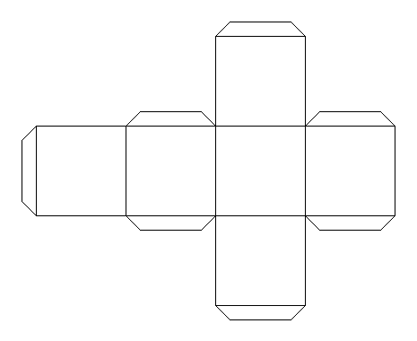

Don’t glue

Slide 25
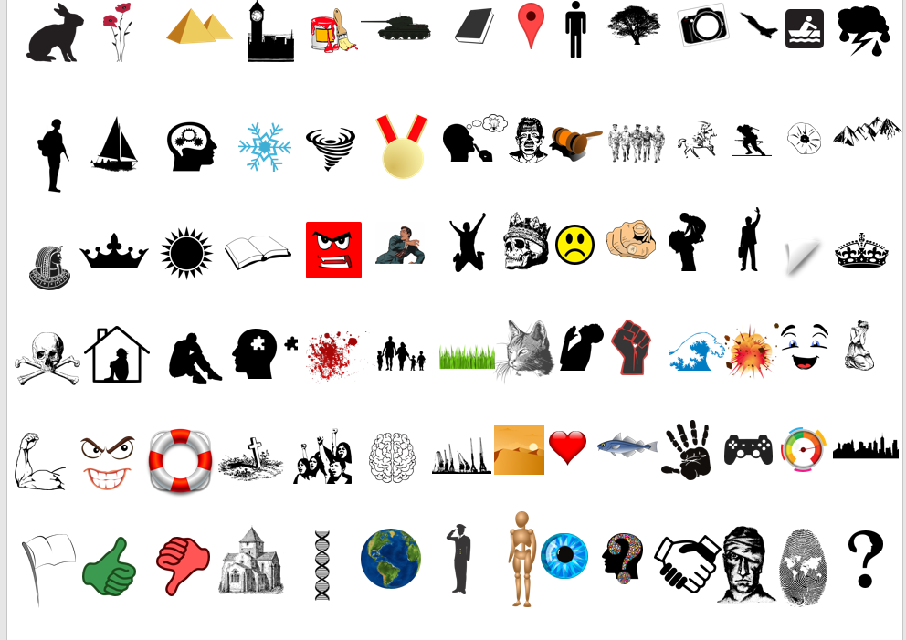
Now that you’ve decorated your cube net, glue your cube together but don’t glue the ‘lid’ at the top. You will need to be able to open and close your cube.
Once you’ve made your cube, use the symbol sheet to choose between 5 to 10 symbols that are related to your poem.
Cut out your symbols and place them inside the cube.
Example:
You could choose the picture of the tank if you’ve been given The Emigree.

Slide 26





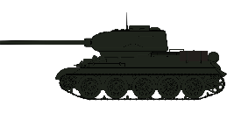














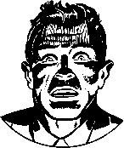

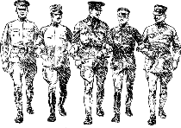
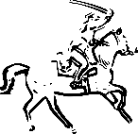




















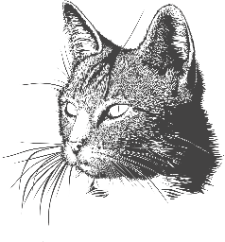


























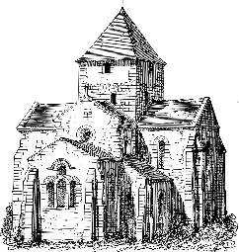


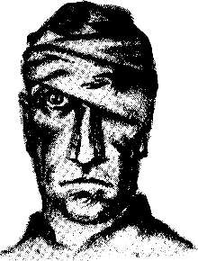









Slide 27

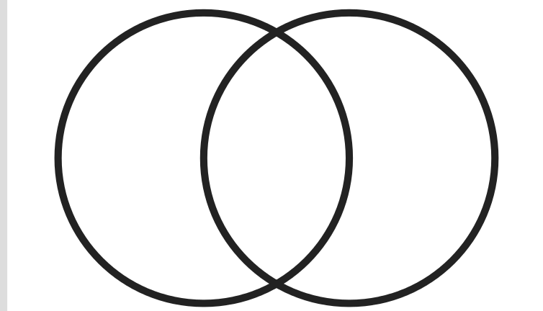






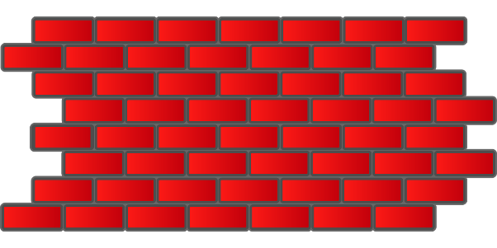
Now that you’ve completed your revision cube, you will compare ideas between poems
Poem 1
Poem 2
Speaker
Similarities:
Tone
Attitudes and emotions
Making comparisons, connections and links between the two
Either create a new revision cube, or work with a friend or another student to create a detailed Venn diagram like this one, making notes on the similarities and differences between the two poems (using their revision cube).
Ensure you have compared the use of language techniques in both poems.
Look at both structure and language in your diagram.
Messages
Techniques or features
Context
Structure

Slide 28

This is an example of a revision comparigon (a combination of a comparison and a hexagon) – go with it.
Write down three themes in three triangles
Write down three poems that link to those themes.
Write down how each poem connects to each theme.
Bonus Challenge: Try to add in quotes and explanations to your connections.
Revision
Comparigon!
The context behind The Charge of the Light Brigade suggests "someone had blundered", but Tennyson asks: "Was there a man dismayed? /
Not though the soldier knew / Someone had blundered." The soldiers have a right to be angry, yet they do not show it.
The speaker praises the soldiers for their lack of fear: “Theirs not to make reply, / Theirs not to reason why, / Theirs but to do and die.”
Charge of the Light Brigade
Fear
Anger
The soldier fears his memories more than anything else: “but near to the knuckle, here and now,
his bloody life in my bloody hands.”
War Photographer
The War Photographer perhaps should be angry but has grown passive to the role he does: "he has a job to do".
Remains
Guilt
The speaker feels an overwhelming sense of guilt about the man he helped to kill: “And the drink and the drugs won’t flush him out –” He tries to find some way to escape his guilt but cannot.
The photographer has a ‘job to do’, but he does it – even though the images of suffering he has taken haunt him and make his hands tremble.

Slide 29
Possible themes:
Fear
Anger
Power of Nature
Power of Humans
Identity
Effects of conflict
Realities of conflict
Memories
Loss
Guilt
Lack of power
Abuse of power
Absence
Notes:
To print off for students

Slide 30
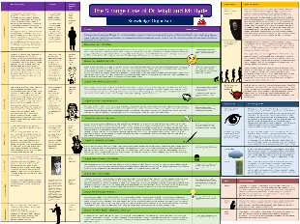
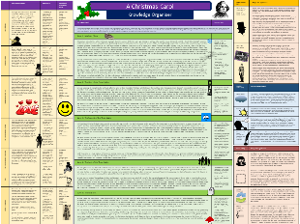
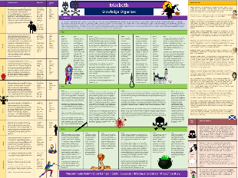
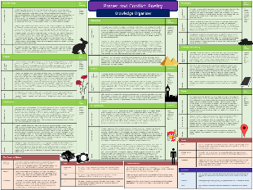
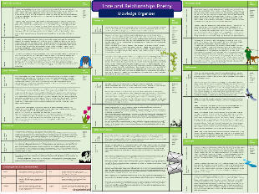
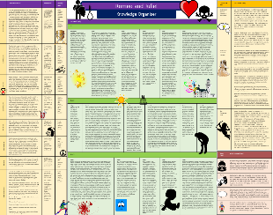
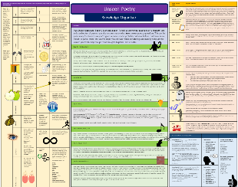
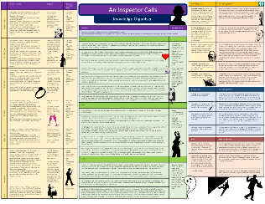
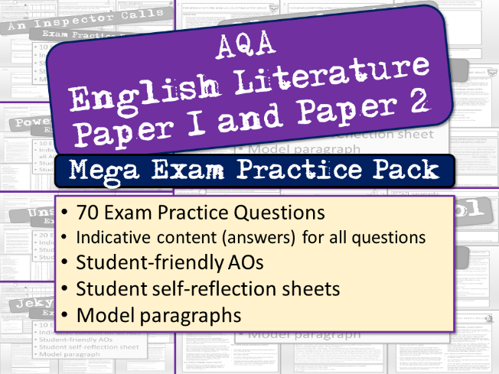
Want to revise English Literature?
Knowledge organisers, with everything in one place:
Jekyll and Hyde
A Christmas Carol
Macbeth
Power and Conflict Poetry
Love and Relationships Poetry
Romeo and Juliet
Unseen Poetry
An Inspector Calls
Literature exam practice packs with ANSWERS

Slide 31



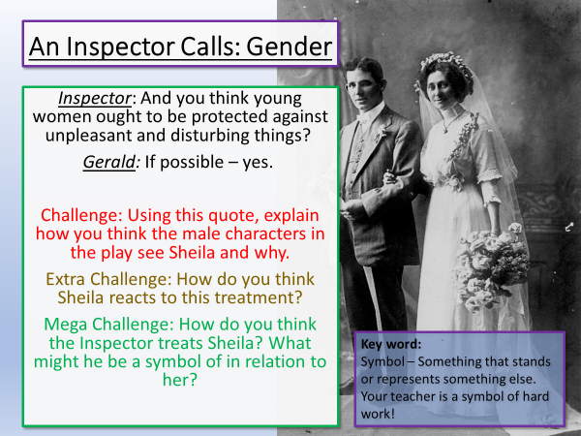
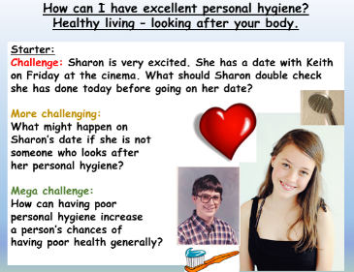
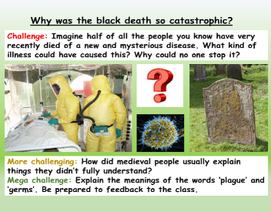
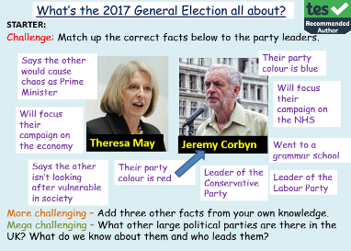

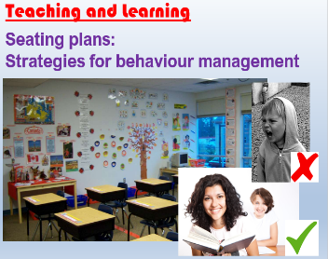




One of the most popular authors on TES!
Email:
info@englishgcse.co.uk
Website:
www.englishgcse.co.uk
This product, or any part of it, is not to be distributed, or resold under any circumstances, including through any websites, groups or organisations, without written permission from the author. Group and whole school licenses are available at the publisher’s request.
Thanks for choosing EC Resources
©EC Publishing Ltd March 20
©Lead Practitioner English March 20
Check out our website for offers and freebies. Right click here, follow the link.
English
PSHE
History
Citizenship
RE
Whole School
Follow us on twitter: @ec_publishing2 or facebook

