Slide 1
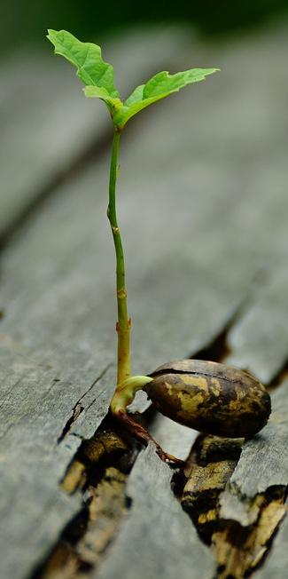
Plant hormones & responses
Do now activity:
What are the raw materials a plant needs in order to survive?
Describe how light can be a limiting factor on the rate of photosynthesis
Have a think about how a plant might respond to gravity? Why is this response important?

Slide 2
Progress indicators
GOOD PROGRESS:
Identify the stimuli that plants are sensitive to
Describe how plants respond to light and gravity
OUTSTANDING PROGRESS:
Explain the role of auxins in a plants response to light and gravity

Slide 3
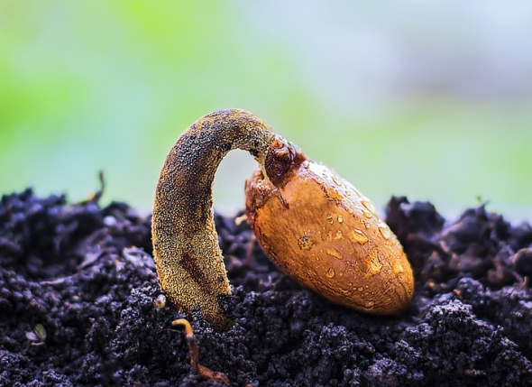
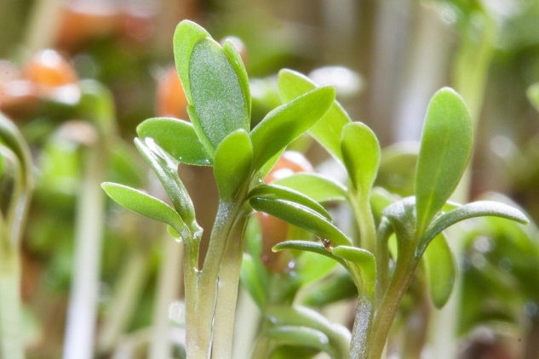
Plants need to respond to light, moisture & gravity
Think > Pair > Share:
Why do you think it is important that they respond to these?
How does the plant respond to these?

Slide 4
These growth responses are called tropisms
Plant shoots are sensitive to gravity and light.
Plants roots grow towards gravity and water
Plants have hormones too, these hormones are what control the growth of the plant shoots.
Plant hormones are called auxins

Slide 5
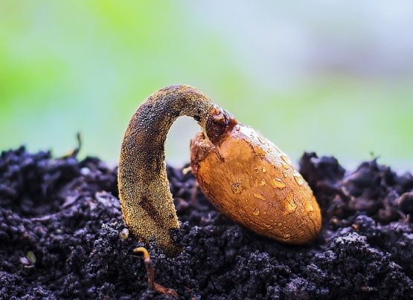
Task: Watch the video and answer the following questions:
What is a tropism?
Describe the difference between positive and negative tropism
Define ‘phototropism’:
Define ‘geotropism’: (also known as gravitropism)
Describe the types of geotropism which roots and shoots undergo
Describe the types of phototropism which roots and shoots undergo
https://www.youtube.com/watch?v=PxSkuyjZ3MM

Slide 6
Self-assessment:
A tropism is a growth response to a stimulus
Positive tropism is when growth is towards the stimulus, negative tropism is when growth is away from the stimulus
Phototropism: growth in response to light
Geotropism: growth in response to gravity
The roots under positive geotropism as they grow towards gravity, whereas the shoots undergo negative geotropism as they are growing upwards and away from gravity.
The roots under negative phototropism as they grow downwards and away from the light, the shoots undergo positive phototropism as they grow towards the light.

Slide 7
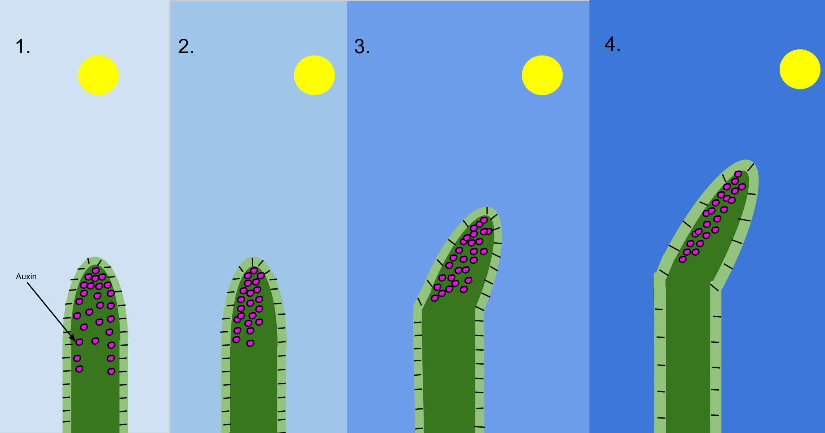
The responses of plants to gravity and light are controlled by a hormone produced by the plant, called auxin.
Cell elongation
Auxin
Task: On your tables are posters of information, use this information to complete the worksheet on auxins and plant growth
Notes:
Image by MacKhayman (Own work) [CC BY-SA 3.0 (https://creativecommons.org/licenses/by-sa/3.0)], via Wikimedia Commons

Slide 8
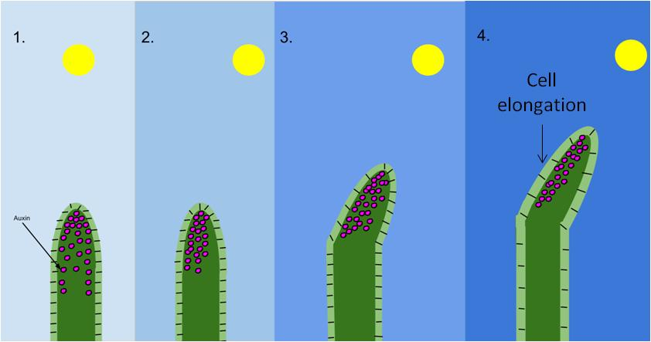
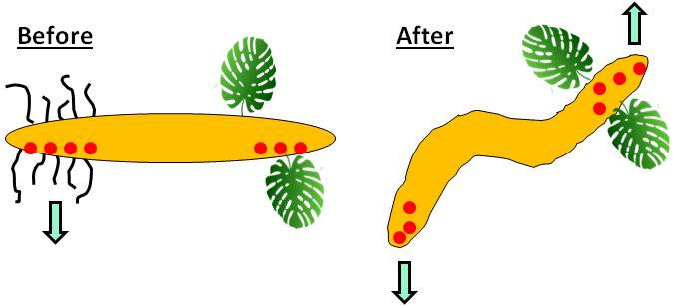
Phototropism in the shoots:
Self-assessment
Auxin accumulates on the shaded side of the shoot, this causes the cells in this area to grow more. Therefore, the shoot grows towards the light.
Gravitropism in the shoots & roots:
In the roots the auxin accumulates on the lower side of both the roots and shoots. In the roots this causes the side with the least auxin to grow more. In the shoots this cause the side with more auxin to grow more.
Notes:
Image by MacKhayman (Own work) [CC BY-SA 3.0 (https://creativecommons.org/licenses/by-sa/3.0)], via Wikimedia Commons

Slide 9
Self-assessment:
a) Plants are sensitive to light and gravity.
b) Plants respond by growing.
c) Growth responses are called tropisms, they are controlled by hormones. One of these is called auxin.
d) Shoots grow towards light and away from gravity.
e) Shoots go upwards so they can obtain light for photosynthesis
f) Roots grow away from light and towards moisture and gravity.
g) Roots go downwards into the sun so that they can obtain water for the plant.

Slide 10
Exam Question
Q. Explain why the tropic responses of shoots and roots are so important in the life of plants.
(4 marks)
Mark Scheme:
Plants, like humans, need to respond to stimuli in their environment in order to survive.
An important stimulus to plants is light, plants grow towards the light in order to maximise their rate of photosynthesis. This provides the plant with a source of energy and the building blocks for new cells to grow.
Plants also need to respond to gravity and moisture, the roots of the plant will grow downwards towards gravity and moisture in the soil.
Roots take up water and mineral ions from the soil, water is needed by the plant for turgidity of it’s roots and stem – this keeps the plant upright. Mineral ions are necessary for the growth of new cells and the general health of the plant.

Slide 11
Plenary ~ Summarise what you have learnt this lesson in three sentences. Use as many key words as you can.
Key Words:
Phototropism
Gravitropism
Auxin
Light
Gravity
Plant
Growth
Shoots
Roots
Tropism

Slide 12
Resources

Slide 13
What is a tropism?
Describe the difference between positive and negative tropism
Define ‘phototropism’:
Define ‘geotropism’: (also known as gravitropism)
Describe the types of geotropism which roots and shoots undergo
Describe the types of phototropism which roots and shoots undergo
What is a tropism?
Describe the difference between positive and negative tropism
Define ‘phototropism’:
Define ‘geotropism’: (also known as gravitropism)
Describe the types of geotropism which roots and shoots undergo
Describe the types of phototropism which roots and shoots undergo
What is a tropism?
Describe the difference between positive and negative tropism
Define ‘phototropism’:
Define ‘geotropism’: (also known as gravitropism)
Describe the types of geotropism which roots and shoots undergo
Describe the types of phototropism which roots and shoots undergo

Slide 15
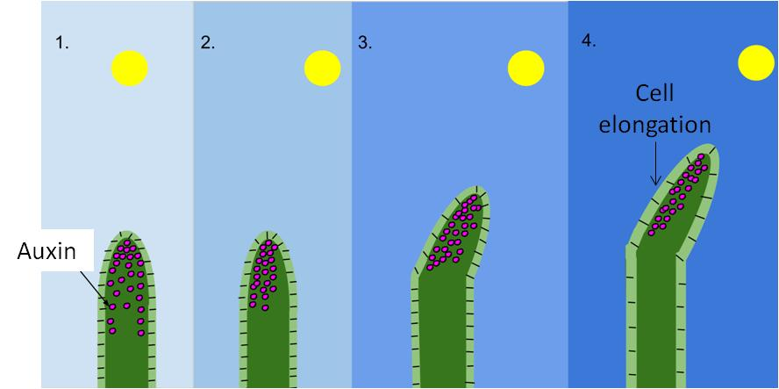
Phototropism
Auxin is produced at the tip of a shoot, When the light falls evenly on the shoot, the levels of auxin are balanced out and equal on both sides. This means the shoot will grow straight up towards the light.
In uneven light conditions the auxin will move from the side of the shoot where the light is falling to the unlit side. This accumulation of auxin on the shaded side of the root causes the cell to grow more, this cell elongation causes the shoot to bend towards the light.
Notes:
Image by MacKhayman (Own work) [CC BY-SA 3.0 (https://creativecommons.org/licenses/by-sa/3.0)], via Wikimedia Commons

Slide 16
Before
After
Gravitropism
Auxin has different effects on root and shoot cells. High levels of auxin accumulate on the lower side of the root. The side of the root with the least auxin grows more, making the root bend and grow downwards towards gravity.
In the shoots, auxin also gathers on the lower side. This has the oppositve effect to the roots, it actually causes the shoot to grow more on the side with the most auxin. Causing the shoot to bend and grow upwards, away from gravity.

