Slide 1
CwK
Sunday, 08 December 2019
Resultant Forces
Do Now Activity
Draw a free body diagram to show the forces acting on a car travelling at steady speed.

Slide 2
Reaction Force
Friction
Forward force
Gravity

Slide 3
Word Consciousness
Stationary-not moving
Velocity- speed in a given direction

Slide 4
Progress Indicators
Good Progress
Calculate a resultant force from two parallel forces acting in opposite directions.
Describe the effect of zero and non-zero resultant forces on the motion of moving and stationary objects.
Outstanding Progress
Calculate resultant forces from several forces acting in different directions.

Slide 5
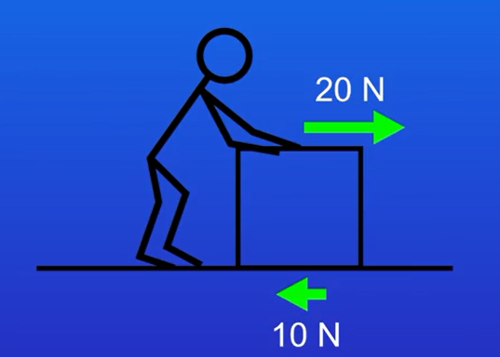
Resultant Force
The resultant force is a single force that has the same effect as all the original forces acting together.
To work out the resultant force we subtract the smaller force from the larger force.
Resultant force of 10N acting towards the right

Slide 6
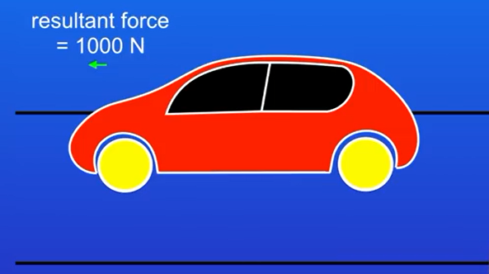
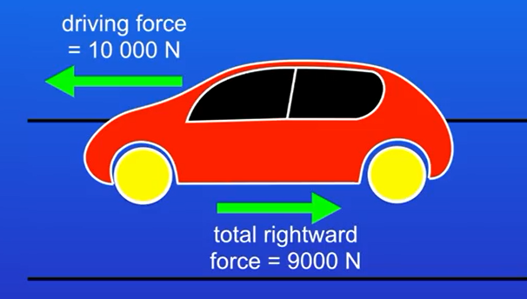
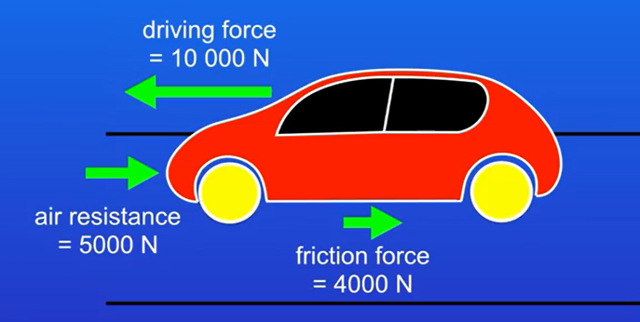
What is the resultant force of this car?

Slide 7
Resultant Force
500N
100N
700N
600N
50N
700N
700N
800N
800N
200N
100N

Slide 8
Newton’s First Law
If the resultant force acting on an object is zero and:
the object is stationary, the object remains stationary
the object is moving, the object continues to move at the same speed and in the same direction. So the object continues to move at the same velocity.

Slide 9
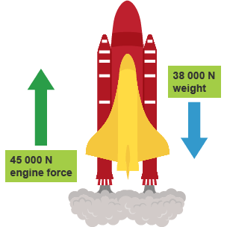
Plenary
What happens to a stationary object if the resultant force is zero?
What happens to a moving object if the resultant force is zero?
Calculate the resultant force of this diagram

