Slide 1
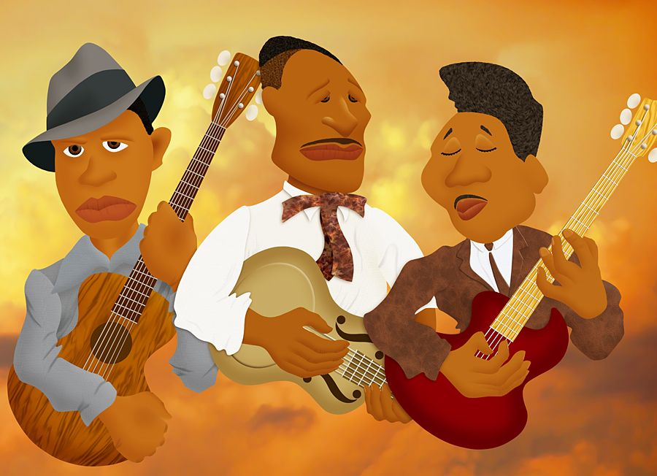
Blues Music
YEAR 7
Assessment

Slide 2
DNA
Complete the Listening and theory test (on your desk)
Extract A
Extract B
Extract C
Extract D

Slide 3
Progress Indicators:
Good | Outstanding
To be able to improvise using three notes of the Blues Scale in time with the backing track and with three clear phrases | To be able to improvise using five notes of the Blues Scale in time with the backing track and with three clear phrases
To secure a grade in line with your flightpath | To secure a grade above your flightpath

Slide 4
What does the Blues Scale look like on the Glockenspiel?
Try improvising using three notes:
C Eb F
When improvising, try to improvise three ‘phrases’ that match with the three 4 bar ‘phrases’ of the 12 bar Blues…
Eb
Gb
Bb
C
F
G
A
C | C | C | C
F | F | C | C
G | F | C | G (C)
C
D

Slide 5
What does the Blues Scale look like on the Glockenspiel?
2. Try improvising using five notes:
C Eb F Gb Bb
When improvising, try to improvise three ‘phrases’ that match with the three 4 bar ‘phrases’ of the 12 bar Blues…
Eb
Gb
Bb
C
F
G
A
C | C | C | C
F | F | C | C
G | F | C | G (C)
C
D

Slide 6
Progress Indicators: Revisited
Good | Outstanding
To be able to improvise using three notes of the Blues Scale in time with the backing track and with three clear phrases | To be able to improvise using five notes of the Blues Scale in time with the backing track and with three clear phrases
To secure a grade in line with your flightpath | To secure a grade above your flightpath

