Slide 1
Music Production

Slide 2
Do Now Activity
Key Term Check! Create a glossary for the following keywords.
Music Production
Music Promotion
Music Distribution
Final Mix
Master Copy
Audio File
AAC/Mp3
Producer
Digital Audio Workstation

Slide 3
L/O How is a song put together? What difference does it make having a producer?
If you have never been in a recording studio, or tried writing a song, the chances are you won’t know how songs are put together. You probably also won’t appreciate just how important the role of a producer is.

Slide 4
Progress Indicators:
Key Terms | Good | Outstanding
Self produce Layer Hook | Describe the role of a producer and suggest what they might contribute to a finished piece of music. | Explain the role of a producer and link their input/contribution to the overall success of a project.
 | List the basic advantages and disadvantages of self-production vs being produced. | Describe the advantages and disadvantages of self-production vs being produced, giving examples of both.
CHALLENGE: | List 3 famous producers. | Evaluate the impact of modern technology on the role of a producer.

Slide 5
Putting a Song Together
You are going to watch two short films – the first will show you Ed Sheeran working with a producer. The second film will show you an artist producing themselves – being a ‘self-producer’.
As you watch the first video, note down how many ideas the producer (Steve , the bald guy) contributed or changed.

Slide 6
Putting a Song Together
Watch this video showing how Ed Sheeran worked with a produced to create ‘Shape of You’, 2017s biggest track!
ED: Artist/Musician
Johnny: Songwriter
Steve:
Producer

Slide 7
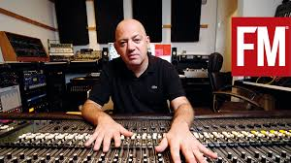
What a Producer Does
Steve played Ed Sheeran the main hook for the song. He had already come up with that.
Steve tried the idea of recording Ed hitting his guitar.
Steve decided on the hook sound.
Steve chose which guitar parts to use and when to use them.
Steve added the 16 beat percussion.
Steve added the melotron part.
As the producer, Steve knew that they were coming up with good ideas so kept Ed & Johnnie working.
Steve added the bass drum sample.

Slide 8
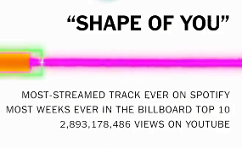
Were producer Steve’s ideas successful?
Write a short paragraph explaining your thoughts…
?

Slide 9
Some artists will contribute most of the production ideas themselves..
Watch this video of Charlie Puth which shows how an artist goes from having an initial idea to recording that idea and ‘producing’ it.

Slide 10
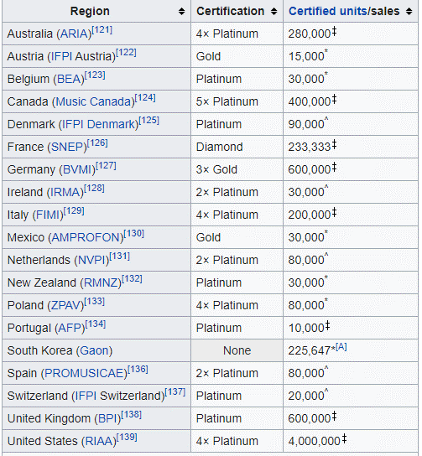
Were Charlie’s production ideas successful? Again, write a short paragraph to show your opinions…
Over 7 Million sales worldwide!

Slide 11
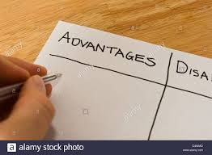
Compare/Evaluate
1. Make a list of the advantages and disadvantages of both types of music production. Self vs Someone else.
2. Suggest which method, if any, you think is better and say why.
3. How much do you think modern technology has changed the role of a music producer?

Slide 12
Music Production
KS3: 1/6

Slide 13
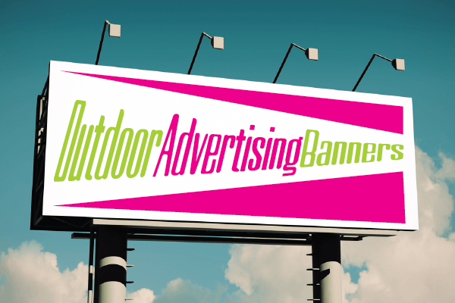
D
N
A
Do Now Activity
Write a list of everywhere that you might see or hear an advert for music.

Slide 14
L/O How is music advertised? What is
PUSH or PULL promotion

Slide 15
Progress Indicators:
Key Terms | Good | Outstanding
Streamed music Downloaded music Promotion campaign Push strategy Pull Strategy Consume | Identify that downloaded music and streamed music are different ways of accessing music. Describe why music has to be promoted and list several ways this can be done. Understand what a Pull strategy is. | Explain the difference between downloaded and streamed music. Suggest examples of promotional methods that make up a Pull strategy. Evaluate which types of advertising are suitable for different target audiences.
CHALLENGE: | List three places you can download music from and three places you can stream music from. | Suggest which types of promotion suit certain target audiences and explain why.

Slide 16
Let’s get thinking…
Q: How much is the UK Music Business worth each year?
A: 5.2 Billion GBP!
(2018-19)
What’s the difference between downloading and streaming music?
60% of that comes from downloading or streaming music.
Downloaded music is stored onto memory and streamed music is only available to be played by a certain website or music provider.

Slide 17
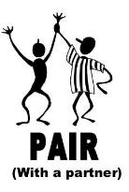
When did you last buy/download/stream a piece of music?
Where did you hear about it? How did you know it existed?
Share your answers by writing them down and sending them to your teacher!

Slide 18
Music has undergone a big change in the way that new artists or bands are promoted.
In the past, Record Companies would ‘PUSH’ an act across the radio, then book them on a TV show, then maybe try to get them in the tabloid newspapers or magazines.
Now it’s all about creating engaging ‘content’ and creating a ‘PULL’ strategy. Put simply, there is so much ‘content’ released online, TV, radio, newspapers and magazines ALL AT ONCE.

Slide 19
How it works…
Playing a song on the radio repeatedly to generate interest. Continue to ‘PUSH’ the song onto unsuspecting listeners.
Once a listener decides they like the song, they will go and find out more about it, maybe buy it.
PUSH

Slide 20
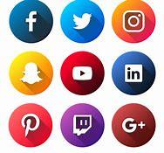
How it works…
PULL

Slide 21
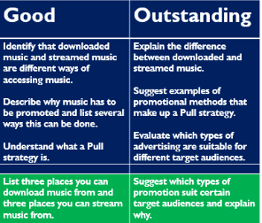
Demonstrate your understanding…
Write one paragraph that explains the difference between PUSH and PULL promotion strategies.

Slide 22
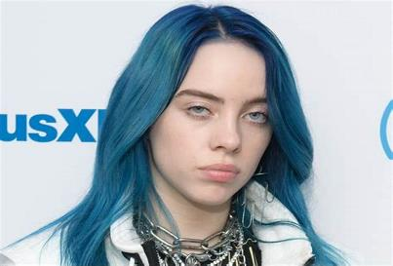
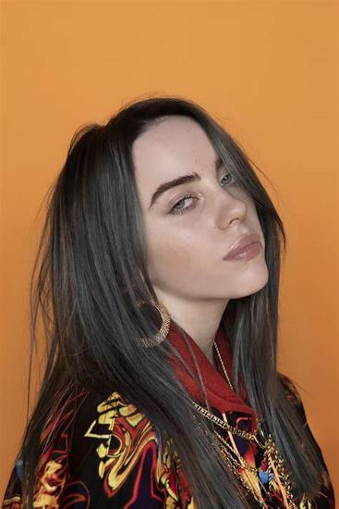
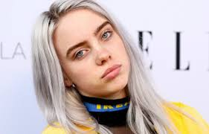
Who is this?
Billie Eilish!
Even I knew who it was!

Slide 23
Billie Eilish’s records have been promoted using a PULL Strategy.
Last year sales:
2.3 billion downloads
Biggest selling artist of 2019.
WHY?

Slide 24
The internet is literately blanketed with all things Billie.
From official videos to behind the scenes, stories, interview videos… There is so much content available to watch and engage with surrounding her album turning up in every corner of the internet under just about any theme from songwriting to production, photography, fashion, personal style, remix cross over videos, comedy even food.
Everything ‘Pulls’ us towards Billie’s brand.

Slide 25
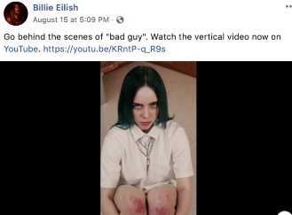
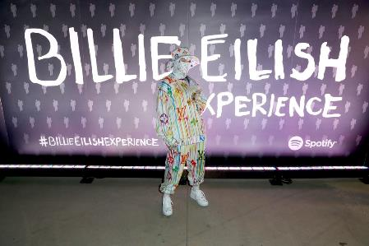
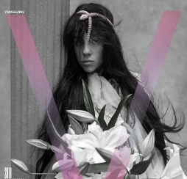
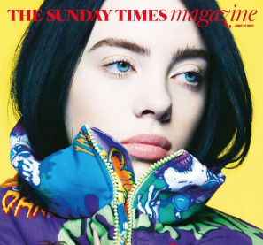
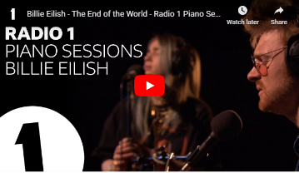

Slide 26
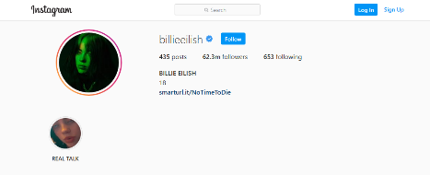
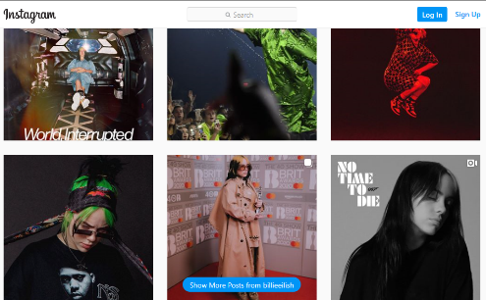
Examples of Twitter and Instagram content.

Slide 27
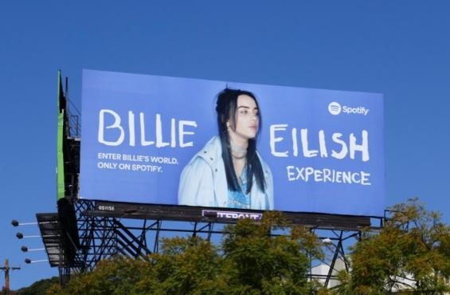
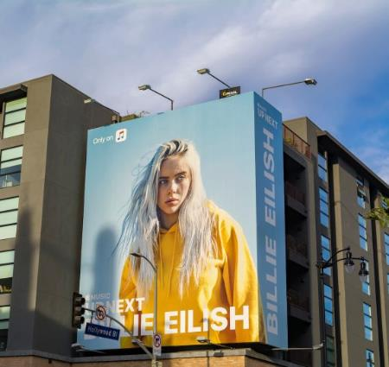

Slide 28
Billie Eilish created an ‘experience’ to help promote her debut album. This was then shared online.
You can watch the video to this here.

Slide 29
Interview with an Advertising Agency
In order for PULL advertising to be effective, an artist or band will have their promotion campaign managed by an advertising agency. These agencies will deal with everything on behalf of the artist and provide a ‘start to finish’ service.

Slide 30
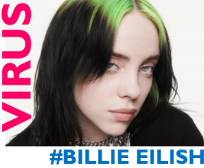
You must include all of this information in your adverts!
Demonstrate Task
The Brief:
The Product:
An advertising agency have asked you to design some new adverts’ for Billie Eilish’s social media to help promote a new single release.
The single release date is 23rd October 2020
The single is called ‘Virus’.
It will be available on all streaming platforms.

Slide 31
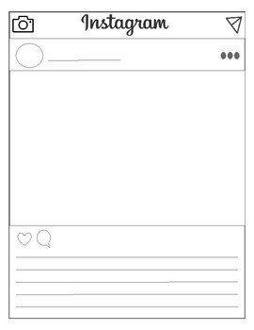
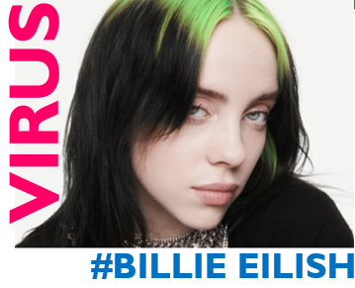
Extension Task: Have a go at designing an Instagram profile for the new single using the template.

