Slide 1
The reactivity Series
Spec. 5.4.1.1 - 5.4.1.2 & 5.4.2.1
DO NOW - 3 questions in 3 minutes
Using your periodic table:
Name three alkali metals
Name three transition metals
How many electrons are in rubidium's outer shell?
Lithium, sodium, potassium, rubidium, caesium or francium
Any of the “dropped down” part (see next slide)
1

Slide 2
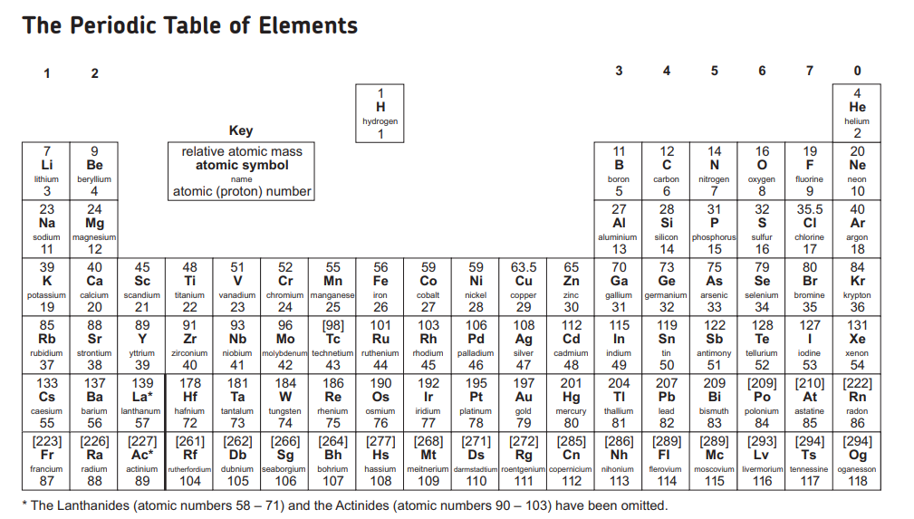

Slide 3
PROGRESS INDICATORS
 | Good progress | Outstanding progress
Grade 1-3 | List the order of common metals in the reactivity series | State whether a reaction will occur or not. Define oxidation and reduction
Grade 4-6 | Describe oxidation and reduction and deduce whether a reaction is oxidation or reduction. | Construct word equations for metals listed in the reactivity series reacting with oxygen, water and acid
Grade 7-9 | Deduce the chemical formulae of the compound formed using their ions. | Evaluate in detail the investigation of metals plus acid, assessing the control of variables and the validity of conclusions drawn from the data collected.

Slide 4
Word Consciousness
Displacement reaction – Where a more reactive element replaces a less reactive element to form a compound
Alkali Metals – Group 1 elements
Oxidation- The gaining of oxygen
Reduction - The losing of oxygen

Slide 5
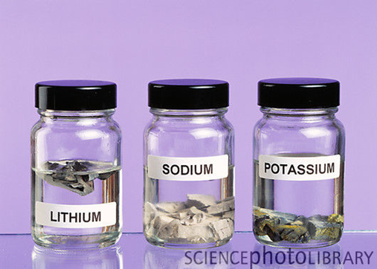
ACTIVITY 1 - ALKALI METALS DEMO
Watch the teacher demonstration or video clip Alkali metals video clip on alkali metals and complete the table below
Metal | Observation | Order of reactivity (1 = highest, 3 = lowest)
Lithium
Sodium
Potassium
Metals react with other substances forming positive ions. The reactivity of a metal is related to its tendency to form positive ions. Metals which form positive ions more easily are more reactive
CHALLENGE - What do your results tell you about the tendency of these elements to form positive ions? HINT: As you go down group 1….

Slide 6
ACTIVITY 1 - ANSWERS
Metal | Observation | Order of reactivity (1 = highest, 3 = lowest)
Lithium | It fizzes steadily and becomes smaller, until it eventually disappears. | 3
Sodium | It fizzes rapidly, and the hydrogen produced may burn with an orange flame before the sodium disappears. | 2
Potassium | The hydrogen ignites instantly. The metal is also set on fire, with sparks and a lilac flame. | 1
CHALLENGE - What do your results tell you about the tendency of these elements to form positive ions? HINT: As you go down group 1….
As you go down group 1 the reactivity of the metals increases e.g. potassium is much more reactive than lithium. Potassium will lose the outer electron more easily than lithium and so potassium is more reactive than lithium. This means the tendency to form positive ions increases down the group.

Slide 7
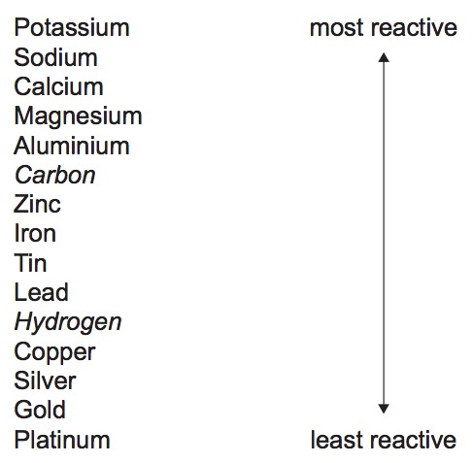
Reactivity series of metals….. What is odd about it?
Please copy this into your book
Carbon and Hydrogen are both non-metals
These can be used to extract metals

Slide 8
Key Facts - METAL OXIDES
Metals react with oxygen to produce metal oxides.
These reactions are known as OXIDATION reactions because the metal gains oxygen.
OXIDATION = gain of oxygen
REDUCTION = loss of oxygen

Slide 9
ACTIVITY 2 - Describe oxidation and reduction and deduce whether a reaction is oxidation or reduction.
Determine whether the reactions are oxidation are reduction reactions. Place a tick in the correct column.
Reaction | Oxidation | Reduction
Zinc + Oxygen
Lead oxide – oxygen
Lithium + oxygen
Copper oxide - oxygen
Potassium + oxygen

Slide 10
ACTIVITY 2 Answers
Reaction | Oxidation | Reduction
Zinc + Oxygen | 
Lead oxide – oxygen |  | 
Lithium + oxygen | 
Copper oxide - oxygen |  | 
Potassium + oxygen | 
SA
Self assess in red pens please

Slide 11
General equations
General equation: Metal + Oxygen → Metal Oxide
Worked example: Sodium + Oxygen → Sodium Oxide
General equation: Metal + Water → Metal Hydroxide + Hydrogen
Worked example: Sodium + Water → Sodium Hydroxide + Hydrogen

Slide 12
ACTIVITY 3 - Construct word equations for metals listed in the reactivity series reacting with oxygen, water and acid
1. Write the word equations for the oxidation of the following metals:
a. Lithium
b. Magnesium
c. Copper (II) 2. Write the word equations for adding water to the following metals:
a. Lithium
b. Magnesium
c. Calcium
CHALLENGE – Deduce the chemical formula of the compounds formed.
HINT: The ions are Li⁺, Mg²⁺, Cu²⁺, O²⁻ Ca²⁺, OH⁻ (hydroxide)

Slide 13
ACTIVITY 3 ANSWERS
1a. Lithium + Oxygen → Lithium Oxide
1b. Magnesium + Oxygen → Magnesium Oxide
1c. Copper (II) + Oxygen → Copper Oxide
2a. Lithium + Water → Lithium Hydroxide + Hydrogen
2b. Magnesium + Water → Magnesium Hydroxide + Hydrogen
2c. Calcium+ Water → Calcium Hydroxide + Hydrogen
SA
Self assess in red pens please
CHALLENGE ANSWERS 1a. Li₂O 1b. MgO 1c. CuO 2a. LiOH 2b. Mg(OH)₂ 2c. Cu(OH)₂

Slide 14
RECAP KS3 –naming salts
A salt name has two parts. The first part is the metal. The second part depend on the acid added to the metal.
If the acid added is HYDROCHLORIC ACID the salt name ends with CHLORIDE.
Example: Reactants = Sodium + hydrochloric acid
Salt formed = Sodium chloride
If the acid added is SULFURIC ACID the salt name ends with SULFATE.
Example: Reactants = Sodium + sulfuric acid
Salt formed = Sodium sulfate

Slide 15
ACTIVITY 4 - Construct word equations for metals listed in the reactivity series reacting with oxygen, water and acid
General equation: Metal + Acid → Salt + Hydrogen
Worked examples:
Sodium + Hydrochloric acid → Sodium chloride + Hydrogen
Sodium + Sulfuric acid → Sodium sulfate + Hydrogen

Slide 16
ACTIVITY 4 - Construct word equations for metals listed in the reactivity series reacting with oxygen, water and acid
QUESTIONS – Write complete word equations for adding metals to acid, using the following as the reactants:
Magnesium + hydrochloric acid
Magnesium + Sulfuric acid
Zinc + Hydrochloric acid
Zinc + Sulfuric acid
Iron + Hydrochloric acid
Iron + Sulfuric acid
CHALLENGE –
Deduce the chemical formula of the salt formed.
HINT: The ions are Mg²⁺, Zn²⁺, Fe²⁺, Cl⁻, SO₄²⁻
HT ONLY
Explain in terms of gain or loss of electrons what is being oxidised and reduced in these reactions

Slide 17
ACTIVITY 4 ANSWERS – PEER ASSESSMENT
QUESTIONS – Write complete word equations using the following as the reactants:
Magnesium + Hydrochloric acid → Magnesium Chloride + Hydrogen
Magnesium + Sulfuric acid → Magnesium Sulfate + Hydrogen
Zinc + Hydrochloric acid → Zinc Chloride + Hydrogen
Zinc + Sulfuric acid → Zinc Sulfate + Hydrogen
Iron + Hydrochloric acid → Iron Chloride + Hydrogen
Iron + Sulfuric acid → Iron Sulfate + Hydrogen
PA
Peer assess in red pens please

Slide 18
ACTIVITY 4 Challenge answers
CHALLENGE – Deduce the chemical formula of the salt formed.
Magnesium chloride → MgCl₂
Magnesium sulfate → MgSO₄
Zinc chloride → ZnCl₂
Zinc sulfate → ZnSO₄
Iron chloride → FeCl₂
Iron sulfate → FeSO₄
SA
Self assess in red pens please

Slide 19
Stretch and challenge
QUESTIONS – Write balanced symbol equations for each of the following word equations
Lithium + Oxygen → Lithium Oxide
Magnesium + Oxygen → Magnesium Oxide
Copper (II) + Oxygen → Copper Oxide
Lithium + Water → Lithium Hydroxide + Hydrogen
Magnesium + Water → Magnesium Hydroxide + Hydrogen
Calcium+ Water → Calcium Hydroxide + Hydrogen

Slide 20
Stretch and challenge answers
ANSWERS
4Li + O₂ → 2Li₂O
2Mg + O₂ → 2MgO
2Cu O₂ → 2CuO
2Li + 2H₂O → 2LiOH + H₂
Mg + 2H₂O → Mg(OH)₂ + H₂
Ca + 2H₂O → Ca(OH)₂ + H₂
SA
Self assess in red pens please

Slide 21
Plenary: How are you feeling?
Put your book onto the colour relating to how you feel about todays topic.

