Slide 1
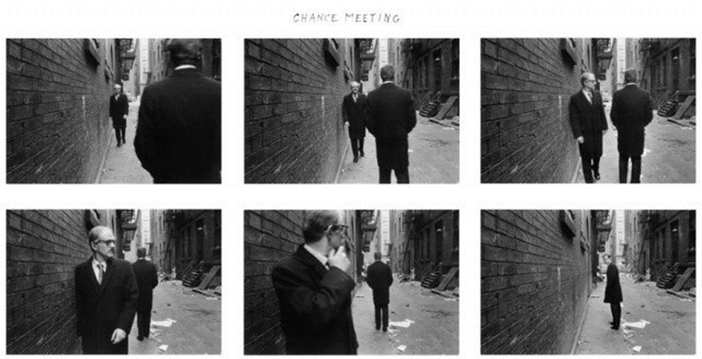
DNA
What can you tell me about these image?
What do you think is going on?
What type of photography is it?

Slide 2
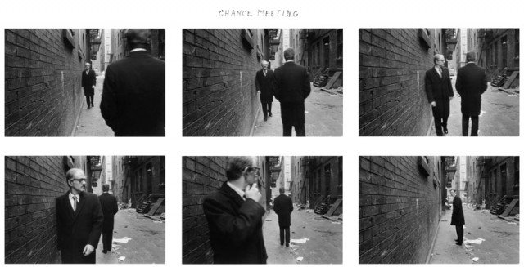
NARRATIVE PHOTOGRAPHY
‘Narrative Photography is the idea that photography can be used to tell a story.’
Narrative image making can come in different forms such as moving image (film) or sequence imagery, magazines, photo essays and still images. Narrative image making is a way to discuss pictures in a story form, such as a book or a series.
However remember- A story is a sequence of events unfolding over time, but a photograph is a single moment frozen in time removed from the timeline- Focusing on an event.
A narrative story has a beginning, middle, and end.
Narrative photography presents a Enigma Code to the viewer, a sort of fill in the blanks of what has happened and is about to happen.
A staged narrative concept can be pretty much anything the photographer wishes to express because the methodology allows you to produce practically anything.
Duane Michaels ‘Chance Meeting’ 1970

Slide 3
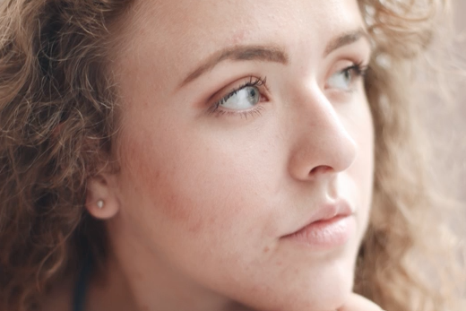
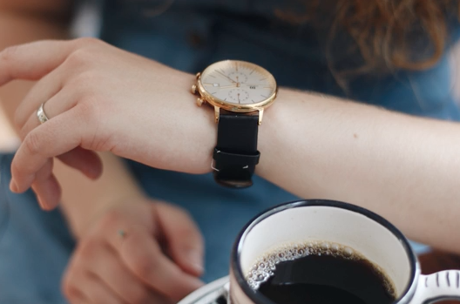
NARRATIVE PHOTOGRAPHY
https://www.youtube.com/watch?v=6Z1DWA-_0eo

Slide 4
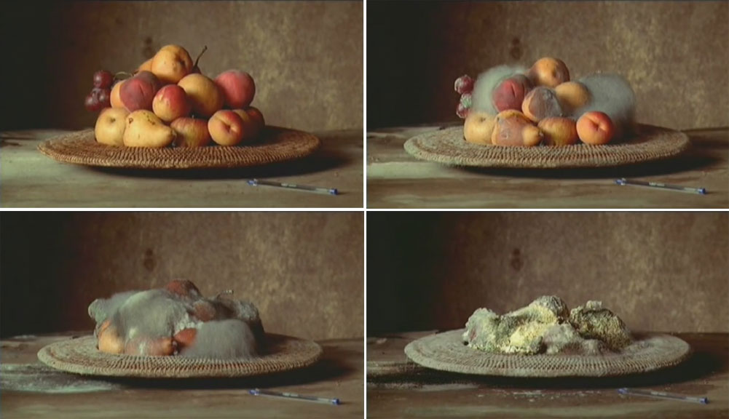
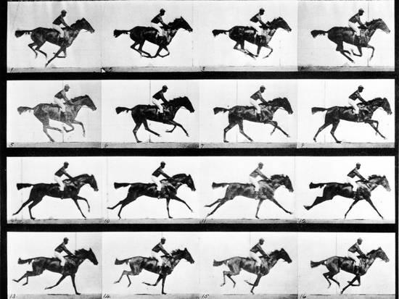
NARRATIVE PHOTOGRAPHY
Duane Michaels ‘Chance Meeting’ 1970
Sam Taylor ‘A matter of time’ 2007
Edward Muybridge ‘Horse in Motion’ 1886

Slide 5
Watch the video
How do you think they produced this music video?
htps://www.youtube.com/watch?v=vzJmloK8am0

Slide 6
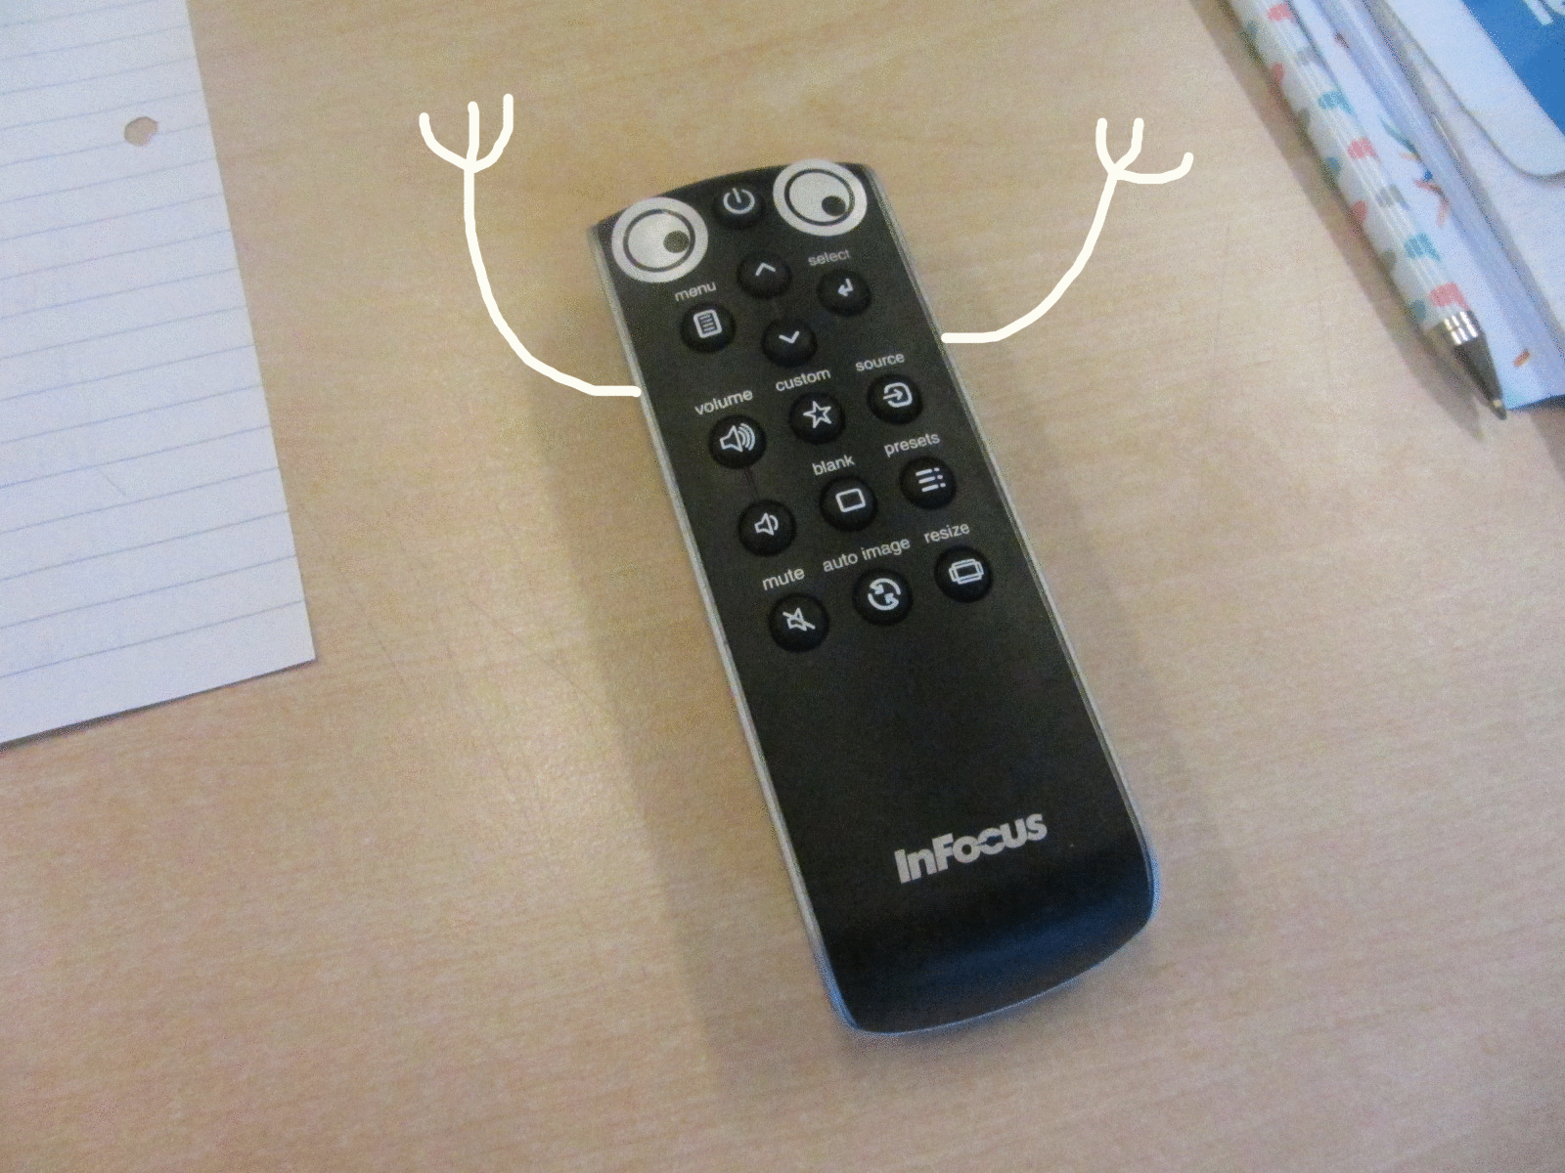
Making a Goggly Eye Object Gif
Select your object from your pencil case and stick some sticker eyes on to it. Using a piece of paper design stick arms/legs
Take 10 photographs of your object, remembering to move your object around so it looks like its moving, including the paper to make him look like his arms/legs are moving too
Upload your images to your area (photography folder)
Save your images as jpeg (Go to File… Save as… Select Jpeg in the drop down box then click save to your area).
Open up the internet and go to http://gifcreator.me/ OR http://ezgif.com/maker/ (if these do not work search for Gif maker and you will find many websites)
Once you are happy with your Gif, make sure you save it onto your area
You may like to experiment with adding text and other drawn elements to your photos!

Slide 7
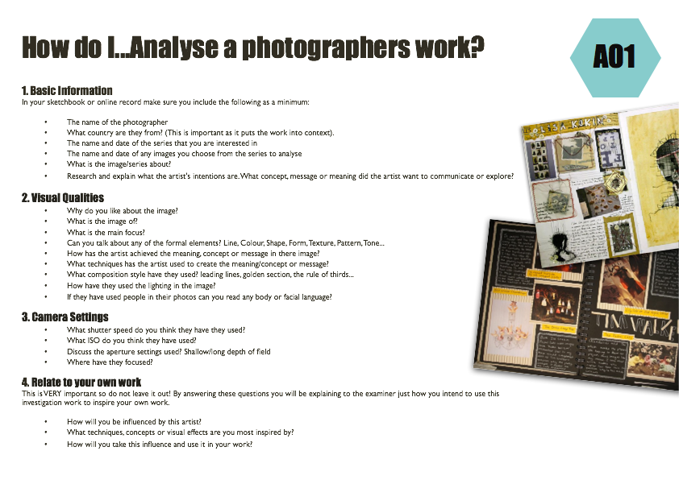
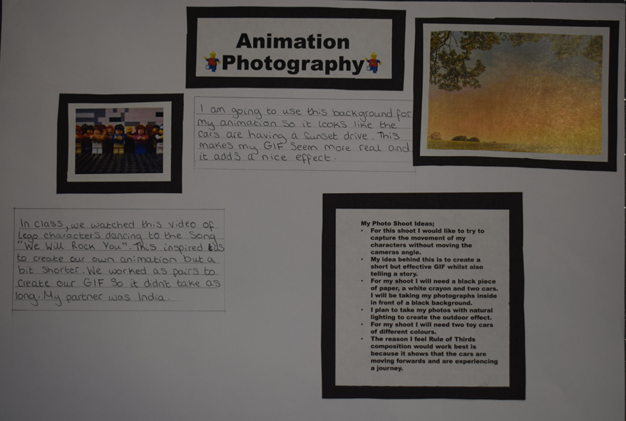
To gain an understanding of the project ‘Dear Photograph’
Title:- Narrative Photography
GCSE photography Progress Indicators
Basic Requirements | Described the work of Taylor Jones and Dear Photograph Presented a selection of images by the photographer in your sketchbook Added the photographers name to the page
Good | Answered some questions from each heading on the ‘How do I…Analyse a Photographers work?’ sheet A range of neatly cut out and presented images for the project
Outstanding | Answered most questions from all the headings on the ‘How do I…Analyse a Photographers work?’ sheet Writing uses detailed and in-depth sentences Creative layout/design for the page used
TASK 1
Find at least 6 images you like and print. Find as much information (plus what you have noted down)
TASK 2
Using the ‘Analysing photographers’ handout handwrite or type up your analysis of one of your found images.
TASK 3
Creatively write the title - on your A3 paper and creatively present the images and information, (discussing at least one photo in detail, information about the project/artist, camera settings, composition of the photos and possible ideas)

Slide 8
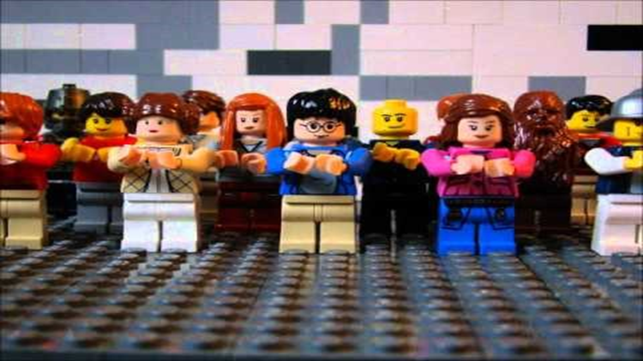
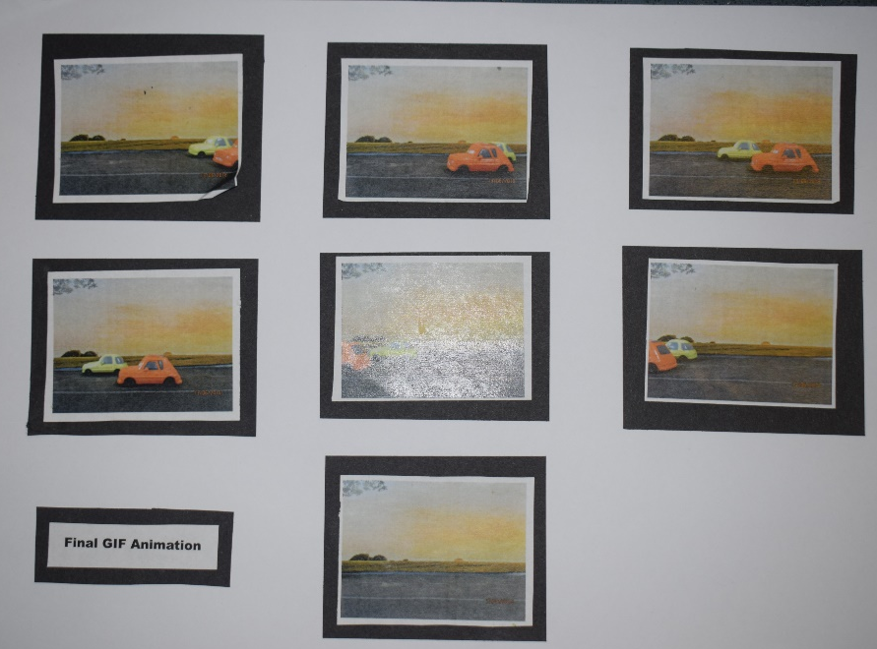
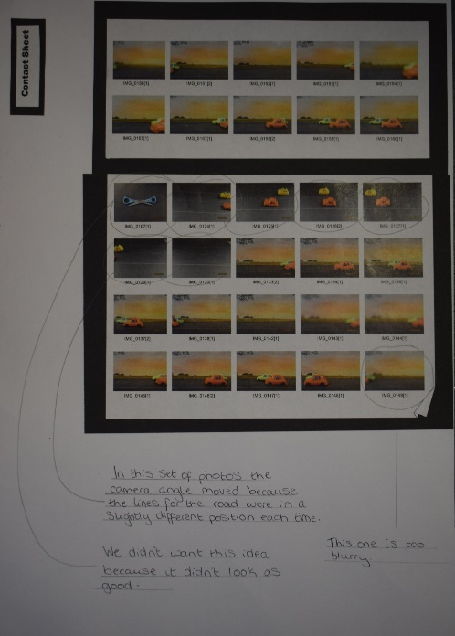
Lesson Objective
To present the results of the GIF craze photo shoot.
Task 4
Photograph an object that you have in your pencil case and turn it into a gif or use one of the characters to create a GIF sequence of events for that character – like the Lego Dance video – using lego men or googly eyes
A3 page must include:-
Creative Title – Animation & Narrative Photography
Contact sheet – annotated with camera settings and best photo’s
Final Photos that create your GIF Animation – discuss GIF(animation made online) results and would could be improved
GCSE photography Success Criteria: Presenting best Images
Basic Requirements | Best unedited and edited images printed and presented on A3 page
Good | Images have been edited, cropped and scaled to improve the final prints - smaller unedited images presented alongside – some discussion one the best images
Outstanding | Creative presentation of the images with discussion and improvement mentioned about GIF images and the actual sequence
http://gifcreator.me/ OR http://ezgif.com/maker/

Slide 9
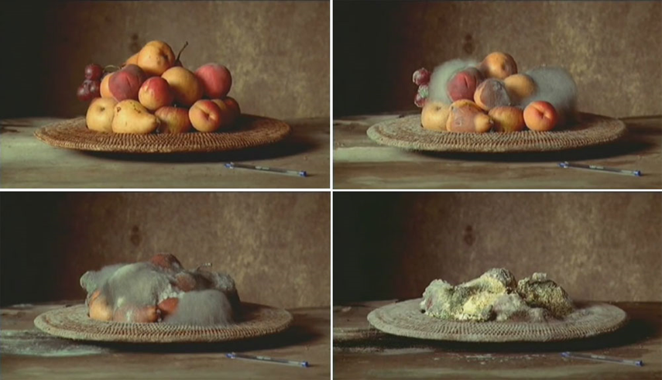
PLENERY
What can you NOW tell me about this type of photography?
What camera settings do you think have been used in the image above?
How will you be influenced by this style?

Slide 11
Peer Assessment Reference Page
Using the sheet/table look through what your partner has done so far on their reference page and tick if completed fully
Glue the assessment to the back of their large paper and hand back for them to complete this lesson

