Slide 1
C/W Date
Lesson Title: The Inspector
Lesson Focus: use a repertoire of strategies to analyse, compare and respond to layers of meaning, subtlety and allusion. Progress indicators:

Slide 2
Week focus: Priestley’s intentions
Word Consciousness – Please record on the back page of your exercise books
Word and definition | Your definition or synonyms
Imposing – when something/someone is impressive, dominant, even a little threatening.
Mouthpiece – a person who speaks on behalf of another person or organisation.
Conscience - a person's moral sense of what is right and wrong

Slide 3
Learning Journey
Week focus: Priestley’s intentions
Last lesson we concluded our focused exploration of Eric as a character.
Today we are moving on to focus on the presence of the Inspector and how he is used by Priestley as a mouthpiece for socialism
In our next lesson we will scrutinise the Inspector’s final warning in Act 3, exploring how the writer has used literary techniques to create deeper meaning.

Slide 4
Mr Birling: ‘a man has to mind his own business and look after himself and his own’ [We hear the sharp ring of a front doorbell.’] | Q. Why do you think Priestley begins the Inspector’s entrance in the middle of Mr Birling’s speech? | Hint: What kind of views is Mr Birling expressing when he is interrupted?
‘The Inspector need not be a big man, but he creates at once an impression of massiveness, solidity and purposefulness’ | Q. What do these adjectives mean? What is Priestley trying to say about the Inspector?
He is a man in his fifties, dressed in a plain darkish suit of the period. He speaks carefully, weightily and has a disconcerting habit of looking hard at the person he addresses before actually speaking” | a. Why does it matter that his suit is ‘plain’? b. Why is it worth mentioning that he speaks ‘carefully’ – do the other characters speak carefully? c. Disconcerting means off-putting/disturbing – why do you think he is meant to have this effect on the characters just by looking at them? | Hint: What kind of clothes are the Birlings wearing? Think back to the introductory SDs.
Mr Birling attempts to regain control, but fails as the Inspector quickly regains his control [The Inspector interrupts Birling ‘cutting through, massively’]. | Q. Do you think Mr Birling is used to being cut off like this, repeatedly? What are we meant to think of the Inspector?
Week focus: Priestley’s intentions

Slide 5
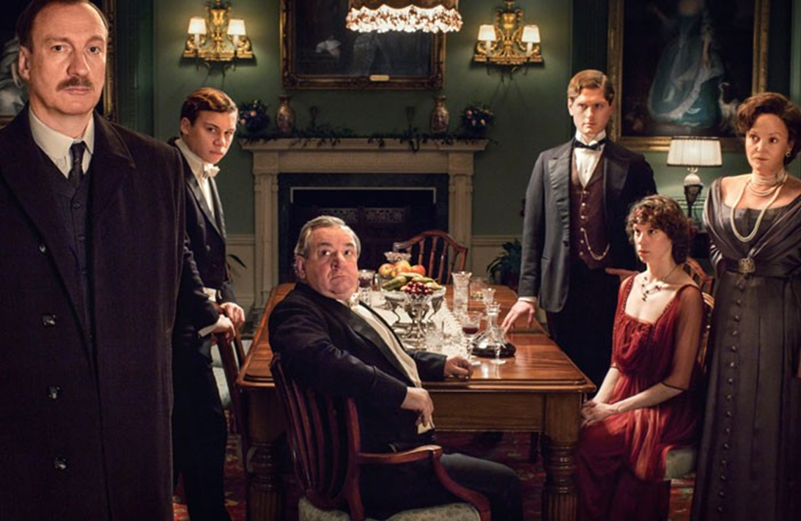
Readers for: pp 56-61
Week focus: Priestley’s intentions
Contiguous Read
Readers for:
Inspector Goole:
Eric:
Mrs Birling
Mr Birling:
Sheila:
Gerald:
Stage Directions:
Once we have finished reading make a note of how the other characters react to the Inspector once he exits…

Slide 6
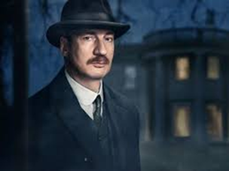
Week focus: Priestley’s intentions
The Inspector’s Purpose - Have a look at these 5 quotations from the Inspector below -What do they tell us about the kind of person the Inspector is? -What message is Priestley trying to convey through his words? -What sort of ideological values are being transmitted through the Inspector?
“...It would do us all a bit of good if sometimes we tried to put ourselves in the place of these young women counting their pennies in their dingy little back bedroom”
“...It’s better to ask for the Earth than to take it”
“Public men, Mr Birling, have responsibilities as well as privileges”
“If there’s nothing else we have to share our guilt”
“This girl killed herself- and died a horrible death. But each of you helped to kill her. Remember that. Never forget it. (He looks from one to the other of them carefully) But then I don’t think you ever will. Remember what you did”

Slide 7
Plenary – Exit Post it
Week focus: Priestley’s intentions
On your post-it note write an explanation of what you think the purpose of Inspector Goole is in An Inspector Calls: Think about…
Why has J.B Priestley chosen to use him as a character? – What message is he there to get across? How is he different from the other characters? – Why are these differences important?
And of course think about the values and beliefs of Socialism…
Stick your note on the board when you’re ready…

