Slide 1
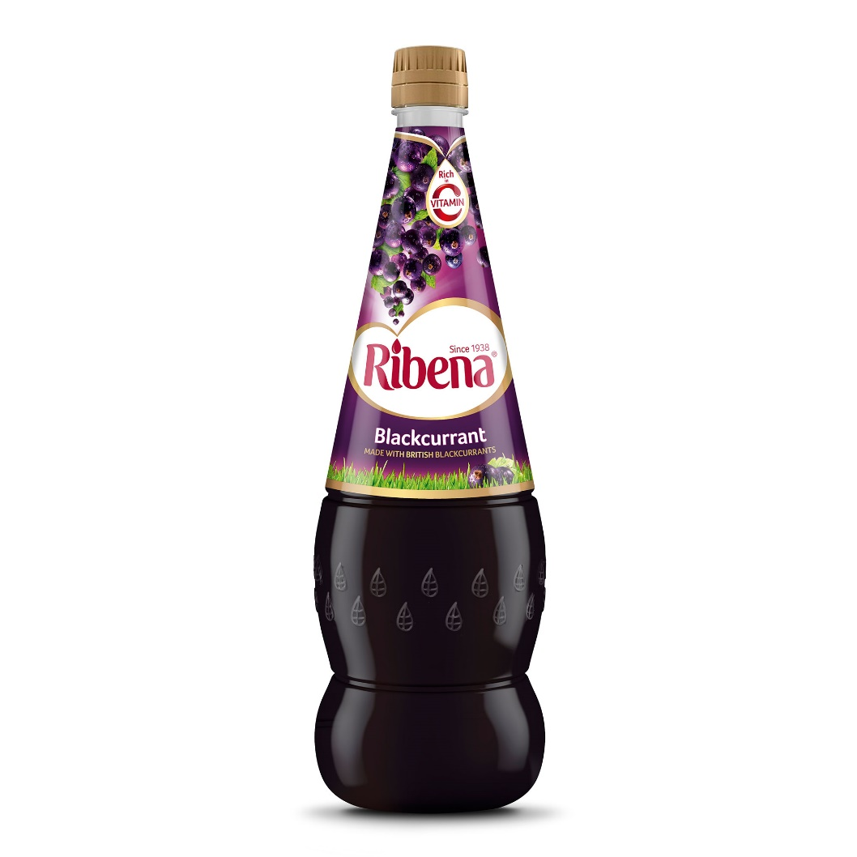
Concentrations of Solutions
C/W
Do Now: Which is the most concentrated and why?
3.2.5

Slide 2
Progress Indicators
C/W
Good
-Identify the unit of concentration Calculate the concentration of a solution in terms of grams per dm3
Outstanding Calculate the mass of a given solute from the volume and concentration of a solution.
3.2.5

Slide 3
Concentrations of Solutions
On your tables: Can you draw an image to represent a high concentration & a low concentration?
High Concentration
Low Concentration
Think of concentration as: How much of a substance you have, per unit volume!

Slide 4
Volume
TASK: Make a list of the units used to measure volume, there are several different ways.
Units of volume
Cube metres m³
Cubic centimetres cm³
Litres L
Mililitres mL
Chemists use their own special unit!
Cubic decimetres dm³

Slide 5
Cubic decimetres – dm³
Cubic decimetres
- 0.1 m = 1 dm = 100cm
0.1m x 0.1m x 0.1m = 1dm³
1 cubic decimetre is equal to 1 litre!
So it’s basically just litres!
HT Only – Now we are going to learn how to convert between cm³ and dm³
0.1 m
0.1 m
0.1 m

Slide 6
Converting Units
1 dm³ = 1000 cm³
So to convert cm³ into dm³ you just have to divide by 1000!
Q1. A solution has a volume of 500cm³, what is its volume in dm³?
500 cm³
= 0.5 dm³
1000

Slide 7
Converting Units
1 dm³ = 1000 cm³
So to convert dm³ into cm³ you just have to multiply by 1000!
Q2. A solution has a volume of 0.432dm³, what is its volume in cm³?
0.432 dm³ x
1000
= 432 cm³

Slide 8
TASK: Converting Units
Your Turn:
What is 0.025 dm³ in cm³?
What is 270cm³ in dm³?
How many cm³ are in 0.052dm³?
A solution has a total volume of 986cm³ what is this in cubic decimetres?
25cm³ is taken from a solution of total volume 0.45 dm³ what volume of the solution remains?
0.025 x 1000 = 25cm³
270 ÷ 1000 = 0.27dm³
0.052 x 1000 = 52cm³
986 ÷ 1000 = 0.986dm³
25 ÷ 1000 = 0.025dm³
0.45 – 0.025 = 0.425 dm³ or 425cm³

Slide 9
Calculating Concentrations of Solutions
Q. If each box has a volume of 1dm³ what is the concentration of each?
12 purple spheres per dm³
4 purple spheres per dm³

Slide 10
Calculating Concentrations of Solutions
“Solute” - The substance that is dissolved.
Concentration = Quantity of solute ÷ volume
12g
4g
1 dm³
1 dm³
12 grams per dm³ = 12 g/dm³
4 grams per dm³ = 4 g/dm³

Slide 11
TASK: Calculating Concentrations
Your Turn:
If 5g of sodium is dissolved in 1dm³ what is the concentration?
If 8g of sodium hydroxide is dissolved in 2dm³ what is the concentration?
What is the concentration of a solution when 50g of hydrogen chloride is dissolved in 5dm³ of water?
How concentrated is a 500cm³ solution that contains 6g of potassium hydroxide?
5g ÷ 1dm³ = 5g/dm³
8g ÷ 2dm³ = 4g/dm³
50g ÷ 5dm³ = 10g/dm³
500cm³ ÷ 1000 = 0.5dm³
6g ÷ 0.5 = 12 g/dm³

Slide 12
Calculating the Mass of a Solute
If you know the concentration and volume of a solution, you can calculate the mass of solute dissolved in it. e.g:
Q3. A solution of potassium hydroxide has a concentration of 10g/dm³, what mass of potassium hydroxide is dissolved in 0.5dm³ of it?
10 g/dm³ x
0.5
= 5g
Quantity of a solute = concentration x volume

Slide 13
TASK: Calculating Masses of Solutes
Your Turn:
What mass of lithium is dissolved in 0.4dm³ of a 15g/dm³ solution?
How many grams of hydrogen chloride are dissolved in 4dm³ of a 1.4g/dm³ solution?
A flask contains 400cm³ of a 5g/dm³ solution of potassium hydroxide. If all the water was evaporated, what mass of potassium hydroxide would remain?
A student took 25cm³ of 0.1g/dm³ sodium thiosulfate solution. What mass of sodium thiosulfate does it contain?
15g/dm³ x 0.4 dm³ = 6g
1.4g/dm³ x 4 dm³ = 5.6g
400cm³ ÷ 1000 = 0.4dm³
5 g/dm³ x 0.4dm³ = 2g
25cm³ ÷ 1000 = 0.025dm³
0.1 g/dm³ x 0.025 dm³ = 0.0025g or 25 mg

Slide 14
Factors affecting Concentration
Q. What would happen to the concentration if we doubled the volume?
If you double the volume you halve the concentration.
This is because the particles of solute are twice as spread out!
12g
1 dm³
2 dm³
12 grams per dm³ = 12 g/dm³
12g ÷ 2dm³ = 6 g/dm³

Slide 15
Factors affecting Concentration
Q. What would happen to the concentration if we haved the volume?
If you halve the volume the concentration doubles.
This is because the particles of solute are twice as close together!
12g
0.5 dm³
1 dm³
12 grams per dm³ = 12 g/dm³
12g ÷ 0.5dm³ = 24 g/dm³

Slide 16
TASK: Advanced Challenge Calculations
Your Turn:
A student had 0.625 dm³ of a 18g/dm³ solution. She evaporated off some of the water so the new volume was 0.500 dm³ what is the new concentration of this solution?
A student intended to make a solution of concentration 5g/dm³, they dissolved 5g of solid in 1.2dm³, they calculated that this gave them a 4.16 g/dm³ solution. What volume should they have filled it to, and how could they fix their over dilution?
18 g/dm³ x 0.625 dm³ = 11.25g of solute.
11.25 ÷ 0.500 dm³ = 22.5 g/dm³
5 g ÷ 5 g/dm³= 1dm³
They could evaporate off 0.2dm³(200cm³) of water.

Slide 17
Concentrations of Solutions
Plenary Discussion: Which is the most concentrated and why?

