Slide 1
Thursday, 24 September 2020
Fractional distillation
DNA: Match up the words to complete the sentences.
The boiling point is the temperature at which a liquid boils or a gas…
Flammability is how easily a substance…
Viscosity is how easily a substance…
The tendency to turn into a gas is known as …
condenses
burns
flows
volatility
volatility - burns - condenses - flows

Slide 2
Progress indicators
Good progress:
- Give some uses of products from crude oil
- Explain how the carbon chain length affects the properties of the hydrocarbon
Outstanding Progress:
- Explain the process of fractional distillation

Slide 3
Word consciousness
Flammability – how easily a substance burns
Viscosity – how easily a liquid flows

Slide 4
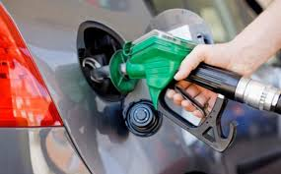
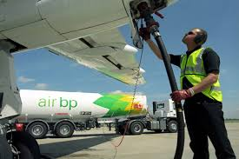
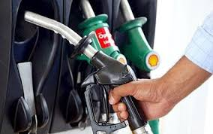
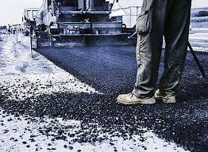
Activity 1: Identify some products made from crude oil
ltreop
lcipsat
Petrol
Plastic
Lubricant
binultarc
nekroes
ideles
inbetmu
kerosene
Diesel
Bitumen
Notes:
Other uses mentioned in the specification include heavy fuel oil, liquified petroleum gases (fuel examples) and solvents, polymers and detergents.

Slide 5
Activity 2: Use the data to explain how chain length affects different properties
Task: For each property write a sentence explaining how the property changes as the length of the carbon chain increases.
E.g. As the length of the carbon chain increases, the colour gets darker.
Property | Propane | Petrol | Diesel
Molecular formula | C₃H₈ | C₆H₁₄ | C₁₆H₃₄
Colour
Boiling point (°C) | -42 | 69 | 287
Flammability | Highly flammable | Flammable | Lower flammability
Viscosity | Very runny | runny | Less runny
Notes:
Petrol is a mixture of similar length hydrocarbons (from 5 to 10 carbon atoms)- for this exercise a hydrocarbon in the middle of the class has been used
Diesel is a mixture of hydrocarbons between 14 and 20 carbon atoms

Slide 6
As the length of the carbon chain increases:
the boiling point increases
the flammability decreases
the viscosity increases

Slide 7
Mini-Plenary: True Or False
Butane (C₄H₁₀) has a longer carbon chain than hexadecane (C₁₆H₃₄).
Flammability decreases as the carbon chain length increases.
Small hydrocarbons are less viscous.
Smaller hydrocarbons have higher boiling points.
False
True
True
False

Slide 8
Activity 3 – explain the process of fractional distillation
Task watch the video and after make notes on the key parts of fractional distillation
https://www.youtube.com/watch?v=PYMWUz7TC3A

Slide 9
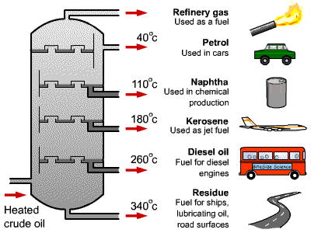
Fractions with low boiling points condense at the top
Fractions with high boiling points condense at the bottom
Notes:
Diagram for pupils to stick in books
Could show fractional distillation demo or this video: https://www.youtube.com/watch?v=3I7yCkSXPos

Slide 10
Fractional distillation key points
Heat to vaporise the hydrocarbons / (crude) oil
Temperature (of column) decreases from bottom to top
As gases / vapours rise up the column, they condense at different points according to their boiling point
Longer chained hydrocarbons condense at bottom (as highest boiling point)
Shorter chained hydrocarbons condense higher up the column (as lowest boiling points)

Slide 11
Demonstrate - 6 mark question
Questions to help you get started:
What is this process called?
What is done to the crude oil to start?
What happens as a result of this?
Why can petrol be separated?

Slide 12
PLENARY – Bingo!
Choose 9 keywords from the choice below – put 1 in each box. First one to get 3 in a row wins.
Hydrocarbon
Condense
Evaporate
Vapour
Fraction
Flammable
Viscosity
Chain
Oil
Petrol
Bitumen
Gas
Liquid
Notes:
12.25 – 12.35

