Slide 1
CwK
Wednesday, 01 July 2020
Safety features of vehicles
Do Now Activity
What factors may contribute towards a car crash?

Slide 2
Self Assess

Slide 3
Progress Indicators
Good Progress
Explain how airbags, seat belts and crumple zones reduce impact forces.
Explain how crash mats, cycle helmets and cushioned surfaces reduce impact forces.
Outstanding Progress
Apply the rate of change in momentum equation

Slide 4
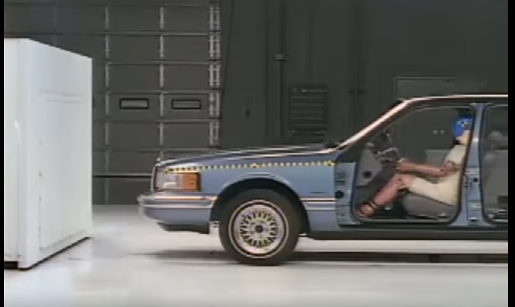
What could be added/changed to make this crash less harmful?
https://www.youtube.com/watch?v=d7iYZPp2zYY

Slide 5
Speed doesn’t kill you!!! Stopping does
it all depends on how fast you slow down.
A car of 1500kg:
Travelling at 7m/s and taking 1 minute to stop, what would be the deceleration?
Travelling at 5m/s and taking 30s to stop. What is the deceleration?
Which is going to cause more harm to the passengers?
Find the impact force to prove this!

Slide 6
A car of 1500kg:
Travelling at 7m/s and taking 1 minute to stop, what would be the deceleration?
a=(0-7)/60 = -0.12m/s²
Travelling at 5m/s and taking 30s to stop. What is the deceleration?
a=(0-5)/30 = -0.23m/s²
Which is going to cause more harm to the passengers?
The car travelling at 5m/s because it decelerates much faster.
Find the impact force to prove this!
F=(mv)/t = (1500x7)/60 = 175N
F= (1500x5)/30 = 250N

Slide 7
it all depends on how fast you slow down.
When you travel faster your body has more momentum going forwards.
When the vehicle stops it changes momentum very quickly to zero, but your body continues to travel with the same momentum as before.
So your body hits the now stationary (or slower) vehicle causing an impact and therefore injury.
If you wear a seat belt your body is ‘stuck’ to the seat and so slows down at the same rate as the vehicle. So you don’t continue to more forwards when the vehicle slows.

Slide 8
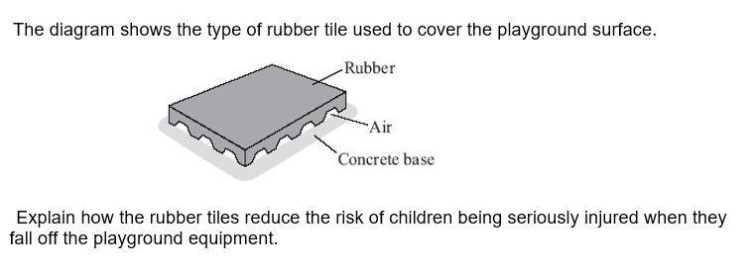
Increases the time taken to stop
Decreases the rate in change of momentum
Reducing the force on the child

Slide 9
Key Points- can be applied to all questions
Increase the time taken to stop
Decrease the rate in change of momentum
Reduces the force

Slide 10
To decrease the impact force we must increase the time taken to slow down.
In vehicles how can we do this?
Seat belts
Air bags
Crumple zones

Slide 11
 | What does it do? | Why?
Safety belts
Air bags
Crumple zones

Slide 12
 | What does it do? | Why?
Safety belts | Increase time taken for the body to stop. | To reduce the force on the body
Air bags | Cushions the body from the hard interior by rapidly inflating and slowly deflating. | To spread the force more evenly over the whole body, therefore reducing the force.
Crumple zones | Increases the time taken for the car to hit the object | Most of the force is absorbed by the crumple zone so reducing the amount of force going to the driver.

Slide 13
Since 1965, all cars manufactured for use in the UK must have seat belts
It is safer for a car driver to be wearing a seatbelt, compared with not wearing a seat belt if the car is involved in a collision.
Explain why

Slide 14
The seat belt stretches
The driver takes a longer time to slow down and stop compared to the other driver who would hit the windscreen
For the same change of momentum
So a smaller force is exerted

Slide 15
Plenary

