Slide 1
You know what to do….
YES I AM A DOG WHO CAN DRIVE!
Do Now Task
Label as many muscles as you can remember:

Slide 2
Do Now Task BUZZ and GO Hint (3rd rotation)
Label as many as you can remember:
Metatarsals
Ulna
Radius
Humerus
Metacarpals
Pelvis
Femur
Ribs
Clavicle
Scapula
Vertebrae
Phalanges
Fibula
Sternum
Tarsals
Tibia
Carpals
Cranium
Phalanges
Patella

Slide 3
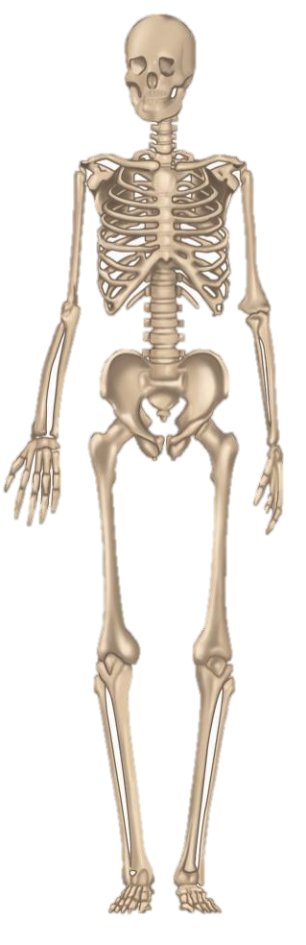
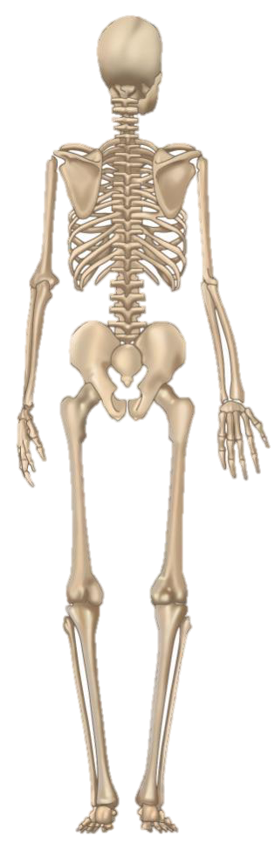
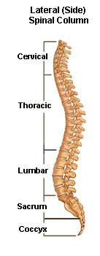
Key
Long
Short
Irregular
Flat (plate)
Atlas & axis

Slide 4
Key
Long
Short
Irregular
Flat (plate)
Cranium
Clavicle
Sternum
Scapula
Humerus
Ribs
Vertebrae
Atlas & axis
Pelvis
Radius
Carpals
Ulna
Metacarpals
7
Phalanges
Femur
12
Patella
Fibula
5
Tarsals
Tibia
5
Metatarsals
Phalanges

Slide 5
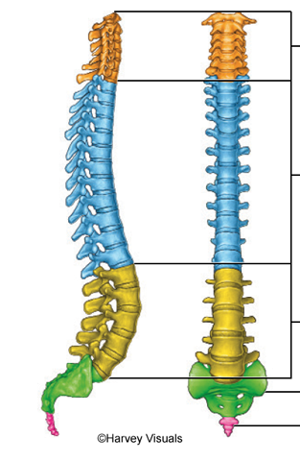
Can
The
Liverpool
Supporters
Come forward?!

Slide 6
Classifications of Bones
This is a stick not a bone!
LO: To begin to understand the classification of the bones

Slide 7
Progress Indicators
Good Progress | Outstanding Progress
Be able to recall the classifications of bones giving an example for each | Linking the functions of the bones to a sporting performance identifying the role they have in that movement
Linking ALL of the functions of the bones to a sporting performance identifying the role they have in that movement. | Will start to discuss the four functions and how they aid two contrasting sporting activities.
3-4
5-7

Slide 8
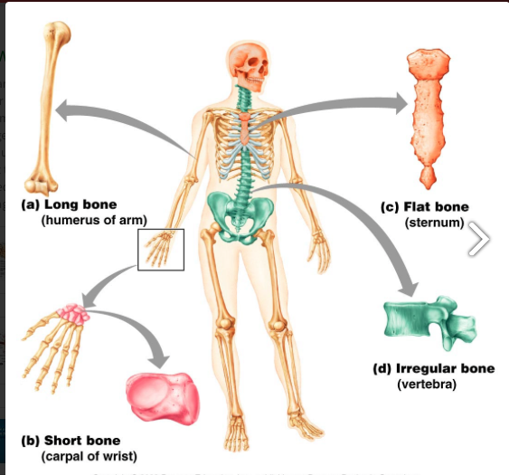
4 Classifications…
Can you suggest any other bones that come under any of the classifications?

Slide 9
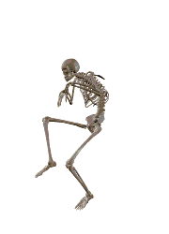
Classifications of bones
Short Bones | Long Bones | Flat Bones | Irregular Bones

Slide 10
F – Flat:
I – Irregular:
L – Long:
S- Short:
These protect the internal organs e.g. ….
attachment of muscles to help movement
Provide shape, protection
Movement - to generate strength and speed
Shock absorption - spreading load

Slide 11
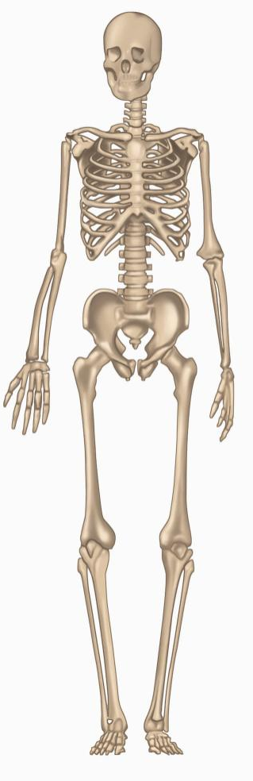
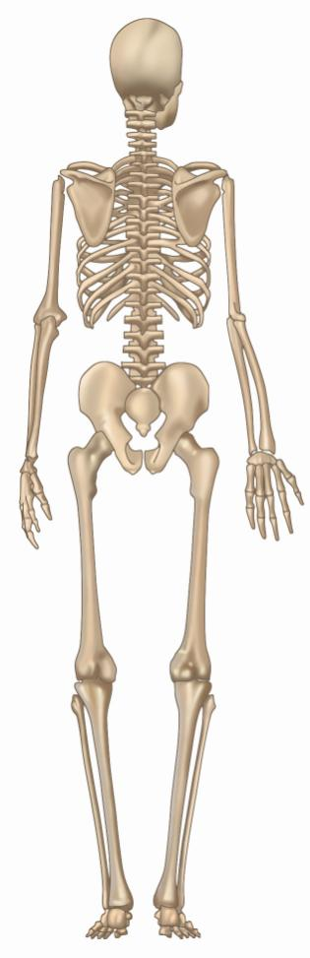
Key
Long
Short
Irregular
Flat (plate)
Cranium
Clavicle
Sternum
Scapula
Humerus
Ribs
Vertebrae
Pelvis
Radius
Carpals
Ulna
Choose 4 colours and
colour your skeleton
Metacarpals
Phalanges
Femur
Patella
Fibula
Tarsals
Tibia
Metatarsals
Phalanges

Slide 12
Demonstrate
Question: Select three classifications of bones and explain their importance in a selected sport.
___/ 6

Slide 13
Identifies one type of bone and briefly describes their importance in a sporting activity. 1 mark awarded for the correct type of bone connected to the correct function. 1 mark awarded if the example is relevant to the sporting situation.
1-2
Identifies two types of bones and describes their importance in a sporting activity. 1-2 mark awarded for the correct type of bone connected to the correct function. 2 marks awarded if the description is a relevant sporting example. Example: short bones like the tarsals in the foot are needed to support the weight of a gymnast when balancing on one leg.
3-4
Identifies three types of bones and explains their importance in a sporting activity. 3 marks awarded for correctly explaining all three types of bones with the correct function. 2-3 marks awarded if the sporting examples are relevant to the functions of each type of bone stated.
5-6

Slide 14
Connect
Pick one sport and explain how types of bone will help them during their performance.
Identify the four types of bones and explain their function.
Select one sport and explain how all 4 types of bones aid the sports performance in that selected sport.
Challenge
Discuss how each type of bone can support in two contrasting types of activities.

Slide 15
Progress Indicators
Good Progress | Outstanding Progress
Be able to recall the classifications of bones giving an example for each | Linking the functions of the bones to a sporting performance identifying the role they have in that movement
Linking ALL of the functions of the bones to a sporting performance identifying the role they have in that movement. | Will start to discuss the four functions and how they aid two contrasting sporting activities.
3-4
5-7

Slide 16
Home learning
Add to your self made skeleton, colour/label long, short, flat and irregular bones.
Due in 30th September

