Slide 1
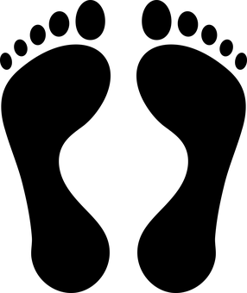
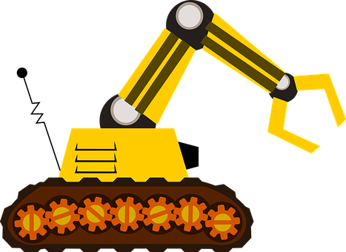
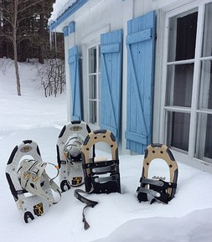
Pressure on Solids
Learning objectives:
Calculate the pressure
Apply ideas of pressure to different situation
Starter: A dam is always thicker at the bottom compared to the top. Why is this? Explain using your knowledge of pressure in liquids.

Slide 2
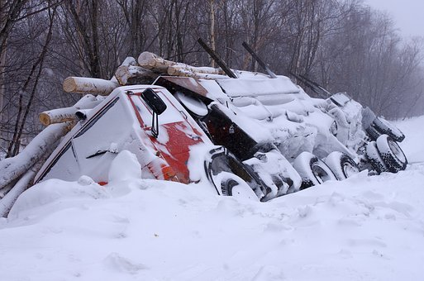
Don’t crack the ice!!
In winter, some parts of Canada are so cold that the lake freezes over with ice thick enough for a road to be made out of them.
But the ice is only thick enough to support trucks for two months of the year, dozens of drivers have been killed since the first ice roads were built 50 years ago.
Perhaps it’s something to do with earning £45,000 in two months that makes them do it?
Think > Pair > Share: If you were a truck driver would you think about doing the job or is it too risky? Explain you answer.

Slide 3
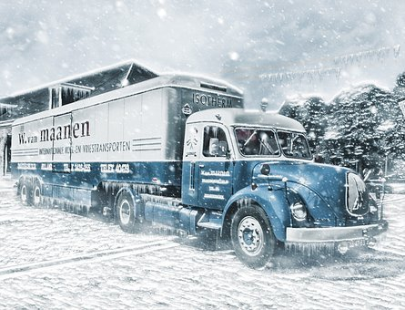
Don’t crack the ice!!
Think > Pair > Share: What do we mean by the word ‘pressure’?
In science, pressure is the amount of force pushing on a certain area.
The bigger the force, the bigger the pressure
The bigger the area, the smaller the pressure
Task: Look at the photo.
How does the truck spread its weight over a large area?

Slide 4
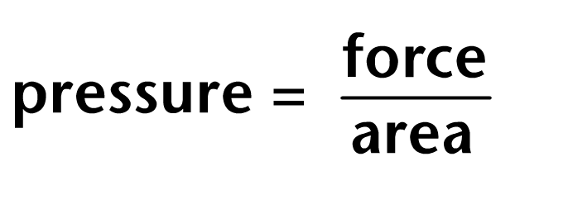
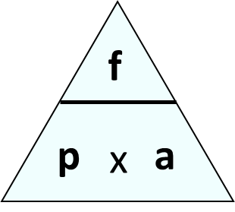
Calculating pressure
Scientists can calculate how much pressure a truck exerts on the ice using this equations:
The scientists need to know the weight of the truck and the area of the truck in contact with the ice to work out the pressure.
Force – Newtons
Area – m² or cm²
Pressure – N/m² or N/cm²

Slide 5
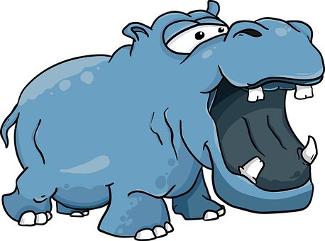
Quick Check
A hippopotamus has a mass of 3.5 tonnes (3500kg). His four feet cover an area of 0.5m² in total.
What does the hippo weigh? (Remember: 1kg = 10N)
What is the hippo’s pressure on the ground?

Slide 6
Self-assessment:
A hippopotamus has a mass of 3.5 tonnes (3500kg). His four feet cover an area of 0.5m² in total.
Weight = 3500kg x 10N = 35,000N
Pressure = force/area
= 35,000N/0.5m²
= 70,000N/m²

Slide 7
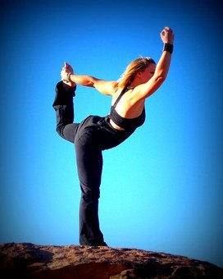
Dave and Vicky are playing on the beach. Dave's weight is 800 N and Vicky's is 650 N.
Task: Use the table to work out the pressure they put on the beach when they are doing the following:
standing on one hand
standing on both hands
standing on one foot
standing on both feet
standing on tiptoe (one foot)
standing on tiptoe (both feet)
Part of body | Body areas (cm²)
 | Dave | Vicky
hand | 140 | 115
foot | 180 | 145
tiptoe | 70 | 55
Use the table to help you complete the calculations!!

Slide 8
Self-assessment:
Person | Standing on.. | Force (N) | Area (cm²) | Pressure (N/cm²)
Dave | One hand | 800 | 140 | 5.71
Dave | Both hands | 800 | 280 | 2.86
Dave | One foot | 800 | 180 | 4.44
Dave | Both feet | 800 | 360 | 2.22
Dave | Tiptoe (one foot) | 800 | 70 | 11.43
Dave | Tiptoe (both feet) | 800 | 140 | 5.71
Vicky | One hand | 650 | 115 | 5.65
Vicky | Both hands | 650 | 230 | 2.82
Vicky | One foot | 650 | 145 | 4.48
Vicky | Both feet | 650 | 290 | 2.14
Vicky | Tiptoe (one foot) | 650 | 55 | 11.81
Vicky | Tiptoe (both feet) | 650 | 110 | 5.90

Slide 9
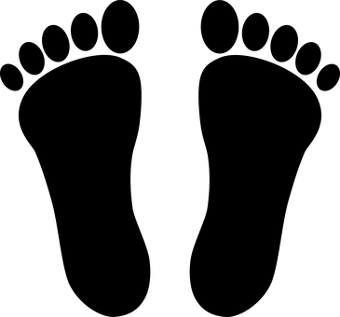
Task: Copy and correct the following sentences:
Pressure is a measure of how much force there is on a certain volume. If you exert a larger force on a larger area, the pressure will be large. If you exert a smaller force on a smaller area, the pressure will be small.
The units for force is kg, the units for area is cm² or m² and the unit for pressure is kg/cm² or kg/m².

Slide 10
Self-assessment:
Pressure is a measure of how much force there is on a certain area. If you exert a larger force on a smaller area, the pressure will be large. If you exert a smaller force on a larger area, the pressure will be small.
The units for force is N (Newtons), the units for area is cm² or m² and the unit for pressure is N/cm² or N/m²

