Slide 1
A picture tells a thousand tales.
DNA - Discuss

Slide 2
Learning Focus
To understand and analyse the poem ‘War Photographer’ by Carol Ann Duffy.
Progress indicators
 | Good | Outstanding
5 | Be able to make some explained comments about the content of the poem and build in comments on some techniques. | Be able to make clear comments on the content and composition of the poem. Identification of techniques is secure and supports comments.
6 | Be able to make clear comments on the content and composition of the poem. . Identification of techniques is secure and supports comments. | Be able to thoughtfully comment on the content and composition of the poem. Clear links to other poems can be made and context can be applied.
7 | Be able to thoughtfully comment on the content and composition of the poem. Clear links to other poems can be made and context can be applied. | Critical exploration of the poem is evident and ideas are thoughtfully explored. Language, structure and form is identified accurately and analysis is developed – layers are considered.

Slide 3


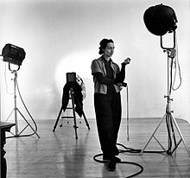
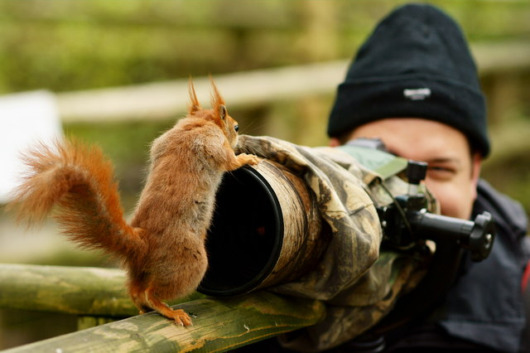

What does a photographer do?

Slide 4


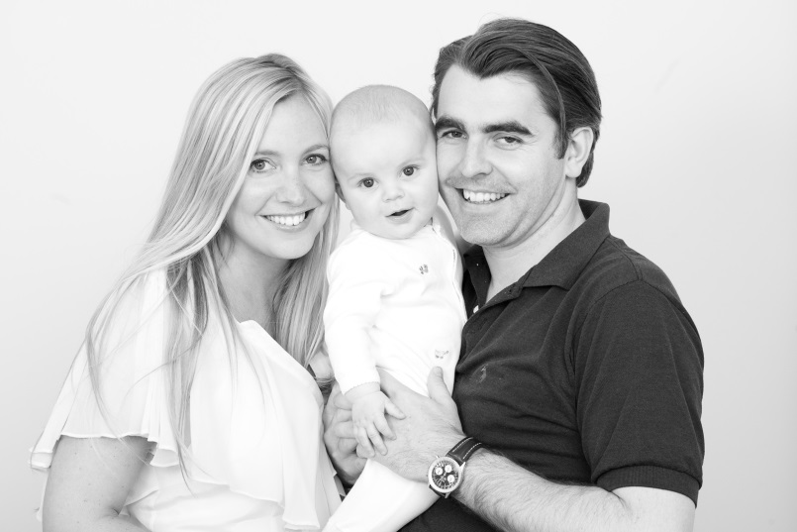


Why do we take photographs?

Slide 5


What are these two images showing us about photos?

Slide 6
Task – discussion summary
Why are photographs taken?
When and why do we take photographs?
What do we need to remember about photographs which are published/put on line?

Slide 7
Learning Focus
To understand and analyse the poem ‘War Photographer’ by Carol Ann Duffy.
Progress indicators
 | Good | Outstanding
5 | Be able to make some explained comments about the content of the poem and build in comments on some techniques. | Be able to make clear comments on the content and composition of the poem. Identification of techniques is secure and supports comments.
6 | Be able to make clear comments on the content and composition of the poem. . Identification of techniques is secure and supports comments. | Be able to thoughtfully comment on the content and composition of the poem. Clear links to other poems can be made and context can be applied.
7 | Be able to thoughtfully comment on the content and composition of the poem. Clear links to other poems can be made and context can be applied. | Critical exploration of the poem is evident and ideas are thoughtfully explored. Language, structure and form is identified accurately and analysis is developed – layers are considered.

Slide 8
DNA
You each have a photograph that was taken in a war setting.
What do we learn from the photo?
What human emotion is being conveyed?
How do we respond to the picture?
What view of war is captured?
What do we learn about humanity?
If you were taking this photograph how would you feel?
What is the photographer trying to do/capture? What is their purpose?
MAKE NOTES around image.

Slide 9
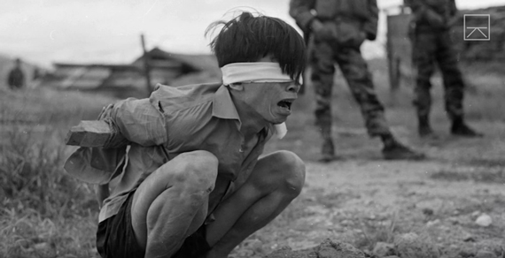
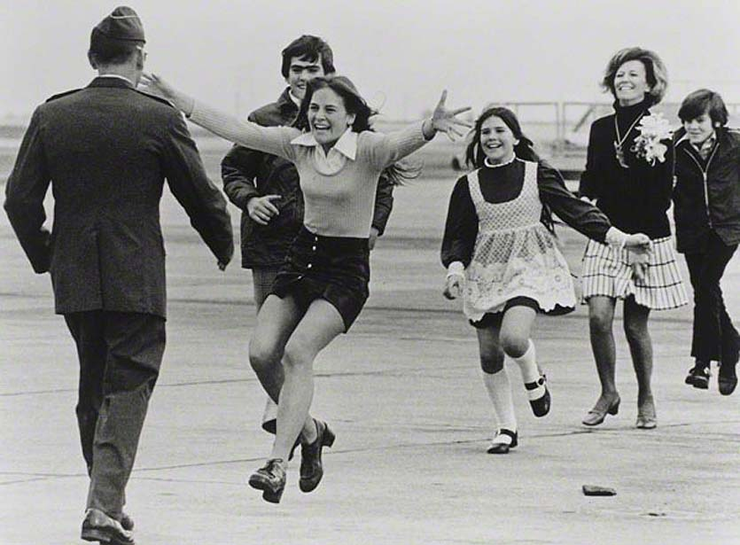
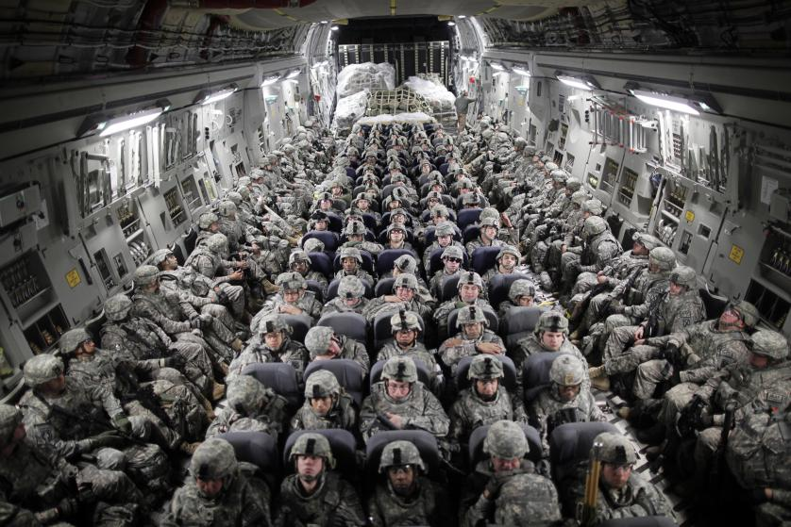

Slide 10
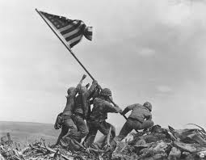
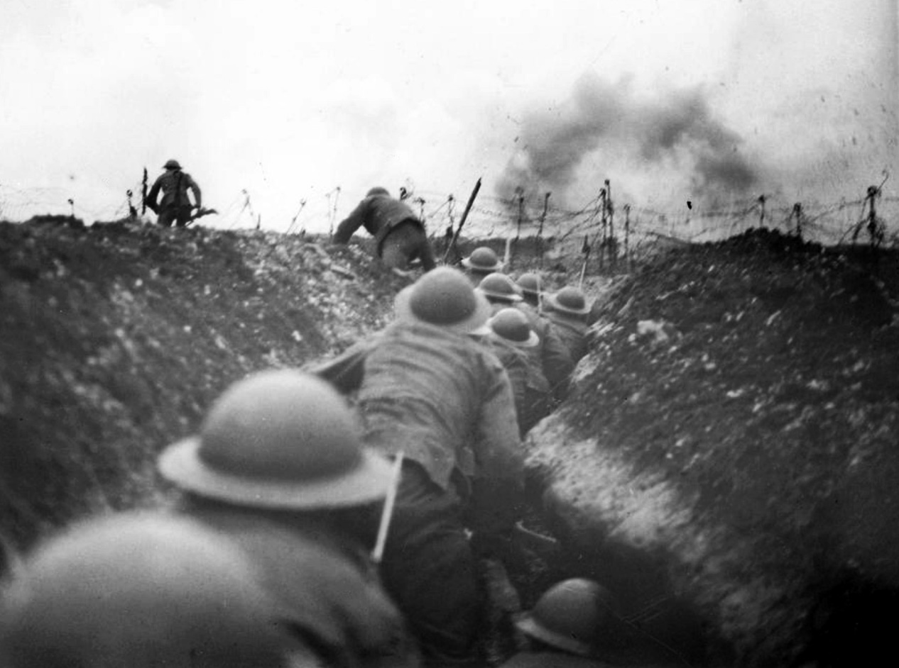

Slide 11
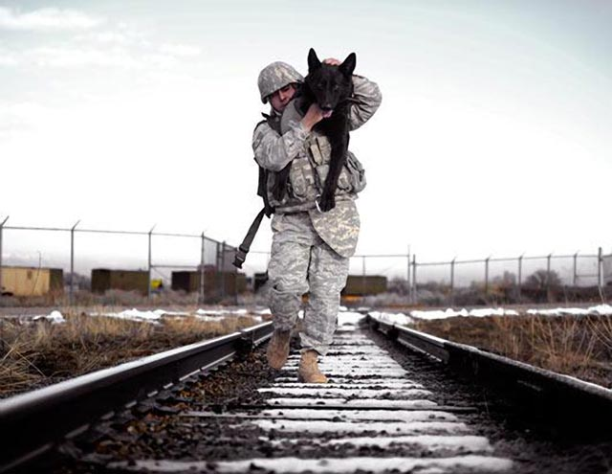
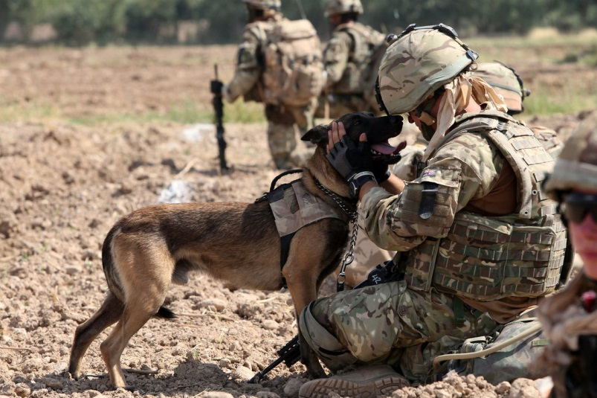
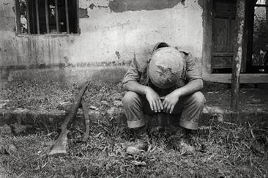

Slide 12
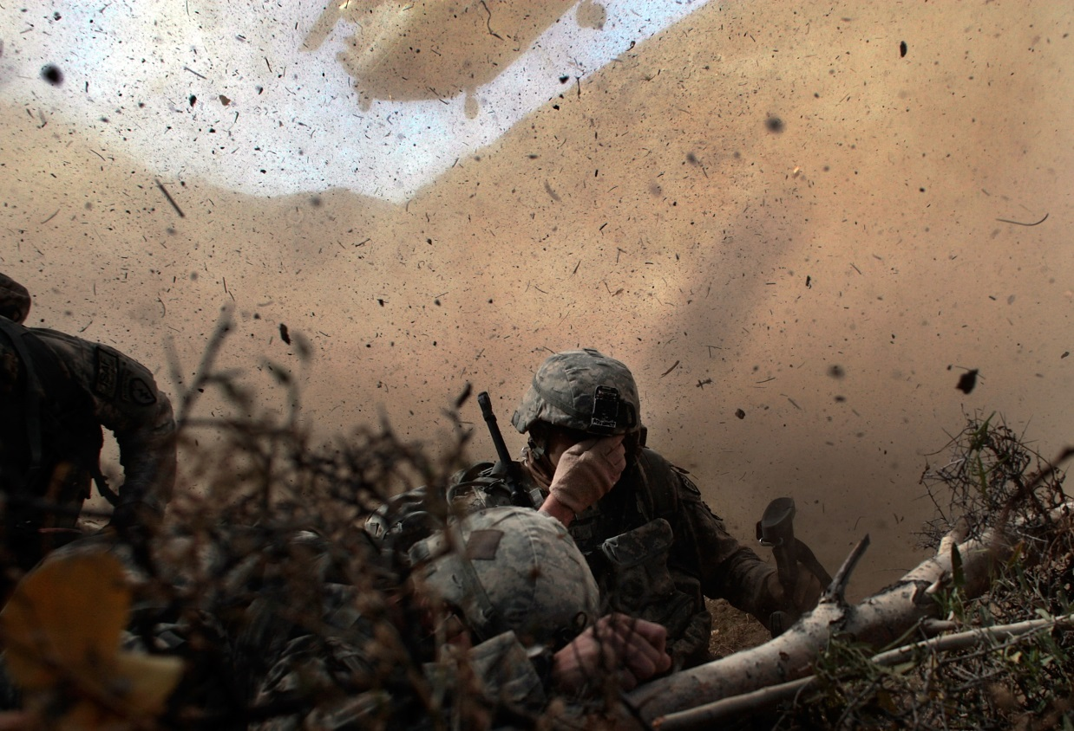
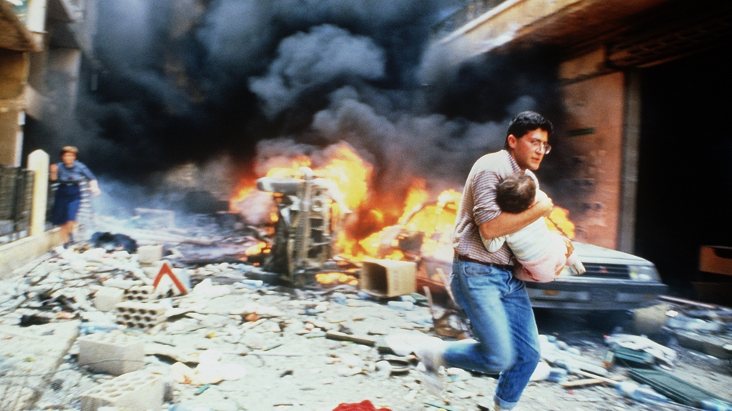

Slide 13
What does a war photographer do? What is their purpose? How involved do they get?
DNA
Independent response –
What does a war photographer do? What is their purpose? How involved do they get?
What is the emotional difference between a soldier and a war photographer?

Slide 14
‘War Photographer’
by Carol Ann Duffy

Slide 15
Learning Focus
To understand and analyse the poem ‘War Photographer’ by Carol Ann Duffy.
Progress indicators
 | Good | Outstanding
5 | Be able to make some explained comments about the content of the poem and build in comments on some techniques. | Be able to make clear comments on the content and composition of the poem. Identification of techniques is secure and supports comments.
6 | Be able to make clear comments on the content and composition of the poem. . Identification of techniques is secure and supports comments. | Be able to thoughtfully comment on the content and composition of the poem. Clear links to other poems can be made and context can be applied.
7 | Be able to thoughtfully comment on the content and composition of the poem. Clear links to other poems can be made and context can be applied. | Critical exploration of the poem is evident and ideas are thoughtfully explored. Language, structure and form is identified accurately and analysis is developed – layers are considered.

Slide 16

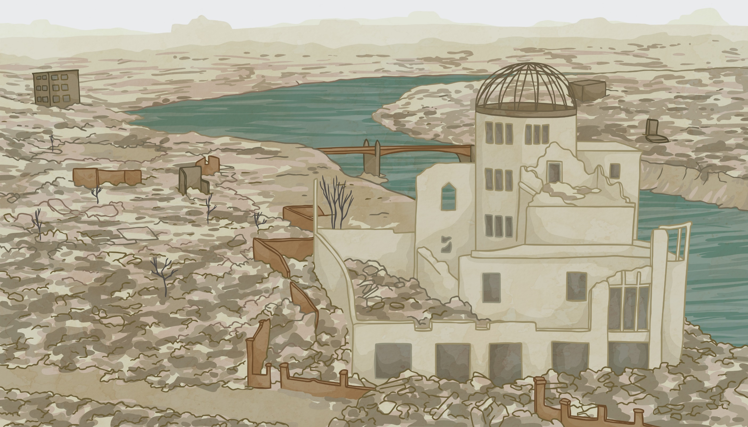
Real Images of War
On the next slide, you will see some images of war from the news. Spend five minutes thinking about how the images make you feel.

Slide 17
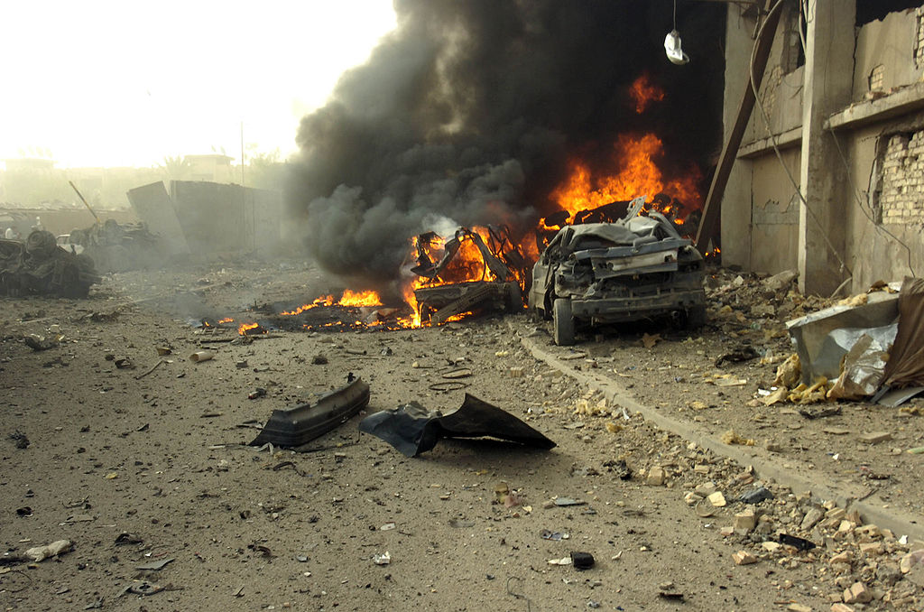
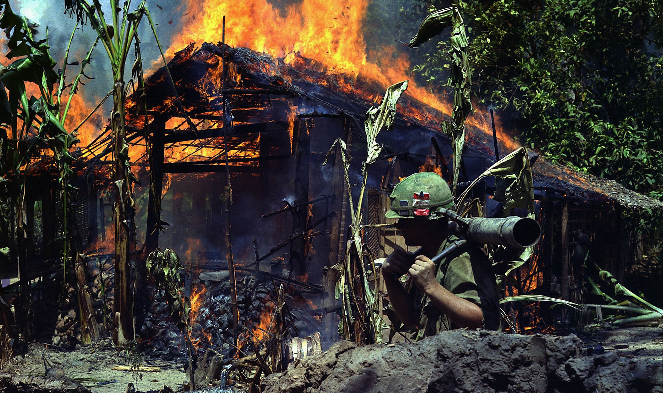
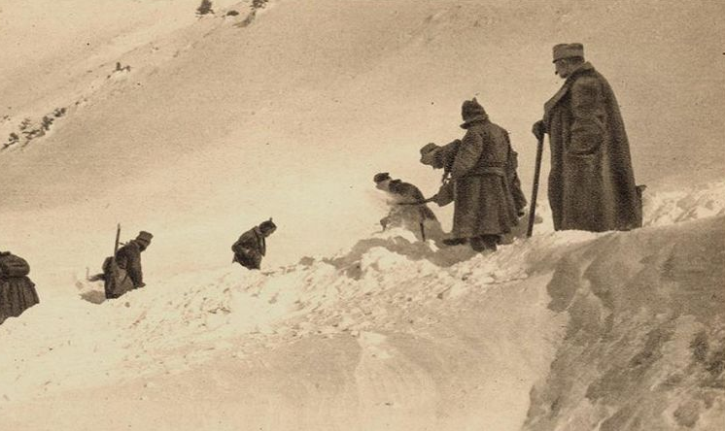
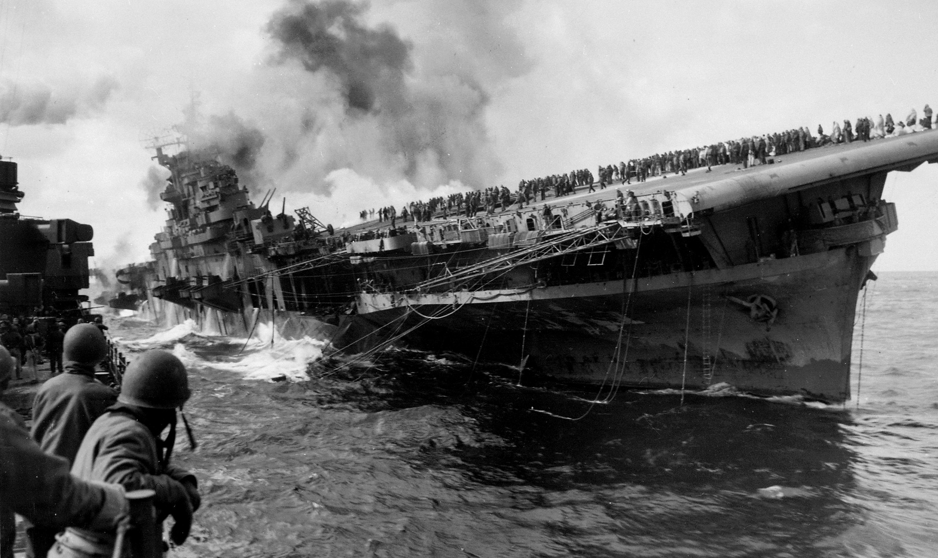
Real Images of War

Slide 18
Real Images of War
Often, these images will appear in newspapers, magazines and news articles.
How do you normally respond when you see these images?
Which of these statements do you think best describes your reaction?
I try not to look at them.
They may be horrible, but they are interesting.
I look at them, but think of something else.
They remind me of how safe I am.
They are bad, but there’s nothing I can do about it.
They make me feel angry.

Slide 19
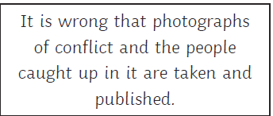
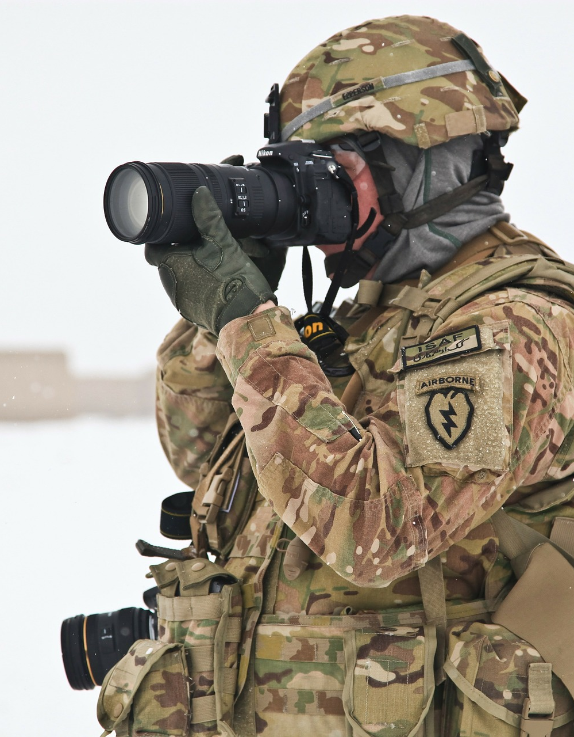
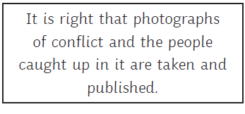
The Role of the War Photographer
Discuss your opinions on whether or not these photographs should be taken. Where do you stand? Put each opinion on the opposite end of a continuum line and mark where you are. Then add your reasons.

Slide 20
Context – Carol Ann Duffy
Carol Ann Duffy is the first female poet laureate (2009-present).
She was born in Glasgow in 1955 to a Roman Catholic family. Many of her poems show a familiarity with Catholicism and its practices.
Her father was a Labour councillor and Duffy became interested in political issues at a young age. A lot of Duffy’s poetry is concerned with isolated and oppressed members of society.
The poem ‘War Photographer’ was written in the 1980s (before digital photography), following conversations with famous photojournalist Don McCullin, who said:
Whilst Duffy was at university in the 1970s, the US was involved in a war with Vietnam that lasted 21 years. One of the most famous photographs that was taken during this time was by photographer Nick Ut, featuring children running and a young girl having been burnt in a napalm attack. Although no specific image is referred to in the poem, links are made to this image in its second stanza.
“Photography for me is not looking; it’s feeling. If you can’t feel what you’re looking at, then you’re never going to get others to feel anything when they look at your pictures.”

Slide 21



What associations do we have with the colour red?
How can we interpret the process of the blank paper going in the solution and the image appearing from nowhere?
Our poem is set prior to digital photography. How would this alter the photographers reaction to picture as he will be seeing them here for the first time – probably from the safety of home?

Slide 22
In his darkroom he is finally alone
with spools of suffering set out in ordered rows.
The only light is red and softly glows,
as though this were a church and he
a priest preparing to atone a Mass.
Belfast. Beirut. Phnom Penh. All flesh is grass.
Sibilance emphasises the quiet, calm environment. He is ‘finally’ alone.
‘ordered rows’ reflects the neatness of the poem’s structure itself.
It also reminds us of the layout of the tombstones in a graveyard.
Red light in photography = ‘safety light’ to prevent light damage to undeveloped film.
Red light in church = ‘sanctuary light’; a symbol of the presence of Christ.
Religious imagery continues the themes of death/funerals. The metaphor of photographer-as-priest implies he is laying to rest the dead (the people in his photographs). ‘All flesh is grass’ comes from Isaiah 40:6 and refers to the shortness of human life.

Slide 23
He has a job to do. Solutions slop in trays
beneath his hands which do not tremble
then though seem to now. Rural England. Home again
to ordinary pain which simple weather can dispel,
to fields which don’t explode beneath the feet
of running children in nightmare heat.
Simple statement of fact, marked by the pause (caesura).
The sibilance here is almost onomatopoeic; the photographer is perhaps working quickly, splashing the solution and losing his sense of precision as his hands ‘tremble’.
The short sentence draws attention to the photographer's current location. He is ‘home’; far away from the drama and misery of war.
Duffy contrasts the children running in English fields with the children running in warzones. ‘nightmare heat’ is juxtaposed with the sense of fun implied by ‘running’.

Slide 24
Something is happening. A stranger’s features
faintly start to twist before his eyes,
a half-formed ghost. He remembers the cries
of this man’s wife, how he sought approval
Without words to do what someone must
and how the blood stained into foreign dust.
Another short sentence begins the stanza. Duffy moves the action on. We are, however, unsure what that ‘something’ is.
Duffy plays with our uncertain sense of time and place – is the photographer literally seeing this as his photographs develop, or is he daydreaming about a past experience?
The image hasn’t fully developed and appears spectral in nature; the word ‘ghost’ also implying death.
The sense of time and place remains uncertain as the photographer now remembers the noises he heard when taking the photograph.
‘foreign dust’ could be a dismissive remark; the English are personally unconcerned by the death of one man in a faraway country.
Again, however, death (blood) is linked to nature (dust). ‘Ashes to ashes, dust to dust’.

Slide 25
A hundred agonies in black-and-white
from which his editor will pick out five or six
for Sunday’s supplement. The reader’s eyeballs prick
with tears between the bath and pre-lunch beers.
From the aeroplane he stares impassively at where
He earns his living and they do not care.
The images are literally black and white, but Duffy could also refer to the idea of an issue being ‘black and white’, insofar as it being easy to understand. Is the war being trivialised?
A supplement is not the main feature. These images are relegated to simply being ‘extra’ news.
We are only moved momentarily until the next distraction; our eyes are merely ‘pricked’ by tears and then we move on.
‘they’ – presumably his employers, who just want to sell stories, or the readers, who spend only moments reading them.

Slide 26
Form and Structure
What do you notice about the structure?
How many lines? 6 lines per stanza
Rhyming pattern? ABBCDD rhyme scheme
Does this continue throughout the poem?
Where else in the poem do you notice a similar sense of order?
What is the effect of the order of the poem?
Consider the link with the subject matter.
The neat, consistent stanzas of the poem seem to reflect the organisation of the war photographer as he carefully develops his photographs. This contrasts with the disorder of war and conflict.

Slide 27
Conflict – comprehension
Do you feel that the poet approves or disapproves of the war photographer’s job?
What key message is the poet trying to convey?
What type of conflict is shown in the poem?
Where is this poem similar or different to any of the 5 other poems we have explored?

Slide 28
Learning Focus
To understand and analyse the poem ‘War Photographer’ by Carol Ann Duffy.
Progress indicators
 | Good | Outstanding
5 | Be able to make some explained comments about the content of the poem and build in comments on some techniques. | Be able to make clear comments on the content and composition of the poem. Identification of techniques is secure and supports comments.
6 | Be able to make clear comments on the content and composition of the poem. . Identification of techniques is secure and supports comments. | Be able to thoughtfully comment on the content and composition of the poem. Clear links to other poems can be made and context can be applied.
7 | Be able to thoughtfully comment on the content and composition of the poem. Clear links to other poems can be made and context can be applied. | Critical exploration of the poem is evident and ideas are thoughtfully explored. Language, structure and form is identified accurately and analysis is developed – layers are considered.

Slide 29
Demonstrate
Compare and contrast how Duffy and one other poet convey war conflict in their work.
Clear Comparisons
Technical analysis
Contextual links

