Slide 1
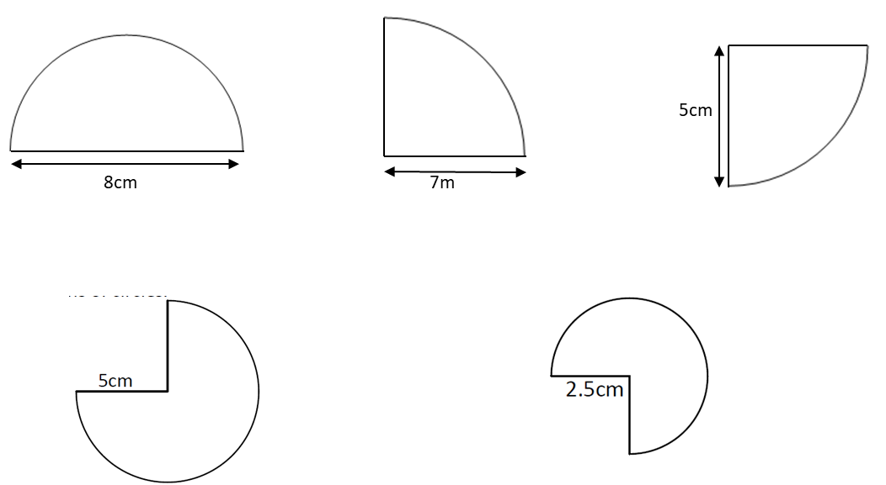
DNA
Answer the questions
Notes:
Option 1

Slide 2
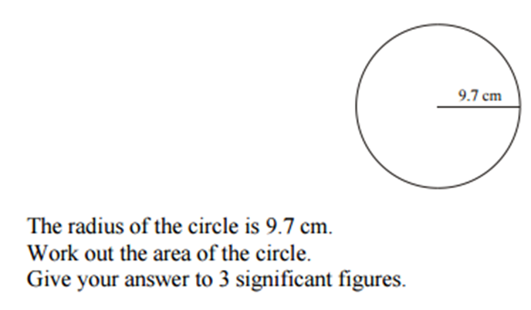
Connect
AMBER
RED
GREEN
Notes:
Reliant on knowledge of types of number on a dice.
Green introduces idea of “or” to stretch students understanding.

Slide 3
Solve Problems – Area, Radius and Diameter
Unit 9 Objective E & F

Slide 4
Progress Indicators

Slide 5
Recap
Area of a Circle

Slide 6
I Do
We Do
Area of a Circle = 68cm²
Find the radius and diameter
Area of a Circle = 54cm²
Find the radius and diameter

Slide 7
Intelligent Practice
Answer the questions on the worksheet

Slide 8
Recap
Circumference of a Circle

Slide 9
I Do
We Do
Circumference of a Circle = 28cm.
Find the radius and diameter.
Circumference of a Circle = 55cm.
Find the radius and diameter.

Slide 10
Intelligent Practice
Finding radius/diameter from the Circumference
A circle has a Circumference of 201.1cm. Find the diameter.
A circle has a Circumference of 1662cm. Find the diameter.
A circle has a Circumference of 63.6cm. Find the diameter.
A circle has a Circumference of 380.1cm. Find the radius.
A circle has a Circumference of 32.2cm. Find the radius.
Stretch: Next slide

Slide 11
Intelligent Practice

Slide 12
Intelligent Practice

Slide 13
Demonstrate
Finding radius/diameter from the Area
A circle has an Area of 240cm². Find the radius and diameter.
A circle has a Circumference of 282cm. Find the radius and diameter.
A circle has an Area of 25.6cm². Find the radius and diameter.
A circle has a Circumference of 380.1cm. Find the radius and diameter.
(e) A circle has an Area of 32.2cm. Find the radius and diameter.

