Slide 1
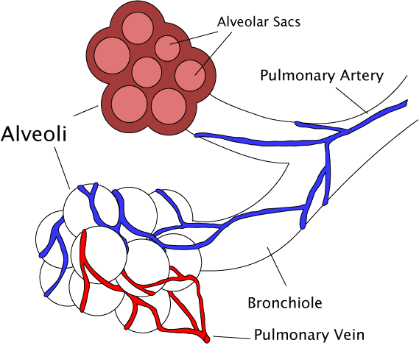
Exchanging Materials
Do now activity:
What adaptations might cells have to increase the rate of diffusion?
Why might the size of an organism effect how quickly it is able to exchange substances with the outside world?
Notes:
By The original uploader was Pdefer at English Wikipedia [GFDL (http://www.gnu.org/copyleft/fdl.html) or CC-BY-SA-3.0 (http://creativecommons.org/licenses/by-sa/3.0/)], via Wikimedia Commons

Slide 2
Progress indicators
GOOD PROGRESS:
To describe how surface area : volume ratio varies depending on the size of an organism
To identify why larger, multicellular organisms need specialised exchange surfaces
OUTSTANDING PROGRESS: To explain the adaptations you might expect to see in organisms that have effective gas exchange systems.

Slide 3
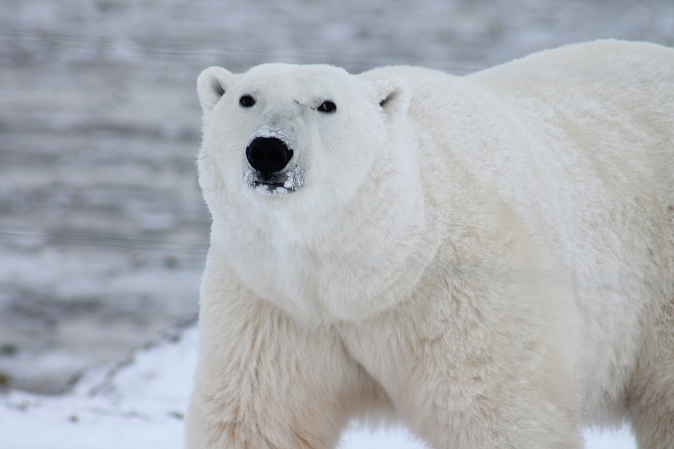
Look at the two organisms below, how might they differ in terms of how they take in oxygen?
O₂
CO₂
CO₂
O₂
O₂
Amoeba
Polar Bear
The amoeba has a large surface area compared to it’s volume, this organism can rely on simple diffusion, osmosis and active transport to exchange materials with the outside world.
The polar bear is a large, complex organism and can’t rely simply on diffusion to supply all it’s cells with the materials they need.
These types of organism have adapted to have specialised exchange surfaces.

Slide 4
Surface area to volume ratio
The surface area to volume ratio of an organism is very important, it makes a difference to the way an organism can exchange substances.
The ratio of surface area to volume falls as objects get bigger
Task: Have a go at completing the values for cubes 2 & 3
2 cm
3 cm
1 cm
SA: 6cm²
Volume: 1cm³
SA: Vol = 6:1
SA: ____
Volume: ____
SA: Vol = ____
SA: ____
Volume: ____
SA: Vol = ____

Slide 5
Self-assessment:
2 cm
3 cm
1 cm
SA: 6cm²
Volume: 1cm³
SA: Vol = 6:1
SA: 24cm²
Volume: 8cm³
SA: Vol = 3:1
SA: 54cm²
Volume: 27cm³
SA: Vol = 2:1
As organisms get bigger, the surface area to volume ratio falls.
As the distances between the centre of the organism and the surface get bigger, simple diffusion is no longer enough to exchange materials between cells and the environment.

Slide 6
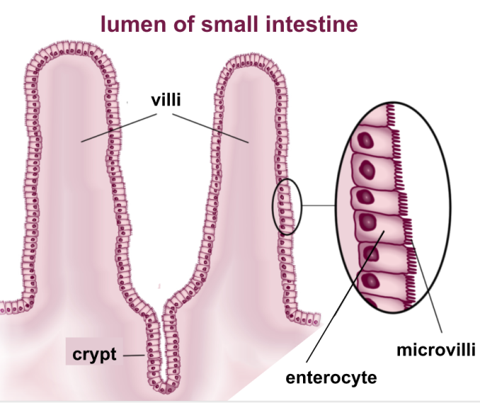
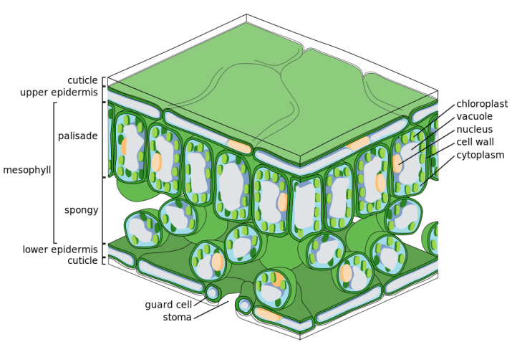
Adaptations for exchanging materials
Think > Pair > Share: Think about the images above, how might they be adapted to exchange substances? Share you ideas with your partner!
Notes:
Plant cross-section By Zephyris (Own work) [CC BY-SA 3.0 (https://creativecommons.org/licenses/by-sa/3.0) or GFDL (http://www.gnu.org/copyleft/fdl.html)], via Wikimedia Commons
Villi By BallenaBlanca [CC BY-SA 4.0 (https://creativecommons.org/licenses/by-sa/4.0)], via Wikimedia Commons

Slide 7
Some common features of an exchange surface are the following:
A large surface area over which exchange can take place
A thin membrane or being thin to provide a short diffusion path
In animals, an efficient blood supply moves the diffusing substances away from the exchange surface to maintain a steep concentration gradient.
In animals, being ventilated makes gas exchange more efficient by maintaining a steep concentration gradient.
Notes:
Plant cross-section By Zephyris (Own work) [CC BY-SA 3.0 (https://creativecommons.org/licenses/by-sa/3.0) or GFDL (http://www.gnu.org/copyleft/fdl.html)], via Wikimedia Commons
Villi By BallenaBlanca [CC BY-SA 4.0 (https://creativecommons.org/licenses/by-sa/4.0)], via Wikimedia Commons

Slide 8
Task: Use information around the room to answer these questions…
Villi – Structure and function
What are villi and where are they found?
Draw and label a diagram of a villi to clearly show three structural features which enable it to carry out it’s function
Muscles, in the walls of the small intestine, keep the food inside it moving along. Blood, flowing in the capillaries inside the villi, keeps taking absorbed nutrients away. How do these two processes maintain a diffusion gradient for nutrients, so they keep diffusing from the intestine and into the blood?
Challenge: Read through the ‘Stop and think..’ box on your worksheet, discuss with your peers and note down your ideas.
Alveoli – Structure and function
Where are alveoli found in the body? Why can they be described as an ‘exchange surface’
Draw and label a diagram of an alveoli to clearly show three structural features which enable it to carry out it’s function
What is an example of a COPD? How do these problems lead to symptoms such as breathlessness?
Challenge: How is a concentration gradient maintained in the alveoli to ensure efficient exchange of oxygen and carbon dioxide?

Slide 9
Peer-assess! Swap your work with your partner, we are going to go through the answers.
Make sure you MARK and CORRECT your partners work.

Slide 10
Villi
These are finger-like projections which cover the inside of your small intestine, this is where all nutrients from your digested food are absorbed into the blood.
The structural features of villi:
3. Nutrients are constantly brought to the intestine, while those which have been absorbed are taken away. This maintains a concentration gradient where there is a higher concentration of the nutrient inside the intestine and a lower concentration in the blood. The nutrient therefore diffuses into the blood down the concentration gradient
Very thin wall, one cell thick
Thousands of tiny villi – huge surface area
Extensive blood capillary network to carry away absorbed nutrients
Notes:
Villi By BallenaBlanca [CC BY-SA 4.0 (https://creativecommons.org/licenses/by-sa/4.0)], via Wikimedia Commons

Slide 11
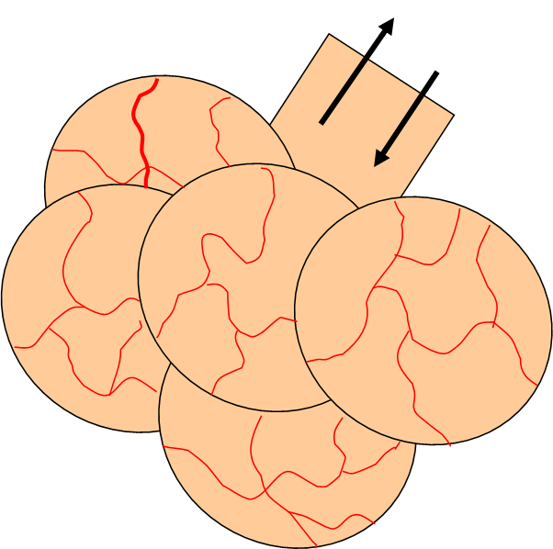
Alveoli
The alveoli are found in the lungs. They can be described as an exchange surface because they oxygen diffuses into the blood and carbon dioxide diffuses out.
The structural features of alveoli:
The rich blood supply allows a constant flow of blood around the lungs which maintains a concentration gradient.
3. Examples of COPD include bronchitis and emphysema. Can be caused by smoking, this leads to inflammation in the lungs which permanently changes the tissue. Thickened walls of the airways and a build up of mucus makes gas exchange difficult, leading to breathlessness
The total surface area of the alveoli can range from 30-50 square metres. This provides a huge surface area for gas exchange to occur.
This moist lining also stops the alveolus from drying and cracking.

Slide 12
Exit Card!
On your exit card write:
3 key words you have learnt this lesson
One fact
One question to test the knowledge of your classmates!
Notes:
Can use a scrap piece of paper for this, or a template as provided!

Slide 13
Exit Card
3 key words: _____________________________
_____________________________
One fact: _____________________________
_____________________________
One question: _____________________________
_____________________________
Exit Card
3 key words: _____________________________
_____________________________
One fact: _____________________________
_____________________________
One question: _____________________________
_____________________________
Exit Card
3 key words: _____________________________
_____________________________
One fact: _____________________________
_____________________________
One question: _____________________________
_____________________________
Exit Card
3 key words: _____________________________
_____________________________
One fact: _____________________________
_____________________________
One question: _____________________________
_____________________________

Slide 14
The exchange surface in the small intestine
The inside of your small intestine is covered with thousands of tiny finger-like projections, called villi.
This is where all the nutrients from your digested food are absorbed into the blood. The villi help this to happen quickly because they have a huge surface area. If the intestine had a smooth lining, fewer nutrients would be able to move across at the same time – absorption would take much longer.
Each villus contains a network of tiny blood capillaries. The blood is constantly on the move, carrying away dissolved nutrients. Some of the nutrients move into the villi by diffusion. They can do this if their concentration in the digested food, inside the intestines, is higher than the concentration in the blood.
The villi have very thin walls, this makes the diffusion pathway short.
To summarise, the lining of the small intestine is a good exchange surface:
Huge surface area, produced by thousands of villi
The villi have thin walls, short diffusion pathway
Villi contain blood capillaries, which carry away absorbed nutrients. This helps to maintain the diffusion gradient between the inside of the intestine and the blood.

Slide 15
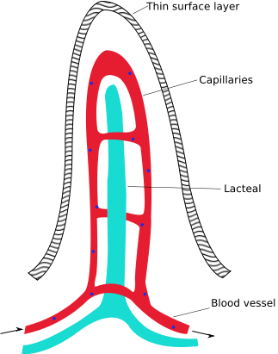
Internal structure of a villus
Stop and think…
People who suffer with coeliac disease have villi which are similar to those shown in the diagrams below. Some symptoms of coeliac disease are weight loss, tiredness and stomach pains. Why do you think that is?
Notes:
By Snow93 (Own work) [Public domain], via Wikimedia Commons

Slide 16
Inside an alveolus
Oxygen makes its way to special air sacs.
Actually, each air sac is found to be a bundle of air sacs. Together, they are known as an alveolus.
The outside of the alveolus is covered with tiny blood vessels.
The total surface area of the alveoli can range from 30-50 square metres. This provides a huge surface area for gas exchange to occur.

Slide 17
The rich blood supply allows a constant flow of blood around the lungs which maintains a concentration gradient.
The blood returns carbon dioxide which diffuses into the alveoli to be breathed out.
Oxygen diffuses into the bloodstream from the alveolus to be carried around the body to respiring cells.
Carbon dioxide
Oxygen

Slide 18
A cross-section of an alveolus
oxygen (O₂) gas passes through here
This moist lining also stops the alveolus from drying and cracking. It lubricates the insides of the air bag.
epithelial lining of the alveolus
This O₂ is then able to dissolve in a small moist lining.

Slide 19
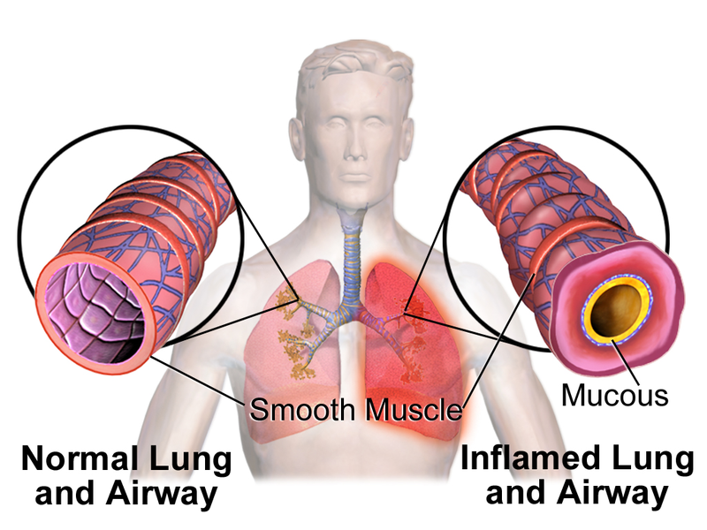
What is COPD?
Chronic obstructive pulmonary disease is the name for a collection of lung diseases including chronic bronchitis, emphysema and chronic obstructive airways.
People with COPD have difficulties breathing. Typical symptoms include:
Increasing breathlessness when active
A persistent cough with phlegm
Frequent chest infection
Why does COPD happen?
The main cause of COPD is smoking. The likelihood of developing COPD increases the more you smoke and the longer you've been smoking. This is because smoking irritates and inflames the lungs, which results in scarring.
Over many years, the inflammation leads to permanent changes in the lung. The walls of the airways thicken and more mucus is produced. Damage to the delicate walls of the air sacs in the lungs causes emphysema and the lungs lose their normal elasticity. The smaller airways also become scarred and narrowed. These changes cause the symptoms of breathlessness, cough and phlegm associated with COPD.
Notes:
Image By BruceBlaus. When using this image in external sources it can be cited as: Blausen.com staff (2014). "Medical gallery of Blausen Medical 2014". WikiJournal of Medicine 1 (2). DOI:10.15347/wjm/2014.010. ISSN 2002-4436. (Own work) [CC BY 3.0 (http://creativecommons.org/licenses/by/3.0)], via Wikimedia Commons

