Slide 1
Year 9 Food Technology Miss Giddings
Lesson one
Notes:
Line up and wait to be called in.
Pen, pencil and planners out.
Think about where your seating as a seating plan and can easily be changed.

Slide 2
Your journey in key stage four
Year 9 – skill building by applying the principles of food science, food choice and Nutrition
Year 10 – 2 mock projects and exam theory
Year 11 – 2 controlled assessment projects and exam
Final Grade in year 11
50% x2 NEA (NONE EXAMINATION ASSESSMENT – COURSEWORK)
50% 1 Examination

Slide 3
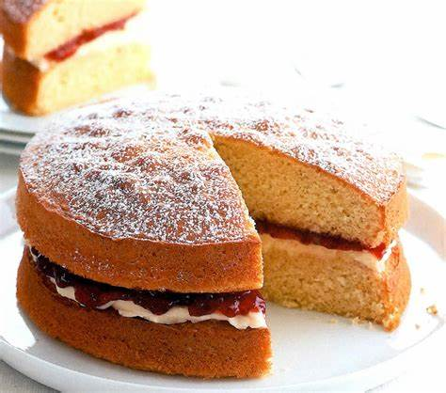
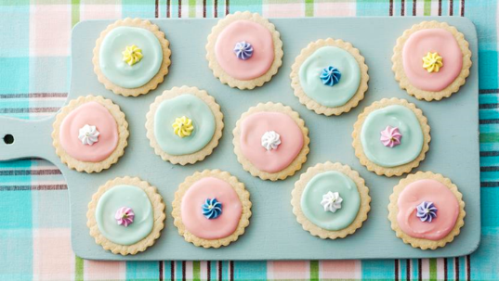
bake off

Slide 4
Analysis Your brief
starter
Brief
Notes:
Pupils to write down the brief in there books

Slide 5
Today’s learning objectives
Learning objectives
Success Criteria:
Create a mood board that will inspire you in you pastry and cake decoration and presentation.
Good You have selected a range of images that meet your brief and laid them out in a creative way.
Outstanding You have annotated your chosen images. Commenting on colour, texture, theme, quality and presentation.
SMSC Focus: Presentation and sensory appeal.
Victoria Sponge
Swiss Roll
Short Bread
Brownies
Choux pastry - profiteroles
Scones
Sausage roll, cherry Bakewell, pizza, pasty, bread, biscuits, Victoria sponge, choux pastry, brownies,
Pie- sweet/savoury, vol au vents, pancakes, cookies, flap jack, jam tarts, doughnuts, hot cross buns, macaron,
Macaron, scones,
Notes:
Pupils to read out learning objectives.
Pupils will pick a level they will work at today and write why in their booklets
5

Slide 6
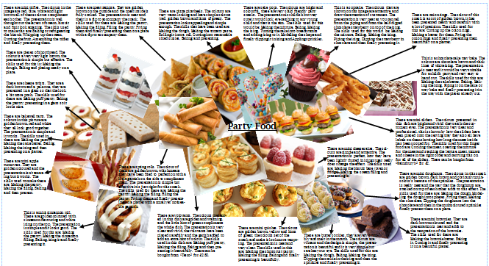

Slide 7
Today’s learning objectives
Plenary
Success Criteria:
Create a mood board that will inspire you in your pastry and cake decoration and presentation.
Good You have selected a range of images that meet your brief and laid them out in a creative way.
Outstanding You have annotated your chosen images. Commenting on colour, texture, theme, quality and presentation.
SMSC Focus: Presentation and sensory appeal.
Notes:
Pupils to read out learning objectives.
Pupils will pick a level they will work at today and write why in their booklets
7

Slide 8
Year 9 Food Technology Miss Giddings
Lesson two
Notes:
Line up and wait to be called in.
Pen, pencil and planners out.
Think about where your seating as a seating plan and can easily be changed.

Slide 9
Do Now
These four rules will help you and others stay safe from food poisoning.
1.Cleaning
2. Cooking
3. Cross contamination
4. Chilling
White board

Slide 10
Today’s learning objectives
LO
Success Criteria:
To understand Food Safety and Food Hygiene
Good – Have a basic understanding of Food Safety and Food Hygiene
Outstanding – Be able to prevent
SMSC: Health & Safety
Notes:
Pupils to read out learning objectives.
Pupils will pick a level they will work at today and write why in their booklets
10

Slide 11
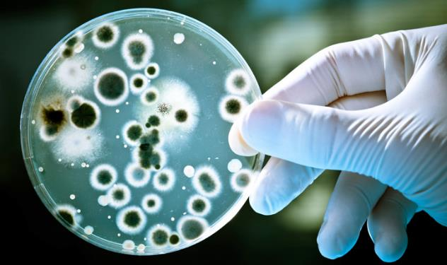
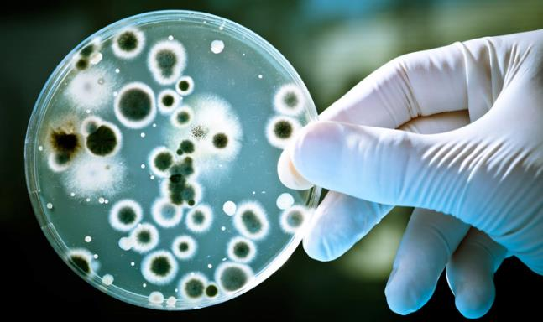
Food hygiene
Settling
Lets talk about bacteria!!
What is bacteria?
Can bacteria contamination cause food poisoning?
Notes:
Class discussion

Slide 12
Food hygiene
Starter
Bacteria
Bacteria can be found everywhere, including raw food, people, air and dust, equipment and utensils, soil, pests, water and food waste.
It is essential to control the conditions that allow bacteria to multiply and cause illness.
Kitchens provide the ideal conditions for bacterial growth.
What do we do to prevent bacterial contamination?
Notes:
Get someone to read them out –
Write down; what do we do to prevent bacterial contamination?

Slide 13
Food Safety
Food safety is all about how food is prepare, served, stored and handled.
It is about keeping yourself, your equipment and your work space clean.
However, it is not as simple as cleanliness. Poor hygiene practices can lead
to food poisoning even in a clean environment.
The food standards agency suggests that food poisoning affects up to 4.5
million people every year. Many mild cases go unreported so the exact
number is unknown. Approximately 40 people die of food poisoning every
year. These tend to be people in the high risk category; the young, the elderly
and the ill.

Slide 14
The 4 C’s of Food safety
These four rules will help you and others stay safe from food poisoning.
Cleaning
Cooking
Cross contamination
Chilling
Notes:
Write the 2 c’s and write out what each mean
Draw a man/woman and identify good hygiene

Slide 15
The 4 C’s of Food Hygiene
Cross contamination
Food poisoning is often caused when harmful bacteria on one food are spread via hands or kitchen utensils to cross-contaminate other foods. Good hygiene helps prevent this.
Chilling
Do not put hot food directly into the fridge or freezer, let it cool sufficiently first; but remember that cooling should be completed within one or two hours after cooking.
Cleaning
Clean kitchen surfaces after preparing foods; try to 'clean as you go'.
After handling raw meat, poultry, fish and other raw foods always wash hands, utensils and surfaces thoroughly and before any contact with other food, especially cooked and ready-to-eat foods.
Cooking
Follow recipes and label instructions on cooking times and temperatures. Remember to pre-heat the oven properly.
Check food is piping hot before serving..
Notes:
Help slide

Slide 16
Personal Hygiene
Good hygiene is very important when working with food. Poor hygiene can lead to the contamination of food, which can result in food poisoning.
Notes:
Write the 2 c’s and write out what each mean
Draw a man/woman and identify good hygiene

Slide 17
Personal hygiene Personal Appearance of Kitchen Staff
STARTER
Wearing of hat or net
Long Hair tied back
No facial piercing
Discreet make-up
Clean complexion no uncovered facial hair
No heavy perfume, scent or aftershave
No exposed skin or hair
Nails short and clean
No nail varnish.
Clean clothes & apron
No jewellery (except wedding ring)
Cuts covered with blue waterproof plasters
No illness or stomach complaints
Full apron or half apron
Flat, comfortable shoes (Non-slip with protective toe caps for kitchen
Loose cothing

Slide 18
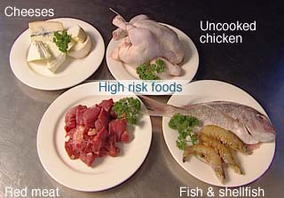
High Risk Foods
Bacteria really like foods which are moist & high in protein.
Q: Can you name any examples of High-Risk Foods?
These foods support the multiplication of harmful bacteria. (Bacteria grows in them easily).
These foods are usually high in protein and moist.
They must be protected from contamination and require refrigerated storage to prevent bacteria multiplying.
These include:
Meat
Fish
Poultry
Dairy products
Eggs
Gravies
Stocks
Sauces
Shellfish
Seafood
Cooked rice
Notes:
Foods that are moist and high in protein, defined as being ready-to-eat and will not be cooked before being eaten.

Slide 19
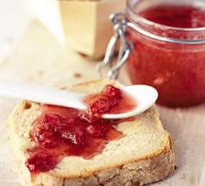
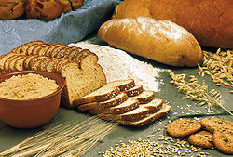
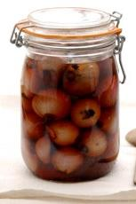
Low Risk Foods
These are usually low in moisture (dry food), low in protein, high in fat, acidic, high in salt, pickled foods, jams and other preserves and other chemically preserved foods.
They are stored in cool dry places.
Q: Can you name any examples of Low-Risk Foods?
However, when water is added to dried food such as milk powder or gravy granules it becomes high risk and must be stored under refrigeration or used immediately!
Bacteria are not able to multiply in dry food or food containing high concentrations of sugar, salt, acid (vinegar - pickled) and other preservatives.
They are stored in cool dry places.
These include:
Lard/Butter
Hard cheese
Dried foods
Cereals
Biscuits
Bread
Crisps
Jam
Canned food
Bacon
Notes:
However when water is added to dried food such as milk powder or gravy granules it becomes high risk and must be stored under refrigeration or used immediately.

Slide 20
Buying safe foods
Most people in the UK buy their food from supermarkets and store it at home in refrigerators, freezers and kitchen cupboards.
Wherever you buy food, there are a number of checks you can do to make sure that the food you buy is in good condition and
Safe to eat.
Notes:
Talk about buying and storing foods correctly

Slide 21
Buying safe foods
What would you look for when buying to determine if the food is safe to eat and fresh.
Fresh fish you would look for…
Fresh meat…
Fresh vegetables…
Fresh Fruit…
Packaged food…
Notes:
Discuss what to look for when buying different types of food to determine if the food is safe to eat and fresh.

Slide 22
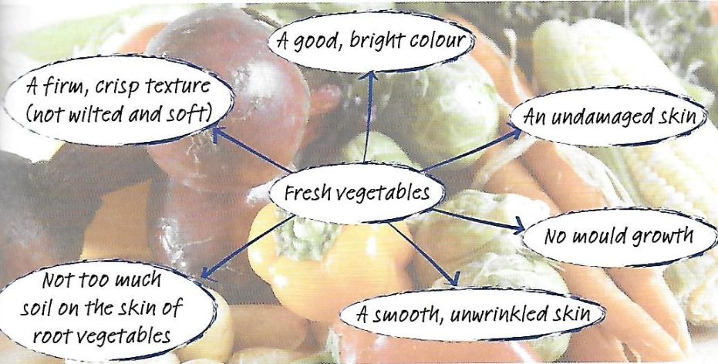
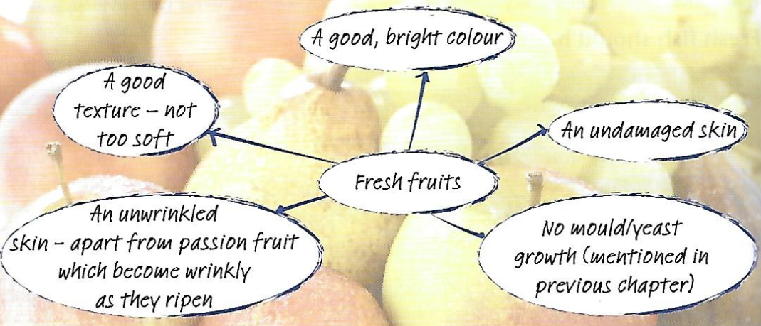
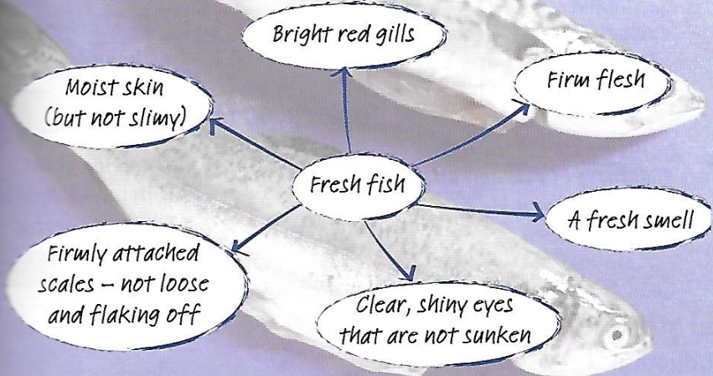
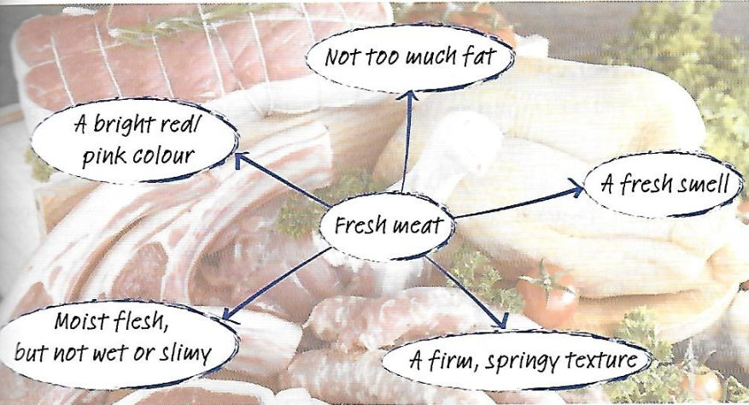
Buying safe foods
What would you look for when buying to determine if the food is safe to eat and fresh.
Notes:
Discuss what to look for when buying different types of food to determine if the food is safe to eat and fresh.

Slide 23
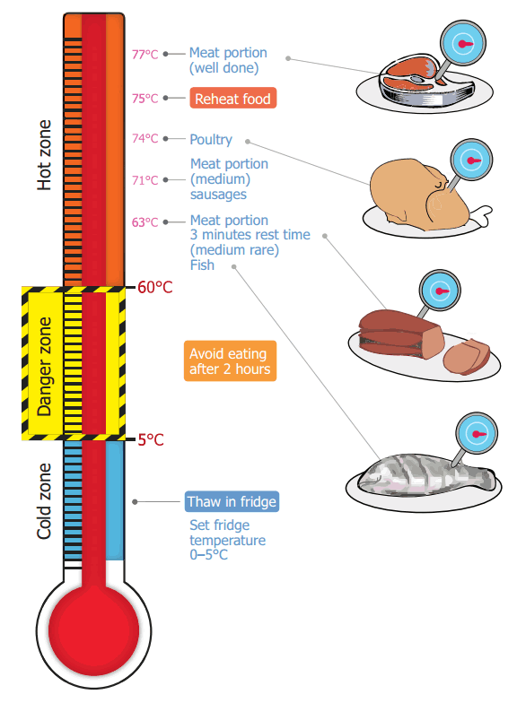
Food storage
Notes:
So you have got your food home, how are we going to store it safely.

Slide 24
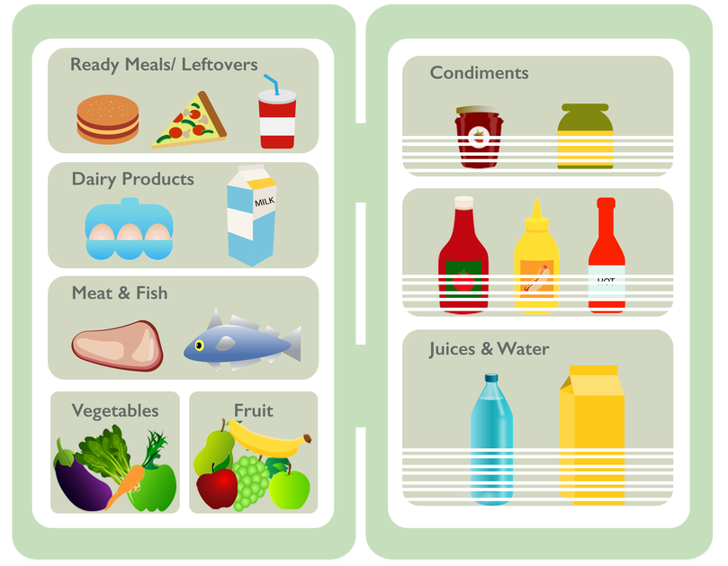
Food storage
Food ingredients and finished products must be
stored at the correct temperature and protected
from contamination.
Raw meats, fish and eggs should always be stored
away from ready to eat foods.
Raw vegetables, including salads may contain bacteria
from the soil and should be kept away from ready
to eat, high risk foods.
Frozen foods still could have bacteria present but
they are dormant.
Never put warm food in the fridge as it will
cause the temperature of the fridge to rise into the
Danger zone.
Using food within the date marks avoids waste and
reduces the risk of cross contamination.
VIDEO!!!
Notes:
https://www.youtube.com/watch?v=BM07Umb8GiM– video

Slide 25
Year 9 Food Technology Miss Giddings
Lesson three – pastry theory
Notes:
Line up and wait to be called in.
Pen, pencil and planners out.
Think about where your seating as a seating plan and can easily be changed.

Slide 26
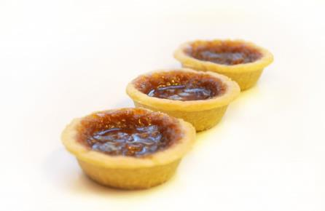
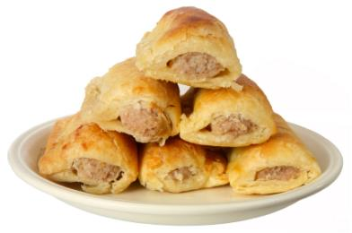
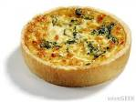
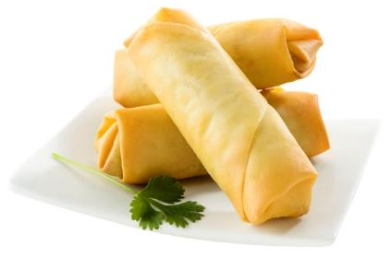
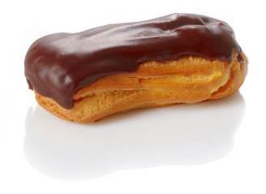
settling
What do all these products have in common?
Short crust
Puff
What types of pastry are used to make these products?
Filo
Choux

Slide 27
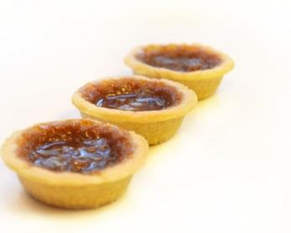
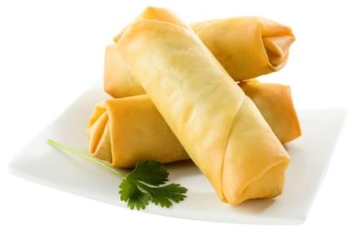
Types of pastry
starter
Different types of pastry can be used to make a range of different food products.
TASK: identify in pairs what the four different types of pastry, and suggest examples of food products that each one is used to make.
Filo
Puff
Short crust
Choux

Slide 28
Todays learning objectives
Learning objectives
Success Criteria: | Completed
To be able to identify different types of pastry.
Good To be able to identify different pastry products.
Outstanding To be able to explain the characteristics of each pastry.
SMSC Focus: High in practical skill

Slide 29
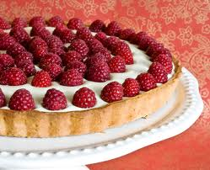
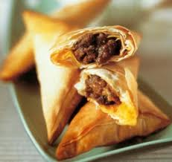
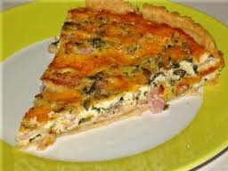
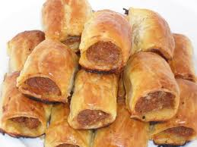
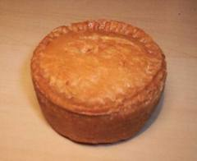
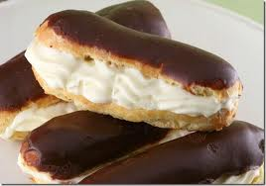
What pastry would work best for the following dishes:
Quiche (savoury flan)
Raspberry Tart
Spicy Meat Samosas
Sausage Rolls
Pork Pie
Chocolate Eclairs

Slide 30
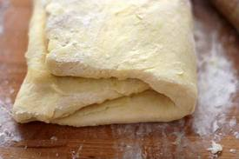
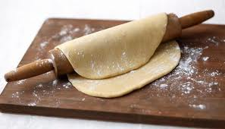
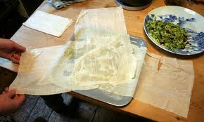
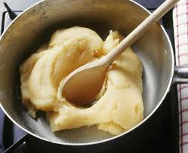
There are four main types of pastry that are most commonly used:
Short crust
Puff
Choux
Filo
3.
1.
4.
2.

Slide 31
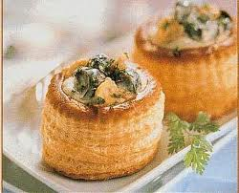
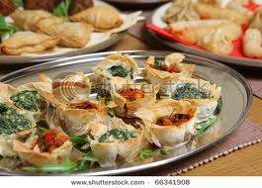
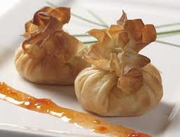
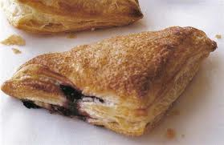
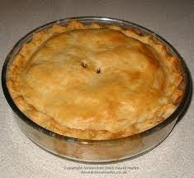
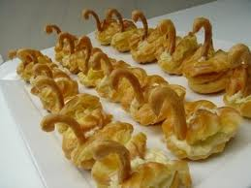
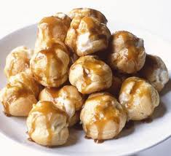
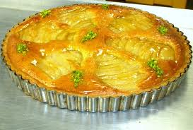
This is what they look like when
they have been cooked:
3.
2.
1.
4.

Slide 32
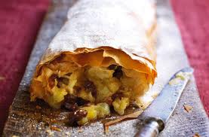
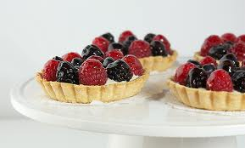
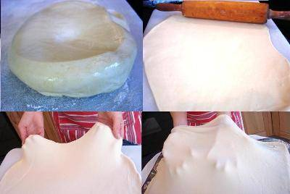
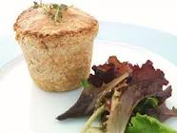
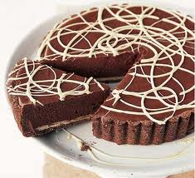
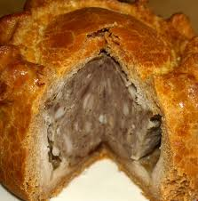
Other Pastries:
Other pastries that are used to make food products include:
Strudel Dough
Pate Sucree Pastry
Suet Pastry
Hot Water crust
Chocolate Pastry

Slide 33
Functions of Pastry Ingredients:
Function of Flour:
The structure of the pastry.
Soft, plain flour is used for shortcrust pastry to give it a short crumb.
Strong plain flour is used in choux and Flaky or puff pastry as it contains more Gluten – this is needed to make the dough and give the pastry elasticity.
Function of fat:
Fat shortens the mixture in shortcrust. It traps air between the layers in flaky Pastry. It adds colour and flavour.
Function of Water:
Binds dry ingredients together.
The use of boiling water in choux pastry gelatinises the starch causing the dough to thicken.
It develops the gluten in flaky/puff and choux pastry.

Slide 34
Pastry Proportions:
Pastry | Ratio | Fat | Flour | Water
Shortcrust | 1:2 | 100g | 200g | 8 teaspoons
Puff | 3:4 | 150g | 200g | 7 tablespoons
Suet crust | 1:2 | 100g | 200g | 7- 8 tablespoons
Choux | 2:3 | 50g | 75g | 8 – 9 tablespoons
Hot Water | 3:8 | 75g | 200g | 5 tablespoons

Slide 35
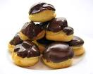
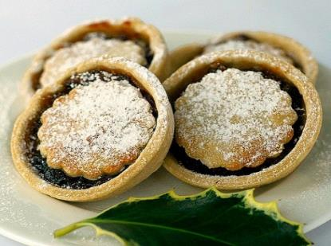
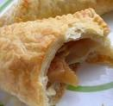
What types of pastry would be used to make the following products?
Main
Profiteroles
Mince Pies
Apple Turnover
Wontons
Pasty

Slide 36
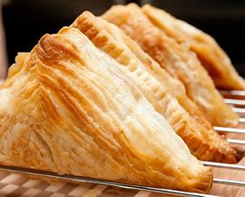
Cut and Paste
Match the Pictures to their pastry
Main Task

Slide 37
Raising agents
Self raising flour has what chemical raising agent in?
Name a biological raising agent?
What chemical raising agent is appropriate for gingerbread?
plenary

Slide 38
Year 9 Food Technology Miss Giddings
Lesson four
Notes:
Line up and wait to be called in.
Pen, pencil and planners out.
Think about where your seating as a seating plan and can easily be changed.

Slide 39
Do Now
1. Name 5 Sensory Words to describe this product? | 2. What is the method called when you mix butter and sugar together with a spoon?
3. Name two ingredients you can to this product to add colour and flavour. | 4. What is your favourite biscuit or cookie? Where is from? How many do you get in a pack? How much are they? Do you know what ingredients are in their?
Challenge 1 – what is coagulation?

Slide 40
Todays learning objectives
Learning objectives
Title: Design Development
Success Criteria: | Completed
Will be able to design your success product to help you plan your practical assessment
Good Will be able to design using pencil your own product
Outstanding Will be able to explain through annotation chosen ingredients through sensory words
SMSC Focus: Sensory Analysis

Slide 41
Sensory Keywords to consider in annotation

Slide 42
Design development ideas
main
TASK: In the books you are to draw a clear and detailed image of your chosen batch of biscuits design, and annotate it clearly to show the ingredients used.
This includes:
Biscuit type – shape, flavour and colour.
Fillings or decoration – types of fillings or topping decoration.
Presentation – How you will chose to present your biscuits.

Slide 43
Ideas

Slide 44
Design development ideas
main
TASK: In your books you are to draw clear and detailed image of your chosen batch of biscuits design, and annotate it clearly to show the ingredients used.
Key Annotation Points
Biscuit ingredients
Biscuit size and shape
Added flavours: zest or extracts
Presentation ideas
Decoration
What do you want it to look like?
How much would you sell it for?
Who are they aimed at? Customer
How many will you make?
Is their any dietary needs you need to
consider?
How will they be packaged?
Flour, butter, and sugar and eggs will be used to make a basic biscuit mix. The techniques used include creaming, mixing and sieving.
I will add vanilla extract and lemon zest to my biscuit mix. This will add a light lemon flavouring.
I will present my finished cake on a wooden chopping board.
I will use a scalloped edge cookie cutter to give shape and decoration to my biscuits.
For decoration I will pipe water icing onto the tops, in different colours.

Slide 45
Todays learning objectives
Plenary
Success Criteria: | Completed
Will be able to design your success product to help you plan your practical assessment
Good Will be able to design using pencil your own product
Outstanding Will be able to explain through annotation chosen ingredients through sensory words
SMSC Focus: Sensory Analysis

Slide 46
Year 9 Food Technology Miss Giddings
Lesson five
Notes:
Line up and wait to be called in.
Pen, pencil and planners out.
Think about where your seating as a seating plan and can easily be changed.

Slide 47
Task:
There are TEN pieces of information that have to be present on Food packaging……
Can you identify them from this milk carton

Slide 48
Today’s learning objectives
Learning objectives
Title: Packaging
Success Criteria: | Completed
Good to understand the importance of food packaging.
Outstanding to be able identify what is necessary to have on Food packaging.
SMSC Focus: Flavouring. Food wastage. Healthy eating through portion sizes.
Notes:
Go through learning objectives – SMSC focuses.
Visual resources – step by step guides

Slide 49
Settling
What is on my
Food packaging

Slide 50
Starter
LOGO – BRAND NAME
Use by information
& best before
Ingredients list/
Nutritional table
Traffic light nutrition
Weight, volume & quantity
What is on my
Food packaging
Contact information
Cooking instructions
How to store the product
Allegan/Dietary guidance
Image ingredients or food included

Slide 51
Nutritional Labels
Nutritional Information has to be included on packaging to display to customers, each nutrients content per 100g.
 | Per 100g | Per 55g serving
Energy | 2180kj/525kcal | 119kj/289kcal
Fat | 33.0g | 18.2g
Of which are saturates | 15.0g | 8.3g
Carbohydrates | 50.0g | 27.5g
Of which are sugars | 2.0g | 1.1g
Protein | 6.5g | 3.6g
Salt | 0.7g | 0.4g

Slide 52
Traffic light labelling
Traffic light labelling on a product shows how healthy it is at a glance.
They use reference intake values to show whether a product has HIGH, MEDIUM, LOW amounts of fat, salt and sugar.

Slide 53
Know your nutritional labelling
main
Calories | Fats | Saturates | Sugars | Salt
kcal | g | g | g | g

Slide 54
Know your nutritional labelling
main
Calories | Fats | Saturates | Sugars | Salt
241 kcal | 0.1g | 0g | 59g | 0g

Slide 55
Using the packaging you have
main
Calories | Fats | Saturates | Sugars | Salt
kcal | g | g | g | g

Slide 56
PARTY RINGS
Jammy Dodgers
Calories | Fats | Saturates | Sugars | Salt
kcal | g | g | g | g
Calories | Fats | Saturates | Sugars | Salt
kcal | g | g | g | g
CHOCOLATE FINGERS
MARYLANDS
Calories | Fats | Saturates | Sugars | Salt
kcal | g | g | g | g
Calories | Fats | Saturates | Sugars | Salt
kcal | g | g | g | g

Slide 57
Exam Question
Callum is designing a label for his food product.
Why is it important that all ingredients are listed?
State four pieces of information, other than ingredients, that the label must include?

Slide 58
What allergen ingredients do you think must be included on packaging?

Slide 59
What allergen ingredients do you think must be included on packaging?
Celery. Cereal. Gluten. Eggs. Fish. Cows milk.
Mustard. Nuts. Peanuts. Sesame seed. Soybeans.

Slide 60
Design development ideas
main
TASK: In your books you are to draw clear and detailed image of your chosen batch of biscuits design, and annotate it clearly to show the ingredients used.
Key Annotation Points
Biscuit ingredients
Biscuit size and shape
Added flavours: zest or extracts
Presentation ideas
Decoration
What do you want it to look like?
How much would you sell it for?
Who are they aimed at? Customer
How many will you make?
Is their any dietary needs you need to
consider?
How will they be packaged?
Flour, butter, and sugar and eggs will be used to make a basic biscuit mix. The techniques used include creaming, mixing and sieving.
I will add vanilla extract and lemon zest to my biscuit mix. This will add a light lemon flavouring.
I will present my finished cake on a wooden chopping board.
I will use a scalloped edge cookie cutter to give shape and decoration to my biscuits.
For decoration I will pipe water icing onto the tops, in different colours.

Slide 61
Design a biscuit packaging
main
Task: To create an informative and creative biscuit packaging for your biscuit you designed last lesson.
Success Criteria:
An eye-catching packaging design
Catchy Brand Name/ Logo design
All Nutritional Information and essential food labelling to met guidelines.

Slide 63
Year 9 Food Technology Miss Giddings
Lesson six
Notes:
Line up and wait to be called in.
Pen, pencil and planners out.
Think about where your seating as a seating plan and can easily be changed.

Slide 64
Design development ideas
main
TASK: In your books you are to draw clear and detailed image of your chosen batch of biscuits design, and annotate it clearly to show the ingredients used.
Key Annotation Points
Biscuit ingredients
Biscuit size and shape
Added flavours: zest or extracts
Presentation ideas
Decoration
What do you want it to look like?
How much would you sell it for?
Who are they aimed at? Customer
How many will you make?
Is their any dietary needs you need to
consider?
How will they be packaged?
Flour, butter, and sugar and eggs will be used to make a basic biscuit mix. The techniques used include creaming, mixing and sieving.
I will add vanilla extract and lemon zest to my biscuit mix. This will add a light lemon flavouring.
I will present my finished cake on a wooden chopping board.
I will use a scalloped edge cookie cutter to give shape and decoration to my biscuits.
For decoration I will pipe water icing onto the tops, in different colours.

Slide 65
Design a biscuit packaging
main
Task: To create an informative and creative biscuit packaging for your biscuit you designed last lesson.
Success Criteria:
An eye-catching packaging design
Catchy Brand Name/ Logo design
All Nutritional Information and essential food labelling to met guidelines.

Slide 66
Todays learning objectives
Learning objectives
Title: time plan
Success Criteria: | Completed
Time plans are important step by steps to make a successful product and to show your independence. Your task is to make a step by step of the impress me practical.
Good Will have a basic step by step with key ingredients and equipment used.
Outstanding Will have a descriptive step by step with accurate ingredients and equipment used.
Merit rewarding task Include hygiene and health and safety rules that you must follow for each step instruction.
Notes:
Go through learning objectives – SMSC focuses.
Visual resources – step by step guides

Slide 67
Practical Assessment Expectations

Slide 68
time plan
Main
Ingredients AND Quantities
Equipment list
Time plan step by step
200g macaroni pasta
100g cheddar cheese
50g soft margarine
50g plain flour
250ml semi-skimmed milk
Success Criteria for outstanding:
Time must be shown
Step by steps must be specific and detailed.
Food safety and Hygiene points present.

Slide 69
Todays learning objectives
Plenary
Title: time plan
Success Criteria: | Completed
Time plans are important step by steps to make a successful product and to show your independence. Your task is to make a step by step of the impress me practical.
Good Will have a basic step by step with key ingredients and equipment used.
Outstanding Will have a descriptive step by step with accurate ingredients and equipment used.
Merit rewarding task Include hygiene and health and safety rules that you must follow for each step instruction.
Notes:
Go through learning objectives – SMSC focuses.
Visual resources – step by step guides

Slide 70
Todays learning objectives
Learning objectives
Title: time plan
Success Criteria: | Completed
Time plans are important step by steps to make a successful product and to show your independence. Your task is to make a step by step of the impress me practical.
Good Will have a basic step by step with key ingredients and equipment used.
Outstanding Will have a descriptive step by step with accurate ingredients and equipment used.
Merit rewarding task Include hygiene and health and safety rules that you must follow for each step instruction.
Notes:
Go through learning objectives – SMSC focuses.
Visual resources – step by step guides

Slide 71
Practical Assessment Expectations

Slide 72
time plan
Main
Ingredients AND Quantities
Equipment list
Time plan step by step
200g macaroni pasta
100g cheddar cheese
50g soft margarine
50g plain flour
250ml semi-skimmed milk
Success Criteria for outstanding:
Time must be shown
Step by steps must be specific and detailed.
Food safety and Hygiene points present.

Slide 73
Todays learning objectives
Plenary
Title: time plan
Success Criteria: | Completed
Time plans are important step by steps to make a successful product and to show your independence. Your task is to make a step by step of the impress me practical.
Good Will have a basic step by step with key ingredients and equipment used.
Outstanding Will have a descriptive step by step with accurate ingredients and equipment used.
Merit rewarding task Include hygiene and health and safety rules that you must follow for each step instruction.
Notes:
Go through learning objectives – SMSC focuses.
Visual resources – step by step guides

Slide 74
Year 9 Food Technology Miss Giddings
Lesson seven
Notes:
Line up and wait to be called in.
Pen, pencil and planners out.
Think about where your seating as a seating plan and can easily be changed.

Slide 75
Notes:
The eatwell guide is based on the main food groups that together provide a healthy, balanced diet.
There are 5 sections to the eat well guide; fruit & veg, protein, dairy, fats and carbohydrates.
Can you name a few products from each group.

Slide 76
Nutrients
starter
There are two different types of nutrients
Macro nutrients
Carbohydrate
Proteins
Fat and oils
Micro nutrients
Fruit and Vegetables
Dairy
Notes:
Go through the nutrition and function of each section

Slide 77
Todays learning objectives
Plenary
Title: Eat well guide
Success Criteria: Understanding the Eat well Guide | Achieved
Good Will be able to recongnise the main food groups for healthy eating.
Outstanding Will be able to identify the functions of these groups within the body.
SMSC Focus: Healthy Food Choices

Slide 78
Mind map of carbohydrates
write down everything you know so far about carbohydrates…

Slide 79
Mind map of carbohydrates
write down everything you know so far about carbohydrates…
helps with digestion
Carbohydrates are made by green plants
give us dietary fibre.
Is a macronutrient
4/5 portions a day
gives you energy.

Slide 80
carbohydrates
Recap
There are two main types of carbohydrates:
Sugars - which provides quick releasing energy
Starch - which provides slow releasing energy

Slide 81
Mind map of Proteins
write down everything you know so far about protein…

Slide 82
Mind map of Proteins
write down everything you know so far about protein…
have 2 or 3 portions a day
Can be source from vegetable or animal
Is a macronutrient
are made up of amino acids
for growth and repair of our skin and muscles.

Slide 83
Proteins
Recap
There are two types of proteins.
ANIMAL sourced
HBV = High Biological Value
Contain all of the essential amino acids
VEGETABLE sourced
LBV = Low Biological Value
Lack one or more of the essential amino acids we need

Slide 84
Mind map of Fats
write down everything you know so far about fats…

Slide 85
Mind map of Fats
write down everything you know so far about fats…
2 to 3 portions a day
source of vitamins and energy
essential fatty acids
helps Insulates and protects organs
Insulates and protects organs

Slide 86
There are two types of fats.
ANIMAL sourced*
Saturated
BAD FATS
Solid at room temperature.
Causes high blood cholesterol.
*With the exception of palm and coconut oil.
VEGETABLE sourced
Unsaturated (GENERALLY) GOOD FATS
Liquid at room temperature.
Can lower blood cholesterol.

Slide 87
Fruit
&
vegetables
Dairy

Slide 88
source of calcium
contain vitamins, mineral and fiber.
2 to 3 portions a day
5 a day
Fruit
&
vegetables
Dairy
strong bones and teeth
Maintain a healthy body

Slide 89
Know your nutritional labelling
plenary
Calories | Fats | Saturates | Sugars | Salt
305 kcal | 16.6g | 7.5g | 0.70g | 0.80g

Slide 90
Know your nutritional labelling
plenary
Calories | Fats | Saturates | Sugars | Salt
305 kcal | 16.6g | 7.5g | 0.70g | 0.80g

Slide 91
Year 9 Food Technology Miss Giddings
Lesson eight
Notes:
Line up and wait to be called in.
Pen, pencil and planners out.
Think about where your seating as a seating plan and can easily be changed.

Slide 92
Notes:
The eatwell guide is based on the main food groups that together provide a healthy, balanced diet.
There are 5 sections to the eat well guide; fruit & veg, protein, dairy, fats and carbohydrates.
Can you name a few products from each group.

Slide 93
Todays learning objectives
Title: Vitamins & Minerals
Success Criteria: Understanding the Eat well Guide | Achieved
Good Will be able to recongnise the main food groups for healthy eating.
Outstanding Will be able to identify the functions of these groups within the body.
SMSC Focus: Healthy Food Choices

Slide 94
Vitamins & Minerals
Watch !!!!
https://youtu.be/ISZLTJH5lYg

Slide 95
Micro
Micro – Small.
Micro nutrients are needed in small amounts.
There are three types of Micro nutrient.
Water Soluble Vitamins
Fat Soluble Vitamins
Minerals
Water Soluble | Fat Soluble
C | A
B group | D
 | E
 | K
Minerals
Calcium
Iron
Sodium
Phosphorus

Slide 96
Micro
Your task is to research Vitamins and Minerals and fill out the worksheet provided.

Slide 97
Fat Soluble Vitamins
This means if the vitamins aren’t used in the body they are stored in fat tissue.
Fat Soluble | Needed For | Source | Deficiency | Excess
A Antioxidant | Vision Growth Immune System Skin | Dairy Products Eggs Orange coloured fruit and veg Oily Fish and Liver | Poor vision Night blindness Stunted growth Weak Immune system | Weak bones
D | Bone & teeth growth | Oily fish Eggs Dairy Products Sun Light Absorption | Rickets Osteoporosis – soft/brittle bones | Kidney damage
E Antioxidant | Protect tissue Skin Eye health Immune system | Dairy Products Dark Green veg Nuts Vegetable oils | Age quickly Wrinkles Skin loses elasticity Weak muscles | Blood clots Nausea Blurred vision
K | Blood clotting Heal wounds Bones | Dark Green Veg Fish, liver, meats Cereals Dairy products | Haemorrhages - Uncontrolled bleeding | none

Slide 98
Water Soluble Vitamins
This means if the vitamins aren’t used in the body they are passed through urine.
Water Soluble | Needed For | Source | Deficiency | Excess
C Antioxidant | Protects the body from infection | Citrus fruits Green veg Potatoes | Scurvy- tiredness Anaemia Cancer
B1 Thiamin | the nervous system and heart | Bread, pasta, rice Liver eggs | Beri-beri (disorder of the nervous system) tiredness
B2 Riboflavin | Release of energy from food | Milk Eggs Green veg | Dry cracked skin around the mouth and nose.
B12 Cobalamin | Nervous system Builds red blood cells | Milk Eggs Meat fish | Anaemia Nerve damage Tiredness

Slide 99
Minerals
Minerals | Needed For | Source | Deficiency | Excess
Calcium | Strong bones and teeth | Milk, cheese, tofu, green veg, hard water | Rickets, osteoporosis | Kidney stones
Iron | Forms part of the heamoglobin | Dark green veg Meat | Anaemia | Stomach pains Constipation Blood poisoning - death
Sodium | Controls water content | Most foods Or added to food | Nausea Muscle cramps | Salt is bad for you!!! High blood pressure and heart disease
Phosphorus | Healthy bones and teeth | Protein rich meats Dairy products Nuts Cereal | Weak muscles Painful bones | Hard for your body to absorb calcium

Slide 100
Task:
Read each case study, pay attention to what each person is suffering from.
Decide which vitamins they must be deficient in (not eating enough of) and suggest what foods each person could eat to make themselves feel better.
Case Study 1
Nana Irene has recently had a fall and broken her wrist. It was not a bad fall and her doctor has said she may have broken her wrist more easily because she is deficient in a certain vitamin. Which vitamin might she be deficient in:
Weak bones: Vitamin ?
What foods should she eat to improve her symptoms?
Case Study 2
After Colin’s recent eye test he was told that his vision is getting worse (deteriorating). What might Colin not be eating enough of to keep his eyes healthy?!
Poor eye health/vision: Vitamin ?
What foods should she eat to improve her symptoms?
Case Study 3
Sandra is suffering from gum disease and has recently found that she does not have as much energy as she used to. Which 2 vitamins might she be deficient in:
Poor gum health: Vitamin ?
Lack of energy: Vitamin ?
What foods should she eat to improve her symptoms?

Slide 101
Exam practise:
1) Identify 2 problems caused by lack of vitamin D.
2) Suggest one way of cooking green vegetables that will reduce the lose of vitamin C. Explain your answer.
3) How could a vegan (someone who doesn’t eat any animal products) ensure they get enough vitamin B2 and B3. Design a meal that is suitable to be eaten by a vegan.

Slide 102
Year 9 Food Technology Miss Giddings
Lesson nine
Notes:
Line up and wait to be called in.
Pen, pencil and planners out.
Think about where your seating as a seating plan and can easily be changed.

Slide 103
Todays learning objectives
Title: Bread theory
Success Criteria: Understanding the functional and chemical properties of basic bread ingredients | Achieved
Good Be able to identify some chemical and functional properties of the ingredients used in bread.
Outstanding Be able to identify a range of chemical and functional properties of the ingredients used in bread.
SMSC Focus:

Slide 104
Tell me something about bread?
Raising Agent
Strong bread flour
Bread

Slide 105
Can you name some breads
from around the world?
Raising Agent
Strong bread flour
Bread

Slide 107
Bread theory
Bread is made using strong bread flour. This flour has a high gluten content which is essential in bread making.
Gluten is the protein in flour and when water is added to strong plain flour a stretchy dough is formed.
It is the gluten that makes the dough stretchy. Gluten can be developed to make it even stretcher and this is done by kneading the dough.
As you knead a bread dough you will feel it becomes softer and stretcher the longer you knead it for. It Is a bit like chewing gum, it starts off quite hard but the longer you chew it the softer the gum becomes.
Yeast is another ingredient used in breadmaking. Yeast is a living organism even though it looks “dormant”. It is just like a human as it need moisture (water), food (sugar), warmth and time to grow. When the yeast grows (also called fermentation) it produces carbon dioxide gas, which then is trapped in the gluten of the dough and produces gas bubbles. As the bread dough is kept in a warm place (proving) the gas expands in the heat causing the bread to rise. The bread dough is stretching round the bubbles of gas giving the bread airy texture, once baked.
The sugar feeds the yeast and help it grow and produce carbon dioxide.
If you add a fat to the mixture, it enriches the dough and gives it colour, flavour and keeps the bread fresher for longer.
Salt is controls the yeasts fermentation, strengthens gluten and balances flavours.

Slide 108
Bread theory Questions.
Why is strong bread flour used for bread making?
What is gluten?
Why is bread left to prove in a warm place?
What four things does yeast need to grow?
What does gas do when it is heated?
What is fat added for?
Why do you add sugar to the dough?
Explain what kneading is and why it is done?
Name 6 breads from other cultures.
Extension: Design 2 new savoury bread products

Slide 109
Strong Bread flour
Gluten
Yeast
Starch
Warm Water
Sugar
Salt
Proving
Kneading

Slide 110
Strong Bread flour | High in gluten. Which makes the flour elastic and stretchy. Gluten forms the framework, structure and shape of the bread.
Gluten | Gluten in a protein found in flour.
Yeast | Natural raising agent that produces carbon dioxide gas when exposed to food, moisture, warmth and time. Which makes the bread rise.
Starch | Is a protein found in flour that when exposed to heat gelatinise and strengths the structure.
Warm Water | Binds the dry ingredients and helps develop gluten formation. Activates dry active yeast.
Sugar | Feeds the yeast and adds sweetness to the flavour.
Salt | Controls the yeasts fermentation (growth), strengthens gluten and balances flavours.
Proving | Is time where the yeast is left to produce carbon dioxide and the gluten is left to rest.
Kneading | Stretches the dough and develops the gluten and forms elastic dough.

Slide 111
Recalling knowledge
Plenary
What is yeast?
What does it need to grow/rise?
What is proving?
Yeast experiment
https://youtu.be/qoxY0z8ukUQ
Notes:
Plenary – recalling knowledge from demonstration
Extension – yeast experiment – three bottles/ three balloons – sugar, yeast and warm water.
111

Slide 112
Year 9 Food Technology Miss Giddings
Lesson ten
Notes:
Line up and wait to be called in.
Pen, pencil and planners out.
Think about where your seating as a seating plan and can easily be changed.

Slide 114
Todays learning objectives
Title: Bread shaping
Success Criteria: To learn a range of bread shaping techniques | Achieved
Good Successful produce 3 bread shapes
Outstanding Successful produce 6 or more shapes
SMSC Focus:

Slide 115
https://www.youtube.com/watch?v=NdTAcAgOONw
Watch and Shape!!

Slide 116
Year 9 Food Technology Miss Giddings
Lesson eleven
Notes:
Line up and wait to be called in.
Pen, pencil and planners out.
Think about where your seating as a seating plan and can easily be changed.

Slide 117
Todays learning objectives
LO
Title: Food choice
Success Criteria: Understanding Food Choice | Achieved
Good Will be able to recongnise the main food choices.
Outstanding Will be able to identify the factors of these groups.
SMSC Focus: Cultural and Social Issues

Slide 118
Task: Define these food choices by adding to the mind map
Good progress – 10 facts
Outstanding progress – 20 Facts
Merits award – 25 facts
Vegetarians
Personal
opinion
Diabetics
Vegan
Food Choice
Dairy free
Islamic
Lactose
intolerant
Religious
beliefs
Coeliac
Intolerance
allergy's
Hindu
Gluten free
Nut

Slide 119
Plenary
Peer Expert Examiners
Activity mark work in red pen
Marking was given in the following:
Verbal feedback
Written feedback
Spelling, grammar Correcting errors
Praise comment
________________________________
________________________________
________________________________
________________________________
Improvement comment
________________________________
________________________________
________________________________
________________________________

Slide 120
Year 9 Food Technology Miss Giddings
Lesson twelve
Notes:
Line up and wait to be called in.
Pen, pencil and planners out.
Think about where your seating as a seating plan and can easily be changed.

Slide 121
What does Ready meals mean?

Slide 122
Main
Ready Meals Project
This project is an opportunity to apply, develop and enhance your understanding of ready to eat foods.
Within this project you will plan, prepare, design and present a range of sauce based dishes.
As well as, gaining a wider knowledge of the functional and chemical properties of ingredients.
Notes:
Pupils to write down the brief in there books

Slide 123
Ready meals can contain all groups of the eat well guide. Making it a well balanced meal
Can you think of a ready meal that contains all of the 5 groups of the eat well guide??

Slide 124
Sauces and finishes are key ingredients in ready meals.
Sauces are used in both savoury and sweet dishes—as an accompaniment or as part of the dish.
You can put pretty much anything you like in sauce. But they usually contain; flour, butter, eggs, cornflour, stock, milk or cream.
1. Roux sauce—white sauce, cheese sauce, custard
2. Blended sauce—chunky guacamole, salsa
3. All in one sauce—simmering ingredients to thicken through heat.
Sauces can be used in other ways;
1. Garnishing/decoration—drizzled cream on soups, custard, jam
2. Glazing—caramel, toffee, sugar glaze

Slide 125
Today’s learning objectives
Learning objectives
Success Criteria:
Create a mind map that will inspire you in you in ready made meals.
Good You have selected a range of images that meet your brief and laid them out in a creative way.
Outstanding You have annotated your chosen images. Commenting on colour, texture, theme, quality and presentation.
SMSC Focus: Presentation and sensory appeal.
Pizza
Curry
Puff pastry pie or pasty
Chicken nuggets
Fish Fingers
Spaghetti Bolognese
Sausage roll
Fajita
Notes:
Pupils to read out learning objectives.
Pupils will pick a level they will work at today and write why in their booklets
125

Slide 126
What makes a good Mind map…
C/W
Date
DNA: What makes a good mind map?
Task:
Using the exemplars that you have been given, you need to identify what makes a good mind map. HINT: write down what you can see… Write down what stands out…

Slide 127
Mind map…
You have the main focus of your project
You have your main idea…
Your examples of your main idea…

Slide 129
Ingredients
Types of foods
Presentation idea
Dietary needs to consider
Eat well Guide
Ready meals
Equipment
Health and safety….
Skills you can demonstrate

Slide 130
Today’s learning objectives
Learning objectives
Success Criteria:
Create a mood board that will inspire you in you in ready made meals.
Good You have selected a range of images that meet your brief and laid them out in a creative way.
Outstanding You have annotated your chosen images. Commenting on colour, texture, theme, quality and presentation.
SMSC Focus: Presentation and sensory appeal.
Pizza
Curry
Puff pastry pie or pasty
Chicken nuggets
Fish Fingers
Spaghetti Bolognese
Sausage roll
Fajita
Notes:
Pupils to read out learning objectives.
Pupils will pick a level they will work at today and write why in their booklets
130

Slide 131
Year 9 Food Technology Miss Giddings
Lesson thirteen
Notes:
Line up and wait to be called in.
Pen, pencil and planners out.
Think about where your seating as a seating plan and can easily be changed.

Slide 132
Do Now
Where does each ingredient sit on the eatwell guide
Notes:
Starter – recalling knowledge – eat well guide and food science of recipe

Slide 133
1. What is a ready meal? | 2. Name the 5 sections of the eat well guide?
3. What are the two types of carbohydrate? | 4. Name a vegetable and an animal source of fat?
Challenge 1 – what is the name given to vegetable fats on food labels?

Slide 134
Todays learning objectives
Learning objectives
Title: Design Development
Success Criteria: | Completed
Will be able to design your success product to help you plan your practical assessment.
Good Will be able to design using pencil your own product.
Outstanding Will be able to explain through annotation chosen ingredients through sensory words. commenting on ingredients, their function and nutrition.
SMSC Focus: Sensory Analysis

Slide 135
Design development ideas
main
TASK: In the books you are to draw a clear and detailed image of your chosen pizza design, and annotate it clearly to show the ingredients used.
This includes:
Dough type – shape, crust, flavour and colour.
Toppings – types of fillings or topping.
Sauce - types of sauce, colour, textures and flavours
Presentation – How you will chose to present your pizza.
Specification:
Design a pizza, in full colour
Annotate using sensory analysis keywords
And reference to the eat well guide.

Slide 136
Design Development idea
Main
TASK: In your books you are to draw clear and detailed image of your chosen pizza design, and annotate it clearly to show the ingredients used.
Pizza Base –
Thin and crispy
Made from:
Flour- structure
Yeast- helps it to rise
Water- binds in together
Sliced Peppers
Adds colour
Adds sweet flavour
Adds moisture
Add vitamin C, A, B
Mushroom-
Thinly sliced
Add a soft texture and colour.
Sauce-
Adds a soft texture
Adds colour
Adds flavour
Cheese-
Adds bright colour
Adds dairy, which is a good source of calcium.
Function is to hold all the topping in place.
Eat well guide
Carbohydrates –
Dairy-
Protein –
Fats oils-
Fruit and vegetables-
Notes:
Example slide

Slide 137
PEER PIN assessment
Main
Success Criteria:
Will be able to design your success product to help you plan your practical assessment
Good Will be able to design using pencil your own product
Outstanding Will be able to explain through annotation chosen ingredients through sensory words. commenting on ingredients, their function and nutrition.

Slide 138
Year 9 Food Technology Miss Giddings
Lesson 14
Notes:
Line up and wait to be called in.
Pen, pencil and planners out.
Think about where your seating as a seating plan and can easily be changed.

Slide 139
Name the four countries of the united kingdom of great Britain
Can you name any international countries

Slide 140
Todays learning objectives
Learning Objectives
Title: Traditional Cuisines
Success Criteria: Understanding Food Culture | Achieved
Good To have a wider understanding of specific Traditional Cuisines
Outstanding To be able to identify a range of Cuisines from Britain and International
SMSC Focus: Cultural and Social Issues
Notes:
Every lesson will start with the intended learning outcomes and you will be expected to pick a LO to work towards. Once you have completed a level you must tick it to show progress.
Pupils to read out learning objectives
Pupils will pick a level they will work at today

Slide 141
Task: As a table of four.
Fill the United Kingdom map by labelling the specific areas with foods from that region.
Good progress – labelling the dishes to the correct location
Outstanding progress - labelling and describing the dishes to the correct location
Extension – can you name any specific dishes from other International countries.

Slide 142
Task: As a table of four.
Make a A3 moodboard of food from a chosen country.
This is called Secondary Research.

Slide 143
Year 9 Food Technology Miss Giddings
Lesson 15 –
Notes:
Line up and wait to be called in.
Pen, pencil and planners out.
Think about where your seating as a seating plan and can easily be changed.

Slide 144
Written Assessment expectations
Section A will be Multi choice questions
Section B is Written Response questions.
Final Grade in year 11
50% x2 NEA (NONE EXAMINATION ASSESSMENT – COURSEWORK)
50% 1 Examination

Slide 145
Multi choice questions
Worth 1 Mark
Written Response
Worth 2 Mark
1. Which of these is not a Macronutrient?
Carbohydrates
Fats
Protein
Dairy
6. What are the sources of these two proteins?
1.High Biological Value_________________________________
2. Low Biological Value________________________________

Slide 146
Todays learning objectives
Learning Objectives
Title: Revision
Success Criteria: To revise for Written Assessment | Achieved
Good To revise a wide range of topics for your written Assessment
Outstanding To be able to identify areas you need to work on and focus on those areas.
SMSC Focus:
Notes:
Every lesson will start with the intended learning outcomes and you will be expected to pick a LO to work towards. Once you have completed a level you must tick it to show progress.
Pupils to read out learning objectives
Pupils will pick a level they will work at today

Slide 147
Revision methods
Areas to focus on:
Eat Well Guide
Nutrition
Food labelling
Packaging
Food safety and Personal safety
Bread Theory – how to make bread
Method of revision:
Mind map
Notes – flash cards
Mini exam questions

Slide 148
Year 9 Food Technology Miss Giddings
Lesson 19 – Written Assessment
Notes:
Line up and wait to be called in.
Pen, pencil and planners out.
Think about where your seating as a seating plan and can easily be changed.

Slide 149
Written Assessment expectations
Section A will be Multi choice questions
Section B is Written Response questions.
Final Grade in year 11
50% x2 NEA (NONE EXAMINATION ASSESSMENT – COURSEWORK)
50% 1 Examination

Slide 150
Multi choice questions
Worth 1 Mark
Written Response
Worth 2 Mark
1. Which of these is not a Macronutrient?
Carbohydrates
Fats
Protein
Dairy
6. What are the sources of these two proteins?
1.High Biological Value_________________________________
2. Low Biological Value________________________________

Slide 151
Today’s learning objectives
Learning objectives
Title: Written Assessment
Success Criteria: | Completed
Will be able recalling knowledge learnt in theory and practical lesson by completing a practical assessment.
Good To attempt all questions with some difficulty in recalling knowledge.
Outstanding To attempt all questions and be able to recall knowledge easily.
SMSC Focus: Food safety and the eat well guide. Recalling learnt knowledge.
Notes:
Go through learning objectives – SMSC focuses.
Visual resources – step by step guides

Slide 152
Email rgiddings@thelinkacademy.org.uk
I will send over the exam paper for you to complete.

Slide 153
Written Assessment
Main task

Slide 154
GCSE Food Nutrition and Preparation
The year will be split into 3 parts!
2 None Examination Assessments – NEA
NEA 1 – food science essay 15%
NEA 2 - Coursework/Practical Exam 35%
- Written Exam Revision 50%

Slide 155
Examination
50% of overall grade
June
1 Hour 45 Minutes
Revision!

Slide 156
NEA2 Nov - February
35% of 50% of overall grade
Task set by Exam board Nov 1st
Food Preparation Task
Research
Practical skills demonstration
20 page Portfolio
3 hour practical exam
Deadline February Half Term

Slide 157
NEA1 – Sept to Oct
15% of 50% of your NEA
Task set by Exam board Sept 1st
Food science Investigation Task
Research
Practical investigations x3
Evaluation
1500-2000 words
Deadline October Half Term

Slide 158
Timelines….
October Half Term – NEA1 completed!
February 2020 – NEA2 Completed
March – June – Exam Revision
June 2020 Food Exam

Slide 159
Catch up Club/Detentions…..
Fridays after school -
“Cake and Catch Up” One hour
Upgrade
If you are behind timeline, you will be called to do 2 hours detentions to catch up

