Slide 1
Levers
Sporting examples

Slide 2
1st Degree Lever

Slide 5
1st Degree Lever

Slide 6
2nd Degree lever

Slide 7
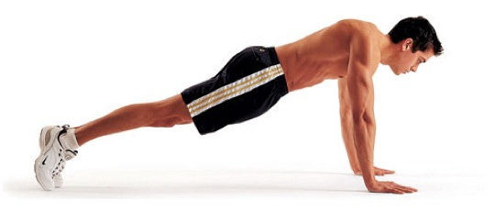
2nd Degree lever
Load
Effort
Fulcrum

Slide 8
3rd Degree lever

Slide 12
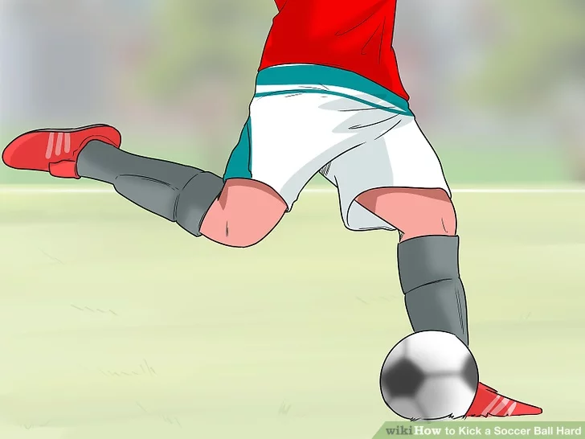
3rd Degree lever

