Slide 1



4.3 Methods of Advertising
Hyperlink(s)
Back button
Forward button

Slide 2


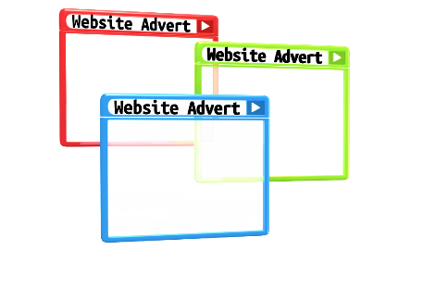





Advertising Media
Identify the different advertising methods available for start-up businesses.
WEBSITES
NEWSPAPERS
SOCIAL MEDIA
MAGAZINES
LEAFLETS
RADIO
LEAFLETS
Progress Indicators
Good – Identify the factors to consider when pricing a product | Excellent – describe the factors to consider when pricing a product

Slide 3


Advertising
Write a definition for advertising
“The use of media to communicate with existing and potential customers about a product or service”
It is important that advertising is planned carefully to
ensure that:
  The correct message gets across
  The intended audience sees the message – at the right time
  The most appropriate media is used

Slide 4
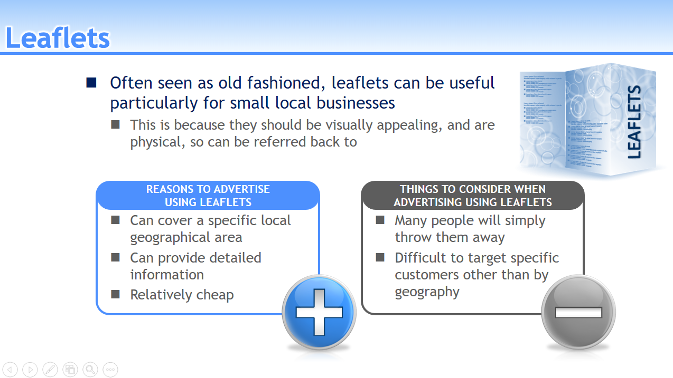
Advertising Media
Research each advertising media by investigating the following:
How it works
Positives
Negatives
Progress Indicators
Good - Describe how different advertising methods work | Excellent – Explain the positive and negatives of each advertising method

Slide 5
DNA – Fix LO3 mini mock
Find the highlighted question.
Use your notes and fix it (in green)

Slide 6


Leaflets
Often seen as old fashioned, leaflets can be useful particularly for small local businesses
  This is because they should be visually appealing, and are physical, so can be referred back to
LEAFLETS
REASONS TO ADVERTISE
USING LEAFLETS
THINGS TO CONSIDER WHEN
ADVERTISING USING LEAFLETS
  Can cover a specific local geographical area
  Can provide detailed information
  Relatively cheap
  Many people will simply throw them away
  Difficult to target specific customers other than by geography

Slide 7
Social Media
Advertising on social media can provide a small business with access to a large audience
  It is an affordable form of advertising that can potentially give access to a wide range of consumers
REASONS TO ADVERTISE
ON SOCIAL MEDIA
THINGS TO CONSIDER WHEN
ADVERTISING ON SOCIAL MEDIA
  Encourages user interaction
  Affordable, and budget can be controlled
  Can target users with particular interests
  Adverts can annoy users
  Adblocking software may prevent adverts being shown
  No control over content adverts appear next to
Notes:
.

Slide 8
Websites
Advertising on websites can allow a small business
to access a large audience
  It is usually paid for on a “per click” basis
    With a budget being set to limit how much a business is spending
REASONS TO ADVERTISE
ON WEBSITES
THINGS TO CONSIDER WHEN
ADVERTISING ON WEBSITES
  Can reach a wide audience
  Affordable, and budget can be controlled
  Can target users with particular interests
  Adverts can annoy users
  Adblocking software may prevent adverts being shown
  May require prolonged period to be effective

Slide 9

Newspapers
Local newspapers can be very effective for small business
  They are unlikely to use national newspapers because:
    They are very expensive
    They are unlikely to want to reach a national audience
REASONS TO ADVERTISE IN
LOCAL NEWSPAPERS
THINGS TO CONSIDER WHEN
ADVERTISING IN LOCAL NEWSPAPERS
  Good for reaching local people
  Reader can refer back
  Detailed information can
  be given
  Limited use of colour
  Readers can easily ignore - little to get their interest
  Limited audience so cost
  per reader can be high

Slide 10
Magazines
Magazines are published regularly and cover specific interests
  This can give a small business access to a particular group of customers
REASONS TO ADVERTISE
IN MAGAZINES
THINGS TO CONSIDER WHEN
ADVERTISING IN MAGAZINES
  Can target specific audiences
  Usually available nationally
  Reader can refer back
  Detailed information can
  be given
  Competing products are also likely to be advertised
  Advertising space must be
  booked well in advance,
  so planning is required

Slide 11
Radio
Small businesses have access to a wide number of local radio stations, catering for different audiences including:
  Different tastes in music
  Different ethnicities
  Talk shows including current affairs
REASONS TO ADVERTISE
ON THE RADIO
THINGS TO CONSIDER WHEN
ADVERTISING ON THE RADIO
  Can use audience profile to target a specific group
  Growing number of stations
  Can use local stations for local campaigns
  Non-visual
  Message is short-lived
  Listeners may ignore adverts
  Not all radio stations are commercial

