Slide 1
Lesson Eleven
C/W Date
Lesson Title: Watson Writes Home
Lesson Focus: - Extract main points and information by using a range of strategies

Slide 2
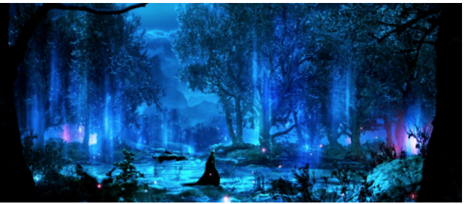
DNA
5 Minute Writing Challenge
First sentence should begin with a preposition.
Needs to maintain a 3rd person narrative.
Include an exclamation mark.
Towered
Luminous
Clandestine
Amiable
Furtive
Meandering

Slide 3
Task - Word Consciousness
1) Please copy this out. If you are using your exercise book, this should be in the back.
2) Please complete this column by putting the definitions into your own words AND coming up with synonyms*. You saw and copied an example of how to do this in lesson 1.
*synonym means alternative words
Word and definition | Your definition or synonyms
Ghoulish (adjective) – resembling or characteristic of a ghoul. – morbidly interested in death or disaster.
Methodical (adjective) – done according to a systematic or established procedure.
Monumental (adjective) – great in importance, extent or size. – serving as a monument.

Slide 4
Learning Journey
Last lesson we looked at a line by line read of some extracts and practised how to ‘dig down’ into language choices.
How will our skills make us better detectives?
What skills did we utilise?
Close analysis, line by line read, deduction and inference at word and sentence level.
Today we are going to look at the letter Watson sends home and see what else we learn about the mysterious case on the moor!

Slide 5
Read – Chapter 6

Slide 6
Task
Write down as much as you can about the following things. You must write in full sentences and include quotes in your answers.
How is the moor described?
What do we learn about Watson?
What do we learn about the Stapletons?
What odd things are occurring at Baskerville Hall?

Slide 7
Task - Summary skills
Write a short summary of the letter that Watson sends home.
You only have 5 sentences, and you must include the most important pieces of information.

Slide 8
Thinking points …
You only need to think about this and do not need to write anything down:
How does Watson feel about the moor?
What strange things are happening at Baskerville Hall?
What reaction is Conan Doyle trying to establish in the reader?

Slide 9
Close Reading – TDQ’s
You are now going to close read a section from Chapter six and focus on Watson and his strange experience.
You will then answer some Text Dependent Questions – questions which will focus on specific words and help you to ‘dig down’ into what Conan Doyle is showing/telling us.
You should answer the questions in full sentences. You can pick up to 3 to ‘explode.’

Slide 10
Close analysis and TDQ’s
What are we learning about Watson’s feelings about the moor when he uses the adjective ‘godforsaken’?
After reminding us that the moor is becoming ‘darker and more terrible’ why has he called the place ‘fascinating’? What do we learn from this contradiction?
Watson personifies the moor when he tells us he walks ‘deep into its heart’. Why personify it? What effect does this have? Why couple this with the idea of going into its ‘heart’?
What sort of location is this moor if it is ‘wind-blasted? Why use this technique and what effect does this have?
I hope that my previous letters and telegrams have kept you up-to-date with all that has occurred so far in this godforsaken place. With each day that I remain here, the moor grows darker and more terrible. But it is fascinating at the same time. When I walk deep into its heart, all traces of modern England are left behind me. Instead, I am surrounded by the stone huts and strange monuments that were constructed by the prehistoric people who once called this wind-blasted place their home.
‘

Slide 11
Close analysis and TDQ’s
Why has the writer chosen the specific time period of ‘2am’ for these events to occur? What is this effect of this choice?
What do the verb choices of ‘peeped’ and ‘hid’ tell us about Watson’s behaviour and his intentions?
When the noun ‘pursuit’ is used what do we learn about Watson’s intentions?
What is the collective effect of using the adjectives ‘ghoulish, sinister and furtive’ to describe Barrymore and his actions?
And now I come to my most important discovery . Last night, around two o’clock in the morning, I was woken by a creak coming from the corridor. I rose from my bed, opened the door and peeped out. A shadow was moving down the hallway and I slipped out of my room in pursuit. I could see the outline of a tall man carrying something, but it was too dark to see who he was. Then, suddenly, he lit a match and held it to the wick of a large candlestick. His face seemed ghoulish and sinister in the light from its flame. It was Barrymore, looking more furtive than I have ever seen him. I swiftly hid behind a large bookcase so he wouldn’t spot me.
‘

Slide 12
Close analysis and TDQ’s
What effect does the adjective ‘blood-chilling’ have on the reader and what does it show us about how Watson reacted?
Why does Watson decide to keep the information about the scream to himself?
TASK – rewrite this section but change the tone so Watson was not frightened.
‘
And what of that blood-chilling howl I heard out by the Grimpen Mire? I have decided not to mention it to Sir Henry. There seemed no point in alarming him over something which may turn out to have a simple, natural explanation. I admit that the sound horrified me, but until I have some more facts at my disposal, or a strong reason to suspect that it was made by an animal, I would have nothing to give him but further worries.

Slide 13
Task… add to your ideas from earlier
How is the moor described?
What do we learn about Watson?
What do we learn about the Stapletons?
What odd things are occurring at Baskerville Hall?

