Slide 1
80/20 – THINK! What do you NEED to cover with your set
Grade | Objective | Outcomes
1-3 | To be able to describe and predict the properties of elements found in Group 1 based upon their electronic configuration | Identify how properties of the elements in Group 1 depend on the outer shell of electrons of these atoms
 |  | Describe the reactions of the first three alkali metals with oxygen, chlorine and water Predict properties from the given trends down the group
4-6
 |  | Construct balanced symbol equations for the reactions of the first three alkali metals with oxygen, chlorine and water
7-9
Specification reference: 5.1.2.5

Slide 2
Group 1-Alkali Metals
CWK
DO IT NOW
Give the element symbols of all elements in group 1
Write the electron structure for the first 3 elements in group 1 and describe how the electron structures are connected
Explain how and why group 1 elements become ions and the type of ion that is formed
Construct a diagram to show how the second element in group 1 becomes an ion
Challenge: Other than electron structure, why are these elements placed in group 1? Give examples.

Slide 3
Group 1-Alkali Metals
CWK
DO IT NOW
Give the element symbols of all elements in group 1
Write the electron structure for the first 3 elements in group 1 and describe how the electron structures are connected
Li
Na
K
Rb
Cs
Fr
All group 1 elements have 1 electron in their outer shell
1. Lithium = 2,1
2. Sodium = 2,8,1
3. Potassium = 2,8,8,1

Slide 4
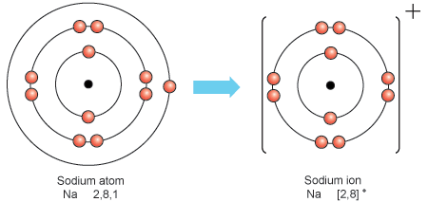
Group 1-Alkali Metals
CWK
DO IT NOW
Explain how and why group 1 elements become ions and the type of ion that is formed
Construct a diagram to show how the second element in group 1 becomes an ion
All group 1 elements lose 1 electron to gain a full outer shell and become +1 ions

Slide 5
Progress indicators
GOOD PROGRESS:
OUTSTANDING PROGRESS:

Slide 6
Word consciousness
Trend – describing the pattern shown in a specific property

Slide 7
Task 1- Use the data to describe the trends in group 7
Element | Melting point (°C) | Boiling point (°C) | Density (g/cm³) | Atomic radius (nm)
Lithium | 181 | 1330 | 0.534 | 0.155
Sodium | 98 | 883 | 0.971 | 0.190
Potassium | 63 | 759 | 0.862 | 0.235
Rubidium | ? | 688 | 1.63 | 0.243
Caesium | 29 | 671 | 1.93 | 0.267
Describe 5 trends as you go down group 1 using the data above (also include the trend for atomic number)
Predict the melting point of rubidium and explain why you predicted that number
Challenge- Water has a density of 1 g/cm³, which elements would float on water and why?
Notes:
Melting point of rubidium = 39 °C (allow any value between 34 and 46)

Slide 8
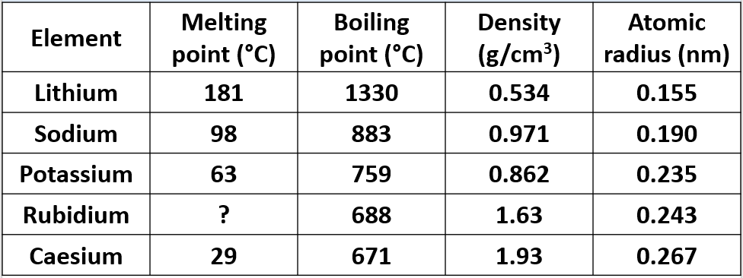
As you go down group 1:
-The melting point _____________
-The boiling point _____________
-The density _____________
-The atomic radius _____________
- The atomic number _____________
2. The melting point of rubidium =
DECREASES
DECREASES
INCREASES
INCREASES
INCREASES
39 °C
*Any value between 34 and 46 is acceptable
Challenge- Water has a density of 1 g/cm³, which elements would float on water and why?
Challenge- Lithium, sodium and potassium all float on water as they have a lower density than water (all below 1 g/cm³)
Notes:
Melting point of rubidium = 39 °C (allow any value between 34 and 46)

Slide 9
Demo of alkali metals in water
Watch your teacher put the first three alkali metals in water
Write down observations for each metal
What is the trend in reactivity as you go down the group?
Lithium
Sodium
Potassium
Floats on water, fizzes, hydrogen gas produced, metal disappears (reacted to form soluble lithium hydroxide)
Melts into silvery ball, floats and moves around surface of water, fizzes, hydrogen gas produced,
Floats and moves quickly across surface of water, hydrogen gas ignites and burns with lilac flame
As you go down the group the reactivity INCREASES
Notes:
If unable to do the demonstration an alternative is this video: https://www.youtube.com/watch?v=y0hrqLTubDM
Brainiac video to show rubidium and caesium: https://www.youtube.com/watch?v=m55kgyApYrY

Slide 10
Summary of reactivity
Group 1 metals are very ___________. Group 1 __________ in reactivity as the ___________ electron gets further away from the nucleus and so is easier to _______. We can make them more ________ by reacting them with other chemicals.
INCREASES STABLE OUTER REACTIVE LOSE
Challenge: Why does the distance from the nucleus effect how easy it is to lose an electron?

Slide 11
Summary of reactivity
Group 1 metals are very reactive. Group 1 increases in reactivity as the outer electron gets further away from the nucleus and so is easier to lose. We can make them more stable by reacting them with other chemicals.

Slide 12
All group 1 elements react in similar ways as they have one electron in their outer shell:
metal + oxygen → metal oxide
M + O₂ → M₂O
metal + chlorine → metal chloride
M + Cl₂ → MCl
metal + water → metal hydroxide + hydrogen
M + H₂O → MOH + H₂
Task - write word and balanced symbol equations for the reactions of lithium, sodium and potassium with oxygen, chlorine and water using the above equation to help you

Slide 13
Reactions of lithium
Lithium + oxygen → lithium oxide
4Li + O₂ → 2Li₂O
Lithium + chlorine → lithium chloride
2Li + Cl₂ → 2LiCl
Lithium + water → lithium hydroxide + hydrogen
2Li + 2H₂O → 2 LiOH + H₂

Slide 14
Reactions of sodium
Sodium + oxygen → sodium oxide
4Na + O₂ → 2Na₂O
Sodium + chlorine → Sodium chloride
2Na + Cl₂ → 2NaCl
Sodium + water → sodium hydroxide + hydrogen
2Na + 2H₂O → 2NaOH + H₂

Slide 15
Reactions of potassium
Potassium + oxygen → potassium oxide
4K + O₂ → 2K₂O
Potassium + chlorine → Potassium chloride
2K + Cl₂ → 2KCl
Potassium + water → Potassium hydroxide + hydrogen
2K + 2H₂O → 2KOH + H₂

Slide 16
Plenary- exam question
Notes:
16
16

Slide 17
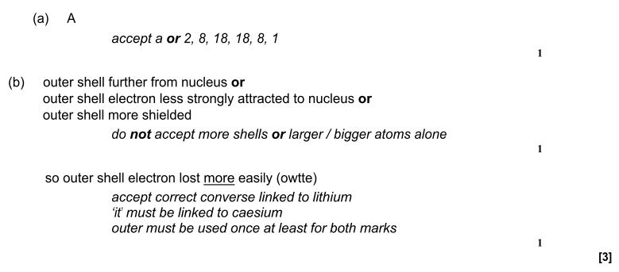
Notes:
17
markscheme and examiner report
17

