Slide 1
Developing Idea
You now need to combine all the styles you have looked at – Andrew Whyte, Tanaka/Slinkachu, Dear Photograph and Narrative Photography and start to develop your own ideas
You will need 3 different ideas – this may be 3 different ways of presenting your one idea or 3 different ideas.
Presenting your idea may include things like a film reel, Instagram feed, storyboard – this is going to be your final piece and is worth 30/120 marks.

Slide 2
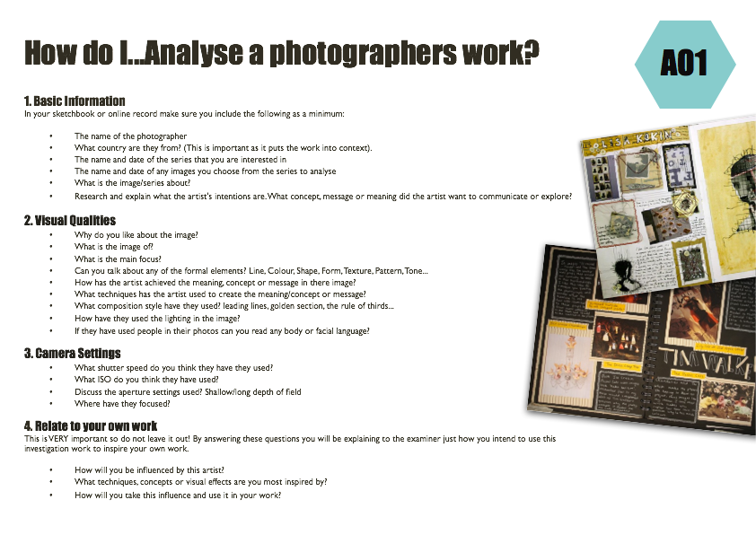
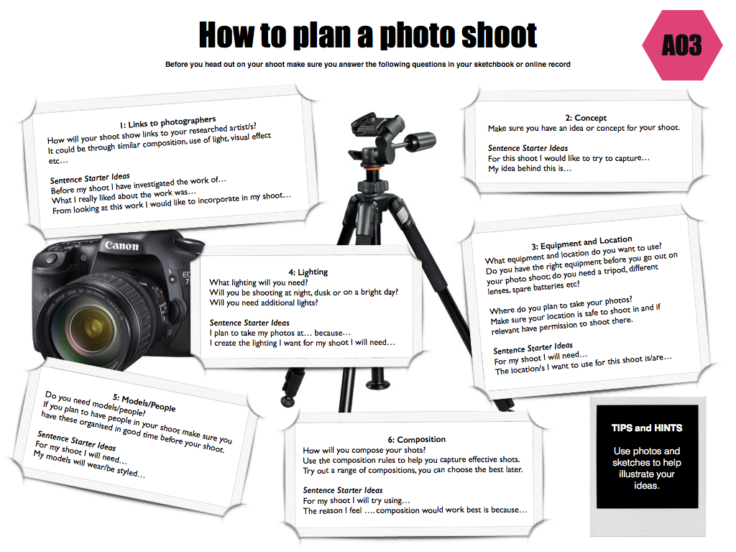
To gain an understanding of the work of a chosen photographer/artist/style that links to your project (Identity) and develop ideas
GCSE photography Progress Indicators
Good | Answered some questions from each heading on the ‘help sheet pages’ A range of neatly cut out and presented images by the photographer/artist/style that link to your development of ideas Ideas are based on your chosen photographer/artist/style
Outstanding | Answered most questions from each heading on the ‘help sheet pages’ Writing uses detailed and in-depth sentences Creative layout/design for the pages used A range of ideas that reflect the style of your chosen photographer/artist/style Camera setting have been discussed and used in various ways Various compositions and lighting have been experimented with
Titles on each page should link
1) Plan of Ideas for your story/theme for your ALIVE project
You should have at least 2 ideas(you need 3 really) – these may be similar ideas but presented in a different way or could be 2 different idea. 3 Plans separate plans of shoots and mind map if you have completed one
Make small versions of your ideas –
flip books /storyboards /instagram
3) Contact Sheet of final photo’s to be used in your final piece and annotated
REMEMBER TO LINK BACK TO YOUR PREVIOUS RESEARCH/PHOTOGRAPHERS STYLES

Slide 3
To gain an understanding of the work of a chosen photographer/artist/style that links to your project (Alive) and develop ideas
GCSE photography Progress Indicators
Good | Answered some questions from each heading on the ‘help sheet pages’ A range of neatly cut out and presented images by the photographer/artist/style that link to your development of ideas Ideas are based on your chosen photographer/artist/style
Outstanding | Answered most questions from each heading on the ‘help sheet pages’ Writing uses detailed and in-depth sentences Creative layout/design for the pages used A range of ideas that reflect the style of your chosen photographer/artist/style Camera setting have been discussed and used in various ways Various compositions and lighting have been experimented with
Titles on each page should link
1) Plan of Ideas for your story/theme for your ALIVE project
You should have at least 2 ideas(you need 3 really) – these may be similar ideas but presented in a different way or could be 2 different idea. 3 Plans separate plans of shoots
Make small versions of your ideas
Contact Sheet of final photo’s to be used in your final piece
Final Piece – must be your best work as it is worth 30/120
Evaluation of final piece
Discuss what went well and things that could be improved, how you made your final piece and how it relates to the photographers/styles you have researched.
REMEMBER TO LINK BACK TO YOUR PREVIOUS RESEARCH/PHOTOGRAPHERS STYLES

Slide 4
LOOK AT YOUR PARTNERS WORK AND ASSES WHAT YOU KNOW NEEDS INCLUDING
Ideas discussion / project discussion / single photograph discussion / camera setting/composition discussion

Slide 7
To gain an understanding of the work of a chosen photographer/artist/style that links to your project (Alive) and develop ideas/final piece
Your should have already:-
1) Minimum 2 Plan of different Ideas for your story/theme for your Alive project
You should have at least 2 ideas(you need 3 really) – these may be similar ideas but presented in a different way or could be 2 different idea. 3 Plans separate plans of shoots
Make small versions of your ideas
Contact Sheet of final photo’s to be used in your final piece
You should be working on………………..(until christmas)
Final Piece – must be your best work as it is worth 30/120
Evaluation of final piece
Discuss what went well and things that could be improved, how you made your final piece and how it relates to the photographers/styles you have researched.
REMEMBER TO LINK BACK TO YOUR PREVIOUS RESEARCH/PHOTOGRAPHERS STYLES
GCSE photography Progress Indicators
Good | A range of neatly cut out and presented images by the photographer/artist/style that link to your development of ideas and discussed Ideas are based on your chosen photographer/artist/style Developed a final piece and evaluated it
Outstanding | Writing uses detailed and in-depth sentences. Camera setting have been discussed and used in various ways. Various compositions and lighting have been experimented with A range of ideas that reflect the style of your chosen photographer/artist/style Creative final piece that encompasses your whole project

