Slide 1
Do Now Activity
What do you know?
Which 2 numbers make up binary code? [1]
Which is bigger 1 GB or 10,000 KB? [1]
Why do computers use binary? [2]
How many bits in a byte? [1]

Slide 2
Do Now Activity - Answers
What do you know?
Which 2 numbers make up binary code? [1]
0 and 1
Which is bigger 1 GB or 10,000 KB? [1]
1GB
Why do computers use binary? [2]
The circuits in a computer's processor are made up of billions of transistors.
1 = on / 0 = off
How many bits in a byte? [1]
8

Slide 3
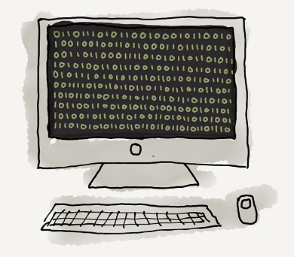
Unit 12 Data Representation
Lesson 1
Good – Describe the use of binary in computers
Outstanding – Convert denary whole numbers (0-255) into 8-bit binary numbers and vice versa.
Binary = a BASE 2 number system invented by Gottfried Leibniz

Slide 4
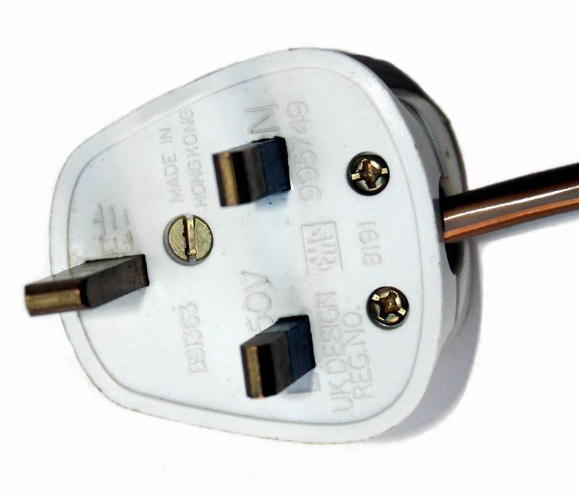
Why do computers use Binary
Computers are powered by electricity
electricity can be in two states
ON Or OFF

Slide 5
Why do computers use Binary
By repeatedly turning the electricity on and off computers create long sequence of ON and OFF events.
We represent ON as 1 and OFF as 0.
These sequences of 1’s and 0’s (ON and OFF events) are called binary code.
ON
OFF
ON
ON
OFF
Binary Code
1 0 1 1 0

Slide 6
Why do computers use Binary
Computers can use these binary codes to
represent anything!
01000000
= “A”
01000000
= Red
010000010101011010101101010101001000001010010111101010….
=

Slide 7
Video
http://www.ictgames.com/flipCounter/mobile/index.html
Notes:
https://www.youtube.com/watch?v=kcTwu6TFZ08

Slide 8
Denary Number System
We usually use a denary number system in maths.
In a denary number system each digit is worth 10 times the digit before it.
so 3 hundreds, 2 tens and 9 units is 329 because (3*100)+(2*10)+(1*9)= 329
100,000 | 10,000 | 1000 | 100 | 10 | 1
 |  |  | 3 | 2 | 9

Slide 9
Binary Number System
Computers use a binary number system.
In a binary number system each digit is worth 2 times the digit before it.
so 1 eight, 1 four and 1 one is 13 because (1*8)+(1*4)+(1*1)= 13
32 | 16 | 8 | 4 | 2 | 1
 |  | 1 | 1 | 0 | 1

