Slide 1
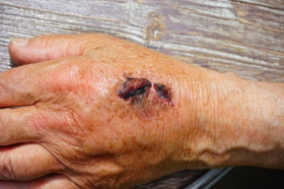
Defence mechanisms
Do now activity:
What is a ‘communicable’ disease?
How do communicable diseases spread from person to person?
What is a white blood cell? How can it protect you against disease?
Keywords
Pathogen
White blood cell
Antibodies
Antigen
Antitoxin

Slide 2
Progress indicators
GOOD PROGRESS:
- Identify the different mechanisms that can prevent pathogens from entering your body
-Describe the role of white blood cells as part of your immune system
OUTSTANDING PROGRESS:
-Explain the different mechanisms that white blood cells can employ to destroy pathogens

Slide 3
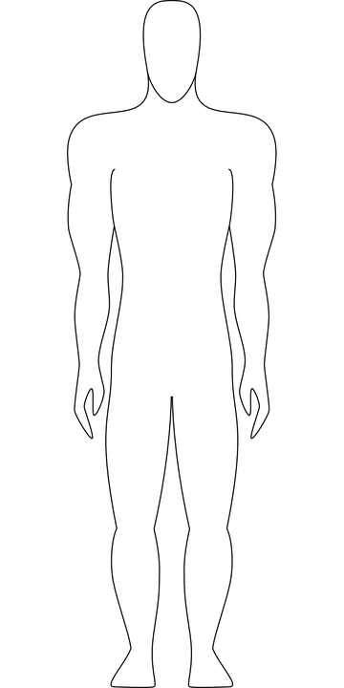
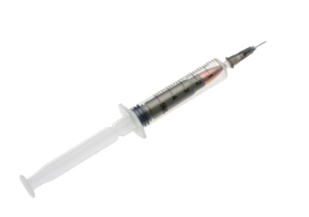

Label the diagram with ways in which pathogens can enter your body
Eyes, ears, mouth and nose!
Intravenous drug use and vaccination
Through open wounds, cuts, grazes and blisters
Sexually transmitted through bodily fluids

Slide 4
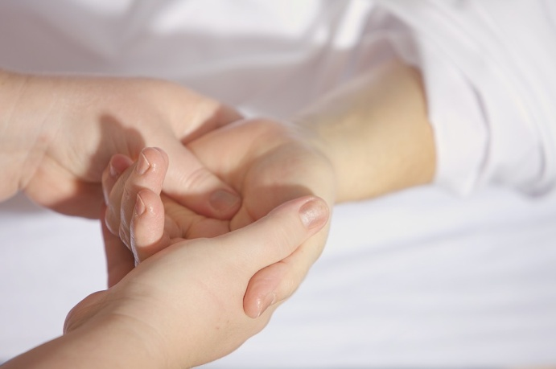
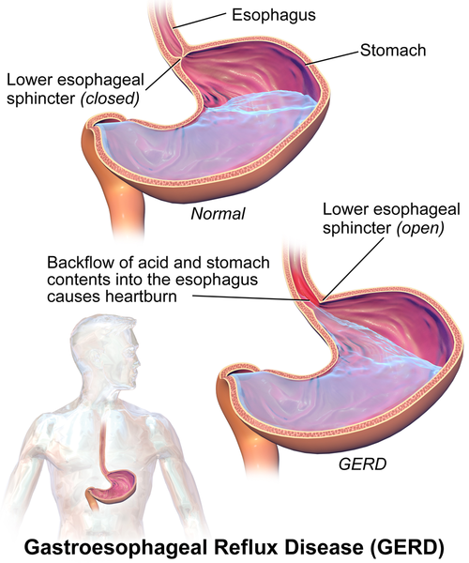

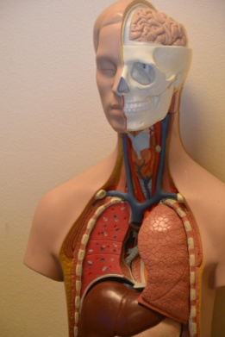
Each day you come across millions of disease-causing microorganisms. Fortunately your body has several ways of stopping the pathogens getting inside.
Can you think of any examples?
A scab can form a seal over a cut
Your skin
Stomach Acid
Breathing system produces mucus
Notes:
Image of stomach acid: By BruceBlaus (Own work) [CC BY-SA 4.0 (https://creativecommons.org/licenses/by-sa/4.0)], via Wikimedia Commons

Slide 5
Defence Mechanisms
Task: Add labels onto your body diagram to show the three main ways in which your body prevents pathogens getting in.
barrier
mucus
skin
scab
pathogen
clot
Green – 5/6 words Amber – 3/4 words Red – 1/2 words
Extension: Complete question 2 on page 33

Slide 6
Some pathogens still manage to get inside your body. Once there they meet with your second line of defence – the white blood cells of your immune system.
White blood cell
White blood cell
Antitoxin
Antibody
Bacterium
Toxin
Antigen
Take in pathogens and destroy them
Bacterium
Some produce antitoxins which cancel the toxins released from pathogens
Special chemicals called antibodies target pathogens and kill them
Phagocytes
Lymphocytes

Slide 7
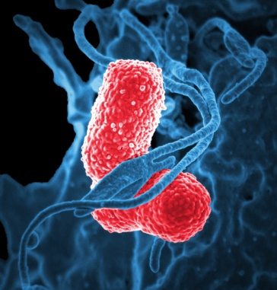
Task: Watch the parts 1-2 of the animation and answer the following questions:
How does bacteria make us ill?
How do viruses spread within the body?
Name two examples of white blood cells
How do phagocytes help to defeat pathogens?
How do lymphocytes help to defeat pathogens?
http://www.bbc.co.uk/schools/gcsebitesize/science/aqa_pre_2011/human/defendingagainstinfectionact.shtml

Slide 8

Self-assessment:
Bacteria make us ill by releasing toxins into our bloodstream
Viruses spread by invading our cells, reproducing within our cells and then bursting out and spreading throughout the body within the bloodstream
Phagocytes & lymphocytes
Phagocytes defeat pathogens by ingesting them and releasing enzymes to destroy the pathogen
Lymphocytes multiple and produce lots of antibodies to destroy the pathogen.

Slide 9
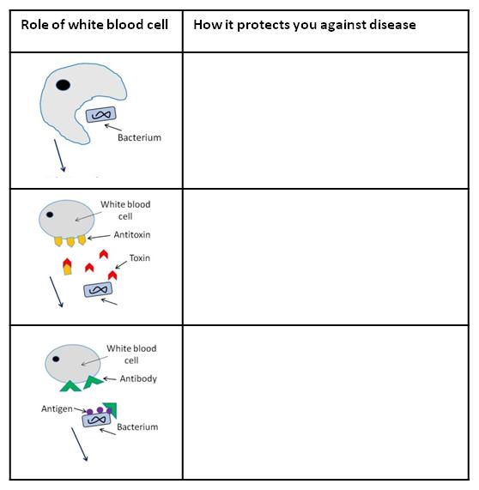
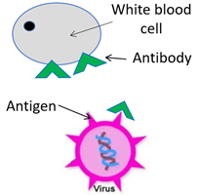
Task: Fill in the table with information on how white blood cells protect you against disease
antitoxins
pathogens
antibodies
destroying
bacteria
toxins
white blood cells
viruses
Extension: Describe what you think would happen if we didn’t have white blood cells?

Slide 10

Self-assessment:
Phagocytes are white blood cells which engulf (take in) pathogens and destroy them
Some white blood cells called lymphocytes produce antitoxins which attach to toxins released from bacteria and prevent them from damaging the body
Lymphocytes can also produce antibodies to attach to antigens on the outside of pathogens to prevent them damaging cells
Extension: If we didn’t have white blood cells then pathogens would ALWAYS make us ill and we would also never get better

Slide 11
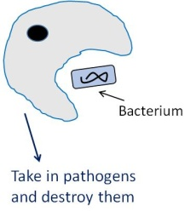
Plenary – Exit Card
Task: Fill in your exit card, write your name on it and make sure you hand it to the teacher as you leave
Three facts I learnt today are…
One thing I didn’t understand was ….
A quiz question for my peers is…

Slide 12
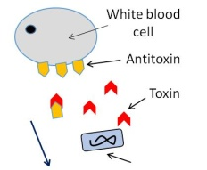
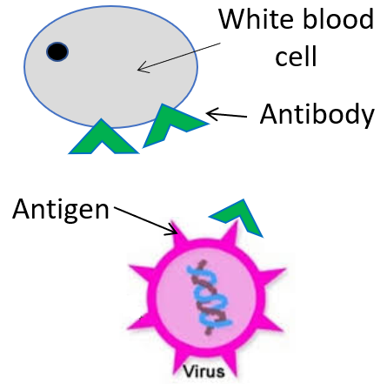
Role of white blood cell | How it protects you against disease
Role of white blood cell | How it protects you against disease
pathogens
antitoxins
pathogens
antitoxins
antibodies
antibodies
antigen
toxins
white blood cells
white blood cells
toxins
bacteria
bacteria
destroy
destroy
antigen

