Slide 1
Do Now Activity
An investigation is carried out to determine the effect of caffeine on reaction time in a group of students. This investigation uses the ruler drop test to determine reaction time.
What would be the independent and dependent variables in this investigation?
What 3 things would you need to control? BE SPECIFIC, THINK – what will affect the results if you don’t control it?

Slide 2
Learning Indicators:
Good progress:
Apply your understanding of the plant responses and field investigation practical’s to examination questions.
Outstanding progress:
Explain how we measure precision of results in science and the significance of standard deviation.

Slide 3



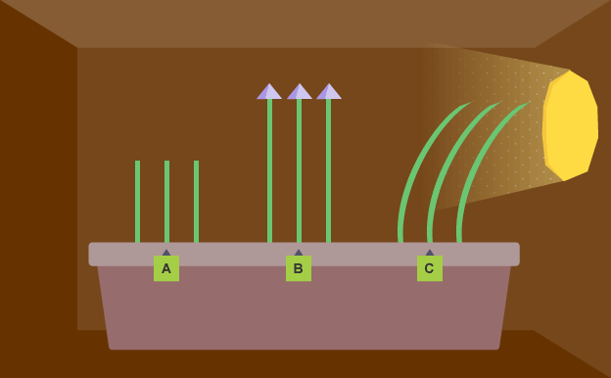
Plant Responses (Triple)
Plant Response Videos

Slide 4
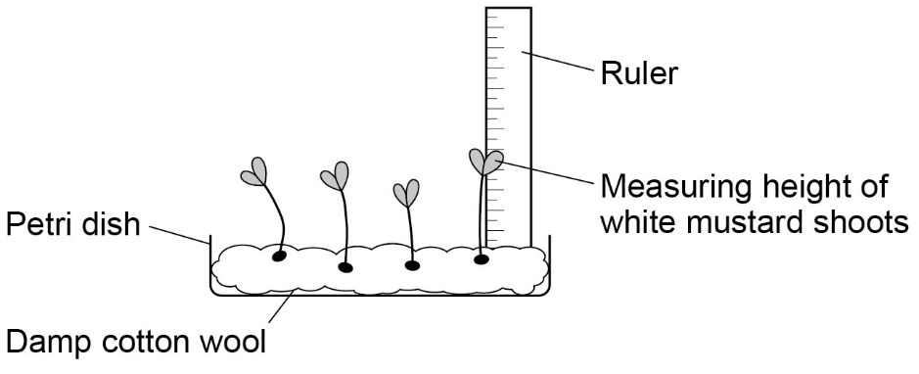
8. Plant Responses (Triple)
Aim: Investigating the effect of light intensity on the growth of mustard seedlings
Apparatus:
white mustard seeds
petri-dishes
cotton wool
a ruler
water
access to a light windowsill and a dark cupboard
Day | Height of seedling in full sunlight in mm
 | 1 | 2 | 3 | 4 | 5 | 6 | 7 | 8 | Mean
1
2
3
4
5
6
7
Safety:
Wash hands after handling seeds

Slide 5
Plant Responses – Quick Questions
What term is used to describe a growth movement in plants?
What chemicals control growth movements in plants?
What is the name of the hormone that controls phototropism and gravitropism?
When investigating the effect of light intensity on the growth of mustard seedlings, list two variables that need to be controlled to make this investigation fair.
What would be the dependent variable in this investigation?

Slide 6
Plant Responses – Quick Questions - Answers
What term is used to describe a growth movement in plants?
What chemicals control growth movements in plants?
What is the name of the hormone that controls phototropism and gravitropism?
When investigating the effect of light intensity on the growth of mustard seedlings, list two variables that need to be controlled to make this investigation fair.
What would be the dependent variable in this investigation?
Tropism
Auxins / Plant hormones / Growth hormones
Auxins
Type of seed / Nutrients / Volume of water given / Number of seeds
Height of seedlings

Slide 7
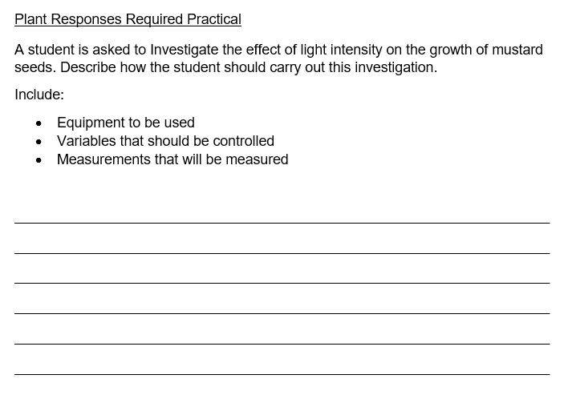
Plant Responses – Exam Style Questions
6 Marks

Slide 8
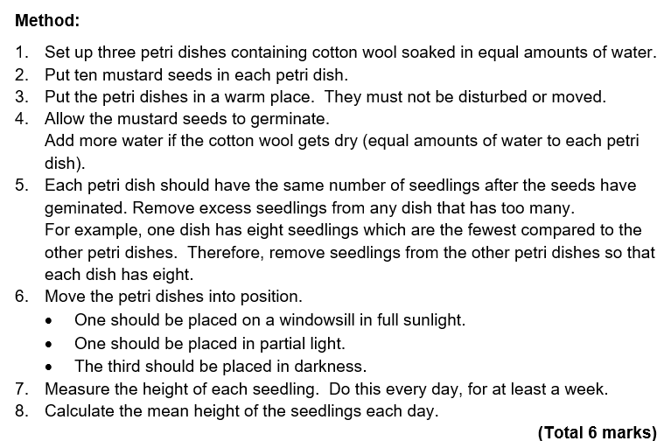
Plant Responses – Exam Style Questions - Answers
Level 3 (5–6 marks): A coherent method is described with relevant detail, which demonstrates a broad understanding of the relevant scientific techniques and procedures. The steps in the method are logically ordered. The method would lead to the collection of valid results.
Level 2 (3–4 marks): The bulk of a method is described with mostly relevant detail, which demonstrates a reasonable understanding of the relevant techniques and procedures. The method may not be in a completely logical sequence and may be missing some detail.
Level 1 (1–2 marks): Discrete relevant points are made which demonstrate some understanding of the relevant scientific techniques and procedures. They may lack a logical structure and would not lead to the production of valid results.
0 marks: No relevant content.
6 Marks

Slide 9
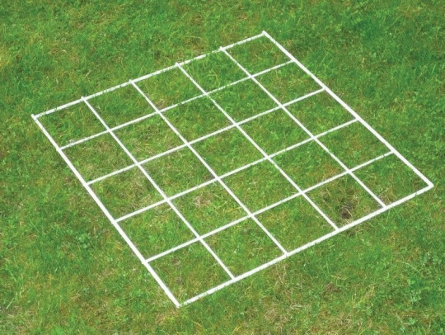
Field Investigations
Quadrats and Sampling

Slide 10
Field Investigations
Aims:
1. Investigating the population size of a plant species using random sampling.
2. Investigating the effect of a factor on plant distribution using a transect line.
Apparatus:
a 25cm x 25cm quadrat
2 x 30 m tape measure
a clipboard
a pen
Paper
Optional: Identification charts and pencil
Safety:
Consider the safety aspects of your chosen site, such as poisonous plants, animal faeces or open water and take appropriate precautions while working.
Wash hands after investigation.

Slide 11
Field Investigations – Quick Questions
Environments are sometimes sampled along a straight line.
What is such a line called?
2. Two students visited two locations and measured the lichens on nine trees in each place. Their results are below.
Calculate the mean for each location. Give your answer to one decimal place.
3. A student wants to investigate the population size of daisies in trampled and un-trampled parts of a school field, what variables should be controlled in this investigation?
Location | Tree 1 | Tree 2 | Tree 3 | Tree 4 | Tree 5 | Tree 6 | Tree 7 | Tree 8 | Tree 9
London | 4 | 6 | 11 | 13 | 4 | 2 | 6 | 2 | 4
N. Wales | 21 | 13 | 18 | 7 | 16 | 2 | 5 | 19 | 1

Slide 12
Field Investigations – Quick Questions - Answers
Environments are sometimes sampled along a straight line.
What is such a line called?
2. Two students visited two locations and measured the lichens on nine trees in each place. Their results are below.
Calculate the mean for each location. Give your answer to one decimal place.
3. A student wants to investigate the population size of daisies in trampled and un-trampled parts of a school field, what variables should be controlled in this investigation?
Transect Line
Location | Tree 1 | Tree 2 | Tree 3 | Tree 4 | Tree 5 | Tree 6 | Tree 7 | Tree 8 | Tree 9
London | 4 | 6 | 11 | 13 | 4 | 2 | 6 | 2 | 4
S. Wales | 21 | 13 | 18 | 7 | 16 | 2 | 5 | 19 | 1
London mean = 5.8 South Wales mean = 12.9
Type of species / Size of quadrat

Slide 13
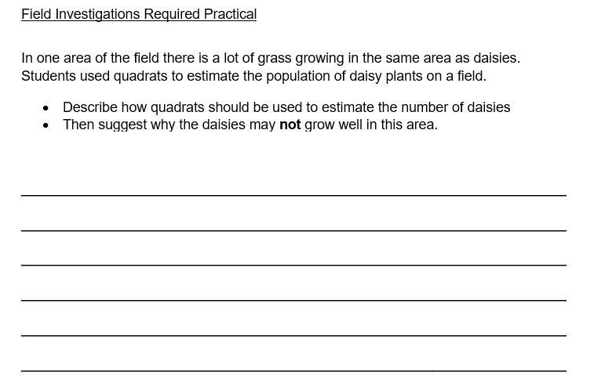
Field Investigations – Exam Style Questions
7 Marks

Slide 14
Field Investigations – Exam Style Questions - Answers
Level 3 (5-7 marks): A very detailed and coherent description is given as to how quadrats are used and an explanation is given which makes logical links between clearly identified relevant points as to why daisy growth may be limited.
Level 2 (3–4 marks): A detailed and coherent explanation is given. Logical links between clearly identified relevant points are made to explain why daisy growth may be limited.
Level 1 (1–2 marks): Discrete relevant points are made. The logic may be unclear.
0 marks: No relevant content
7 Marks

Slide 15
Standard Deviation in Science
Standard deviation is an important measure of spread or dispersion.
For example, the following two data sets are significantly different in nature and yet have the same mean, median and range. Some sort of numerical measure which distinguishes between them would be useful.
1, 7, 12, 15, 20, 22, 28
1, 15, 15, 15, 15, 16, 28
The standard deviation of the first set of data is significantly larger than the standard deviation of the second set of data (ie there is more spread about the mean in the first set of data).

Slide 16
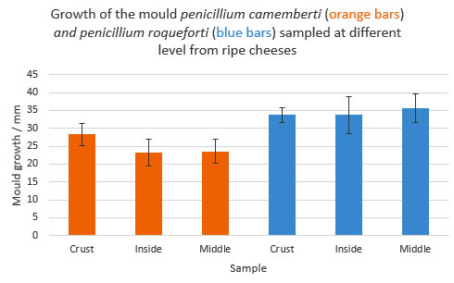
Example
Standard deviation is an important measure of spread or dispersion. It tells us how far, on average the results are from the mean. Therefore if the standard deviation is small, then this tells us that the results are close to the mean, whereas if the standard deviation is large, then the results are more spread out.
THIS CAN HELP WITH DECIDING HOW PRECISE RESULTS ARE!
Growth of the mould P.roqueforti is significantly more in the inside of ripe cheese than the growth of P.camemberti is in the crust of ripe cheese.

