Slide 1
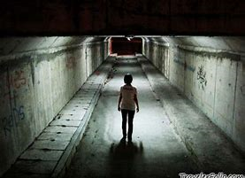
The Writing Strategy
Lesson One
C/W
Title
Underline
Date
Adverb = a word that describes how the action (verb) is completed.
Running wildly (wildly is how they are running so it is an adverb).
DNA: Do now activity.
5 minutes.
Write down as many sophisticated adverbs as you can.
Use an adverb to start a single sentence which describes the person in this image.

Slide 2
C/W Date
Lesson Title: Overview
Lesson Focus: evaluate the ways ideas, viewpoints and themes may be interpreted according to perspective
Progress indicators:

Slide 3
Word Consciousness – Write down these two words, and your own definition of them.
Word and definition | Your definition or synonyms
Cyclical (adjective) occurring in cycles; recurrent
Description (noun) a spoken or written account of a person, object, or event.

Slide 4
Learning Journey
So far this term we have been focusing on the reading section.
What skills did the writer’s use to structure their piece?
Today we are going to apply our understanding of structure to the structure you will expected to use for Paper 1 Q5.

Slide 5
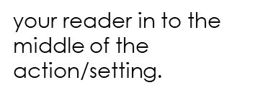
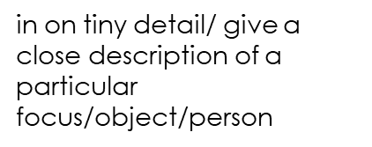

Writing sections
Drop
Zoom in
Zoom in
Shift
Zoom out
On the left hand side are explanations of the structure we want you to use when you are describing something.
TASK - Read through the descriptions of each section and then on the next slide watch the ALMA short video and fill in the table – identify what is happening during the drop, zoom in, zoom in, shift, zoom out sections.
This pattern may be repeated more than once so be prepared to make LOTS of notes.
in on another tiny detail
your perspective, time or location.
Notes:
https://www.youtube.com/watch?v=irbFBgI0jhM

Slide 6

ALMA – watch the film and fill in the grid. The youtube link is in the notes at the bottom of the screen.
Alma Short film:
Drop
Zoom in
Zoom in
Shift
Zoom out
Task:
Fill in the grid with descriptions of what happened in each section.
Challenge: looking back were there any hidden clues?
When you have had a go look at the suggested answers on the next slide.
in on another tiny detail
your perspective, time or location.
Notes:
https://www.youtube.com/watch?v=irbFBgI0jhM

Slide 7
ALMA:
Alma Short film:
Snow was falling over the city of houses and through the streets. The setting appears picturesque and beautiful.
Next the clip zooms in on a character Alma who is skipping through the streets
Alma focuses on a whiteboard and looks in the shop window whilst being outside. Alma is intrigued by a doll almost identical to herself.
Shifts to inside the shop, where we see all the dolls etc
Zoomed in on the doll on the bicycle trying to escape and Alma reaching to touch her own doll. Linked back to the start as it repeated the beginning with a new doll/child. (cyclical structure)
Drop
Zoom in
Zoom in
Shift
Zoom out and link
Top mark students craft their writing to show structure. We will all be expected to use and practise using Drop, Shift, Zoom & Link.
in on another tiny detail
It does not have to be paragraphs and paragraphs and paragraphs and paragraphs.
It is all about quality over quantity.
your perspective, time or location.

Slide 8
These are the assessment objectives for this question. Read through them carefully.
AO6: Candidates must use a range of vocabulary and sentence structures for clarity, purpose and effect, with accurate spelling and punctuation
AO5: Communicate clearly, effectively and imaginatively, selecting and adapting tone, style and register for different forms, purposes and audiences. Organise information and ideas, using structural and grammatical features to support coherence and cohesion of texts

Slide 9
Assessment Objectives – what sort of skills do you think you need to show for each AO? Add to the lists below.
A05 | A06
Adverbs Metaphor | Sentence types Paragraphs Shifts

Slide 10

Drop
Drop
Have a go at planning two sets of drop to zoom sequences based on the image below.
Shift
Shift
Zoom in
Zoom in
Link
Link

Slide 11
Descriptive Writing AO5
Now read through this example.
Drop – Billowing ash clouds enshrouded the sky over his head. He charged violently through the open space. Darting in and out of explosions, his face was steeled with concentration as he rushed towards anything that resembled a sanctuary for his fatigued body. Finally, in amongst the chaos and mayhem, he saw a spot to which he ran. He dropped down into the burrow like a dazed rabbit.
Shift – Racing through his mind were memories of the summer. When the sun beamed down on where he sat. Birds were chirping a chorus tune and, beside him, the most enchanting woman of all. In her company, he felt the warmth of summer embrace him and consume his heart. Her azure eyes, her coquettish smile – she was a goddess that made him feel as though he had arrived at God’s gates. He strained to think of her voice, the sound of her hum…
Zoom – Shells thundered around him. Fire blasted in front of him. Sending him back to the hole in which he cowered. He slowly peeped his head up. Swivelling around, he could see the battlefield. Grass frazzled from heat. Blown body parts, possibly of friends, were heaped together in tight bundles.
Link – He lifted himself up from the dirt and found all of the strength within him to bolt once more towards the enemy lines. He ran. Heart heavily beating against his chest. Breathing rapidly. He ran and ran. Until eventually his figure had been lost in the gulf of ominous ash clouds that enveloped the field.

Slide 12
Over to you
Your turn now:
Think of an example of something you have watched and identify the Drop, Shift and Zoom Out within it
This can be a section of a film, a TV series or even a novel you have read.

Slide 13
DNA: Each of the sentence below starts with a feeling. Complete the last three in the style of the first one.
Lesson Two
Lonely, she walked the corridor.
Elated,...
Jealous, ...
Angry, …

Slide 14
C/W Date
Lesson Title: Drop
Lesson Focus: exploit the full range of structures, style and links to achieve specific effects
Progress indicators:

Slide 15
Word Consciousness – Write down these words, and your own definition of them.
Word and definition | Your definition or synonyms
ominous (a) – giving the worrying impression something bad will happen
billowing (v) - to fill with air and swell outwards or move/flow with an undulating motion
enshroud (v) – envelop completely/hide from view

Slide 16
Learning Journey
Last lesson we looked at the Writing Strategy and the structure you will be expected to use.
What structural elements can you remember?
Today we are going to look at how to craft the drop section.

Slide 17

Descriptive Writing AO5
Write 1 sentence to describe the weather in this image. Write it in the top left box
Now look at the criteria in the challenge box and re-write your one sentence into a short paragraph.
Some support
1 = add a connective
2 = include a simile
3 = add a piece of punctuation
4= add an adverbial phrase at the start
5= include a metaphor
6= Use a subordinate clause

Slide 18
Descriptive Writing AO5 – Annotating the Drops
All of the extract below are ‘DROPS’ where we are dropped into the description.
I have seen the tempests, when the scolding winds
Have rived the knotty oaks, and I have seen
The ambitious ocean swell and rage and foam,
To be exalted with the threatening clouds:
But never till to-night, never till now,
Did I go through a tempest dropping fire.
A soft fall rain slips down through the trees and the smell of ocean is so strong that it can almost be licked off the air.
Trucks rumble along Rogers Street and men in t-shirts stained with fishblood shout to each other from the decks of boats. Beneath them the ocean swells up against the black pilings and sucks back down to the barnacles. Beer cans and old pieces of Styrofoam rise and fall and pools of spilled diesel fuel undulate like huge iridescent jellyfish.
The sullen wind was soon awake,
It tore the elm-ops down for spite,
and did its worst to vex the lake.
I was startled to find that Eal Marsh House, too, was invisible, not because the darkness of evening had fallen, but because of a thick, damp, sea-mist that had come rolling over the marshes and enveloped everything, myself, the house behind me, the end of the causeway path and the countryside ahead. It was a mist like a damp, clinging, cobwebby thing, fine and yet impenetrable. It smelled and tasted quite different from the yellow filthy fog of London; that was choking and thick and still, this was salty, light and pale and moving in front of my eyes all the time.

Slide 19
TASK – annotate all of the drops to explore how someone else has used language and structure.
This one has been done for you.
Strong noun – better than storm to show how awful this weather is.
Adjective suggests the wind is telling off the trees and attacking them.
Adjective suggest that the ocean is trying hard to grow in side and increase in volume.
I have seen the tempests, when the scolding winds
Have rived the knotty oaks, and I have seen
The ambitious ocean swell and rage and foam,
To be exalted with the threatening clouds:
But never till to-night, never till now,
Did I go through a tempest dropping fire.
Rule of three (all verbs) show how aggressive the ocean is and how is is constantly moving and attacking.

Slide 20
Annotate the language and structure that has been used in this DROP
A soft fall rain slips down through the trees and the smell of ocean is so strong that it can almost be licked off the air.
Trucks rumble along Rogers Street and men in t-shirts stained with fishblood shout to each other from the decks of boats. Beneath them the ocean swells up against the black pilings and sucks back down to the barnacles. Beer cans and old pieces of Styrofoam rise and fall and pools of spilled diesel fuel undulate like huge iridescent jellyfish.

Slide 21
Annotate the language and structure that has been used in this DROP
The sullen wind was soon awake,
It tore the elm-ops down for spite,
and did its worst to vex the lake.

Slide 22
Annotate the language and structure that has been used in this DROP
I was startled to find that Eal Marsh House, too, was invisible, not because the darkness of evening had fallen, but because of a thick, damp, sea-mist that had come rolling over the marshes and enveloped everything, myself, the house behind me, the end of the causeway path and the countryside ahead. It was a mist like a damp, clinging, cobwebby thing, fine and yet impenetrable. It smelled and tasted quite different from the yellow filthy fog of London; that was choking and thick and still, this was salty, light and pale and moving in front of my eyes all the time.

Slide 23
The Drop:
Drop your reader into the middle of the action/setting.
Watch the Woman in Black clip.
YouTube address is in the notes at the bottom of the page if the link doesn't’t work.
Watch the clip from The Woman in Black. Make notes about what you could include into the drop section if you were writing this up.
Notes:
https://www.youtube.com/watch?v=6a55YS6nWOY

Slide 24
The Drop:
Independent Writing:
Challenge: Can you use any of the word consciousness vocabulary in your paragraph
Drop your reader into the middle of the action/setting.
Now write your drop paragraph – spend at least 10 minutes on this.

Slide 25

Review
Now look back at the sentence you wrote for this task on slide 17.
After looking in more detail at the drop can you now re-write this sentence and make it better?
TASK – have a go.

Slide 26
DNA - below are subordinate clauses which are parts of sentence which don’t make sense on their own but will add detail to other sentences.
TASK – Write a new sentence, one for each subordinate clause, where you pop the clause in and it makes sense.
CLUE – look at where the commas and capital letters are to tell you if it goes in the middle or at the start of a sentence.
Lesson Three
3. With an ape like fury,
1. ,which was sleeping,
2. ,who was ravenous,

Slide 27
C/W Date
Lesson Title: Your drop
Lesson Focus: engage a reader in a range of ways through inventive use of voice, point of view or character and establish and sustain clear, credible viewpoints on complex subjects.
Progress indicators:

Slide 28
Word Consciousness – Write down these words, and your own definition of them.
Word and definition | Your definition or synonyms
Manifesting (Verb) show (a quality or feeling) by one's acts or appearance
Melancholy (Noun) a feeling of sadness, typically with no obvious cause.
Tempestuous (Adjective) characterised by strong and turbulent or conflicting emotion.

Slide 29
Learning Journey
Last lesson we looked at the devices that could go into a drop and looked at different drops.
We then used this to help craft our own drop based on a stimulus.
Today we are going to create the drop for our creative writing image using what we learnt last lesson.

Slide 30
Your stimulus:
Watch the beginning of the scene up to O:30. What elements could you focus on in your drop? Remember not too many and make sure they link.
YouTube address is in the notes section at the bottom.
Remember to look beyond the image. What else could exist within this environment.
Notes:
https://www.youtube.com/watch?v=v2r1ZOSd--A

Slide 31
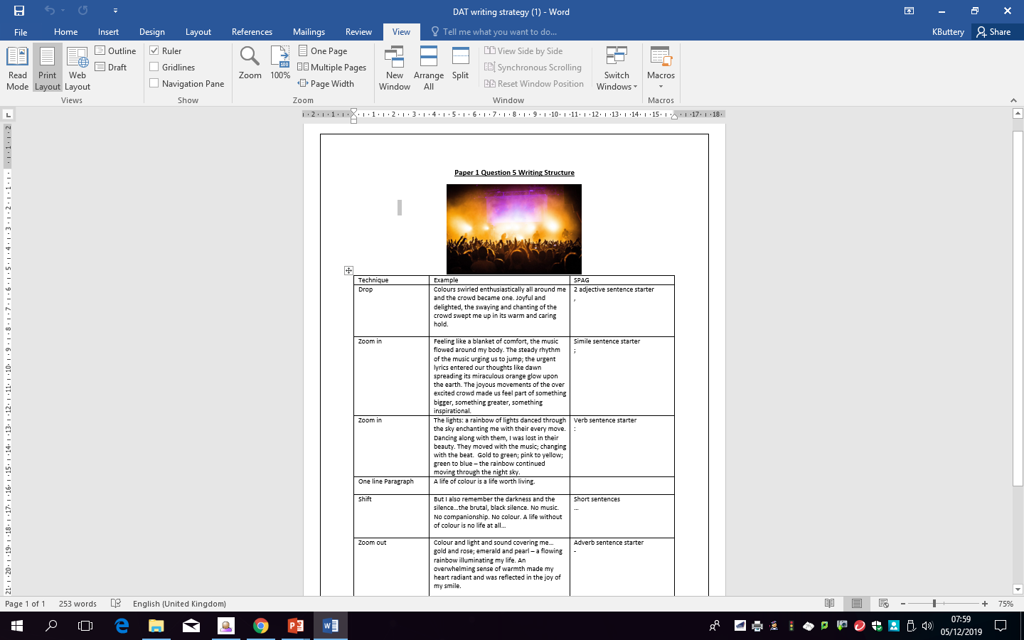
Success Criteria:
What stylistic features could you use in your drop to make it engaging?

Slide 32
Success Criteria:
Alliterative sentences.
Ambitious vocabulary
Extended metaphors to describe objects or things.
Sophisticated onomatopoeia
What stylistic features could you use in your drop to make it engaging?
Personification
Short sentences – Could start with a triadic set of short sentences.
Adverb sentence starters.
Exclamatory sentences.
Feeling sentence starters.

Slide 33
SPAG Task – below are a variety of sentences which tell us something. Your task is to turn them into ‘showing’ sentences where we show the information without telling it.
Telling Sentence | Showing Sentence
It had been raining heavily. | Deep puddles covered the path.
It was a very dark night.
There was a strong wind.
She was nervous.
He was shy.
She was very happy.

Slide 34

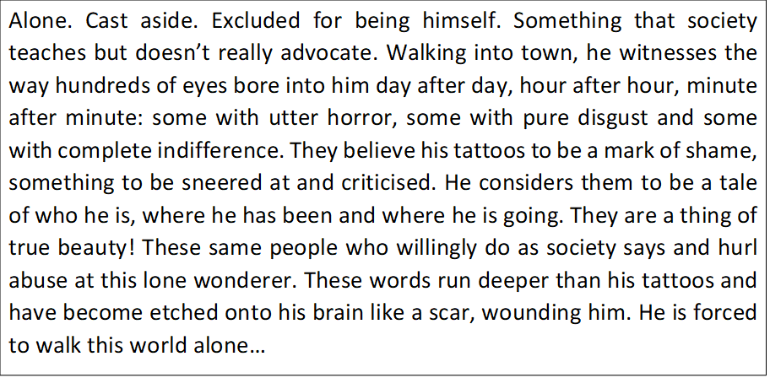
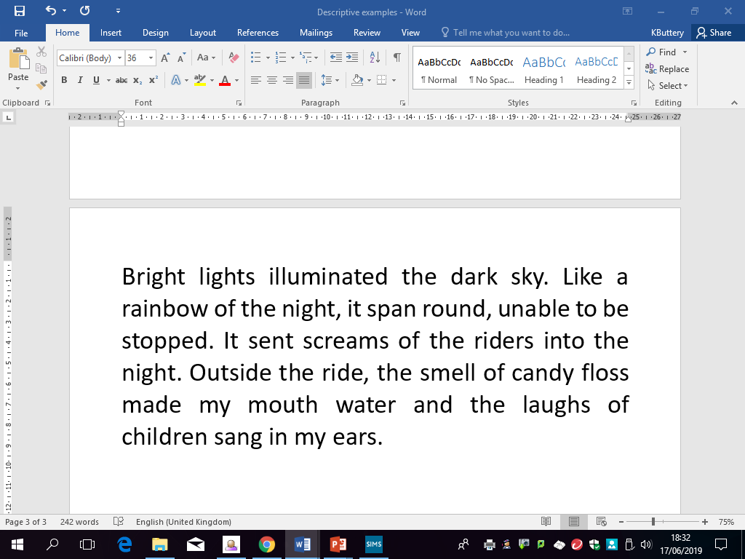
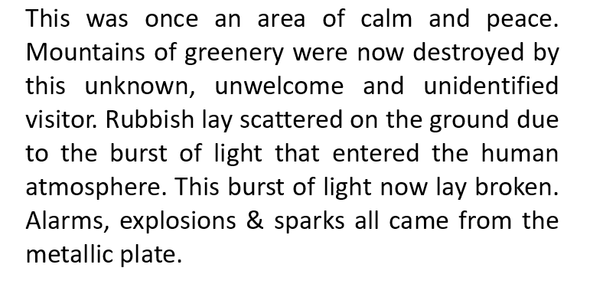
Analysing Drops:
1.
Read the three ‘DROPs’ on this slide and put them in order of which you think worst to best.
Then explain why you think this and write down what makes the best one the best, in your opinion.
2.
3.
Challenge: remember to identify the devices and the elements of show not tell!
Notes:
Examples justify the answers - keywords

Slide 35
The Drop:
Independent Writing:
Challenge: Can you use any of the word consciousness vocabulary in your paragraph
Drop your reader into the middle of the action/setting.
Re-watch the extract from Hacksaw Ridge and write a DROP where you use show don’t tell techniques.

Slide 36
Review – read your drop and decide how many of the 4 success criteria you have achieved.
Success Criteria:
I can use sophisticated vocabulary for effect.
I can drop the reader straight into the action.
I can use a variety of sentences within my creative writing.
I can use punctuation for purpose and effect.

Slide 37
DNA
TASK - Make a list of everything you have learnt about the DROP section of your writing.
Think about what it does and the techniques you can use in it.

Slide 38
C/W Date
Lesson Title: Zooming in
Lesson Focus: shape, craft and adapt sentences and punctuation from a wide repertoire of styles and types deployed by writer
Progress indicators:
Notes:
You might need 2 lessons on crafting the 2 zoom in paragraphs with your groups

Slide 39
Word Consciousness – Write down these words, and your own definition of them.
Word and definition | Your definition or synonyms
Abyss (Noun) a deep or seemingly bottomless chasm
Malevolent (adjective) having or showing a wish to do evil to others.

Slide 40
Learning Journey
Last lesson we focused on crafting the drop section of our piece.
What can you remember about going from macro to micro detail?
Today we are going to focus on one perspective/subject per zoom in paragraph. In order to do this effectively we are going to explore the importance of showing not telling within our writing.

Slide 41
Our focus: The ZOOM in

Slide 42
Your stimulus:
Watch from 0:30 – 2:00 What elements could you focus on in your 2 zoom in sections? Remember this must continue with the same tone/mood of the drop paragraph.
Make a list of ideas. You may need to watch the clip more than one. When you have written as much as you can, then have a look on the next slide for some help and suggestions.
Remember to look beyond the image. What else could exist within this environment.
Notes:
https://www.youtube.com/watch?v=v2r1ZOSd--A

Slide 43
Possible ideas – teacher support:
Zoom 1:
Zoom 2:
The monumental appearance of the ridge as an intimidating force.
The look on the young innocent men's faces.
The vigorous explosives above.
The inequality between the young men and the destructive inhuman enemy.
The ascent up the ridge towards no mans land.
The description of the ridge and the rope leading them towards doom
Could focus on one character here.
The general description of the men as one here moving in.
Notes:
https://www.youtube.com/watch?v=v2r1ZOSd--A

Slide 44
Zoom in One
:
Zoom in :
Write your first zoom in

Slide 45
Zoom in Two
:
Zoom in :
Write your Second zoom in

Slide 46
Review Task: go back to your work and try to add in the 4 criteria from below.
Success Criteria:
I can effectively use a simile sentence starter
I have used verb sentence starters for effect
I have attempted to use Semi colons for…
I have included colons for…

Slide 47
C/W Date
Lesson Title: Exploring Shifts
Lesson Focus: -exploit the full range of structures, style and links between paragraphs to achieve specific effects
Progress indicators:

Slide 48
Learning Journey
So far in our creative writing we have crafted three paragraphs.
We have created a similar tone within these 3 paragraphs.
Today we are going to look at how tone is altered or changed to have a different effect.

Slide 49
Word Consciousness – match up the technique and definitions.
Technique | Definition
1. Perspective | A particular place or position
2. Tone | The mental and moral qualities distinctive to an individual
3. Flashback | A particular attitude towards or way of regarding something; a point of view.
4. Location | A thing that happens or takes place
5. Character | The atmosphere or pervading mood of something
6. Course of events | Set in a time earlier than the main story. Or memory of an event in the past
Challenge: Can you think of anymore techniques we could use to shift the focus?

Slide 50
Word Consciousness – Answers – did you get then right?
Technique | Definition
1. Perspective | A particular attitude towards or way of regarding something; a point of view.
2. Tone | The atmosphere or pervading mood of something
3. Flashback | Set in a time earlier than the main story. Or memory of an event in the past
4. Location | A particular place or position
5. Character | The mental and moral qualities distinctive to an individual
6. Course of events | A thing that happens or takes place,
Challenge: Can you think of anymore techniques we could use to shift the focus?

Slide 51

As we watch the video, note the shifts in perception.
Note the perception of several characters.
Notes:
https://www.youtube.com/watch?v=RxPZh4AnWyk

Slide 52
From Here → To There
From here: everyone is laughing and cynically judging
Susan Boyle sings
To there: standing ovations and adulation
There are many clips which follow a similar narrative arc on these types of shows. And any dramatic scene or sequence from a book has simple shifts like this.

Slide 53
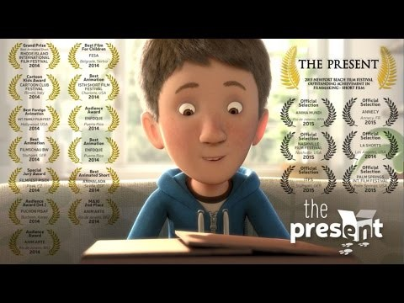
Analysing shifts:
Watch the clip and make a note of the shifts that you can spot.
Notes:
https://www.youtube.com/watch?v=WjqiU5FgsYc

Slide 54
Analysing shifts: Write a short paragraph answering the questions in the box below.
Why was this shift so important? What did it do to the audience and why did the creator wait until the last clip to reveal the key piece of information about the boy?
Ultimately what can a really good SHIFT do to the audience?
Notes:
https://www.youtube.com/watch?v=WjqiU5FgsYc

Slide 55

Plan your shift:
Use ‘The Present’ & Susan Boyle’s X Factor journey to help inform how to plan for your own shift in your Hacksaw Ridge piece of writing. Watch from 2:00:- 4:00
Perspective
Flashback
Time
Location
Focusing on different characters or objects
Attitude of the narrator/a character towards something or someone
Course of events

