Slide 1
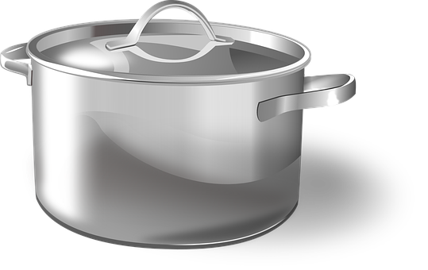
Energy Transfer: Particles
Do now activity: Describe the difference between ‘temperature’ and ‘energy’

Slide 2
Progress indicators
GOOD PROGRESS:
Recall the definition of a conductor
Describe how energy is transferred by particles in conduction and convection.
OUTSTANDING PROGRESS:
Explain how an insulator can reduce energy transfer.

Slide 3
What is a conductor?
A conductor is something that lets heat energy flow through it. When heat energy travels through solids. This is called conduction.
Some materials are better heat conductors than others, a poor heat conductor is called an insulator.
Task: Can you name some examples of materials which make:
good conductors of heat
good insulators

Slide 4
Conductors and Insulators
Metals are good heat conductors
Air is a good insulator if it is trapped. The feathers on birds trap air to keep the bird warm.
An insulator is a material which is a poor conductor, energy is transferred very slowly through an insulator.

Slide 5
Particles & Conduction
When a solid is heated the particles gain energy and vibrate more. The particles bump into each other & pass the energy on.
Discuss: Conduction occurs best in solids – why do you think that is?

Slide 6
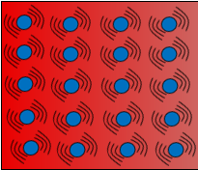
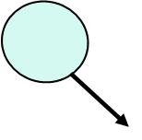
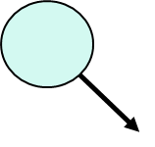
Discuss: Conduction occurs best in solids – why do you think that is?
Conduction occurs best in solids because the particles are very close together.
Conduction does not occur very well in liquids and hardly occurs at all in gases because the particles are a long way apart.

Slide 7
Task: Draw a cartoon strip of an object being heated up, include a zoomed in section to show what is happening to the particles in the object as more heat energy is applied.

Slide 8
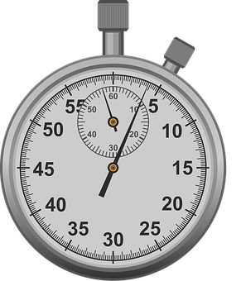
Investigate: Testing conductors
Equipment:
Different rods – copper, wood, plastic, iron, zinc.
Bunsen burner & heatproof mat
Tripod
Stopwatch
Safety clip
Petroleum jelly
Method:
Set up the apparatus up as shown opposite.
At the end of one of the rods attach a safety clip using petroleum jelly.
Heat the other end of the rod with a Bunsen burner and measure the time taken for the drawing pin to fall off.
Repeat with the other types of rod.
Which is the best conductor? Which is the worst?

Slide 9
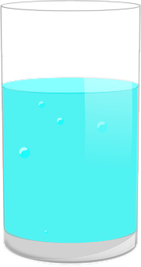
Particles & Convection
Task: Watch the video and complete the following questions in your books:
Describe the process of convection
Where does convection take place?
Describe the pathway hot and cold particles take when moving in a convection current.
Draw an example of this in your books.

Slide 10
Self-assessment:
Convection is how heat energy travels in moving currents.
Convection takes place in liquids and in gases.
When particles become hot, they gain heat energy and start to vibrate more. This means they spread out and become less densely packed together. The hotter particles rise up through denser and cooler water particles, the cooler water particles then sink to the bottom where they then get heated up.
An example:

Slide 11
Task: Draw a cross-section of a room in a house with a radiator on.
Show how a convection current might occur with the air particles in this room
Include:
Arrows to show the direction in which heat energy is being transferred
Labels to show cold air & hot air
Extra Challenge: Include extra additional labels to explain what is happening at each stage.

Slide 12
Self-assessment:
Cold air
Hot air

Slide 13
Plenary – What did you learn this lesson?
3 facts
3 key words
1 question to test your peers

