Slide 1
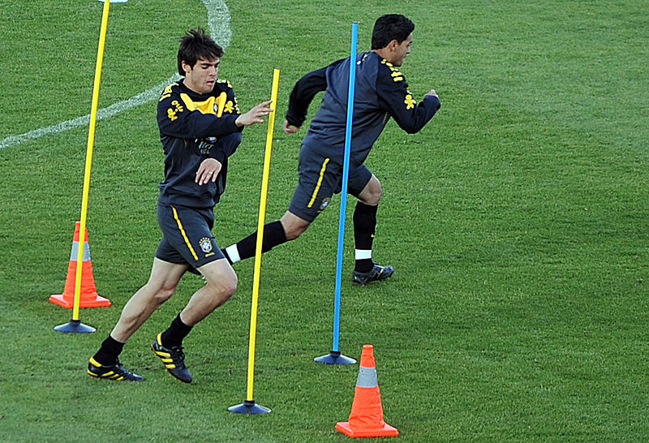
What are you learning about today?
Notes:
Teachers will strategically work with their students to develop a climate that is conducive to learning. It will include consideration of 3 main areas:
The physical environment
The social/emotional environment
The intellectual environment

Slide 2
Title: Revision – Injuries
DO NOW…
Name 2 soft tissue injuries (2) Strain, T Elbos, G Elbow, abrasion
Name 2 ways of reducing the risk of injuries (4) Protective equipment, check facilities, adherence to rules, P traininig
What is an example of an abrasion (1) cut/graze to the skin/blister
Give two examples of a fracture (2) simple/compound/greenstick/stress
What drug will help a boxer get down to a lower weight category (1) Diuretics
What drug will give you more red blood cells (1) EPO
A high jumper has injured his ankle, what drug may he take so he can continue? (1)
. Which PED masks pain? (1) Narcotic analgesics
What is the aerobic threshold for exercise? (2) 60-80% MHR
What is the anaerobic threshold for exercise? (2) 80-90% MHR

Slide 4
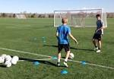
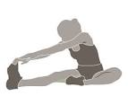
Warming Up & Cooling Down
Progress Indicators
Good Progress
Recall the phases of a warm up & cool down
Recall the benefits of a warm up and cool down
Outstanding Progress
Recall the phases and benefits of a warm up and call down giving examples of each in a sporting context
Notes:
Teachers explicitly share the purpose of the lesson/s with their students so that the students are in no doubt as to what is expected of them during the lesson. The teacher will:
Make the content, skills and thinking explicit
State clearly what the students will have learned by the end of the lesson
Share the criteria against which the learning will be assessed.

Slide 5
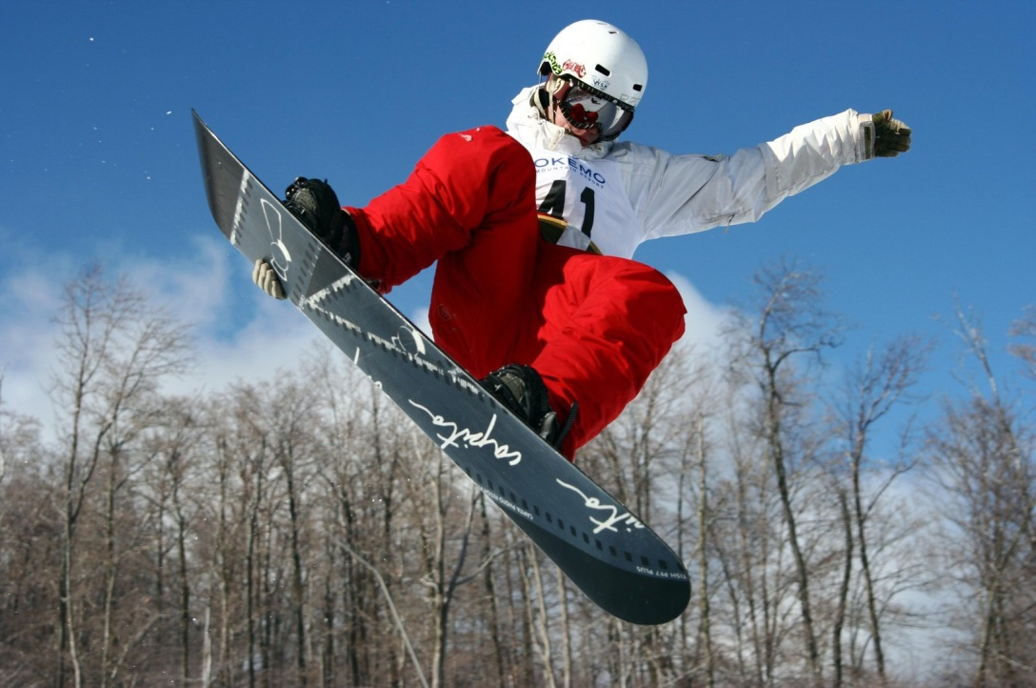
Understanding the exercise session
A training or exercise session should consist of:
A warm up – prepare the body for activity
Main activity/session/sport
Cool down – to return the body to a resting state
All performer should prepare well for exercise. A thorough warm up is vital to prepare the mind and body.
Notes:
Now students will be presented with or introduced to the new information that they are required work with. Teachers need to consider what will be the best way to present the information so that it provides for maximum inclusion of the students.

Slide 6
What is the benefits of a warm up?
Reduces risk of Injuries
Stretching the joints and muscles helps to reduce the chance of injury.
Increases Core Temperature
Gentle activity raises the body’s core temperature.
Prepares the Mind
Improve concentration, motivation for activity
Gradually increases heart rate.
What does each picture trying to say?

Slide 7
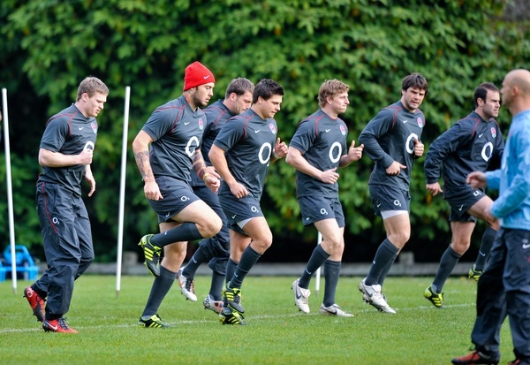
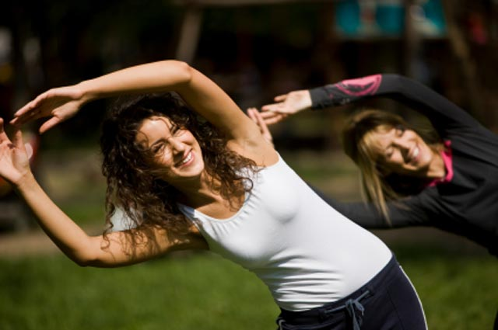
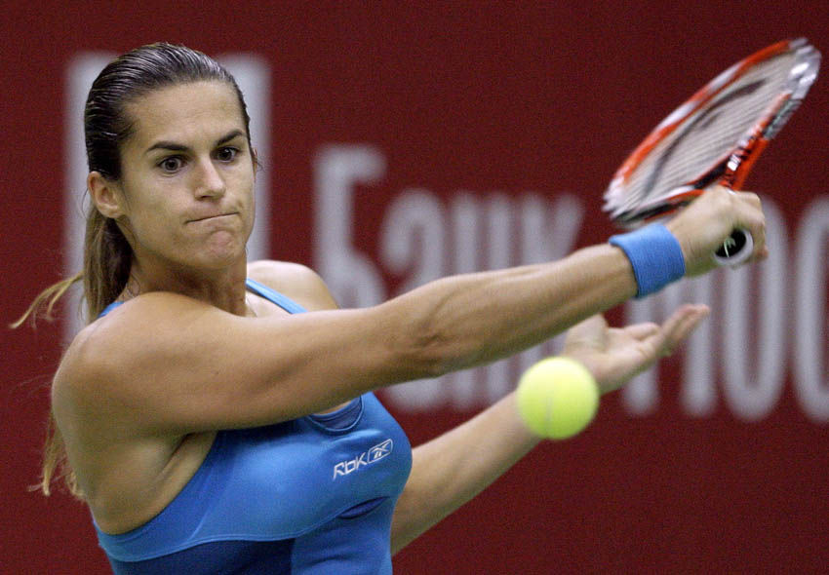
What are the three phases of a warm up?
A warm up should last at least 10 minutes and consist of:
1: Pulse raiser
Involves gentle jogging, running and sprinting.
2: Stretches
Increase range of movement at the joint
3: Exercise Specific Drills
Drill/activities that prepare you for your activity. Examples:
Passing in football, shooting in netball, dribbling in basketball, volley shots in tennis

Slide 8
What is the benefits of a cool down?
Reduces Soreness and Stiffness Stretching helps prevent the joints and muscles becoming sore and stiff.
Stops blood pooling – keeps blood circulating and slowly returns
Removes Lactic Acid
Continuing gentle movement reduces the build up of lactic acid.
The following reasons highlight the importance of a cool down at the end of any exercise session:

Slide 9
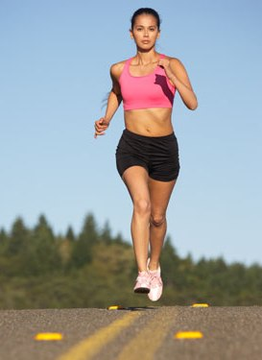
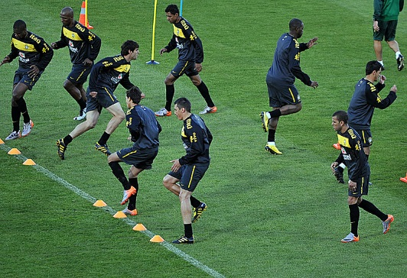
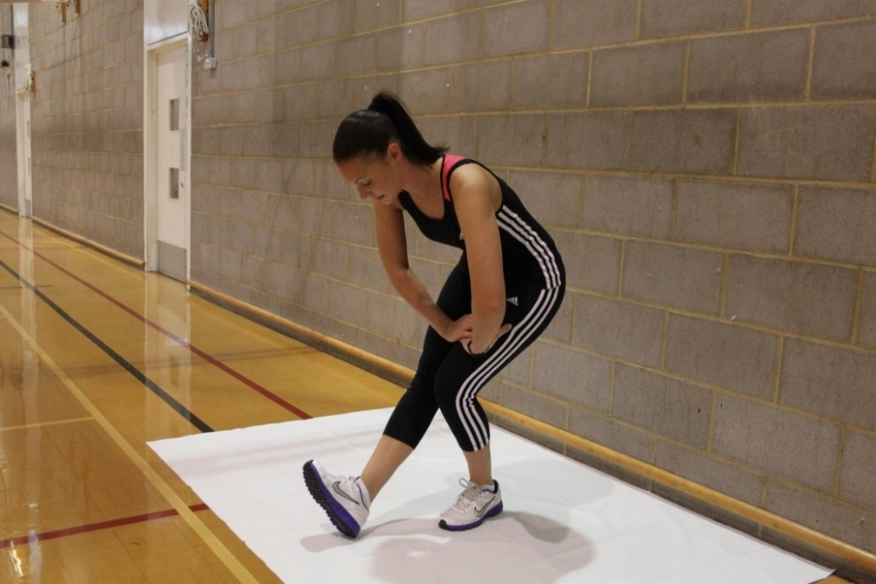
The Phases of a Cool Down
The cool down is the final part of any session. It allows the body to slowly return back to normal.
1 The first part is gentle aerobic work.
i.e. Gentle walking and jogging.
2 The second part is gentle stretching exercises of all the major joints and muscles of the body.
A cool down will return the body to a complete resting state. Gentle stretching will remove lactic acid and prevent muscles cramps.
A cool down will also prevent DOMS
(delay onset muscle soreness)

Slide 10
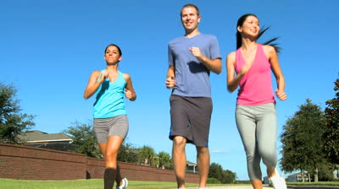
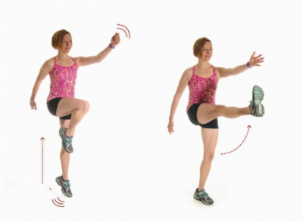
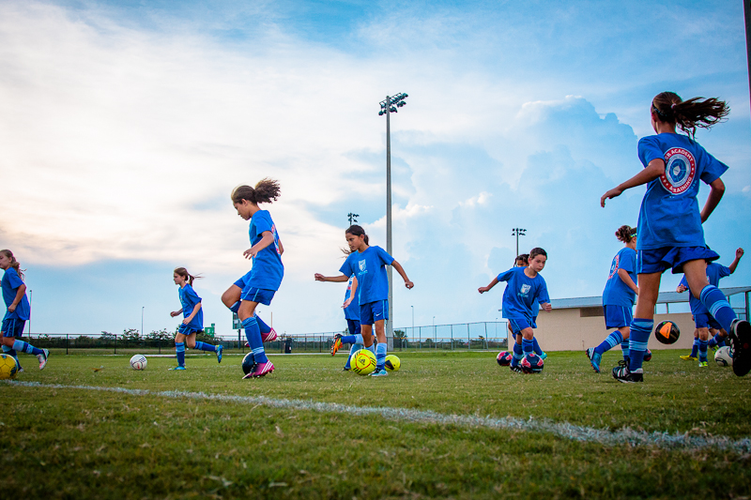
Warm up and Cool Down example
Billy is a 15 year old rugby player who plays district football. Here is his typical pre game routine
Stage 1: Pulse raiser
Involves gentle jogging, skipping, side stepping and gentle sprints x3.
Stage 2: Stretches
From head to toe the body needs to be stretched including all major muscle groups. These may be static (still) stretches or dynamic (movement based)
Stage 3: Exercise Specific Drills
Players use a ball to dribble, pass and shoot in order to ready the body for a game.
Notes:
Students are given the time and opportunity to develop understanding of the new information and to practice using their developing skills. The students are actively engaged in exploring the content. At this time it would be common for them to be working in groups, talking with each other about, their work quite often making errors but most of all working towards building a personal understanding what they have been presented with.

Slide 11
Apply it!
Answer TWO questions of different colours in your books:
Challenge yourself but make it count!!!!
Warm up and Cool Down
Describe 2 reasons for a warm up and cool down (2)
Using examples, identify the 3 phases of a warm up. (6)
Explain how the cool down part of a session should be conducted and why it is important. (2)
Describe a typical warm up for a hockey player prior to a match. (3)
Notes:
Students are participating in a task or tasks that will allow them to demonstrate their developing understanding of the content that was presented. During this time teachers and students may be involved in assessing and evaluating the outcomes of the students’ learning. Over time there should be a variety of techniques and methods used to determine the levels of achievement

Slide 12
Review it!
Exam questions
Which one of the following is a not a benefit of a warm up? (1)
A Increases muscle temperature
B Increases skill level
C Prepares the mind
D Reduces the chance of injury
2. (i) Give two reasons why a warm up should be used before a performance. (2)
Reason 1
..........................................................................................................................................................................................................................................
Reason 2
..........................................................................................................................................................................................................................................
Notes:
Reviewing is a critical element in the process of teaching and learning as it is at this point that teachers can challenge the students to make their learning explicit. Although Review is the last of the elements of the cycle to be described, it should not be seen as coming only at the end of a lesson. It is useful to include different review opportunities throughout every lesson so that teachers and students can identify challenges and supports, and strengths and weaknesses. Review is a significant part of developing metacognitive awareness.

Slide 13
Review it!
Marks Scheme:
B
Any from the following;
* gradually increases heart rate,
* increase core muscle temperature,
* prepares the mind
* reduces the chance of injury.

