Slide 1
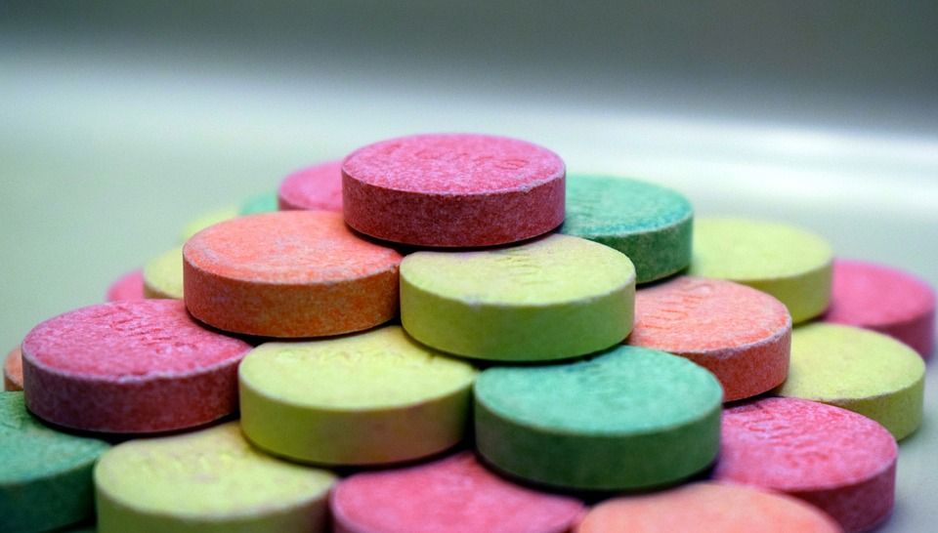
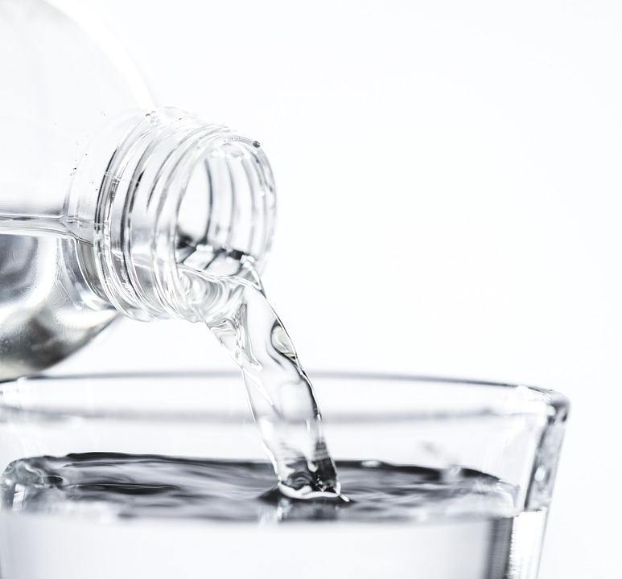
Neutralisation
Do now activity: Explain why a universal indicator is better than litmus paper for informing us about acids & alkalis
Notes:
The author of this website quoted above. [CC BY-SA 4.0 (https://creativecommons.org/licenses/by-sa/4.0)]

Slide 2
Progress indicators
GOOD PROGRESS:
State examples of useful neutralisation reactions
Describe how pH changes in neutralisation reactions
OUTSTANDING PROGRESS:
Explain how to investigate pH changes during neutralization reactions

Slide 3
Recap: The pH scale
What are indicators used for?
What would the pH be for a :
Strong acid
Weak alkali
Strong alkali
Indicators can be used to find out whether a solution is acid, alkaline or neutral
Universal Indicator can be used to find the pH of a solution
Acid – red, pH less than 7
Neutral – green, pH = 7
Alkali – blue/purple, pH greater than 7
Neutral
Strong acid
Weak acid
Weak alkali
Strong alkali

Slide 4
Task: Sort the following substances into two columns – acids and alkali
Notes:
All teachers must Model and Teach this section i.e. go through the activity, model and teach students the main concepts and CHECK their understanding

Slide 5
Self-assess your work:
Acid Alkali
Battery acid
Bee sting
Distilled water
Fizzy drink
Lemon juice
Milk
Damp skin
Washing up liquid
Vinegar
Egg white
Blood
Wet indigestion powder
Kitchen cleaner
Oven cleaner
Toothpaste
Washing powder
Washing soda
Wasp sting

Slide 6
Neutralisation
When you react acids with alkalis, a neutralisation reaction takes place. The acid is cancelled out by the alkali.
In a neutralisation reaction, a salt and water are produced
sodium hydroxide
pH 14
neutralisation
hydrochloric acid
pH 1
sodium chloride
pH 7

Slide 7
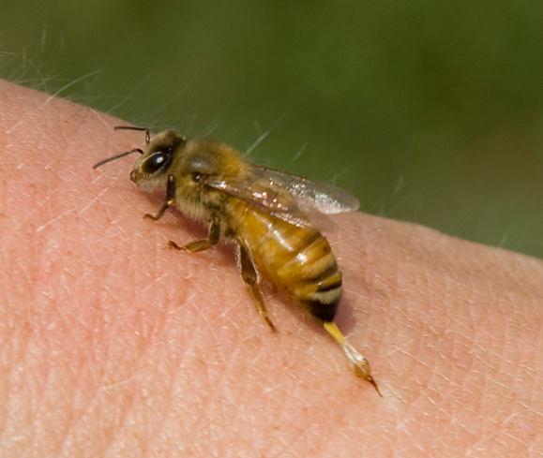
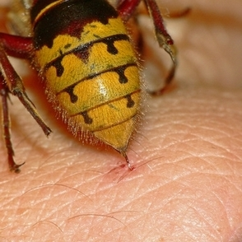
Task: Write the following questions into your books and leave space to write your answers:
Is a wasp sting acidic or alkaline?
Is a bee sting acidic or alkaline?
Why do we have hydrochloric acid in our stomach?
What is the word equation for a neutralisation reaction:
https://www.youtube.com/watch?v=_cB2vSaalXg

Slide 8
Self-assessment:
A wasp sting is slightly alkaline.
A bee sting is slightly acidic.
We have hydrochloric acid in our stomach to aid with digestion.
Acid + Alkali → Salt + Water
:

Slide 9
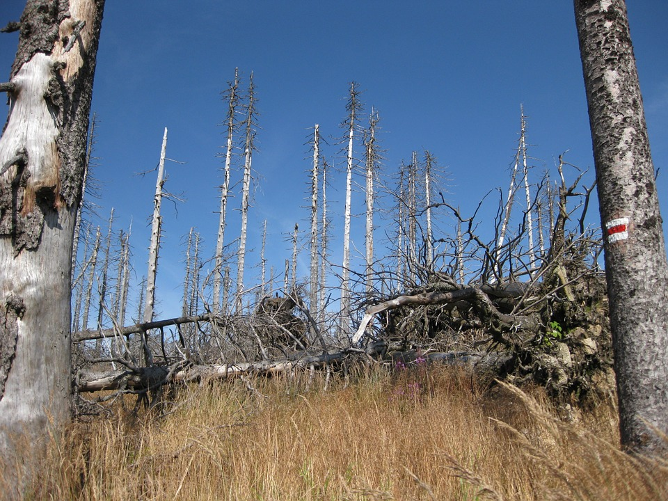
Task: 1. Read the information on useful neutralisation reactions
2. Write 3 sentences summarising what you have learnt from this passage of writing

Slide 10
Soil for crops
Some soils are more acidic than others, every plant has it’s favourite soil pH. Many plants are unable to grow in soils which are very acidic. For example, tea plants grow best between pH 5-6 and tomato plants grow best in soil which is between pH 5.5-7. Farmers can add a base to the soil to help neutralize the soil, making is less acidic.
Acidic lakes
Toxic gases which are released into our atmosphere from vehicles and industries can dissolve into rainwater, this forms acid rain. Acid rain is particularly damaging to our environment, if it falls into lakes it can stay there for a long-time causing damage to animals and plants living in the lake.
Environment agencies can release bases into lakes, via airplane/helicopters, this helps to increase the pH of the lake.

