Slide 1
My reflection
Good progress:
Excellent progress:

Slide 2
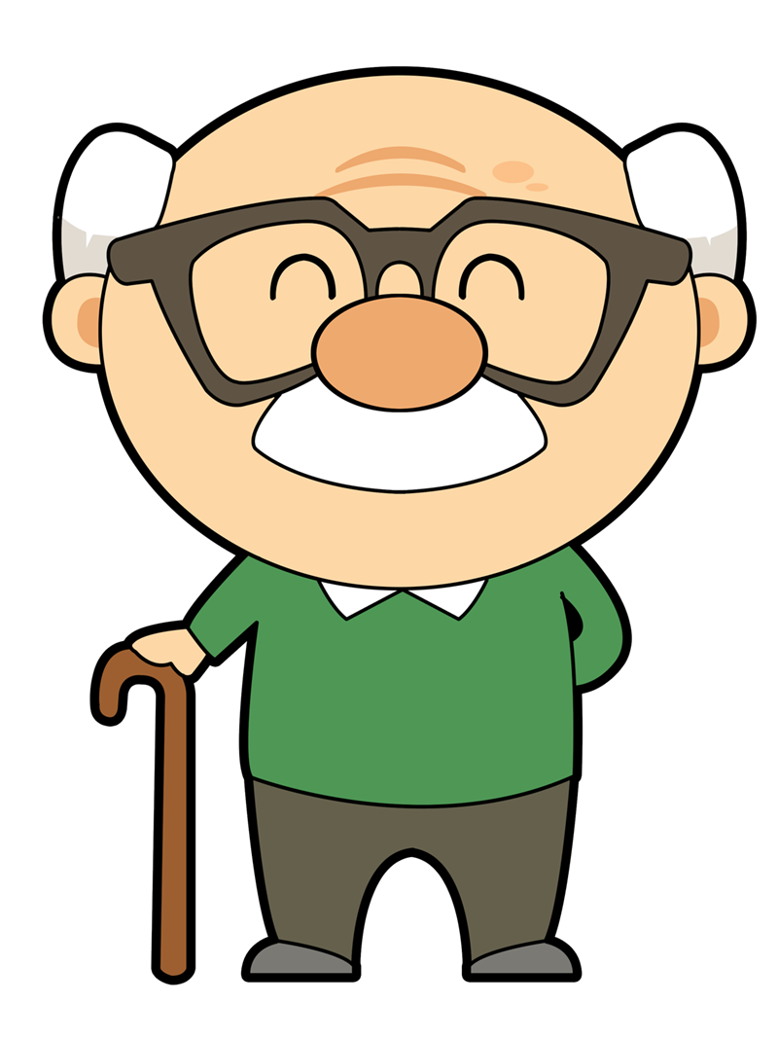
My evaluation…
You should have been photographed completing your demonstration for case study:
Helping the elderly with Dementia and/or arthritis at lunch time.
Shadowing a play worker who is supporting a child that has an unexplained bruise.

Slide 3
My evaluation…strengths
Task:
When completing your evaluation you will need to comment on each care value that you have said you will demonstrate using the following tasks/questions:
Explain how you demonstrated each care value.
Using your do now, which skills would did you apply to each care value?
Using your “script”, explain what you did well.

Slide 4
My evaluation…weaknesses
Task:
When completing your evaluation you will need to comment on each care value that you have said you will demonstrate using the following tasks/questions:
(Re-cap) Explain how you demonstrated each care value.
What did you find difficult?
Are there any care values that you didn’t pick and thought you should?
Which care values did you not feel confident in demonstrating and why?

Slide 5
My evaluation… feed back
Task:
When completing your evaluation you will need to comment on each care value that the teacher has commented on using the following tasks/questions:
Which parts of the feed back do you agree with and why?
Which parts of the feedback do you disagree with and why?

Slide 6
My evaluation…improvements
Task: (**Merit and distinction only**)
When completing your evaluation you will need to comment on each care value that you have said you will demonstrate using the following tasks/questions:
(Re-cap) Explain how you demonstrated each care value.
Which areas of your demonstration do you think need to be improved and why?
If you were to develop the care value, how would you do this?
You need to make comments on how you would use the teachers feed back to give yourself suggestions; please make sure that this is written in as much detail as possible.

