Slide 1
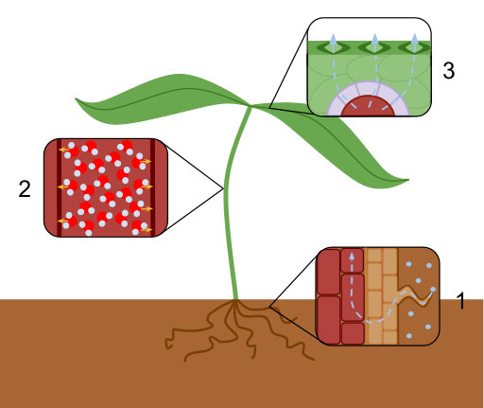
Evaporation & Transpiration
Do now activity:
What are some structural differences between the xylem and the phloem vessels?
In which part of the leaf are you more likely to find stomata?
Explain the role of the stomata in the plant.
Notes:
Image by Laurel Jules - Own work, CC BY-SA 3.0, https://commons.wikimedia.org/w/index.php?curid=26331125

Slide 2
Progress indicators
GOOD PROGRESS:
- Identify the structure of the guard cells and stomata
OUTSTANDING PROGRESS:
- Explain the process of transpiration in a plant

Slide 3
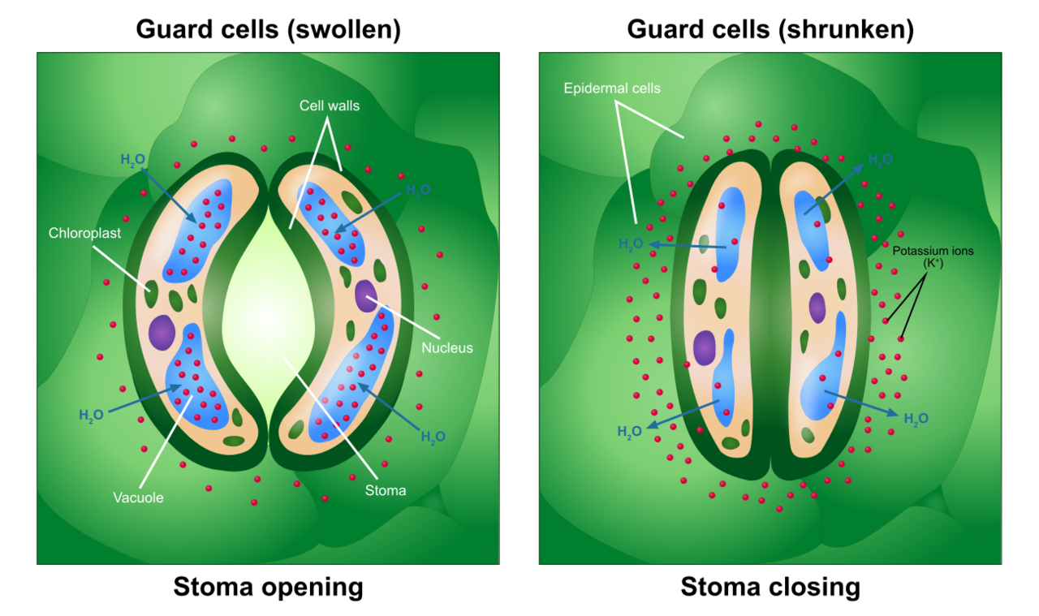
Guard cells & stomata
All over the leaf surface are small openings called stomata. The stomata can be opened when the plant needs to allow air into the leaves.
The size of the opening is controlled by the guard cells. This in turn controls the carbon dioxide going into the leaf and the oxygen and water vapour leaving it.
Notes:
Image By Ali Zifan - Own work, CC BY-SA 4.0, https://commons.wikimedia.org/w/index.php?curid=50720970

Slide 4
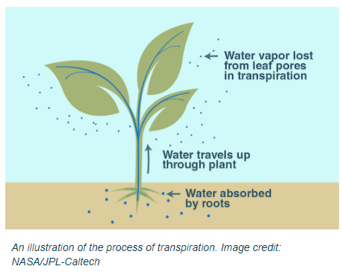
Water loss from the leaves
When the stomata are open, plants lose water vapour through them as well. The water vapour evaporates from the cells lining the air spaces and then passes out of the leaf through the stomata by diffusion.
This loss of water vapour is known as transpiration.
Notes:
Image By Ali Zifan - Own work, CC BY-SA 4.0, https://commons.wikimedia.org/w/index.php?curid=50720970

Slide 5
Task: Watch the video and answer the following questions:
What is transpiration?
What is an adaptation of root hair cells?
How is water pulled up through the plant?
Why is water needed by the plant?
What are some environmental factors that affect the rate of transpiration?
Explain what happens to the guard cells in order to make the stomata:
a) Open
b) Closed
https://www.youtube.com/watch?v=Kv_0udatlh8

Slide 6
Self-assessment:
Transpiration is the evaporation of the water from the aerial parts of a plant – leaves & stem
An adaptation of a root hair cell is that it has a large surface area so more water can be absorbed.
Evaporation of water from the surface of the leaf causes a transpiration pull, this moves water into the roots, up through the stem and into the leaves. Water is cohesive (sticks together) so this results in a transpiration stream
Water is needed for photosynthesis and to keep the plant cells turgid – this supports the plant.
Environmental factors affecting the rate of transpiration are: light intensity, temperature, wind, humidity.
a) When water is taken into the guard cells by osmosis this results in turgidity of the guard cells, as they fill and bend this opens the stomata
b) When water leaves the guard cells the guard cells become flaccid, this closes the stomata.

Slide 7
Describing transpiration
1. Water is lost from the leaf by evaporation, through open stomata
2. Water moves up through the stem and into the leaves to replace water lost by evaporation
3. Water moves into the roots from the soil by osmosis – this replaces the water moving up the stem
Notes:
Image by Laurel Jules - Own work, CC BY-SA 3.0, https://commons.wikimedia.org/w/index.php?curid=26331125

Slide 8
Task: Write a short passage explaining how water moves through a plant during the process of transpiration.
Try and use as many of the key words below as possible and use the diagram to help you!
leaves
evaporation
water
diffusion
stomata
transpiration
stem
roots
cohesion
xylem
Notes:
Image by Laurel Jules - Own work, CC BY-SA 3.0, https://commons.wikimedia.org/w/index.php?curid=26331125

Slide 9
9 marks = 9 minutes
Task: Exams question practice
Notes:
Image by Laurel Jules - Own work, CC BY-SA 3.0, https://commons.wikimedia.org/w/index.php?curid=26331125

Slide 10
Self-assessment:
Q1.
(a) (i) guard (cells)
allow phonetic spelling
1
(ii) any one from:
ignore reference to cells
• allow carbon dioxide to enter
allow control loss / evaporation of water or control transpiration rate
• allow oxygen to leave.
allow ‘gaseous exchange’
1
(b) (i) 200
correct answer gains 2 marks with or without working
allow 1 mark for 0.1 × 0.1 = 0.01 (mm²)
2
(ii) more / a lot of / increased water loss
allow plant more likely to wilt (in hot / dry conditions)
1
(c) (i) 0.12
1
(ii) the lower surface has most stomata
1
stomata are now covered / blocked (by grease)
1
so water cannot escape / evaporate from the stomata
ignore waterproof
to gain credit stomata must be mentioned at least once
1
[9]

Slide 11
Self-assessment:
(ii) more / a lot of / increased water loss
allow plant more likely to wilt (in hot / dry conditions)
1
(c) (i) 0.12
1
(ii) the lower surface has most stomata
1
stomata are now covered / blocked (by grease)
1
so water cannot escape / evaporate from the stomata
ignore waterproof
to gain credit stomata must be mentioned at least once
1
[9]

Slide 12
Plenary: Write down 6 key words from the lesson today!
Notes:
Image by Laurel Jules - Own work, CC BY-SA 3.0, https://commons.wikimedia.org/w/index.php?curid=26331125

Slide 13
What is transpiration?
What is an adaptation of root hair cells?
How is water pulled up through the plant?
Why is water needed by the plant?
What are some environmental factors that affect the rate of transpiration?
Explain what happens to the guard cells in order to make the stomata:
a) Open
b) Closed
What is transpiration?
What is an adaptation of root hair cells?
How is water pulled up through the plant?
Why is water needed by the plant?
What are some environmental factors that affect the rate of transpiration?
Explain what happens to the guard cells in order to make the stomata:
a) Open
b) Closed

