Slide 1
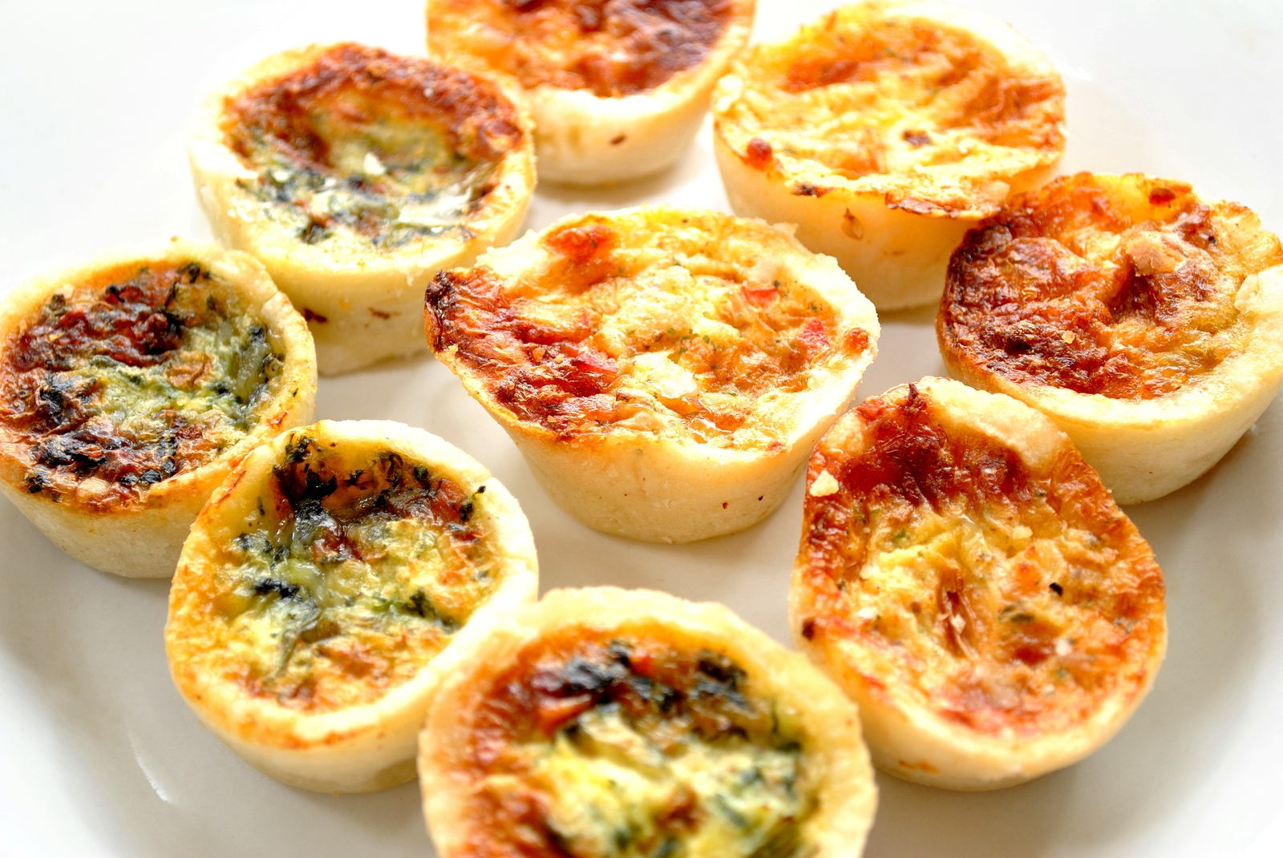
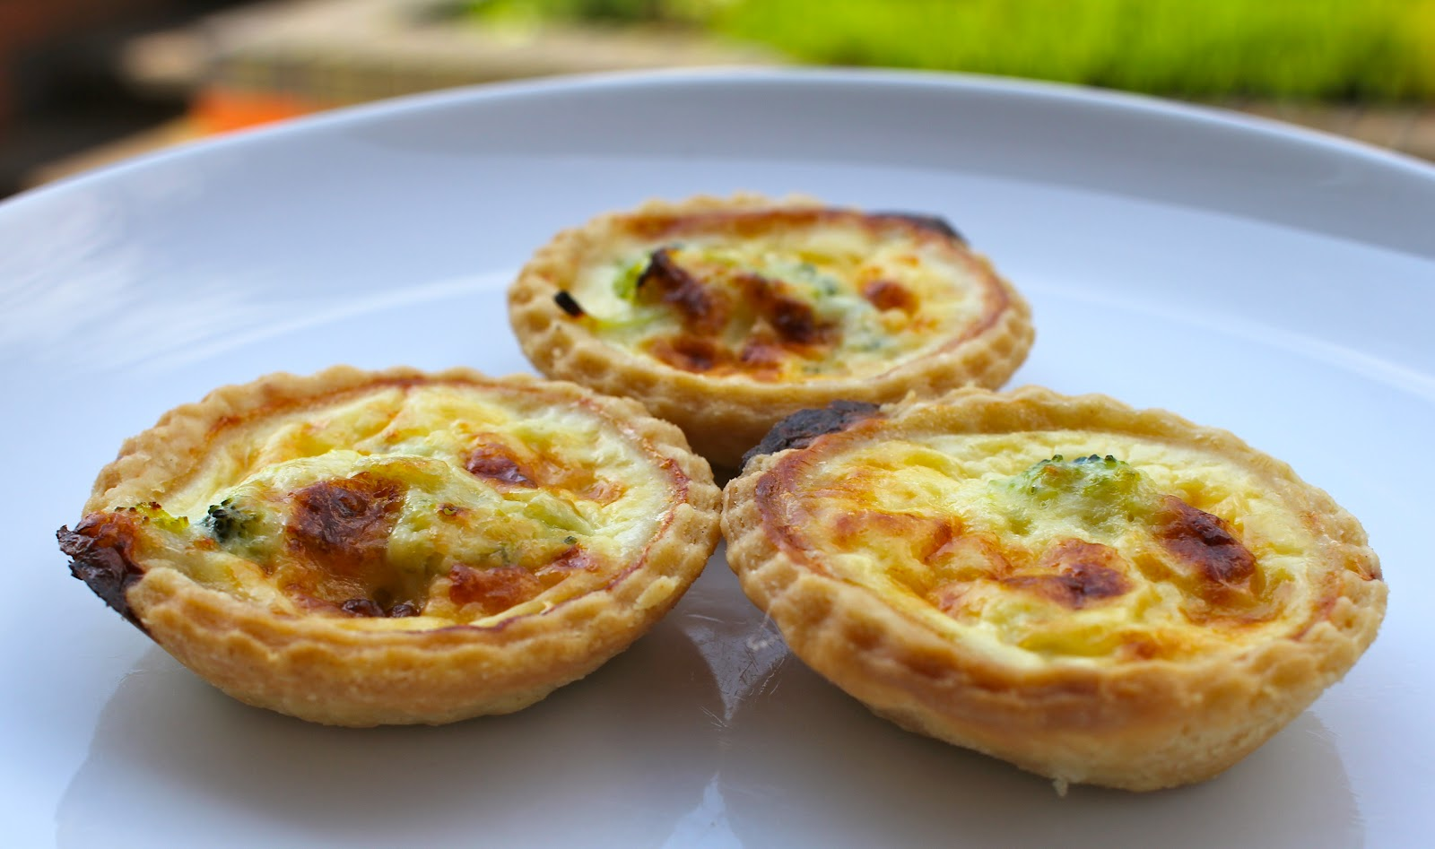
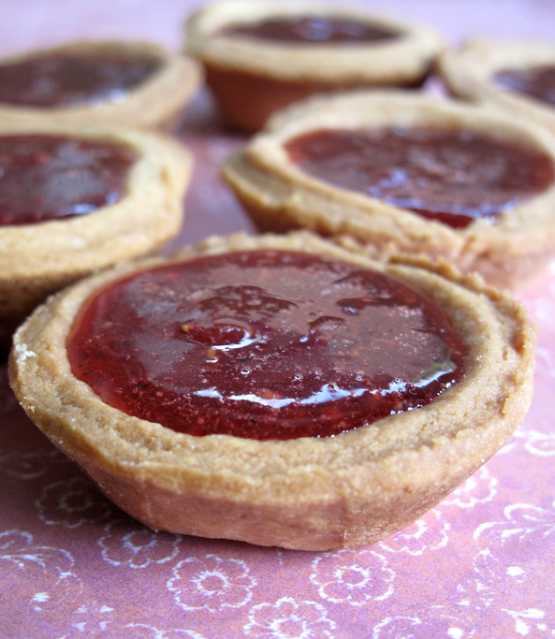
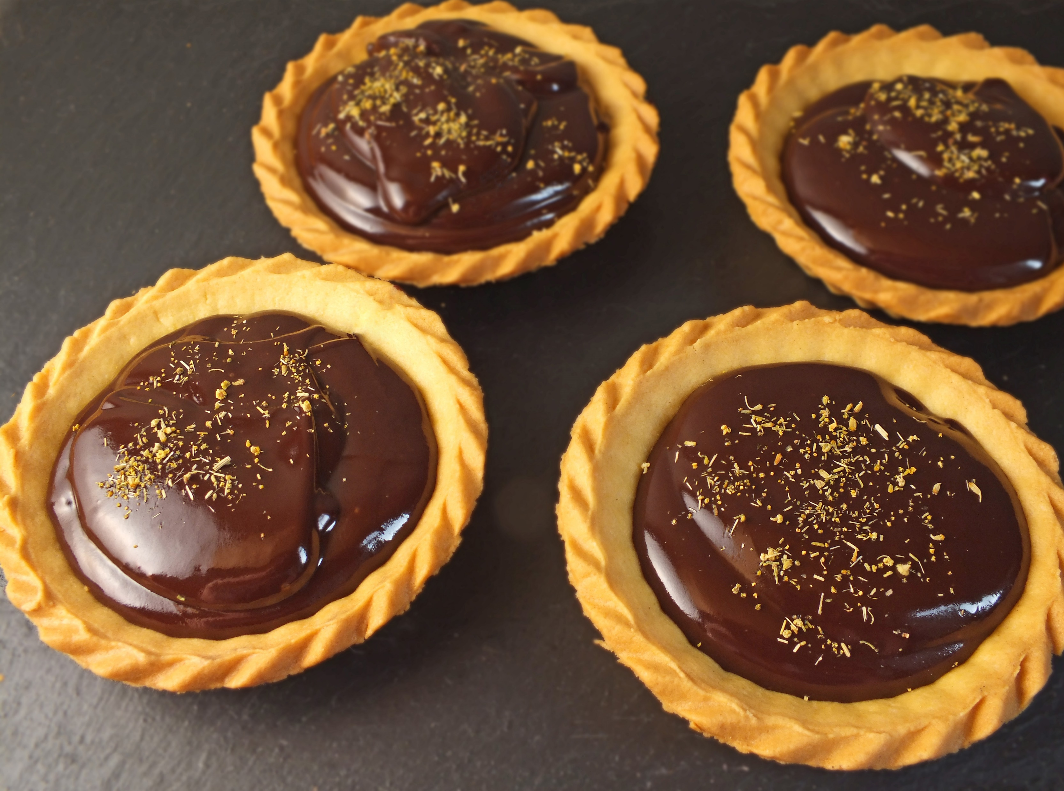
Step by Step Shortcrust Tarts
Equipment
Measuring Scales
Mixing bowl
Measuring jug
Mixing spoon
Fork
Sharp knife
Cupcake tray
Cookie cutters
Rolling pin
Chopping board
Grater
spoon
Ingredients
Short crust pastry
100g plain flour
50g butter/margarine
2-3x 15ml water
Savoury quiche Filling
2 eggs
100g grated cheese
200ml milk
Sweet Filling
Jam or
chocolate spread

Slide 2
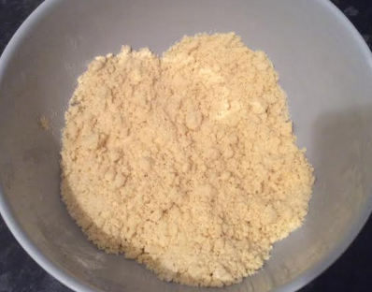
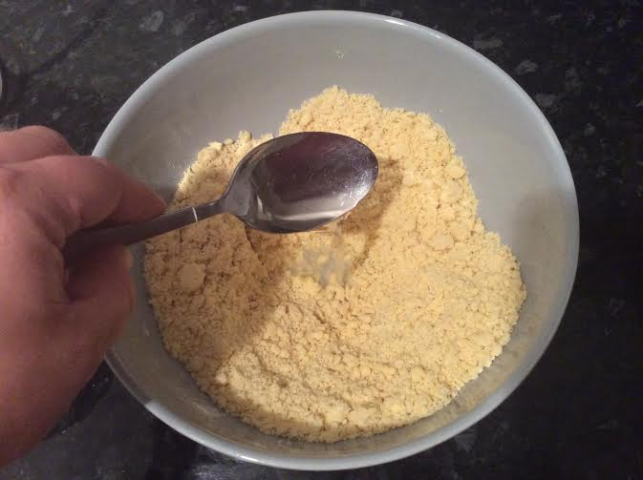
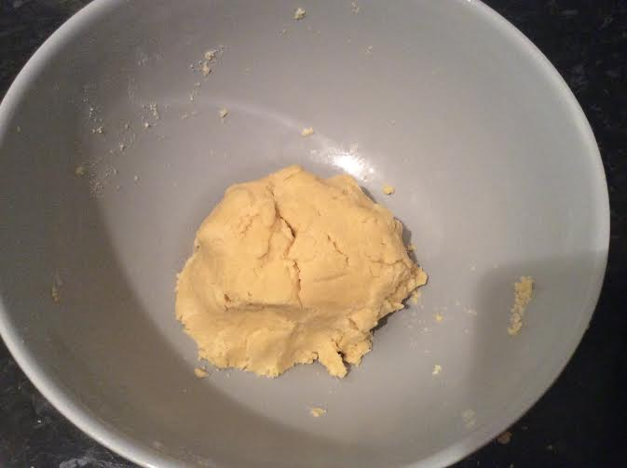
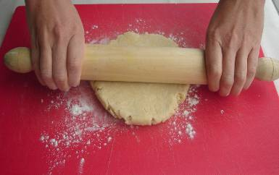
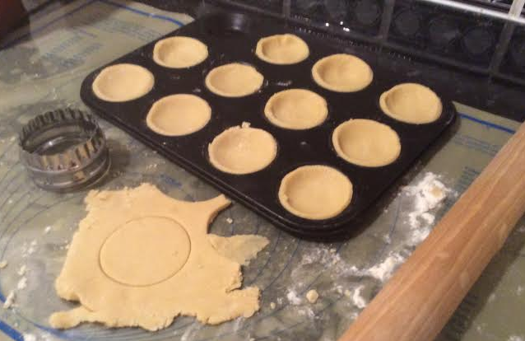
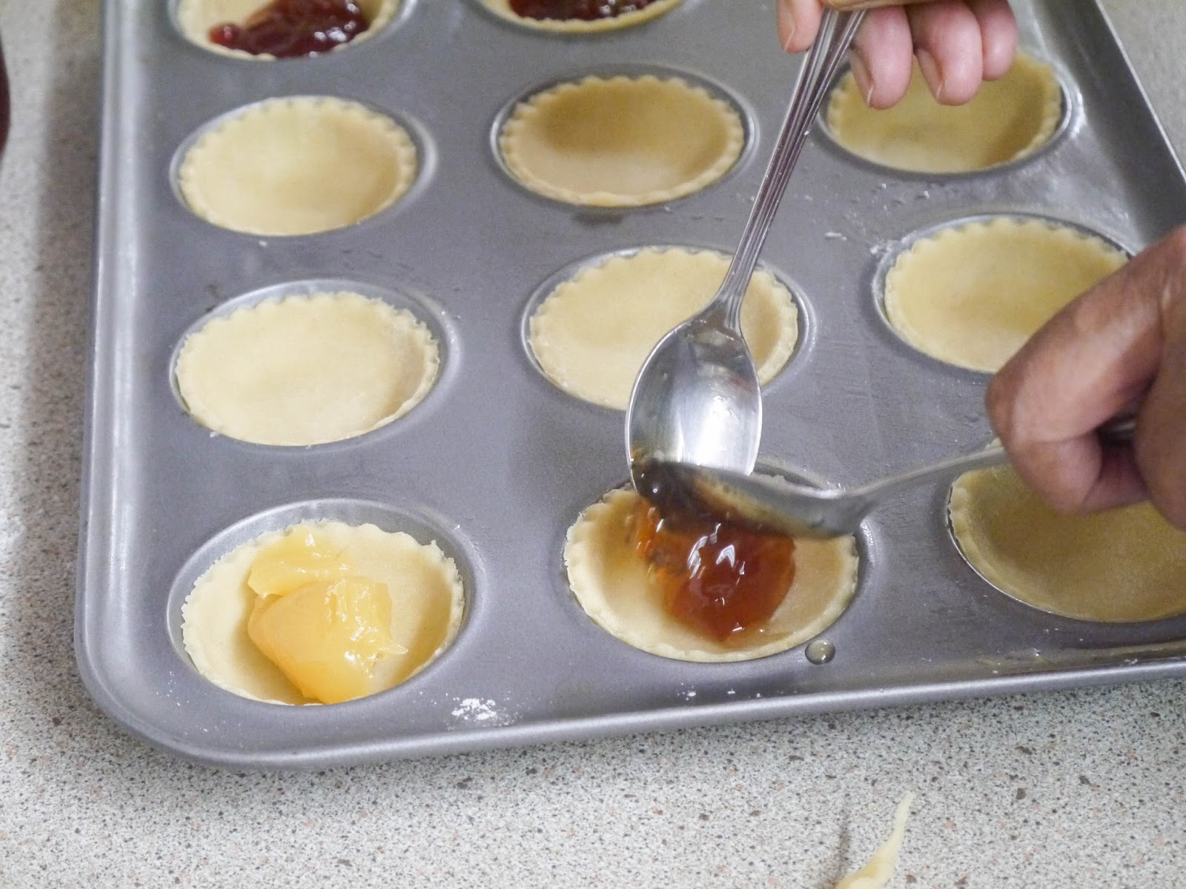
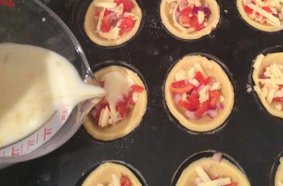
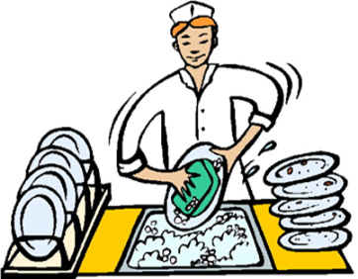
Step by Step Shortcrust Tarts
1. Pre-heat your oven to 190°C, gas mark 5.
2. In a bowl, rub the 50g butter into the 100g plain flour until the mixture resembles breadcrumbs.
3. Make a well in the centre of the breadcrumb mixture and add the 2 tablespoons cold water. Use a palette knife to mix it through.
4. Bring the dough together with your hands. If a dough does not form, gradually add a little more water and repeat the step.
5. Transfer the dough to a lightly floured surface, and roll it out to the thickness of a 2 pence coin using a rolling pin.
6. Cut out the dough using a cutter, and place the pastry circles in a muffin tin.
8. Whilst your tarts are cooking, wash up your equipment and clean your work areas.
7. Quiche – mix together the quiche ingredients in a measuring jug.
Poor the mixture careful into each tart case. Bake in the oven for 10 – 15 minutes. Cook until slightly brown.
7. Sweet – place the tarts in the oven for 10 – 15 minutes. Once cooled spoon in jam or chocolate spread.

