Slide 1
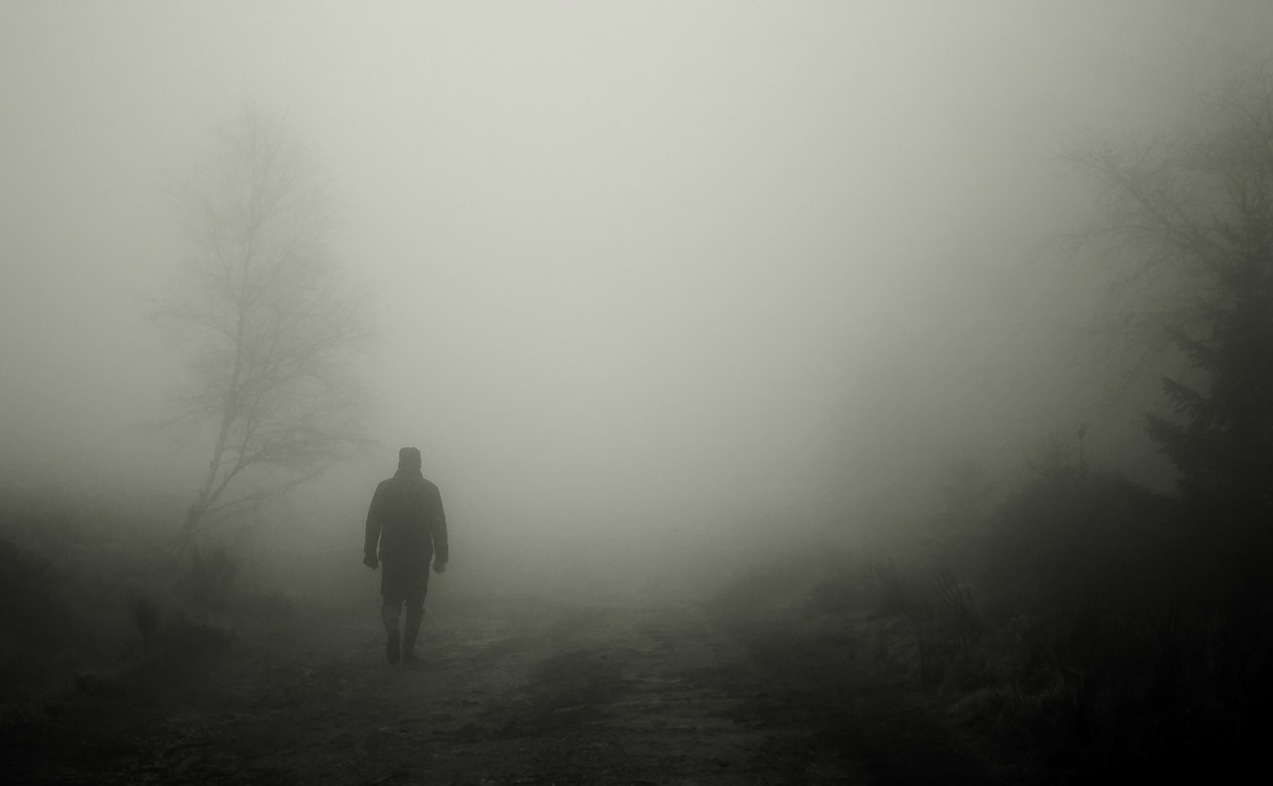
A local newspaper is running a creative writing competition and the best entries will be published. Either
Write a story about a crime as suggested by this picture:
or
Describe witnessing a crime taking place.
(24 marks for content and organisation 16 marks for technical accuracy)
[40 marks]

Slide 2
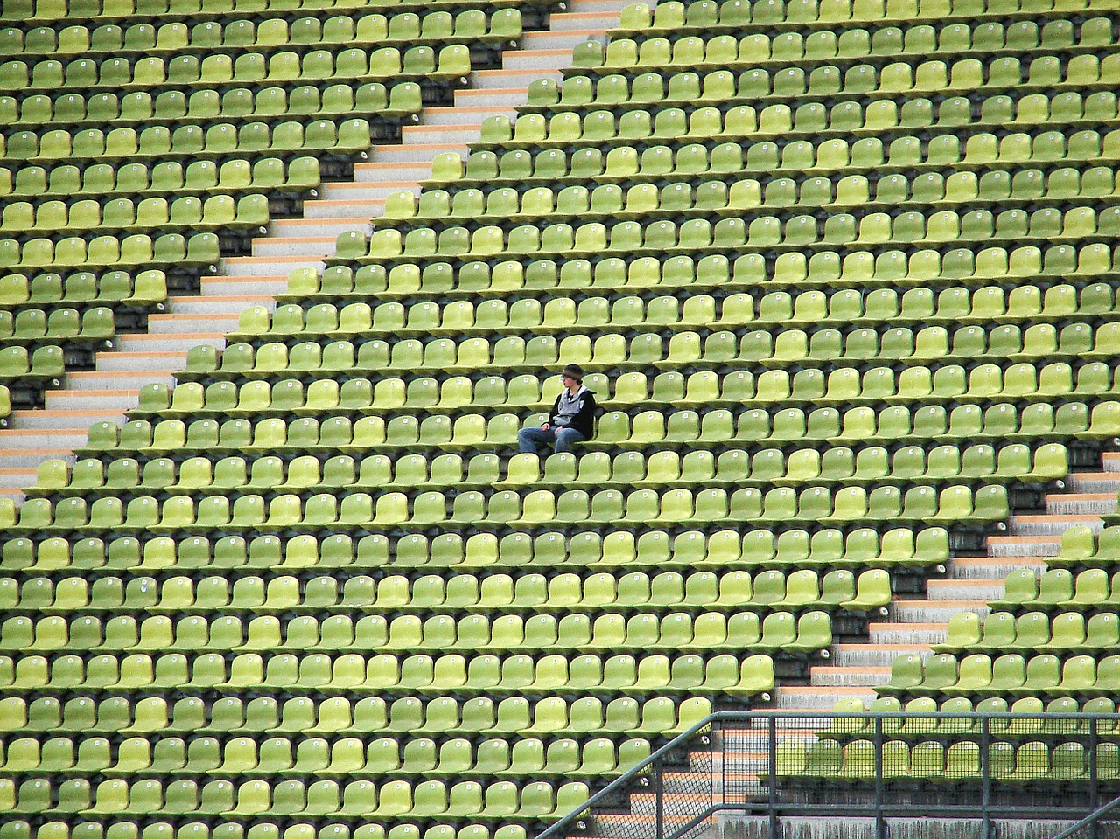
Your local newspaper is running a creative writing competition and they want to publish the winning entries.
Either Describe a day out as suggested by this picture:
Or Write a story about being disappointed. (24 marks for content and organisation 16 marks for technical accuracy) [40 marks]

Slide 3
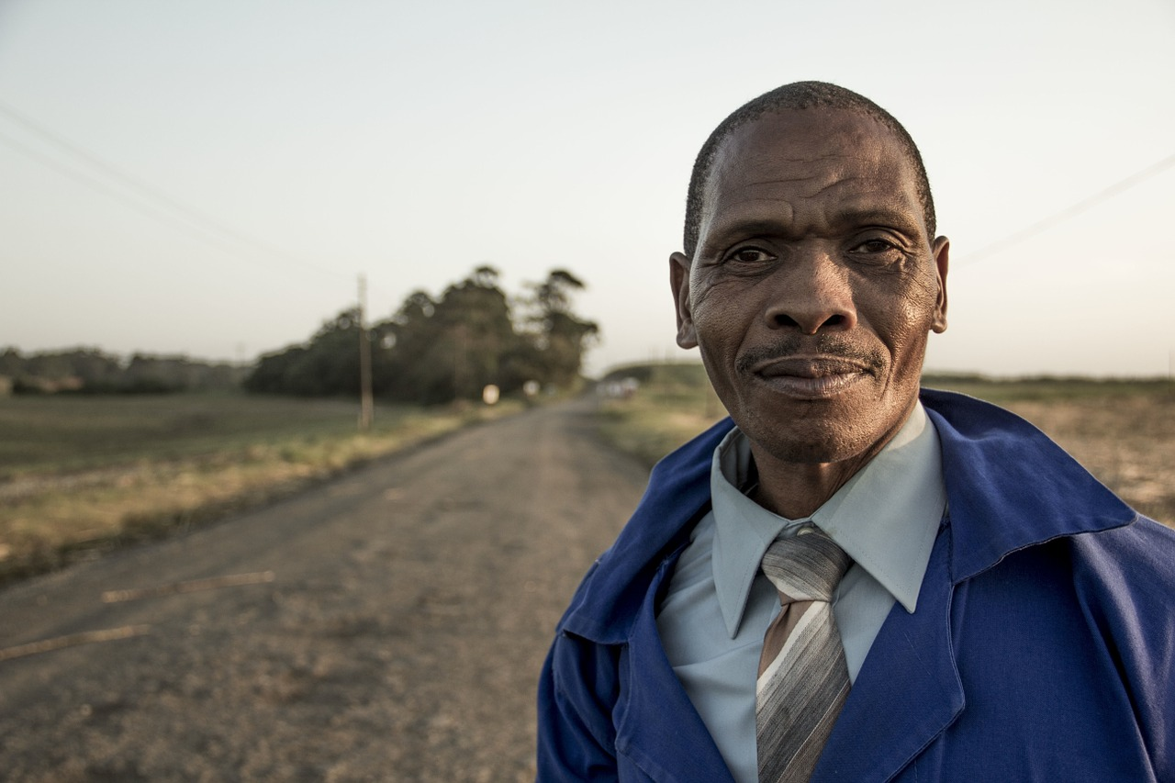
A magazine has asked for contributions for their creative writing page.
Either:
Write a description of an older man as suggested by this picture:
Or:
Write a story that begins with the sentence: ‘I'll remember that day for the rest of my life.’ (24 marks for content and organisation 16 marks for technical accuracy) [40 marks]

