Slide 1
Introduction to electrolysis
Spec. 5.4.3.1 – 5.4.3.2
Do Now: How many words can you make out of the letters in…
Electrolysis
Too easy? … only make science words!

Slide 2
PROGRESS INDICATORS
 | Good progress | Outstanding progress
Grade 1-3 | Define electrolysis. | Describe electrolysis in terms of movement of ions.
Grade 4-6 | Write a word equation to describe the electrolysis of a molten ionic compound. | Write a balanced symbol equation including state symbols for the overall electrolysis of a molten ionic compound.

Slide 3
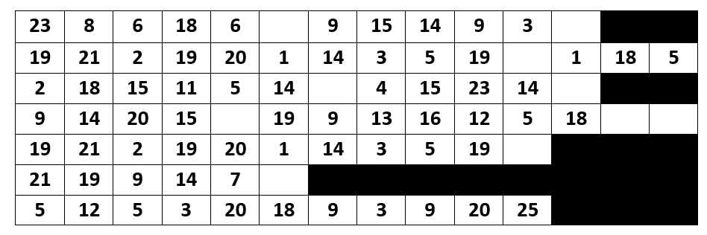
Activity 1: Define Electrolysis
Complete the code breaker to find out the definition of electrolysis.
A | B | C | D | E | F | G | H | I | J
1 | 2 | 3 | 4 | 5 | 6 | 7 | 8 | 9 | 10
K | L | M | N | O | P | Q | R | S | T
11 | 12 | 13 | 14 | 15 | 16 | 17 | 18 | 19 | 20
U | V | W | X | Y | Z | Code breaker key
21 | 22 | 23 | 24 | 25 | 26

Slide 4
Activity 1: Define Electrolysis
Answer: Where ionic substances are broken down into simpler substances using electricity.

Slide 5
ACTIVITY 2: Describe electrolysis in terms of movement of ions.
Watch the video clip and then record as many facts as you can remember about electrolysis https://www.youtube.com/watch?v=AhTRiL6xjBA
An ionic solid can’t be electrolysed because the ions are in fixed positions and can’t move.
CHALLENGE
Why can’t an ionic solid conduct electricity?
Notes:
https://www.youtube.com/watch?v=AhTRiL6xjBA

Slide 6
Word Consciousness
Electrolysis – Where an ionic substance is broken down into smaller substances using electricity
Electrolysis – Where an ionic substance is broken down into smaller substances using electricity
Electrolysis – Where an ionic substance is broken down into smaller substances using electricity
Electrode - A conductor that allows the flow of electricity into the electrolyte. Usually made out of graphite.
Anode - The positive electrode.
Cathode - The negative electrode.
Anion - The negative ion it moves to the anode during electrolysis.
Cation - The positive ion it moves to the cathode during electrolysis.
Electrolyte - The molten (melted) or aqueous (dissolved in water) ionic substance that is being electrolysed.

Slide 7
Activity 3: Describe the process of electrolysis in terms of movement of ions
Rearrange these statements into an order that describe the process of electrolysis.
Ions are discharged at the electrodes to produce elements
Electrodes are placed into the electrolyte and connected to a power pack. One will be positively charged, the anode, and the other will be negatively charged, the cathode.
A ionic substance is melted or dissolved in water to enable the ions to move freely within the solution. This solution is called the electrolyte.
When an electric current is passed through the electrolyte the ions move. The negative ions, cations, in the electrolyte will move to the cathode and the positively charged ions, anions, will move to the anode.

Slide 8
Activity 3: Describe the process of electrolysis in terms of movement of ions
Rearrange these statements into an order that describe the process of electrolysis.
A ionic substance is melted or dissolved in water to enable the ions to move freely within the solution. This solution is called the electrolyte.
Electrodes are placed into the electrolyte and connected to a power pack. One will be positively charged, the anode, and the other will be negatively charged, the cathode.
When an electric current is passed through the electrolyte the ions move. The negative ions, cations, in the electrolyte will move to the cathode and the positively charged ions, anions, will move to the anode.
Ions are discharged at the electrodes to produce elements
SA
Self assess in red pens please!

Slide 9
ACTIVITY 4: Write a word equation to describe the electrolysis of a molten ionic compound.
HINT: Remember all metals produce a positive ion
Complete the table.
Compound | Product at the cathode | Product at the anode
lead bromide | lead | bromine
zinc chloride | zinc | chlorine
sodium chloride | sodium | chlorine
aluminium oxide | aluminium | oxygen
CHALLENGE: Can you write the chemical formula for each element or compound in the table above.

Slide 10
ACTIVITY 4 ANSWERS
Compound | Product at the cathode | Product at the anode
lead bromide (PbBr) | lead (Pb) | bromine (Br)
zinc chloride (ZnCl₂) | zinc (Zn) | chlorine (Cl₂)
sodium chloride (NaCl) | sodium (Na) | Chlorine (Cl₂)
aluminium oxide (Al₂O₃) | Aluminium (Al) | Oxygen (O₂)
SA
Self assess in red pens please!

Slide 11
ACTIVITY 5: Write a balanced symbol equation including state symbols for the overall electrolysis of a molten ionic compound.
Use the table to write the word equations for the electrolysis of zinc chloride, sodium chloride and aluminium oxide.
Worked example:
Lead bromide → lead + bromine
Balanced symbol equation: PbBr₂ _{(l)} → Pb _{(s)} + Br₂ _{(g)}
CHALLENGE: Write balanced symbol equations for the three compounds.

Slide 12
Activity 5 answers
1. Zinc chloride → zinc + chlorine
ZnCl₂ _{(l)} → Zn _{(s)} + Cl₂ _{(g)}
2. Sodium chloride → Sodium + chlorine
2NaCl _{(l)} → 2Na _{(s)} + Cl₂ _{(g)}
3. Aluminium oxide → aluminium + oxygen
2Al₂O₃ _{(l)} → 4Al _{(s)} + 3O₂ _{(g)}
SA
Self assess in red pens please!

Slide 13
plenary
Fill in the gaps.
When an ionic compound is melted or dissolved in water, the ions are free to move about within the liquid or solution. These liquids and solutions are able to conduct electricity and are called electrolytes. Passing an electric current through electrolytes causes the ions to move to the electrodes. Positively charged ions move to the negative electrode (the cathode), and negatively charged ions move to the positive electrode (the anode). Ions are discharged at the electrodes.
Missing words:
current electrolytes ionic negative melted positive dissolved move electricity

