Slide 1
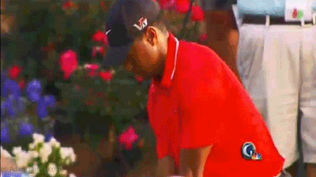
LO: To investigate benefits for taking part in Sport and Physical Education and well-being
Emotional, Social and Physical Health
12/02/20

Slide 2
DNA
The reasons why I take part in sport and physical activities is….

Slide 3
Keep heathy
Look good
Enjoyment
Make friends
Enjoy the competition
Relieve stress
Feel better
Bigger muscles
Increase strength
Be apart of a team
Improve image
Money
Self confidence
Its good for you

Slide 4
Well-being
‘a state of physical, emotional and social health’

Slide 5
Physical ability and participation can be improved by having good _______________…
If you cannot do this NEATLEY then use the sheet!

Slide 6
Well-being
Physical ability and participation can be improved by having good well-being…
If you cannot do this NEATLEY then use the sheet!
Physically Healthy
Emotionally Healthy
Socially Healthy

Slide 7
Emotionally Healthy is improved by sport because…
People who are emotionally or ‘psychologically’ healthy are happy, self-confident, self-aware and resilient. They understand their emotions and can control their behavior.
They can cope with both positive and negative criticism and change and can bounce back from life's challenges
promotes ‘feel good’ factor because of the release of serotonin, which helps you feel happier, preventing depression
improve self-esteem and confidence because you succeed and challenged yourself (physical challenge)
Gives you enjoyment which makes you happier
Increase confidence in stressful situations
Stimulates growth of brain cells, reducing the risk of age-related diseases such as dementia
Exercises releases hormones called endorphins, which make you feel happier and more relaxed,
reduces stress and tension
For Aesthetic appreciation – If something looks good it is appreciated and makes you feel good

Slide 8
Exam Question: (Emotional)
Which of the following is considered to be a a emotional benefit of exercise?
working as a team
developing friendship
Increasing confidence
improved coordination
(1)

Slide 9
Physically Healthy is improved by sport because…
Taking part in more physical activity and developing your components of fitness will help improve your physical health
Taking part in sport reduces your body fat so body composition is better. This helps increase self esteem, less chance of heart diseases
Strength: Less prone to osteoporosis as bones are stronger through weight baring exercise
burns up stored fat Cardiovascular endurance burns more calories
Cardiovascular endurance: Can increase life expectancy, less chance of developing diseases and immune systems becomes more effective.
Improving co-ordination can help in life so you can do lots of different things, less injuries
Improves flexibility – less injuries.
Strength: Less prone to injury and tendons, ligaments and muscles are stronger
Muscle tone and strength – Power, enabing you to push heavy objects out the way if needed

Slide 10
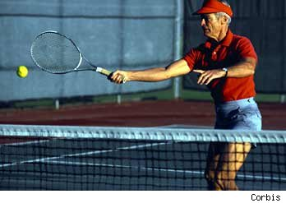
Exam Question: (Physical)
Over 50s tennis player
Figure 1 shows an individual participating in physical activity.
a) Identify two physical benefits he may gain through participation on physical activity (2)
b) Playing/ participating is one way an individual can be involved in physical activity. identify two other types of roles that an individual could take on to sustain their involvement in physical activity. (2)

Slide 11
Socially Healthy people can
Socially health people are able to form and maintain good relationships with others. (doesn't’t mean they wont have disagreements)
Communicate effectively and resolve disputes
Show fulfillment by being part of a team and work well to achieve a common goal
Develop teamwork and co-operation
Be sensitive to the needs of others and can adapt to different social situations
Be able to meet new people, and make new friends

Slide 12
Are the reasons different for different people...
Think about the different people in the world do they all have the same benefits to take part?
Task:
Give at least 3 benefits for each, 5+ explain why:
Yourself (3)
A sunday league footballer (male, 27) (3)
A 55 year old female (part time nurse) (3)

Slide 13
Homework
GCSE PE Task
Use the internet to research any content you cannot remember!
There is an option of 30 bullet points in this section
You need to chose 12 bullet points and produce a slide on each (create 15 minimum slides) as a revision tool
Pictures, key notes and keywords must be included!

Slide 14
What we have covered so far…
Structure of the Skeleton (bones)
Classification of bones (long bones etc…
Functions of the skeleton
Classifications of joints (pivot etc...)
Movements (flexion etc…)
Roles of ligaments and tendons
Different muscles (voluntary, involuntary and cardiac)
Antagonistic Pairs
Fast twitch and slow twitch characteristic
Skeletal and muscles working together
Functions of the cardiovascular system
Structure of the cardiovascular system
Structure of the blood vessels
Vasoconstriction and vasodilation
Functions of the blood vessels
Vital capacity and tidal volume
Components of the respiratory system
Structure of the alveoli to enable gaseous exchange
Respiratory and Cardiovascular working together
The use of glucose
Anaerobic and aerobic respiration
The short term effects of exercise on the body systems
The long term effects of exercise on the body systems
Interpretation of graphs for HR
Definitions of fitness, exercise and health
Components of fitness
Fitness tests
Normative data interpretation
Why we fitness test
Training methods

Slide 15
Complete the warm up
and cool down ppt started
before half term

