Slide 1
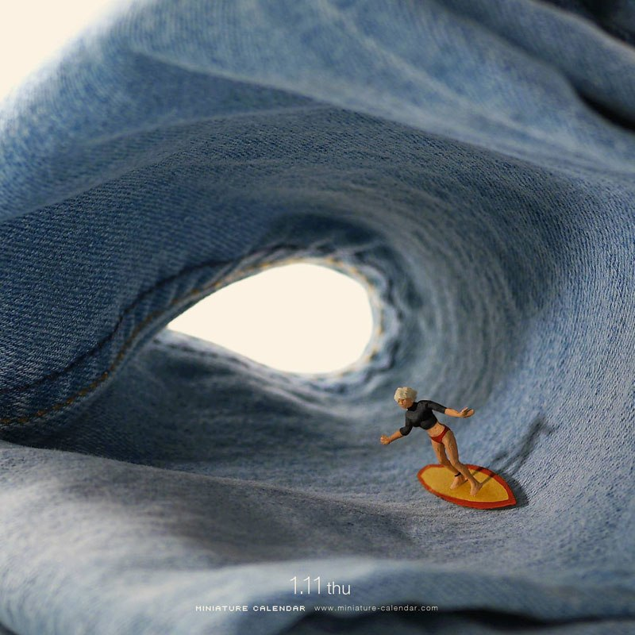
Out fox the class

Slide 2
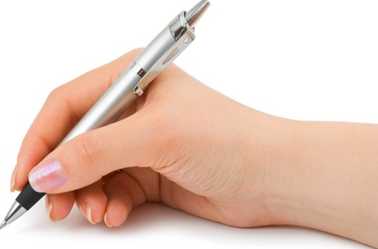
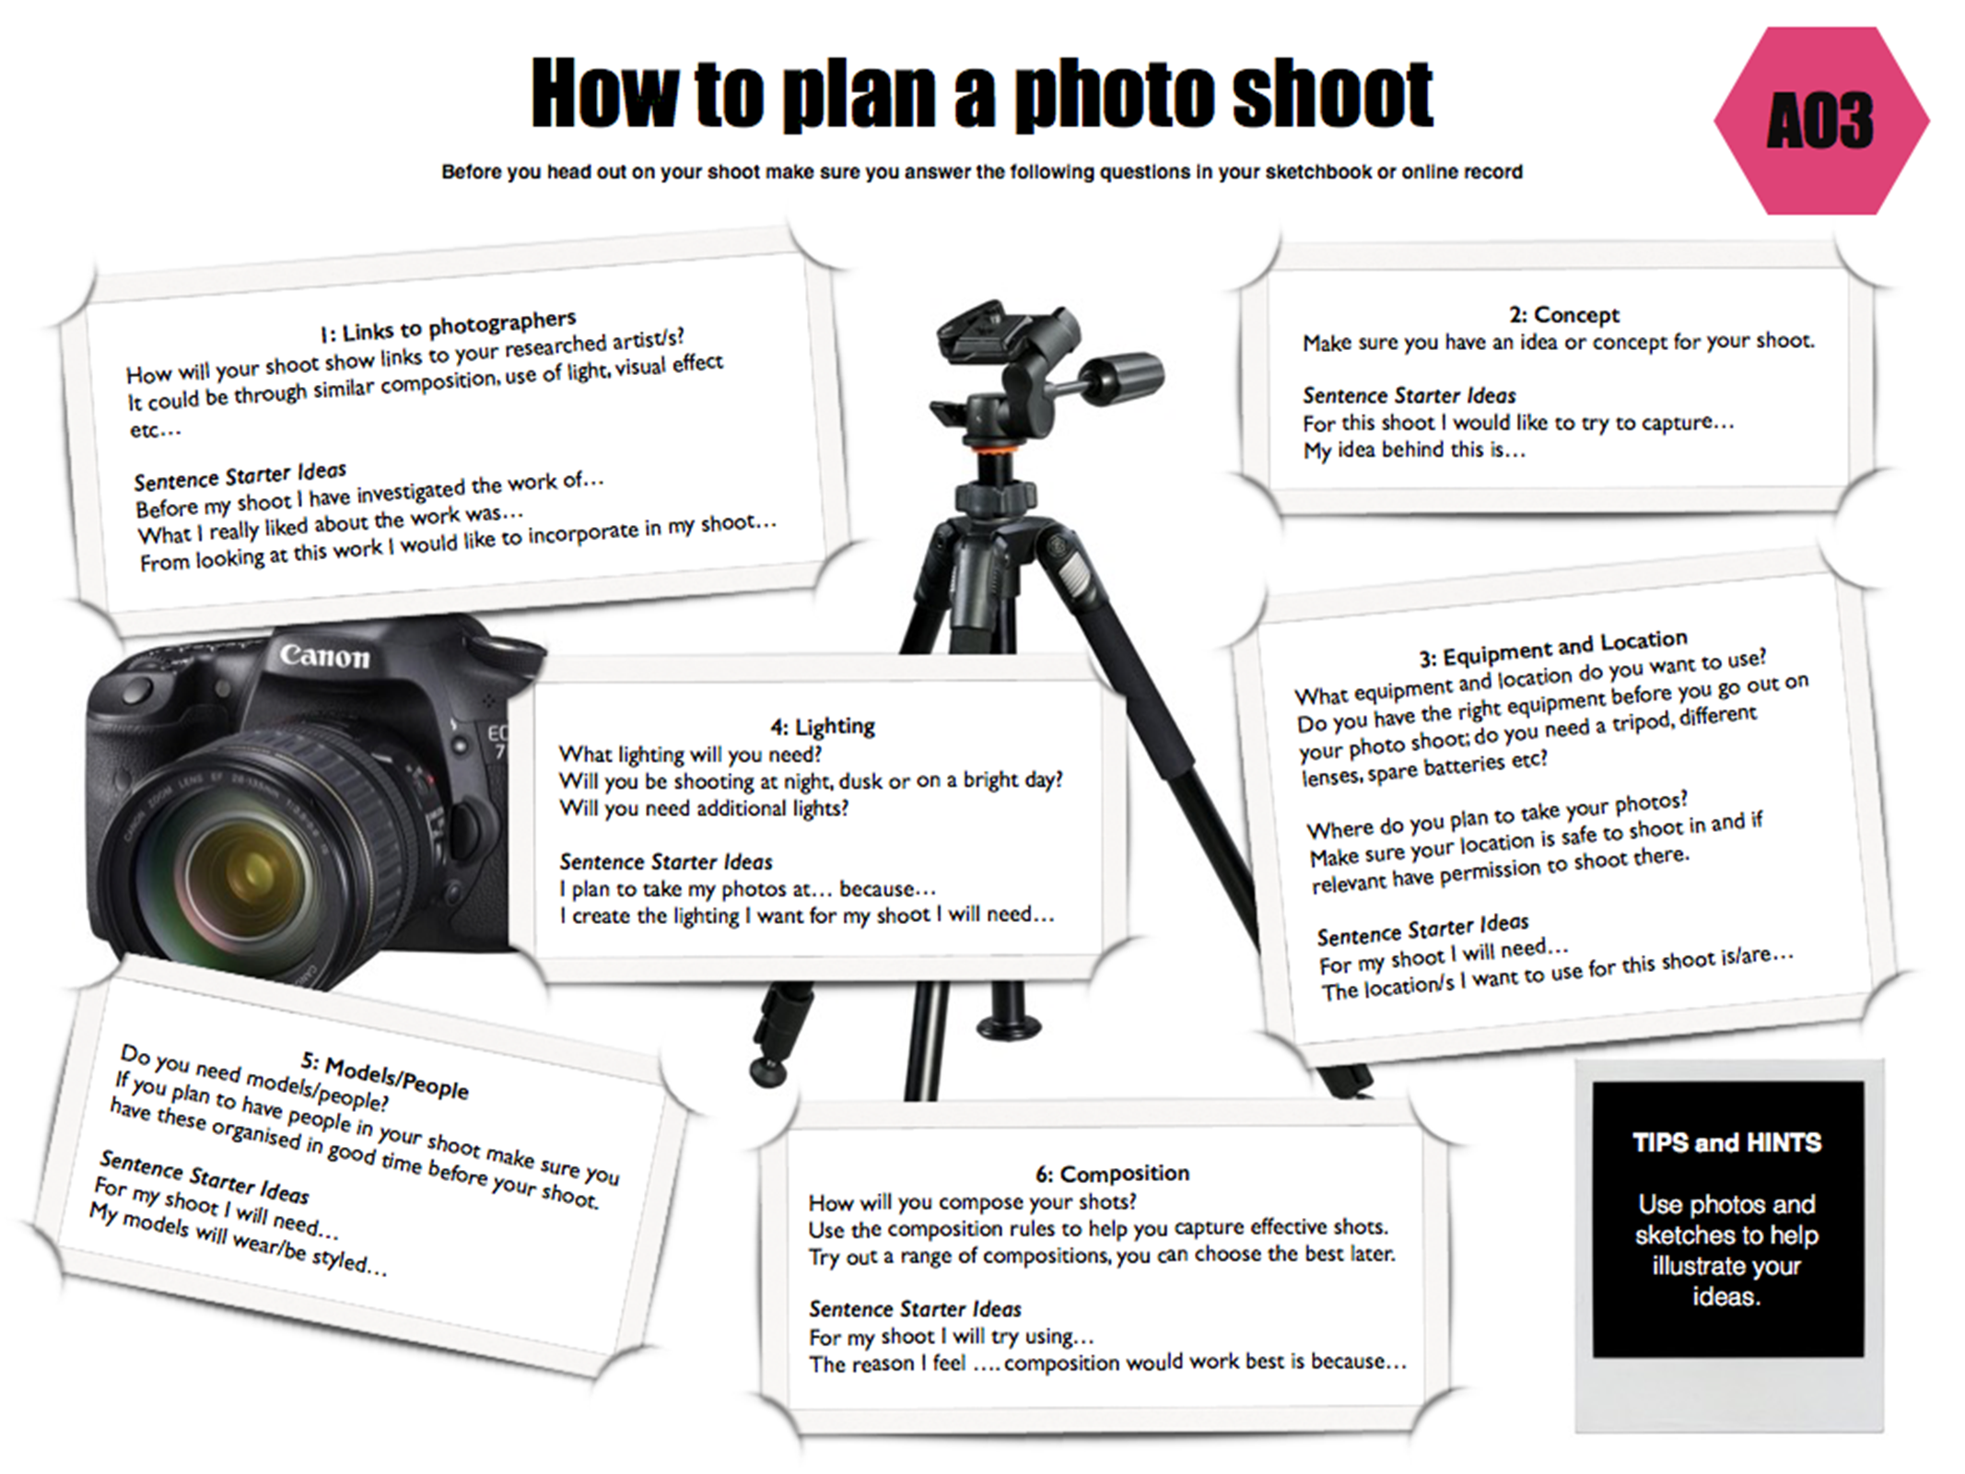
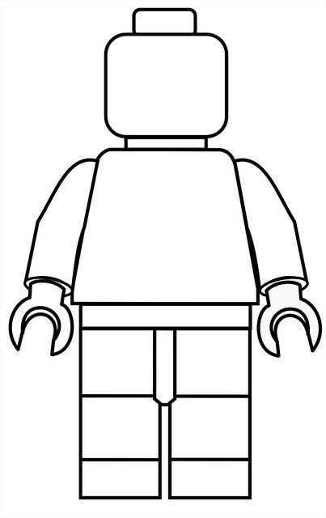
To plan out a photo shoot using a set of given headings
GCSE photography Progress Indicators
Basic Requirements | Have an idea of the photos you wish to take next lesson Answered some questions on the ‘How do I…plan a photo shoot?’ sheet Notes are presented in a clear manner
Good | Answered most questions from some of the headings on the ‘How do I…plan a photo shoot?’ sheet Notes are presented in a clear and organised manner
Outstanding | Answered all questions from all the headings on the ‘How do I…Analyse a Photographers work?’ sheet Writing uses detailed and in-depth sentences Creative layout/design for the page used Thumbnail sketches used to illustrate composition ideas
Title –PHOTO SHOOT PLAN
TASK 1
Using the handout plan your Tatsuya/Slinkachu/Little People Project photo shoot on A3 paper. (How to Plan Your Photo Shoot)
Remember that you should demonstrate your understanding of aperture, focus and composition in your photographs and so must consider this when planning your photo shoot.
All area’s on the sheet should be covered – you may wish to have mini sub heading (to ensure your have covered each area) and mount writing on black paper
Task 2
Sketch out ideas for your photoshoot and add labels to these. (show where the camera will be, your miniature figure and what they will be doing).You can trace from collected images

Slide 4
Link to photographers work
Concept behind the shoot
Equipment and Location
Lighting
Models and People
Compositions used

