Slide 1
DNA
Anagrams – Explain the key words
Notes:
Option 1

Slide 2
Connect
Calculate the circumference of a circle with:
Diameter = 4cm Diameter = 8cm
Radius = 6cm Radius = 7cm
Find the circumference
Notes:
Reliant on knowledge of types of number on a dice. Green introduces idea of “or” to stretch students understanding.

Slide 3
Area of Circles and Parallelogram
Unit 9 Objective C + D

Slide 4
Progress Indicators

Slide 5
Area of a Circle = π x radius²

Slide 6
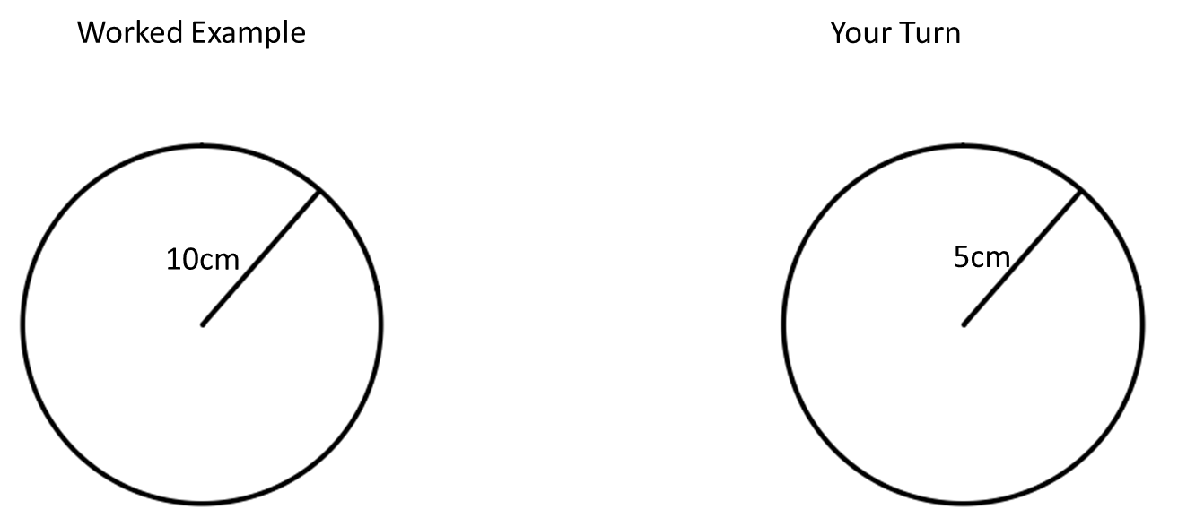
I do
We do

Slide 7
Answer the questions on the worksheet

Slide 8
What is a parallelogram?
What does it look like?
What properties does it have?

Slide 9
What is a parallelogram?
What does it look like?
What properties does it have?

Slide 10
Area of a Parallelogram = base x height

Slide 11
I do
We do

Slide 12
Answer the questions on the worksheet

Slide 13
Demonstrate
Find the area of circles with:
Radius = 9m
Radius = 11cm
3) Radius = 15m
4) Diameter = 8cm
5) Diameter = 20m
6) Diameter = 14cm

