Slide 1
Do Now Activity:
Lets go back…right back!
Name a function of the skeleton
Name 2 types of bones
Name 2 types of synovial joints
Name 4 types Movements
What is the difference between tendons and ligaments
Name 2 short term effects of exercise on the CV system
Name 2 long term effects of exercise on the CV system

Slide 2
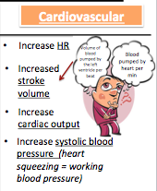
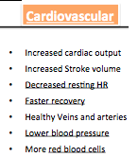
Do Now Activity:
Red and White blood production:
Protection:
Platelets:
Storage of calcium and Phosphorus:
Movement:
Muscle Attachment:
Name a function of the skeleton
Ball and Socket
Hinge
Pivot
Condyloid
Flexion
Plantar Flexion
Dorsi Flexion
Extension
Adduction
Abduction
Rotation
Circumduction
F – Flat:
I – Irregular:
L – Long:
S- Short:
Name 2 types of bones
Name 2 types of synovial joints
Name 4 types Movements
Like – Like
What is the difference between tendons and ligaments
Name 2 short term effects of exercise on the CV system
Name 2 long term effects of exercise on the CV system

Slide 3

Effects on the Respiratory system
Date: Monday 2 March, 2020
 | GOOD | OUTSTANDING
6+ | TBAT explain the immediate and long term effects of exercise on the respiratory system and explain how they benefit athletes | TBAT predict how regular exercise will impact on your sports performance.
4-5 | TBAT describe the immediate and long term effects of exercise on the respiratory system | TBAT explain the immediate and long term effects of exercise on the respiratory system and explain how they benefit athletes
3 | TBAT identify the immediate and long term effects of exercise on the respiratory system | TBAT describe the immediate and long term effects of exercise on the respiratory system
What’s my target level?

Slide 4



QUESTION:
Discuss the immediate effects and long-term training effects in physical activity on the respiratory system, and explain why those effects are beneficial to an athlete. (6 Marks)
Have a go at the 6 mark question on the respiratory system
Attempt 1
Remember:
Read the question
Highlight key words
Make a plan (if needed)
There are many effects which take place on the respiratory system………
Immediate effects are………….
Long term effects on the respiratory system………
To conclude……….

Slide 5
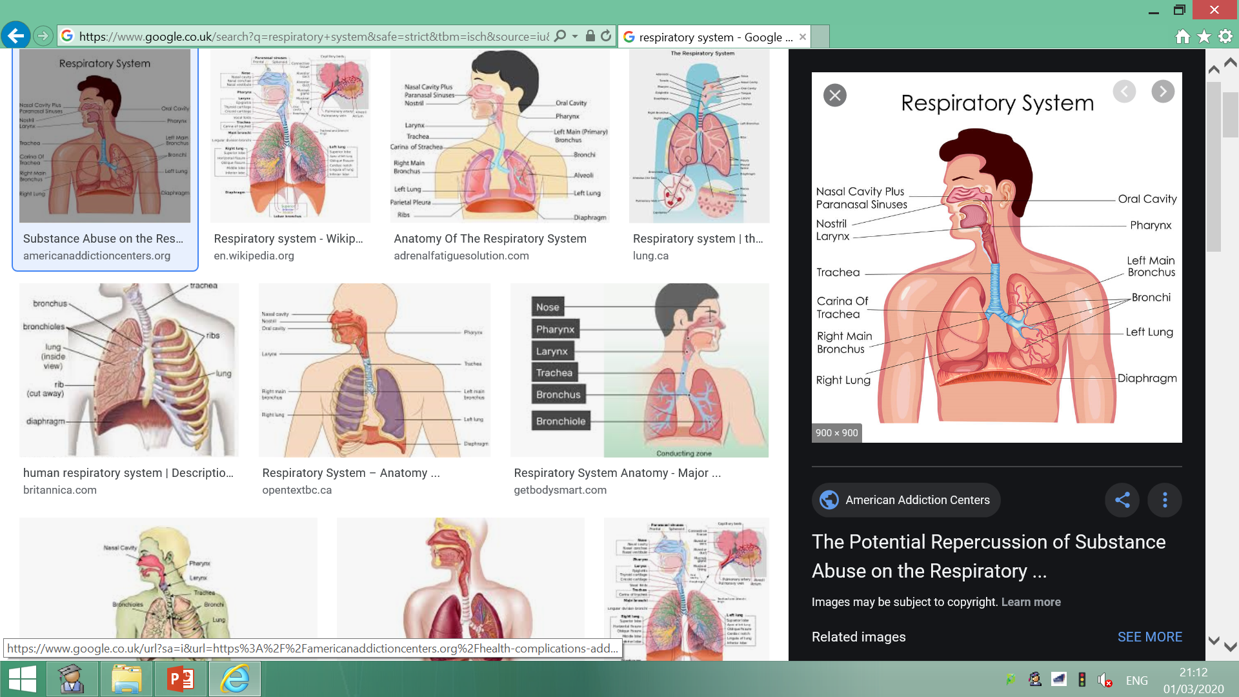

TASK:
Can you identify/describe/explain the immediate effects of exercise on the respiratory system?
Challenge….
Explain the following term vital capacity
(2 mark)

Slide 6

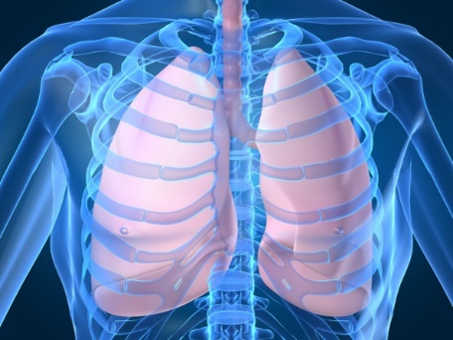
Immediate effects of exercise
Increase in breathing rate (faster breathing) therefore increases the removal of carbon dioxide
Increase in depth of breathing/tidal volume (more air taken in with each breath) therefore increases the amount of oxygen take to the lungs in each breath
Quicker gas exchange in the alveoli

Slide 7
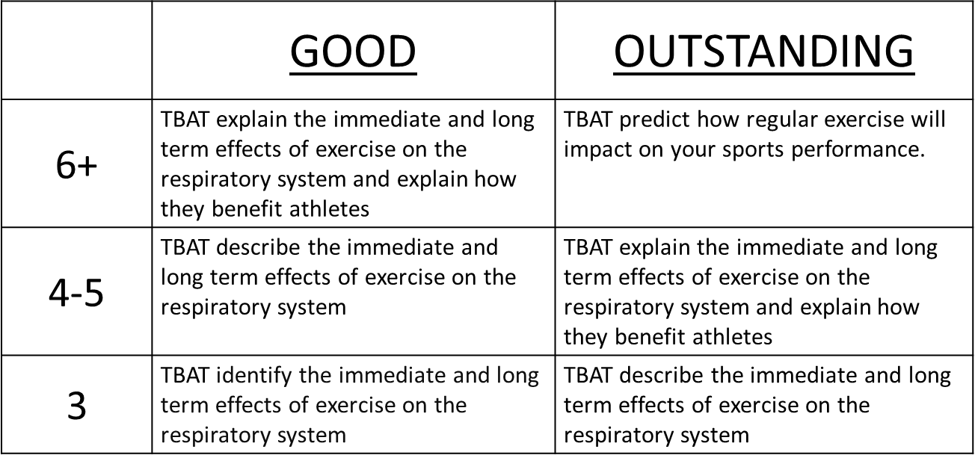
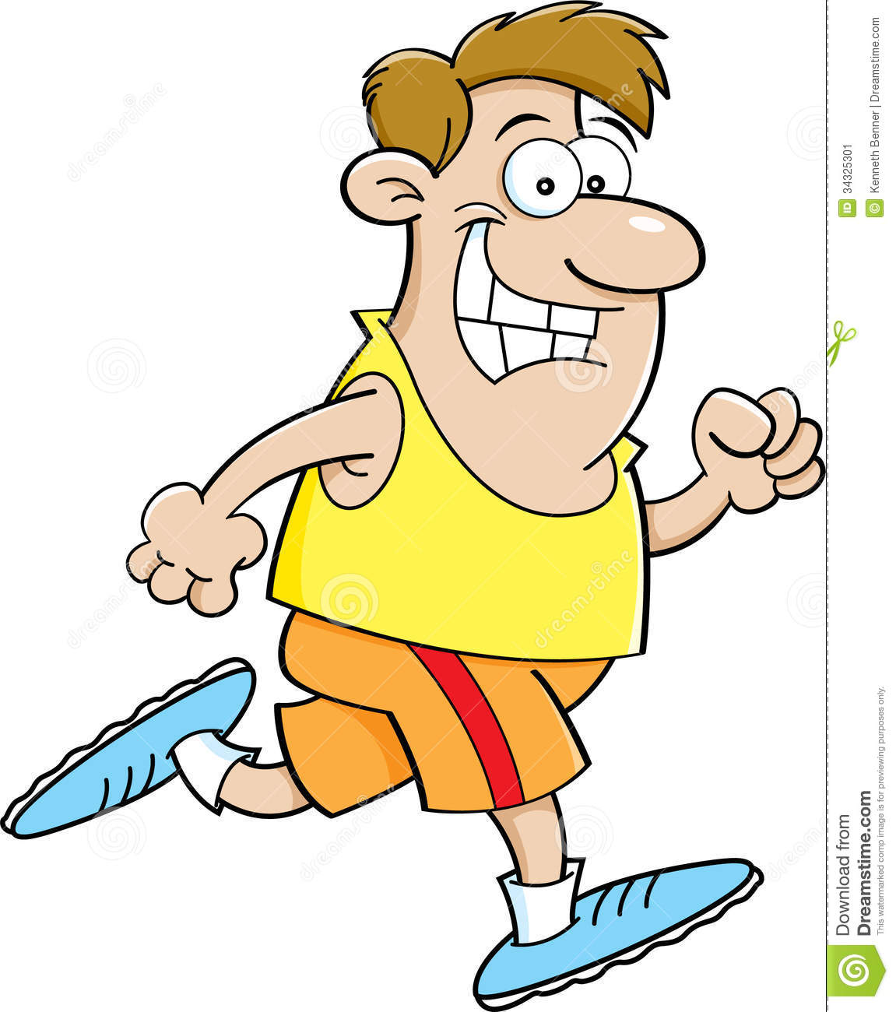
Apply your knowledge to answer the following question on your learning mat.
Exam Q: Exercise causes an increase in demand on the respiratory system. Explain ONE benefit of these changes to a performer (2)
Challenge…..
Explain the term tidal volume (2 mark)

Slide 8


Pass your answer to your shoulder partner
RED PEN
USE THE MARK SCHEME and MARK THEIR WORK.
Write what they need to improve on.
 | GOOD | OUTSTANDING
6+ | TBAT explain the immediate and long term effects of exercise on the respiratory system and explain how they benefit athletes | TBAT predict how regular exercise will impact on your sports performance.
4-5 | TBAT describe the immediate and long term effects of exercise on the respiratory system | TBAT explain the immediate and long term effects of exercise on the respiratory system and explain how they benefit athletes
3 | TBAT identify the immediate and long term effects of exercise on the respiratory system | TBAT describe the immediate and long term effects of exercise on the respiratory system

Slide 9

Mark scheme
Exam Q: Exercise causes an increase in demand on the respiratory system. Explain ONE benefit of these changes to the performer (2)
Increase in breathing rate (faster breathing) therefore increases the removal of carbon dioxide preventing lactic acid build up
or
Increase in depth of breathing/tidal volume (more air taken in with each breath) therefore increases the amount of oxygen taken to the lungs in each breath which allows more oxygen to be delivered to the working muscles.
or
More effective gas exchange in the alveoli which means oxygen and carbon dioxide is exchanged quicker so more oxygen can be sent to working muscles resulting in a sustained performance.
Why have I highlighted some text in purple?
PASS BACK _ GREEN PEN THE CORRECTIONS NEEDED
Notes:
Reviewing is a critical element in the process of teaching and learning as it is at this point that teachers can challenge the students to make their learning explicit. Although Review is the last of the elements of the cycle to be described, it should not be seen as coming only at the end of a lesson. It is useful to include different review opportunities throughout every lesson so that teachers and students can identify challenges and supports, and strengths and weaknesses. Review is a significant part of developing metacognitive awareness.

Slide 10
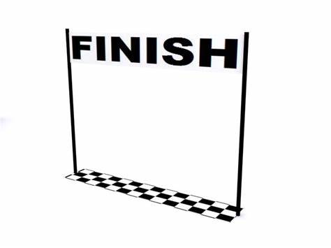

Go the extra mile…..
Explain, in simple terms, the difference between aerobic and anaerobic training
(2 mark)
If you trained for 6 weeks, what would you expect to happen to your respiratory system
TASK:
Can you identify/describe/explain the long term effects of exercise on the respiratory system?

Slide 11

Long term effects of exercise
Increased number of alveoli – you can take in more air and extract oxygen more effectively
Increased strength of intercostal muscles - respiratory system is stronger so it can contract more forcefully when needed
Increased strength of diaphragm – respiratory system is stronger so it can contract more forcefully when needed
Increase lung volume – due to increased tidal volume and vital capacity
Due to all of the above you can provide more oxygen for transport to the working muscles to help with energy production.

Slide 12
Exam Question
If you are stuck:
Resource sheet
Ask your learning partner
Ask the teacher
Apply your knowledge to answer the exam question on long term effects of exercise: Exam Q: Identify and explain TWO long-term benefits of regular training on the respiratory system (4)
Why…therefore, because, which means…
Remember:
Read the question
Highlight key words
Make a plan (if needed)
Go the extra mile…. Explain why the alveoli have such a large blood supply? (2 marks)
 | GOOD | OUTSTANDING
6+ | TBAT explain the immediate and long term effects of exercise on the respiratory system and explain how they benefit athletes | TBAT predict how regular exercise will impact on your sports performance.
4-5 | TBAT describe the immediate and long term effects of exercise on the respiratory system | TBAT explain the immediate and long term effects of exercise on the respiratory system and explain how they benefit athletes
3 | TBAT identify the immediate and long term effects of exercise on the respiratory system | TBAT describe the immediate and long term effects of exercise on the respiratory system

Slide 13
MARK SCHEME: Long term effects of exercise
Two out of any of the below – corrections in GREEN
Increased number of alveoli – you can take in more air and extract oxygen more effectively
Increased strength of intercostal muscles - respiratory system is stronger so it can contract more forcefully when needed
Increased strength of diaphragm – respiratory system is stronger so it can contract more forcefully when needed
Increase lung volume – due to increased tidal volume and vital capacity
Due to all of the above you can provide more oxygen for transport to the working muscles to help with energy production.

Slide 14
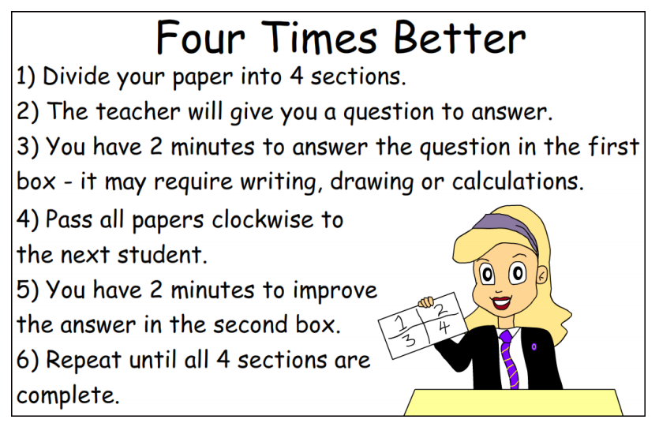
Split your page as below….. Write your TARGET GRADE
Title – FOUR TIMES BETTER
1. Me:
2. Name_______
My target grade _______
Question:
Discuss the immediate effects and long-term training effects in physical activity, on the respiratory system, and explain why those effects are beneficial to an athlete. (6 marks)
3. Name_______
4. Name_______

Slide 15

Attempt 2 (GFG)
QUESTION:
Discuss the immediate effects and long-term training effects in physical activity on the respiratory system, and explain why those effects are beneficial to an athlete. (6 Marks)
Using your knowledge from todays lesson you are now going to have a second attempt at answering the 6 mark question.
Remember:
Read the question
Highlight key words
Make a plan (if needed)
Go the extra mile…..
Design your own “extra mile ” task …
What could you do?
(Drawing, story board, exam questions … your choice)
 | GOOD | OUTSTANDING
6+ | TBAT explain the immediate and long term effects of exercise on the respiratory system and explain how they benefit athletes | TBAT predict how regular exercise will impact on your sports performance.
4-5 | TBAT describe the immediate and long term effects of exercise on the respiratory system | TBAT explain the immediate and long term effects of exercise on the respiratory system and explain how they benefit athletes
3 | TBAT identify the immediate and long term effects of exercise on the respiratory system | TBAT describe the immediate and long term effects of exercise on the respiratory system
Notes:
Students are participating in a task or tasks that will allow them to demonstrate their developing understanding of the content that was presented. During this time teachers and students may be involved in assessing and evaluating the outcomes of the students’ learning. Over time there should be a variety of techniques and methods used to determine the levels of achievement

Slide 16
Mr Mark Scheme – peer assessment
Short term benefits
Increase in breathing rate (faster breathing) (ss) therefore increases the oxygen intake and aids with the removal of carbon dioxide (ds)
Increase in depth of breathing/tidal volume (more air taken in with each breath) (ss) which means an increases in the amount of oxygen taken to the lungs in each breath(ds)
More effective gas exchange in the alveoli (ss) which means oxygen and carbon dioxide is exchanged quicker (ds)
Long term effects:
Increased number of alveoli (ss) therefore you can take in more air and extract oxygen more effectively (ds)
Increased strength of intercostal muscles (ss) therefore respiratory system is stronger (ds)
Increased strength of diaphragm (ss) therefore respiratory system is stronger (ds)
Increase lung volume (ss) therefore due to increased tidal volume and vital capacity (ds)
Due to all of the above you can provide more oxygen for transport to the working muscles (ss) which means the athlete will be able to work for longer (ds)
Conclusion:
Summing up key points from above relating to the athlete and why it benefits them
Remember you do not get a point for each statement for these questions, you get marks for the quality of your overall answer
Mark Scheme
1-2:
A number of simple statements that discuss the benefit short term and long term training on the respiratory system and why these effects are important to an athlete
1-2 Developed statements linked to long term effects linked to the above
No conclusion
3-4:
Minimum of 3 developed statements that discuss benefit of short term and long term training on the respiratory system and explain why these effects are important to an athlete (no balance)
Short conclusion
5-6:
At least 4 developed statements that discuss the benefit of short term and long term training on the respiratory system and explain why these effects are important to an athlete (balanced and succinct responses)
Conclusion
Peer Assessment
RED PEN MARK
Write your name:
What have they done well.
What do they need to include next time?
Challenge: GFG
Using feedback add a sentence to progress your work more

Slide 17
Effects on the Respiratory system
Date: Monday 2 March, 2020
 | GOOD | OUTSTANDING
6+ | TBAT explain the immediate and long term effects of exercise on the respiratory system and explain how they benefit athletes | TBAT predict how regular exercise will impact on your sports performance.
4-5 | TBAT describe the immediate and long term effects of exercise on the respiratory system | TBAT explain the immediate and long term effects of exercise on the respiratory system and explain how they benefit athletes
3 | TBAT identify the immediate and long term effects of exercise on the respiratory system | TBAT describe the immediate and long term effects of exercise on the respiratory system
What’s my target level?

