Slide 1
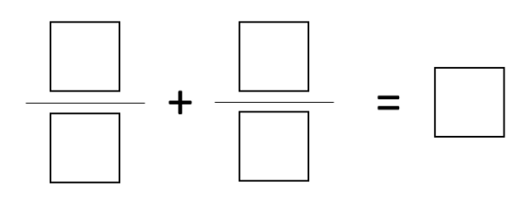
DNA
Directions: Using the digits 1-9, fill in the blanks to make a whole number sum. Use each digit only at most one time. Can you make all whole numbers from 1 to 9?
Notes:
Option 1

Slide 2
Adding & Subtracting Fractions with Mixed numbers
Unit 4D3

Slide 3
Prior learning:
Place value.
Percentage as an amount out of 100.
Multiplication and division.
Ordering integers on a number line.
Unit 5 - Fractions, Decimals
and Percentages
Shading fractions of diagrams, equivalence and simplification of fractions.
57-59,61
Convert between improper fractions and mixed numbers.
63-64
65-66,
67-70
Four operations with mixed and improper fractions.
60
Order fractions.
Find fractions of an amount.
77
Calculate a percentage of an amount and percentage change.
84-90
73-76,
82-83
Convert between fractions, decimals and percentages and compare them.
Calculate simple and compound interest.
93-94
Next steps:
Calculating proportions of pie charts.
Using multipliers.
Reverse percentages.
Reverse fractions.

Slide 4
Progress Indicators:

Slide 5
RECAP
How do we change these to improper fractions?

Slide 6
How do we change these to mixed numbers?

Slide 7
Worked Example
Your Turn
Calculate:
$$2\frac{1}{2} + 3\frac{2}{5}$$
Calculate:
$$2\frac{1}{3} + 3\frac{2}{5}$$
Calculate:
$$2\frac{1}{2} − 1\frac{2}{5}$$
Calculate:
$$2\frac{1}{3} − 1\frac{2}{5}$$

Slide 8
1. $1\frac{1}{2}+ 1\frac{1}{3}$
2. $1\frac{1}{2}+ 1\frac{1}{4}$
3. $1\frac{1}{2}+ 1\frac{1}{5}$
4. $2\frac{1}{2}+2\frac{1}{5}$
5. $2\frac{1}{7}+ 1\frac{1}{3}$
6. $1\frac{x}{2}+ 1\frac{2x}{2}$
7. $2\frac{1}{2}− 1\frac{1}{3}$
8. $2\frac{1}{2}− 1\frac{1}{4}$
9. $2\frac{1}{2}−2\frac{1}{4}$
10. $2\frac{1}{4}−2\frac{1}{2}$
11. $3\frac{1}{5}−2\frac{1}{2}$
12. $2\frac{2x}{2}− 1\frac{x}{2}$

Slide 9
1. $1\frac{1}{2}+ 1\frac{1}{3}$
2. $1\frac{1}{2}+ 1\frac{1}{4}$
3. $1\frac{1}{2}+ 1\frac{1}{5}$
4. $2\frac{1}{2}+2\frac{1}{5}$
5. $2\frac{1}{7}+ 1\frac{1}{3}$
6. $1\frac{x}{2}+ 1\frac{2x}{2}$
$$2\frac{5}{6}$$
$$2\frac{3}{4}$$
$$2\frac{7}{10}$$
$$4\frac{7}{10}$$
$$3\frac{10}{21}$$
$$\frac{4+3x}{2}=2\frac{3x}{2}$$
7. $2\frac{1}{2}− 1\frac{1}{3}$
8. $2\frac{1}{2}− 1\frac{1}{4}$
9. $2\frac{1}{2}−2\frac{1}{4}$
10. $2\frac{1}{4}−2\frac{1}{2}$
11. $3\frac{1}{5}−2\frac{1}{2}$
12. $2\frac{2x}{2}− 1\frac{x}{2}$
$$1\frac{1}{6}$$
$$1\frac{1}{4}$$
$$\frac{1}{4}$$
$$−\frac{1}{4}$$
$$\frac{7}{10}$$
$$\frac{2+x}{2}=1\frac{x}{2}$$
@gjmcconnell88

Slide 10
We Do
Exam Question:
$$1\frac{2}{3}$$
$$\frac{1}{5}$$
2

Slide 11
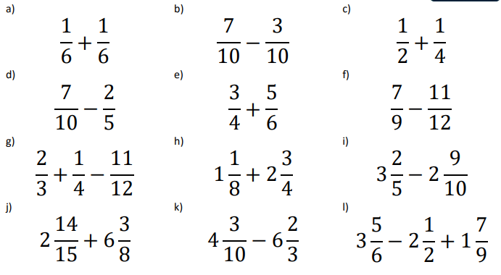
Demonstrate:

Slide 12
Demonstrate:
$1) 3\frac{3}{4} −2\frac{1}{2}$
$2) \frac{3}{5}+ 2\frac{1}{3}$
$$7\frac{3}{6}$$
$3)$
$$\frac{2}{8}$$
4

Slide 13
Connect
Complete:
 | Solve: | $$3\frac{3x}{4}−2\frac{x}{4}$$

