Slide 1
80/20 – THINK! What do you NEED to cover with your set
Grade | Learning Objective | Learning Outcome
1 | Describe the structure and function of the skeleton | Recall the structure of the skeleton Describe the functions of the skeletal system Explain how lifestyle choices can effect your bones
2
3

Slide 2
Skeleton
Do now activity: Explain how a bell-jar model can show us what happens inside the lungs when we breathe in and out.

Slide 3
Progress indicators
GOOD PROGRESS:
Recall the structure of the skeleton
Describe the functions of the skeletal system
OUTSTANDING PROGRESS:
Explain how lifestyle choices can effect your bones

Slide 4
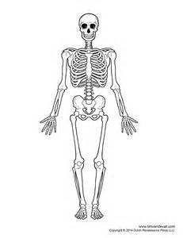
Bones, bones, bones!!!
https://www.youtube.com/watch?v=2gerXkG_8ME
Task: Watch the video and try to label the main bones of the human body!

Slide 5
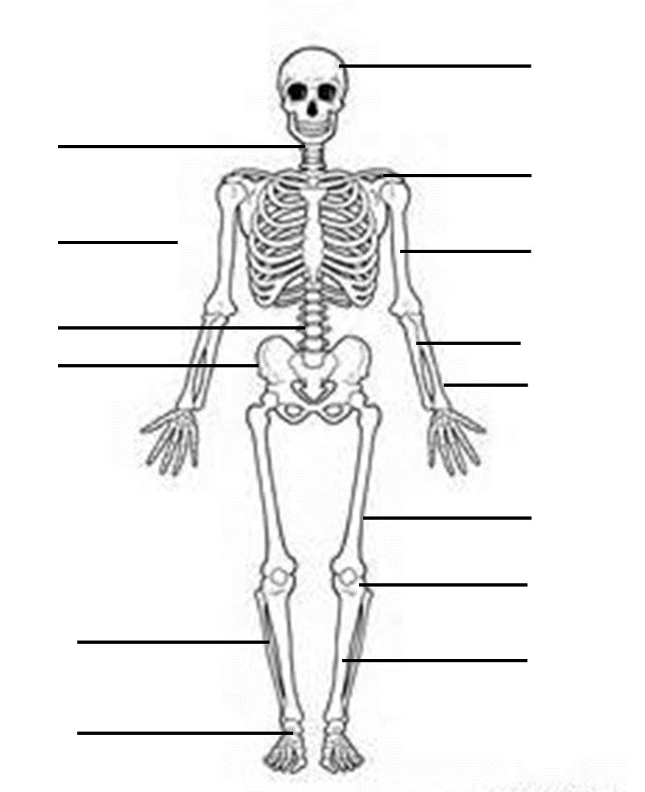

Slide 6
How many did you get?
skull
jaw bone
collar bone
sternum
humerus
vertebral column
ulna
pelvis
radius
femur
kneecap
fibula
tibia
ankle

Slide 7
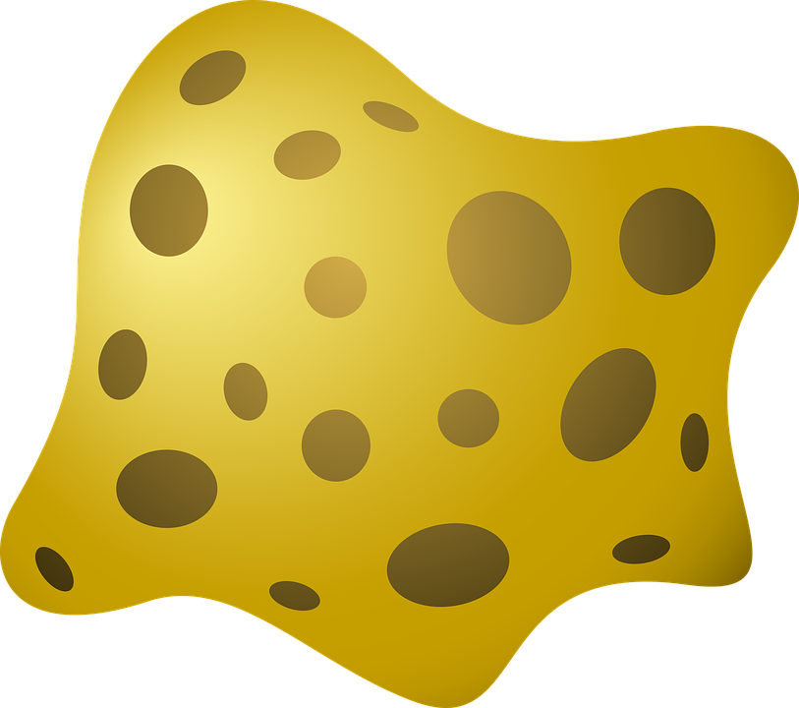
What are bones?
Bones are made from living tissue which has its own blood supply.
Compact bone
Spongy bone
Bone marrow
Bone is able to grow and change and can repair itself when damaged. Calcium and other minerals hep to make bones strong but also flexible.

Slide 8
Think > Pair > Share: What are some of the functions of the skeleton?
Functions of the skeleton

Slide 9
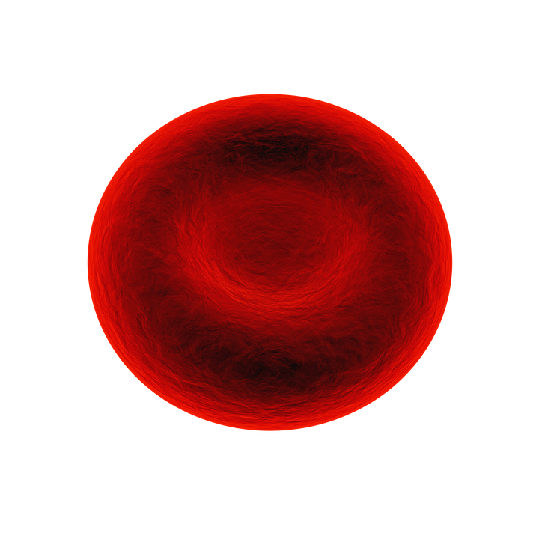
Self-assessment:
Support the body
Make blood cells
Functions of the skeleton
Protect vital organs
Help the body to move

Slide 10
Task: Complete the following sentences:
Word bank: protects, skull, skeleton, movement, support, joints, bone marrow, blood cells, red, white
Protection: bone is hard and rigid and _______ delicate organs e.g. ribs around heart and lungs, ____ protects the brain and the backbone protects the spinal cord.
______: without a skeleton you would not be able to sit, stand or hold yourself up.
________: the many _____ (where two bones meet) in your skeleton allow you to move. For example, the joint at the knee allows your leg to bend. Without joints, your skeleton would be rigid.
Produces blood cells: ____ ______ is in the centre of large bones. It is here where _____ _____are made. There are three types of blood cells – ____, white and platelets.

Slide 11
Self-assessment:
Protection: bone is hard and rigid and protects delicate organs e.g. ribs around heart and lungs, skull protects the brain and the backbone protects the spinal cord.
Support: without a skeleton you would not be able to sit, stand or hold yourself up.
Movement: the many joints (where two bones meet) in your skeleton allow you to move. For example, the joint at the knee allows your leg to bend. Without joints, your skeleton would be rigid.
Produces blood cells: bone marrow is in the centre of large bones. It is here where blood cells are made. There are three types of blood cells – red, white and platelets.

Slide 12
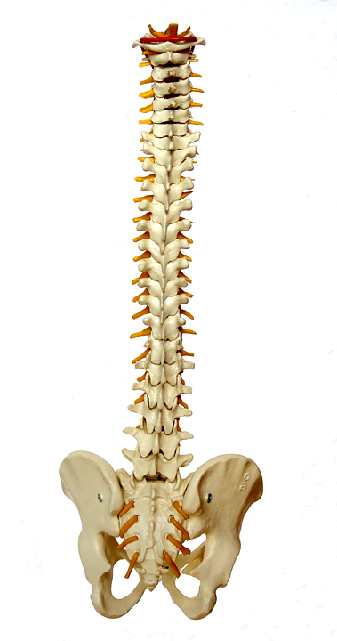
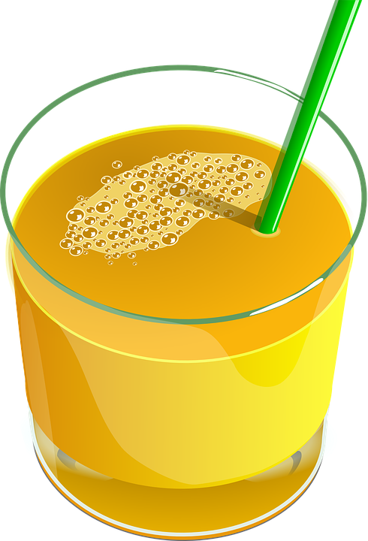
Task: Read the information sheet and answer the following questions:
What are animals with back bones known as?
What’s another word for your spine?
What is the role of the spinal canal?
How can carbonated drinks/fruit juices affect your teeth?
Explain how can highly acidic foods affect your bones.
Explain how you can strengthen your skeleton.

Slide 13
Vertebrates and invertebrates
Animals with backbones are vertebrates. The vertebral column, also known as the backbone or spine, is a bony skeletal structure found in vertebrates. It is formed from individual bones called vertebrae (singular: vertebra), which houses the spinal canal, a cavity that encloses and protects the spinal cord.
Looking after your skeleton
Your teeth are not bones but are part of the skeletal system.
Many people consume carbonated beverages, fruit juice and highly acidic foods every day but probably don't realize that they may be harming their teeth. The acid in the foods we eat and drink can cause tooth enamel to wear away and teeth can become sensitive and discoloured.
High acidic food intake can adversely affect your bones by causing them to lose calcium, weaken and not function properly.
Strengthen your skeleton by drinking milk and eating other dairy products (like low-fat cheese or frozen yogurt). They all contain calcium, which helps bones harden and become strong.
Be active! Another way to strengthen your bones is through exercise like running, jumping, dancing, and playing sports.

Slide 14
Self-assessment:
Animals with backbones are known as vertebrates.
Another name for your spine is your vertebral column or backbone.
The role of the spinal canal is a cavity which houses and protects the spinal cord.
Carbonated drinks/juices cause tooth enamel to wear away which causes teeth to become more sensitive and discoloured.
Highly acidic foods/drinks can lead to your bones losing calcium which could cause them to become weak and lose function over time.
You can strengthen your skeleton by eating foods rich in calcium, such as drinking milk and eating other dairy products. You can also strengthen your bones by exercising.

Slide 15
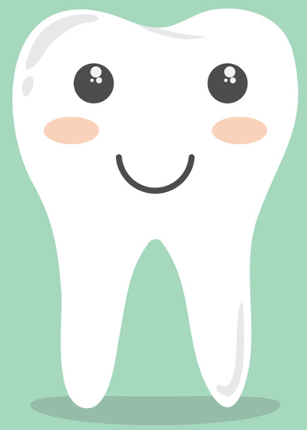
Plenary – True or False?
Your skeleton can be affected by whether you eat highly acidic foods
We are vertebrates because we have a back bone
Insects are also examples of vertebrates
You can strengthen your skeleton by drinking orange juice
Calcium is a type of vitamin which helps your bones grown stronger
True
True
False
False
True

Slide 16
Resources

Slide 18
Vertebrates and invertebrates
Animals with backbones are vertebrates. The vertebral column, also known as the backbone or spine, is a bony skeletal structure found in vertebrates. It is formed from individual bones called vertebrae (singular: vertebra), which houses the spinal canal, a cavity that encloses and protects the spinal cord.
Looking after your skeleton
Your teeth are not bones but are part of the skeletal system.
Many people consume carbonated beverages, fruit juice and highly acidic foods every day but probably don't realize that they may be harming their teeth. The acid in the foods we eat and drink can cause tooth enamel to wear away and teeth can become sensitive and discoloured.
High acidic food intake can adversely affect your bones by causing them to lose calcium, weaken and not function properly.
Strengthen your skeleton by drinking milk and eating other dairy products (like low-fat cheese or frozen yogurt). They all contain calcium, which helps bones harden and become strong.
Be active! Another way to strengthen your bones is through exercise like running, jumping, dancing, and playing sports.

