Slide 1
1. How did Galen develop the theory of four humours? | 2. How did doctors use the four humours to treat patients?
3. How did Vesalius develop the knowledge of anatomy? | 4. How did Snow develop the understanding of disease?
Challenge 1 – What is the connection between these 4?

Slide 2
Health and the People: What can we remember?
Classwork
Good
You can identify key factors in the development of treatment
You can describe the key events that led to progress/change in the treatment of disease
Outstanding
You can assess which factor is the most influential in the progress of the treatment of disease

Slide 4
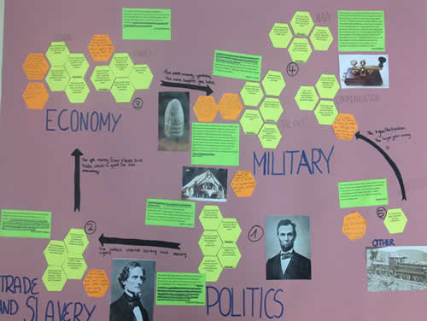
Instructions.
1. Organise these hexagons into categories of your choice. You can only place a hexagon touching another it links to.
2. When you are happy with your categories and hexagon placement, glue them to your paper.
3. Add a title for each category you have created, and you can colour-code hexagons if it helps you.
4. Use the blank hexagons to add new information.
5. Do any of your categories link to each other? Add arrows to show the links, then add reasons for the link along the arrow.
CHALLENGE: Decide which single event, person or factor was the biggest cause of World War One and explain why.

Slide 5
Hundreds of high-tech medical and surgical treatments are being carried out because of the modern technology e.g. x-rays, micro-surgery, transplants, etc
In the 18th C Doctors were increasingly trained to use scientific methods and doctors were trained more professionally.
New herbs started to appear from other countries. Appearance of new remedies opened up a huge number of possibilities for treatments and cures
People started to realise infection was everywhere – dirty clothes, medical instruments and unwashed hands.
Religious treatments were encouraged by the Church (prayer), even doctors would recommend supernatural treatments
In the Middle Ages, Galen was popular with the Church, which meant that his work was widely promoted and taught to doctors.
Nightingale created different wards separating surgical patients and infectious patients, making it safer for patients
Lister’s use of carbolic acid as an antiseptic in surgery made it safer and cleaner for patients
Once the three major problems of surgery had been solved, doctors were able to carry out more daring and intrusive surgery.
Simpson’s discovery of chloroform as an anaesthetic more surgery took place that was more complicated and lengthier
Fleming discovered the antibiotic penicillin, which was developed, and mass produced by Florey and Chain and used to save soldiers during WWI
Galen and Hippocrates ideas were believed as there seemed to be evidence to prove their ideas were correct and they covered everything in detail.
During the Black Death, supernatural and natural treatments were very popular and encouraged
Printing press allowed for individuals work to be published and spread
Vesalius had proved some of Galen’s work wrong which made it easier for other scientists and physicians to make new discoveries.
The Industrial Revolution saw developments in medicine. Many pieces of scientific and medical equipment improved because industries developed the ability to create more precise equipment.
Only after the work of Pasteur and Koch in the late nineteenth century could Snow’s discovery and Jenner’s vaccination be understood and others developed.
In the 18th C people would receive treatment and surgery in their own homes as it was cleaner
Advances in microscopes and the ability to produce higher-powered images enabled scientists to identify the DNA
Growth of alchemy in the Renaissance period meant that people began to look for chemical cures for diseases instead of relying on herbs and blood-letting.
Better understanding of DNA and how each part of the genome affects the body, helped scientists to recognise genetic disorders
In 1948 the government set up the National Health Service (NHS). This gave millions of people access to free healthcare for the first time.
Elrich created a magic bullet– a chemical cure attacking the microbes in the body causing disease, at the same time, leaving the body unharmed
Harvey did help prove blood circulation and the importance of the heart BUT… had little practical use in medical treatment

Slide 7
1. Why was the NHS significant? | 2. Why germ theory significant?
3. Why was Manchuria significant? | 4. Why was the Munich agreement significant?
Challenge 1 – What is the connection between these 4?

Slide 8
Health and the People: What can we remember?
Classwork
Good
You can identify key factors in the development of treatment
You can describe the key events that led to progress/change in medicine
Outstanding
You can assess which factor is the most influential in the change in medicine

Slide 9
Plan answers to the following questions:
‘Government action is the most important reason why there were improvements in care and treatments in hospitals in the twentieth century.’ How far do you agree?

Slide 10
‘Individuals were the most important reason why there were improvements in understanding the causes of illness and disease in the twentieth century.’ How far do you agree?

Slide 11
‘Communication was the most important reason why there were improvements in treatments in the twentieth century.’ How far do you agree?

Slide 12
‘Chance was the most important reason why there were improvements in medicine in the twentieth century.’ How far do you agree?

Slide 13
‘Science and technology was the most important reason why there were improvements in surgery.’ How far do you agree?

