Slide 1
Creative Writing Challenges

Slide 2
Choose a category
10 Minute Stories
Whose is this?
Location, location, location
Word Limit

Slide 3
10 Minute Stories
Objective:
Create a story within ten minutes based on the stimulus shown on screen. This could be a title, an opening line, an image or an idea.
Continue
Back

Slide 4
Whose is this?
Objective:
Write a short story or description based on the item you see onscreen, explaining who it belongs to.
Continue
Back

Slide 5
Location, location, location
Objective:
Write a short description of the given location. Keep an eye on your time limit!
Continue
Back

Slide 6
Word Limit
Objective:
Write a story based on the stimulus and the given word limit.
Continue
Back

Slide 7
10 MINUTE STORIES
1
2
3
4
5
6
7
8
9
Back

Slide 8
10 Minute Stories
Write about a time when you felt scared.
Back to 10 Minute Stories

Slide 9
10 Minute Stories
Write a story that begins with the line:
They had almost made it.
Back to 10 Minute Stories

Slide 10
10 Minute Stories
Write a story with the following title:
The Phone Call
Back to 10 Minute Stories

Slide 11
10 Minute Stories
Write about an event you have been to or been involved in. This could be a school show, an assembly, a presentation, or anything similar.
Back to 10 Minute Stories

Slide 12
10 Minute Stories
Your story must be set in your local town or village. Create a story about something strange happening there.
Back to 10 Minute Stories

Slide 13
10 Minute Stories
Write a story about something strange or odd happening in your school.
Back to 10 Minute Stories

Slide 14
10 Minute Stories
Write about a time you felt ashamed or embarrassed.
Back to 10 Minute Stories

Slide 15
10 Minute Stories
Write a story with the following title:
The Emergency.
Back to 10 Minute Stories

Slide 16
10 Minute Stories
Write a story beginning with the following:
I had never seen anything so disgusting in my life.
Back to 10 Minute Stories

Slide 17
WHOSE IS THIS?
1
2
3
4
5
6
7
8
9
Back

Slide 18
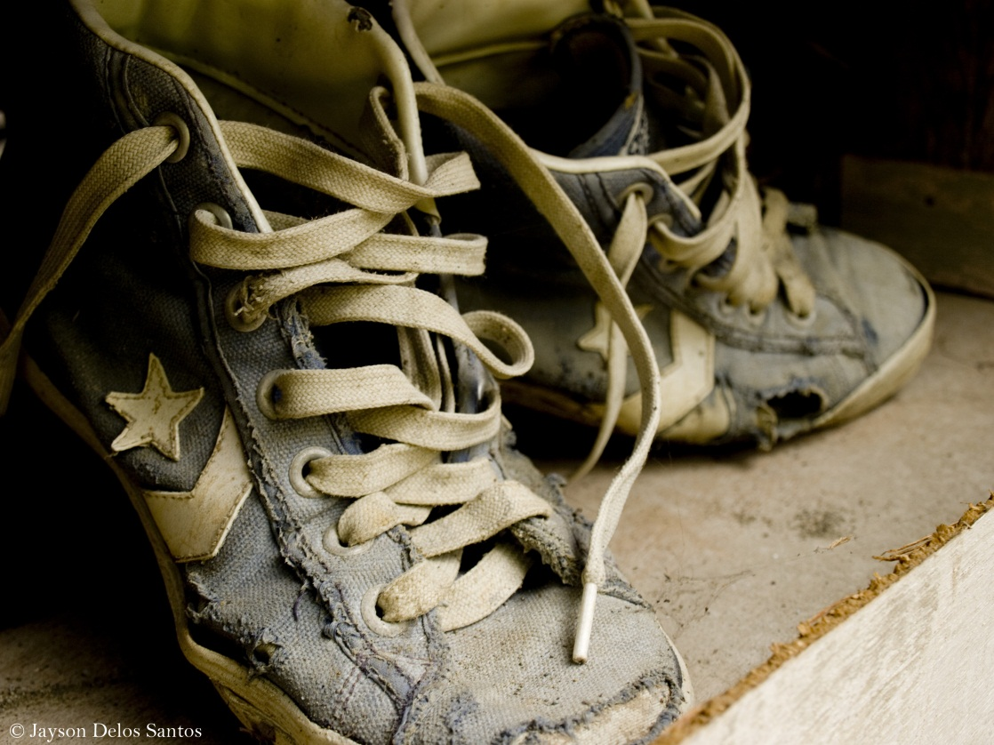
5 minutes
Consider:
The colour
The condition
The style
The brand
Who do these shoes belong to? Where have they been? What have they seen? Write about the shoes or the person who wears them.
Back to Whose is this?

Slide 19
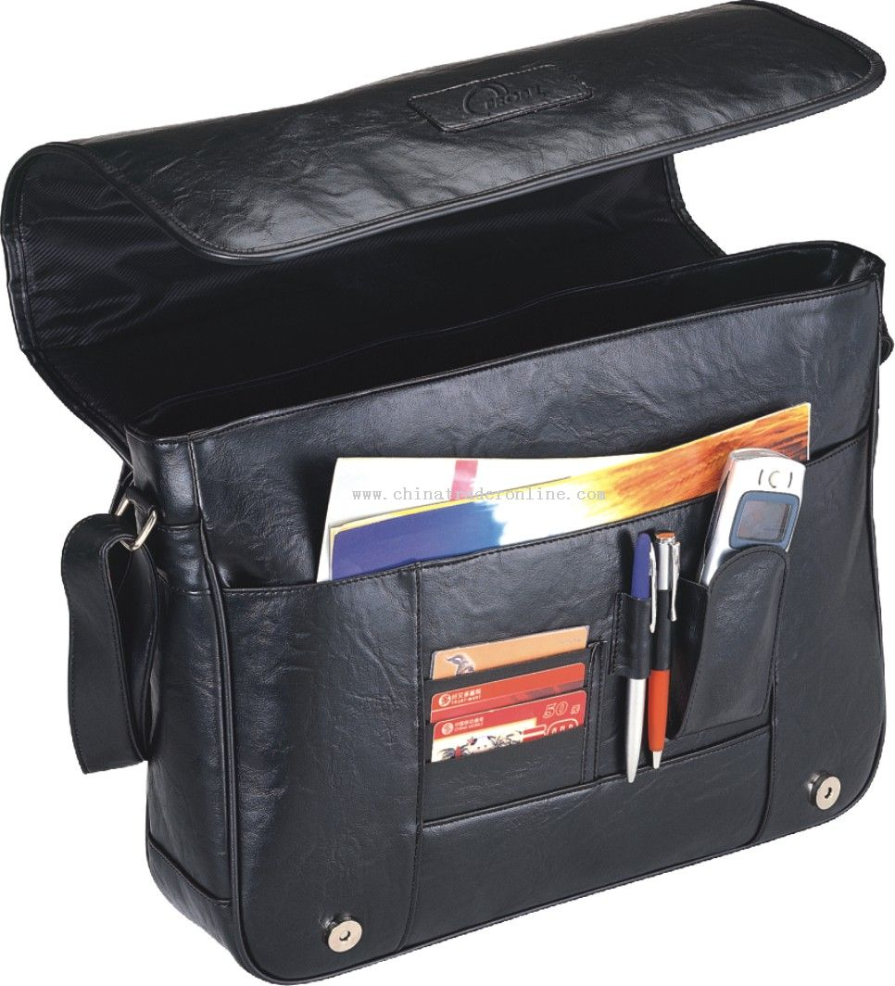
7 minutes
Consider:
The colour
The condition
The style
The accessories
Who does this bag belong to? Where has it been? What has it seen? Write about the bag or the person who owns it.
Back to Whose is this?

Slide 20

7 minutes
Consider:
The colour
The condition
The style
The game being played
Who does this console belong to? Where has it been? What has it seen? Write about the console or the person who owns it.
Back to Whose is this?

Slide 21
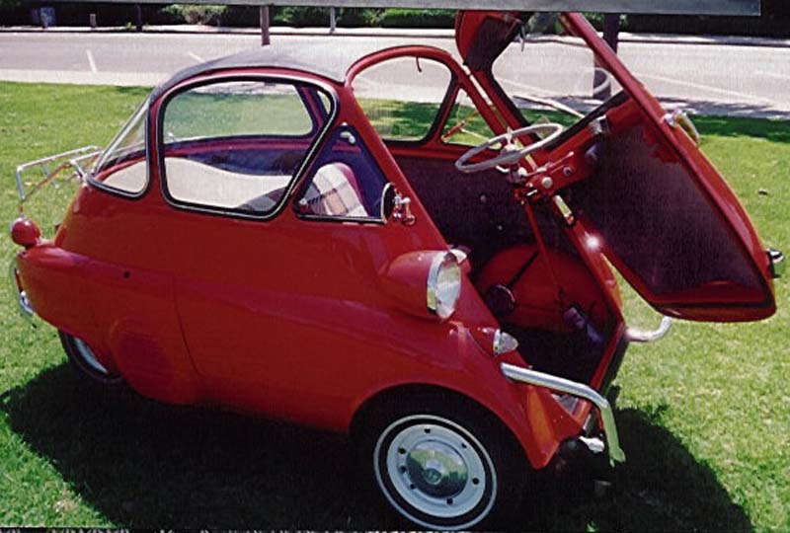
7 minutes
Consider:
The colour
The condition
The style
Who does this car belong to? Where has it been? What has it seen? Write about the car or the person who owns it.
Back to Whose is this?

Slide 22
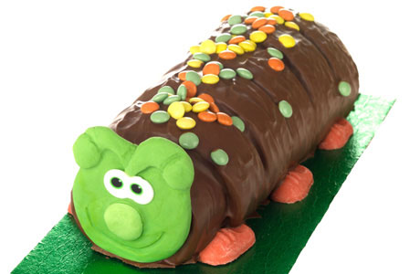
5 minutes
Consider:
The colour
The condition
The style
The event
Who does this cake belong to? Where has it been? What has it seen? Write about the cake or the person who created it or is about to eat it.
Back to Whose is this?

Slide 23
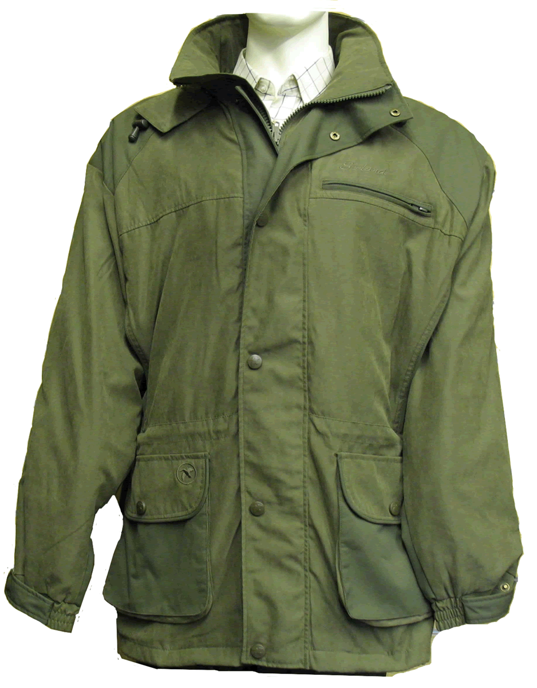
5 minutes
Consider:
The colour
The condition
The style
The brand
Who does this coat belong to? Where has it been? What has it seen? Write about the coat or the person who owns it.
Back to Whose is this?

Slide 24
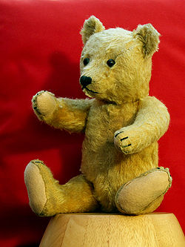
6 minutes
Consider:
The colour
The condition
The style
The age
Who does this bear belong to? Where has it been? What has it seen? Write about the bear or the person who owns it.
Back to Whose is this?

Slide 25
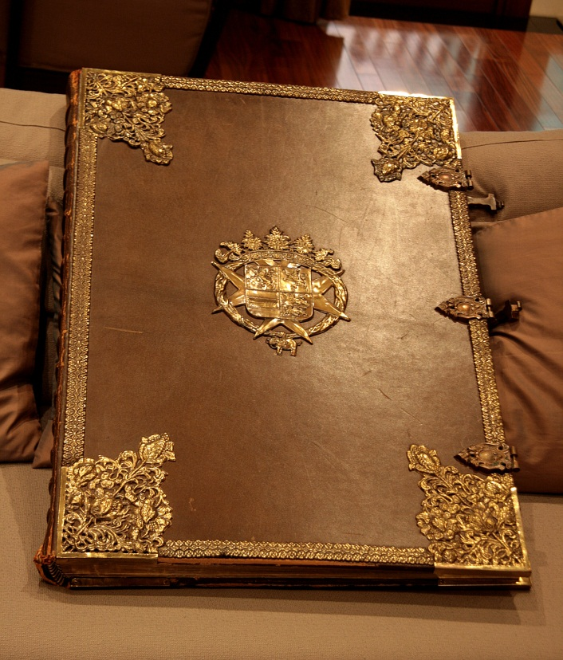
8 minutes
Consider:
The colour
The condition
The style
The age
Who does this book belong to? Where has it been? What has it seen? Write about the book or the person who owns it.
Back to Whose is this?

Slide 26
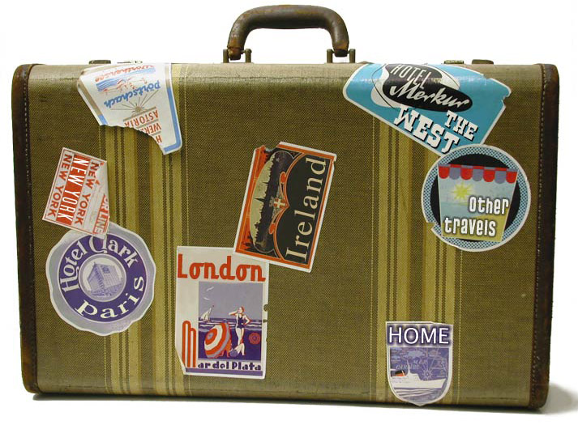
9 minutes
Consider:
The colour
The condition
The style
The accessories
Who does this suitcase belong to? Where has it been? What has it seen? Write about the suitcase or the person who owns it.
Back to Whose is this?

Slide 27
LOCATION, LOCATION, LOCATION
1
2
3
4
5
6
7
8
9
Back

Slide 28

7 minutes
Write a description of what you would do and see on this beach. Don’t forget to use the five senses to describe what’s around you.
Back to Location, location, location

Slide 29
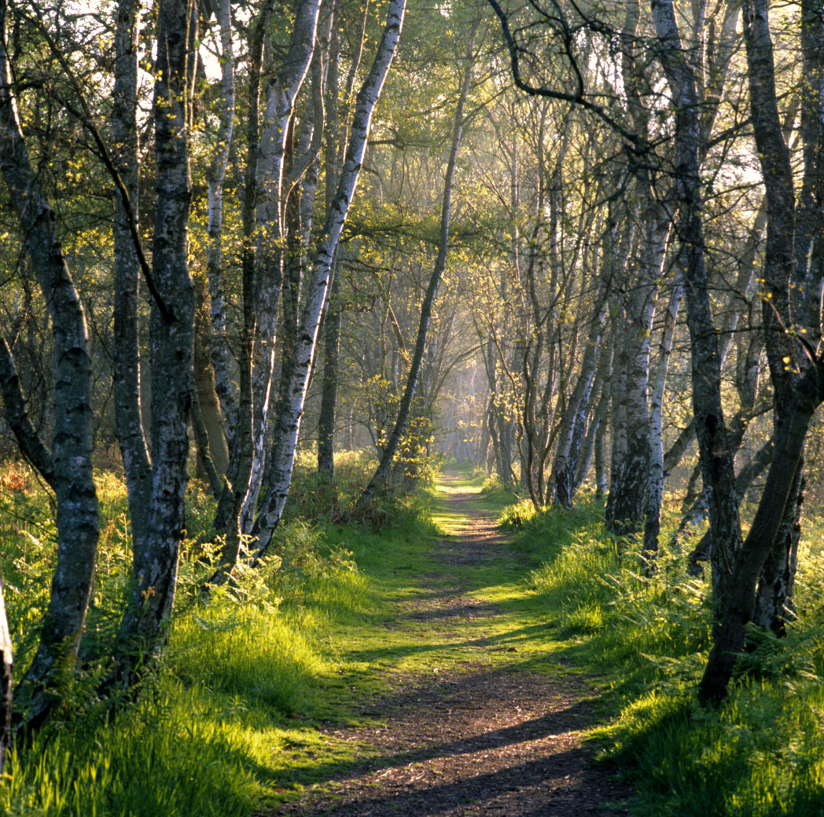
6 minutes
Write a description of what you would see while walking down this path. Don’t forget to use the five senses to describe what’s around you.
Back to Location, location, location

Slide 30
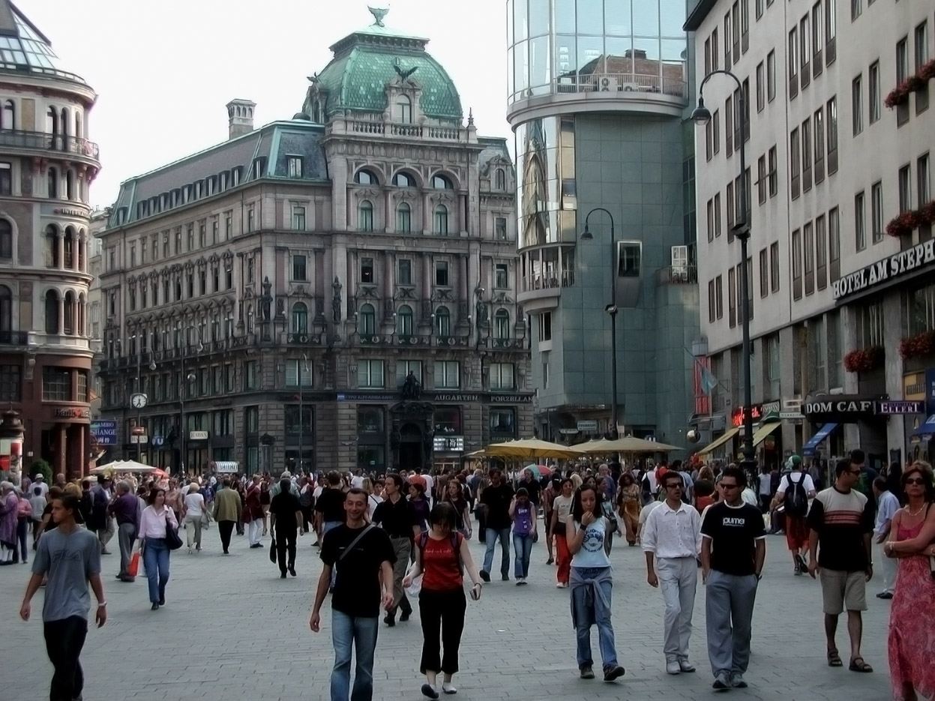
7 minutes
Write a description of what you would do and see in this city centre. Don’t forget to use the five senses to describe what’s around you.
Back to Location, location, location

Slide 31

5 minutes
Write a description of what you would do and see on this farm. Don’t forget to use the five senses to describe what’s around you.
Back to Location, location, location

Slide 32
8 minutes
Write a description of what you would do and see on this mountainside. Don’t forget to use the five senses to describe what’s around you.
Back to Location, location, location

Slide 33
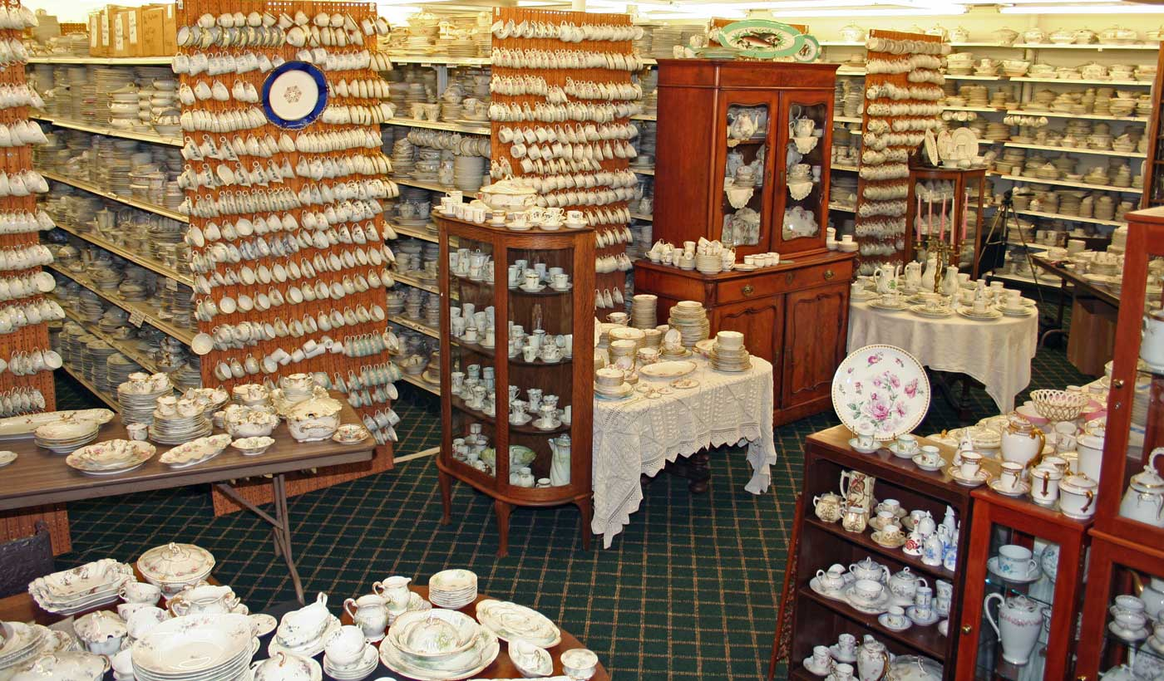
6 minutes
Write a description of what you would do in this shop and who you might see. Don’t forget to use the five senses to describe what’s around you.
Back to Location, location, location

Slide 34
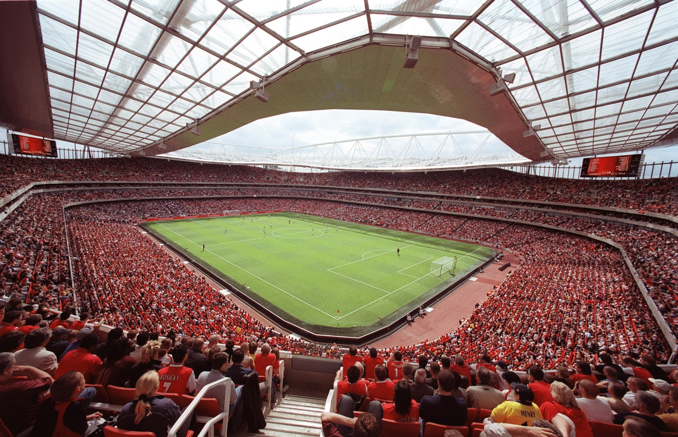
7 minutes
Write a description of what you would do and see in this stadium. Don’t forget to use the five senses to describe what’s around you.
Back to Location, location, location

Slide 35
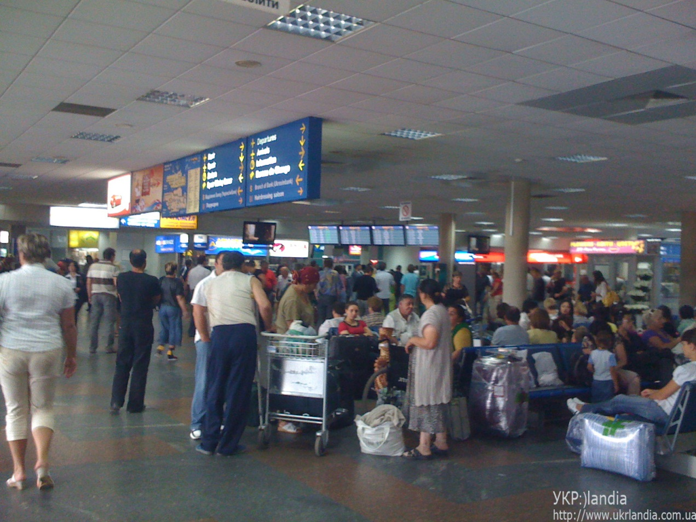
8 minutes
Write a description of what you would see in this terminal. Don’t forget to use the five senses to describe what’s around you.
Back to Location, location, location

Slide 36
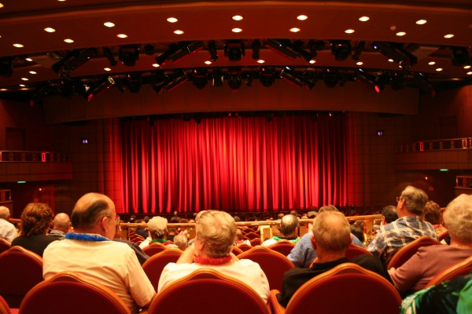
8 minutes
Write a description of what you are about to see and who is around you. Don’t forget to use the five senses to describe what’s around you.
Back to Location, location, location

Slide 37
WORD LIMIT
1
2
3
4
5
6
7
8
9
Back

Slide 38
In 100 words or less, write a story with the title:
The Visitor.
Back to Word Limit

Slide 39
In 100 words or less, write a story about a wild animal stalking its prey in the jungle.
Back to Word Limit

Slide 40
In 100 words or less, write a story beginning with the following:
He had to calm down.
Back to Word Limit

Slide 41
In 80 words or less, write a story with the title:
Being Alone.
Back to Word Limit

Slide 42
In 80 words or less, write a story about someone waiting for an important message.
Back to Word Limit

Slide 43
In 80 words or less, write a story about someone’s journey on public transport.
Back to Word Limit

Slide 44
In 50 words or less, write a story with the title:
The Cat.
Back to Word Limit

Slide 45
In 50 words or less, write a story about someone watching somebody else.
Back to Word Limit

Slide 46
In 10 words or less, write a story about a tragedy.
Back to Word Limit

