Slide 1
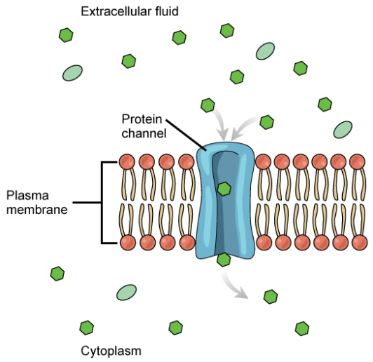
Active Transport
Do now activity:
Compare the process of diffusion to osmosis, what are the similarities? What are the differences?
Think about the term ‘active transport’ – how do you think this process might differ from diffusion and osmosis?
Notes:
Image: Biology: Active Transport by CNX OpenStax licensed under CC-by-SA 4.0

Slide 2
Progress indicators
GOOD PROGRESS:
To describe the process of active transport
To be able to compare the process of active transport to diffusion and osmosis
OUTSTANDING PROGRESS: To explain why active transport is an important process for living organisms

Slide 3
Osmosis and diffusion are passive processes, this means substances will always move down a concentration gradient.
High concentration
Low concentration
Active transport is an active process, this means substances are moved against their concentration, from an area of low concentration to an area of high concentration.
Low concentration
High concentration

Slide 4
Task: Watch the video on active transport and answer the following questions:
What is required in order for active transport to take place?
What is the name of the structure which carries molecules across the cell membrane during active transport?
Which process released the energy needed for active transport?
Give an example of a plant cell where active transport commonly takes place.
Which organelle is prevalent (more common) in cells that carry out active transport more frequently?
https://www.youtube.com/watch?v=eDeCgTRFCbA

Slide 5
Self-assessment:
Energy is needed for active transport to occur
A protein carrier which spans the cell membrane
Respiration releases energy in the form of ATP, this is required for active transport to take place.
An example of a plant cell is a root hair cell, this is where mineral ions are actively pumped from the soil into the plant from a low to a high concentration.
Mitochondria is more prevalent in cells where active transport occurs more frequently. Mitochondria is the site of respiration in cells, therefore more energy will be released.

Slide 6
Diffusion, osmosis and active transport
Task: Sort the following statements into the correct columns.
Remember: The statements can apply to more than one process!
Diffusion
Osmosis
Active Transport
Passive process
Active process
Requires energy
Does not require energy
Moves molecules against a concentration gradient
Move molecules down a concentration gradient
Moves substances from a high to a low concentration
Moves substances from a low to a high concentration
Movement of water only

Slide 7
Diffusion
Osmosis
Active Transport
Passive process
Does not require energy
Moves substances down a concentration gradient
Moves substances from a high to a low concentration
Passive process
Does not require energy
Moves substances down a concentration gradient
Moves substances from a high to a low concentration
Movement of water only
Active process
Requires energy
Moves molecules against a concentration gradient
Moves substances from a low to a high concentration

Slide 8
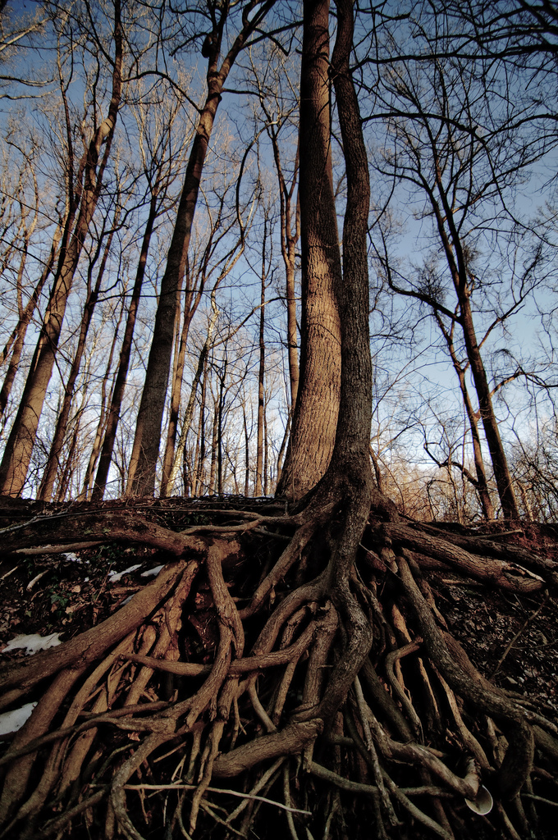
The importance of active transport
Active transport is widely used in cells and there are particular examples where this is especially important.
Plants often live in soil where mineral ions are usually found in dilute solutions, more dilute than the solution within the plants root hair cells.
By using active transport, the plant can still absorb the mineral ions against the concentration gradient.
Notes:
Image: Rooted by AnyaLogic licensed underCC-by-SA 2.0

Slide 9
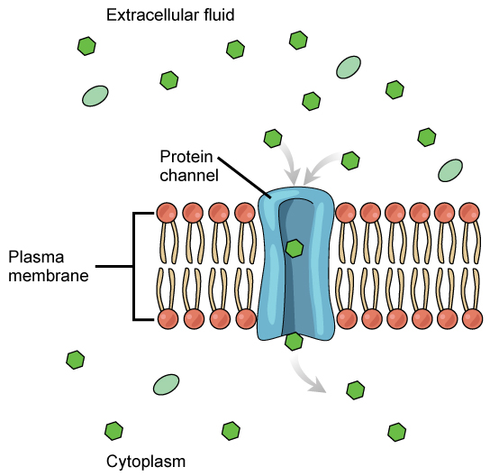
In humans, an example of active transport is the active absorption of glucose from your gut and kidney tubules into your blood. This is often done against a large concentration gradient.
Glucose is needed for respiration so it is important to get as much as possible from the gut.
Quick Check:
Describe how active transport works in a cell (4 marks)
Explain why cells that carry out a lot of active transport also have many mitochondria (2 marks)
Notes:
Image: Biology: Active Transport by CNX OpenStax licensed under CC-by-SA 4.0

Slide 10
Plenary: Past-paper exam question:
Epithelial cells carry out active transport.
a) Name one food molecule absorbed into epithelial cells by active transport. (1)
b) Why is it necessary to absorb some food molecules by actvie transport? (1)
c) Suggest why epithelial cells have many mitochondria. (2)
d) Some plants also carry out active transport, give on substance that plants absorb by active transport. (1)

Slide 11
Self-assessment:
Sugar / glucose 1
Against a concentration gradient / from a low to a high concentration 1
Required energy
Derived from respiration 2
d) Minerals / ions / nitrates / phosphates 1

Slide 12
What is required in order for active transport to take place?
What is the name of the structure which carries molecules across the cell membrane during active transport?
Which process released the energy needed for active transport?
Give an example of a plant cell where active transport commonly takes place.
Which organelle is prevalent (more common) in cells that carry out active transport more frequently?
What is required in order for active transport to take place?
What is the name of the structure which carries molecules across the cell membrane during active transport?
Which process released the energy needed for active transport?
Give an example of a plant cell where active transport commonly takes place.
Which organelle is prevalent (more common) in cells that carry out active transport more frequently?

