Slide 1
Mind to be Kind
Act of Kindness
Tell someone that you love them!
Theme of the Week: Patience #Learningthatinspires.

Slide 2
Our values

Slide 3
We are all in this together
Well done. We have survived our first week of a national lockdown.
We are getting used to the constraints of social distancing and self-isolation.
To help you through these difficult times, we have put together some more ideas that might be helpful.
Together we can get through whatever the coming days, weeks and months may throw at us. Please be patient.

Slide 4
Be kind to your mind
During this extraordinary time in your lives, things have changed, things are different and so it will become very important to be kind to those around us.
Also, you need to be kind to yourself and be kind to your mind.
This may take some time to establish so be patient.
Patience is calmly accepting that things can happen in a different order than the one you have in your mind.
Patience is when you’re supposed to be angry or frustrated but you choose to understand.

Slide 5
What are you grateful for?
Task
Write your own list of things you are grateful for.
Grateful for:
Being alive
Being healthy
Sunny days
Watching the sun rise/set
Good music

Slide 6
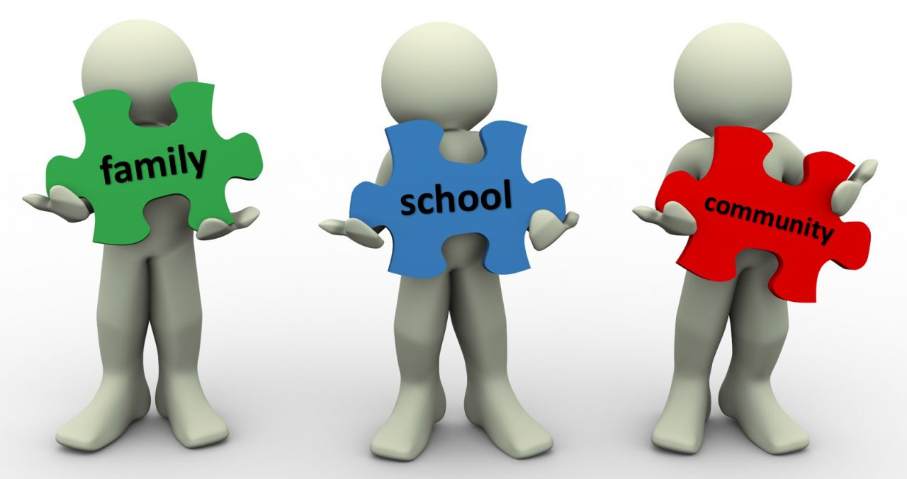
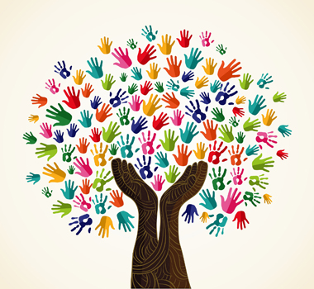
School community challenge
Coming soon, we will be asking you to submit videos of yourselves showing off your sporting skills.
Record yourselves demonstrating kick ups, scoring skills, juggling, handstands, gymnastics or any other sporting skill (it only needs to be a few seconds long).
The best videos will be shared on our Facebook page. Keep checking for info.
Come on, let’s do this!
Notes:
Short video clip 51 secs

Slide 7
Wellbeing
Maintain a routine – plan out what you will do each day.
Remember the basics – eat healthy foods/keep hydrated.
Keep moving – 30 minutes of exercise.
Manage your time – make a to-do list e.g. learn to sing, get enough sleep.
Mindful colouring – sketch/draw a picture and colour it in.
Music – listen to some calming or your favourite music/write a song or poem.
Keep a journal – write down how you are feeling.
Control – 3 things in your control: your thoughts, your dreams & your actions.
Laughter – tell a silly joke, play a silly game or watch a comedy.

Slide 8
Wellbeing tip of the week
Patience is caring, patience is kind, patience will help to calm your mind.
https://www.mind.org.uk/information-support/tips-for-everyday-living/wellbeing/wellbeing/

Slide 9
What are you anxious about?
Task
Write down any anxious thoughts you may have.
Now walk away, leave them and do some exercise.
A few hours later:
Write down if what you were anxious about actually happened, whether it was as bad as you expected and what you did to cope with the situation.

Slide 10
LET’S
GET
TALKING
Do a virtual lunch date with friends and family
Set the table
Video call friends or family
Talk
Laugh
Eat
Enjoy

Slide 11
Weekly Puzzle Corner - Wordsearch
Can you complete this in 5 minutes?

Slide 12
Weekly Puzzle Corner - Split words
This is an anagram game. You are given a theme along with a group of words whose letters are jumbled.
To solve the puzzle, the letters must be rearranged to display the correct word.
Theme: FIRE FIGHTING

Slide 13
Positive Quotes
If you have to choose between being kind and being right, choose being kind and you will always be right.
Being kind is classy.
Don’t be pushed around by the fears in your mind, be led by the dreams in your heart.
Be mindful even if your mind is full.
If the words you spoke appeared on your skin, would you still be beautiful?

Slide 14
Mind to be Kind
Act of Kindness
Tell someone that you love them!
Theme of the Week: Patience #Learningthatinspires.

