Slide 1
Component 3 exam prep and revision
Good progress: To identify the social factors and give examples.
Excellent progress: to demonstrate knowledge and understanding of the social factors to a given scenario and apply the pies to show how it affects health and well being.

Slide 2
Social, emotional and cultural factors…
Here are a list of social, emotional and cultural and lifestyle factors:
Social interactions
Stress
Willingness to seek help or access services
Can you find any factors in this exam?

Slide 3
Social, emotional and cultural factors…
Here are a list of social, emotional and cultural and lifestyle factors:
Social interactions
Stress
Willingness to seek help or access services
Can you find any factors in this exam?

Slide 4
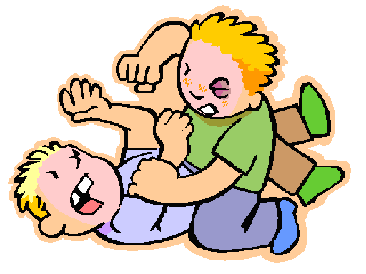
relationships…
Unsupportive relationships
Examples of bad relationships:
Bullying
Bereavement
Neglect
Abuse
Being controlled
s
V
Supportive relationships
Examples of good relationships:
Having good friends
Family
Partners
Support from professionals (nurses doctors)

Slide 5
Social, emotional and cultural factors…task
Task:
What supportive relationships did Brian have? (1)
How have the relationships identified been turned into unsupportive ones? (1)
Create a mini PIES chart on how Brian’s development has been affected by the change of unsupportive relation ships.. (8)

Slide 6
relationships…
Social isolation
Examples of being socially isolated:
Bullying
Bereavement
Divorce
Being mentally ill
Homeless
Being disabled
Personal difficulties
Living with a condition (autism)
s
V
Social integration
Examples of social groups:
School (or any other form of education)
Being employed
Family
Friends
Being part of religion
Culture
LGBT
Gender

Slide 7
relationships…task
Social isolation
Examples of being socially isolated:
Bullying
Bereavement
Divorce
Being mentally ill
Homeless
Being disabled
Personal difficulties
Living with a condition (autism)
Seeking help:
Think about a person’s health and well being…
Use the examples of social groups and social isolation… what services may you need to improve your health and well being (8)?
Social integration
Examples of social groups:
School (or any other form of education)
Being employed
Family
Friends
Being part of religion
Culture
LGBT
Gender

Slide 8
relationships…task
Answers:
Councellor
Job centre
Financial help (loans from families and friends)
Religious guidance (funerals, births, deaths, getting married (marriage councillor)
Being part of religion
Cultural routines
LGBT community
Gender specific doctors
Charities (Autism outreach)
Bering given disabled badges
Legal advice
Your local council
Homeless shelters
Your GP

Slide 9
Stress…
What is stress?
Stress is when you have a mental or emotional strain, coming from a demand which is made on you.
Examples of stress:
The death of a loved one.
Divorce.
Loss of a job.
Increase in financial obligations.
Getting married.
Moving to a new home.
Chronic illness or injury.
Emotional problems (depression, anxiety, anger, grief, guilt, low self-esteem).
Taking care of an elderly or sick family member.
Traumatic event, such as a natural disaster, theft, rape, or violence against you or a loved one.

Slide 10
Stress…task
Short term affects of stress: | Long term affects of stress:
Feeling cold | Loss of appetite
Less sensitive to pain | Breakdowns
Faster breathing | Accidents
Dry mouth | Headaches
Wide eyes | Mood swings
Pale face | High blood pressure
Faster heartbeat | Anxiety
Using one of the scenarios above, you need to:
Copy the scenario you have chosen…
Create a mini PIES on how the stress of the event can affect their development (8)….
Task:
Divorce – Angelina Jolie divorces Brad Pitt.
Getting married – Meghan Markle marries Prince Harry and Moves to a new home; Windsor Castle.
Traumatic event – Young girl loses her leg in Smiler crash.

