Slide 1
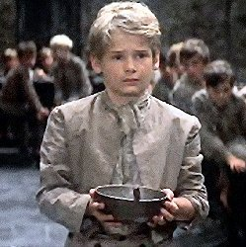
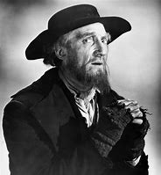
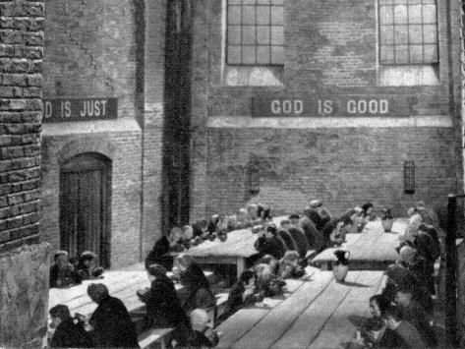
Lesson 12 Oliver
Title: Exploring The Workhouse
Lesson focus: analyse in depth and detail writers’ use of literary, rhetorical and grammatical features on different readers
Notes:
Learners respond independently

Slide 2
DNA
Mind map everything you can recall about Victorian England

Slide 3
Learning Journey
Last lesson we looked at the way Dickens had been influenced by Victorian justice system
We continued to deepen our contextual understanding whilst selecting and commenting on evidence from the text
Today we will bring together all of our learning so far and answer some questions on The Workhouse
Notes:
Learners respond independently

Slide 4
TDQs on the extract from Chapter 2- The Workhouse
List 2 things about the room from the first sentence
Who ladles out the gruel at meal-times?
Why do the bowls from which the orphans eat ‘…never wanted washing’?
For how many months did Oliver and his companions suffer ‘…slow starvation’?
Who decides that Oliver should ‘…walk up to the master…and ask for more’?

Slide 5
TDQs on the extract from Chapter 2- The Workhouse
Large stone hall, has a copper at the end of it
The Master
Because the orphans eat every last mouthful of the porridge- their bowls are literally polished clean
Three months
The other boys (they held a council)

Slide 6
Oliver Twist – Extract fro Chapter 2 – In the Workhouse
He rose from the table; and advancing to the master, basin and spoon in hand, said: somewhat alarmed at his own temerity: "Please, sir, I want some more." The master was a fat, healthy man; but he turned very pale. He gazed in stupefied astonishment on the small rebel for some seconds, and then clung for support to the copper. The assistants were paralysed with wonder; the boys with fear.
"What!" said the master at length, in a faint voice. "Please, sir," replied Oliver, "I want some more." The master aimed a blow at Oliver's head with the ladle; pinioned him in his arms; and shrieked aloud for the beadle. The board were sitting in solemn conclave, when Mr. Bumble rushed into the room in great excitement, and addressing the gentleman in the high chair, said, “Mr. Limbkins, I beg your pardon, sir! Oliver Twist has asked for more!" There was a general start. Horror was depicted on every countenance. "For (r)more!¯" said Mr. Limbkins. "Compose yourself, Bumble, and answer me distinctly. Do I understand that he asked for more, after he had eaten the supper allotted by the dietary?" "He did, sir," replied Bumble. "That boy will be hung," said the gentleman in the white waistcoat. "I know that boy will be hung." Nobody controverted the prophetic gentleman's opinion. An animated discussion took place. Oliver was ordered into instant confinement; and a bill was next morning pasted on the outside of the gate, offering a reward of five pounds to anybody who would take Oliver Twist off the hands of the parish. In other words, five pounds and Oliver Twist were offered to any man or woman who wanted an apprentice to any trade, business, or calling. "I never was more convinced of anything in my life," said the gentleman in the white waistcoat, as he knocked at the gate and read the bill next morning: "I never was more convinced of anything in my life, than I am that that boy will come to be hung."
The room in which the boys were fed, was a large stone hall, with a copper at one end: out of which the master, dressed in an apron for the purpose, and assisted by one or two women, ladled the gruel at meal-times. Of this festive composition each boy had one porringer, and no more- except on occasions of great public rejoicing, when he had two ounces and a quarter of bread besides. The bowls never wanted washing. The boys polished them with their spoons till they shone again; and when they had performed this operation (which never took very long, the spoons being nearly as large as the bowls), they would sit staring at the copper, with such eager eyes, as if they could have devoured the very bricks of which it was composed; employing themselves, meanwhile, in sucking their fingers most assiduously, with the view of catching up any stray splashes of gruel that might have been cast thereon. Boys have generally excellent appetites. Oliver Twist and his companions suffered the tortures of slow starvation for three months: at last they got so voracious and wild with hunger, that one boy, who was tall for his age, and hadn't been used to that sort of thing (for his father had kept a small cookshop), hinted darkly to his companions, that unless he had another basin of gruel (r)per diem,¯ he was afraid he might some night happen to eat the boy who slept next him, who happened to be a weakly youth of tender age. He had a wild, hungry eye; and they implicitly believed him. A council was held; lots were cast who should walk up to the master after supper that evening, and ask for more; and it fell to Oliver Twist. The evening arrived; the boys took their places. The master, in his cook's uniform, stationed himself at the copper; his pauper assistants ranged themselves behind him; the gruel was served out; and a long grace was said over the short commons. The gruel disappeared; the boys whispered each other, and winked at Oliver; while his next neighbours nudged him. Child as he was, he was desperate with hunger, and reckless with misery.

