Slide 1
GCSE ENGLISH LANGUAGE – PAPER ONE REVISION

Slide 2
REVISION - LESSON THREE

Slide 3
YOUR STARTER: GCSE LANGUAGE MEGA RETENTION QUIZ
Today you will be given fifteen questions. These questions all relate to the terms on your knowledge organiser.
You have seen ten of these questions before. These ten have been mixed up with new questions.
Remember, the purpose of this task is to help you remember the subject terminology you will need in the exam.
1. What is a concrete noun?
2. What is a verb?
3. What is a dynamic verb?
4. What is an exclamatory sentence?
5. What is olfactory imagery?

Slide 4
YOUR STARTER: GCSE LANGUAGE MEGA RETENTION QUIZ
Today you will be given fifteen questions. These questions all relate to the terms on your knowledge organiser.
You have seen ten of these questions before. These ten have been mixed up with new questions.
Remember, the purpose of this task is to help you remember the subject terminology you will need in the exam.
6. What is a noun?
7. What is an abstract noun?
8. If something is monosyllabic, what is it?
9. What is alliteration?
10. What is tactile imagery?

Slide 5
YOUR STARTER: GCSE LANGUAGE MEGA RETENTION QUIZ
Today you will be given fifteen questions. These questions all relate to the terms on your knowledge organiser.
You have seen ten of these questions before. These ten have been mixed up with new questions.
Remember, the purpose of this task is to help you remember the subject terminology you will need in the exam.
11. What is a static verb?
12. What is an interrogative sentence?
13. What is auditory imagery?
14. What is hyperbole?
15. What is a declarative sentence?

Slide 6
YOUR STARTER: GCSE LANGUAGE MEGA RETENTION QUIZ
Mark your answers. Remember, you will be tested on these again so try your best to remember them.
1. What is a concrete noun?
2. What is a verb?
3. What is a dynamic verb?
4. What is an exclamatory sentence?
5. What is olfactory imagery?
1. Nouns you can physically see or touch.
2. A word used to describe an action, state or occurrence.
3. A verb that shows continued or progressive action. They occur over a span of time.
4. A sentence type used to express surprise about something unexpected or extraordinary.
5. Imagery pertaining to odours, scents or the sense of smell.

Slide 7
YOUR STARTER: GCSE LANGUAGE MEGA RETENTION QUIZ
6. What is a noun?
7. What is an abstract noun?
8. If something is monosyllabic, what is it?
9. What is alliteration?
10. What is tactile imagery?
6. A word that refers to a person, place or thing.
Mark your answers. Remember, you will be tested on these again so try your best to remember them.
7. Words that name things you cannot physically see or touch. Things that are not tangible.
8. A word or utterance consisting of one syllable.
9. The occurrence of the same sound at the beginning of adjacent or closely connected words.
10. Imagery pertaining to physical textures or the sense of touch.

Slide 8
YOUR STARTER: GCSE LANGUAGE MEGA RETENTION QUIZ
11. Verbs that express a state rather than an action. They usually relate to thoughts, emotions, relationships, senses etc.
Mark your answers. Remember, you will be tested on these again so try your best to remember them.
11. What is a static verb?
12. What is an interrogative sentence?
13. What is auditory imagery?
14. What is hyperbole?
15. What is a declarative sentence?
12. A sentence which has a grammatical form showing it is a question.
13. Imagery pertaining to sounds, noises, music or the sense of hearing.
14. Exaggerated statements or claims not meant to be taken literally.
15. A declarative sentence (also known as a statement) makes a statement and ends with a full stop. It's named appropriately because it declares or states something.

Slide 9
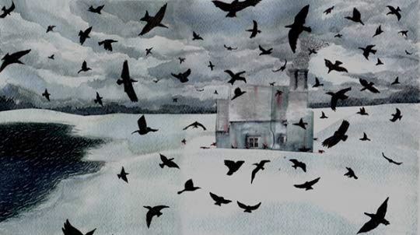
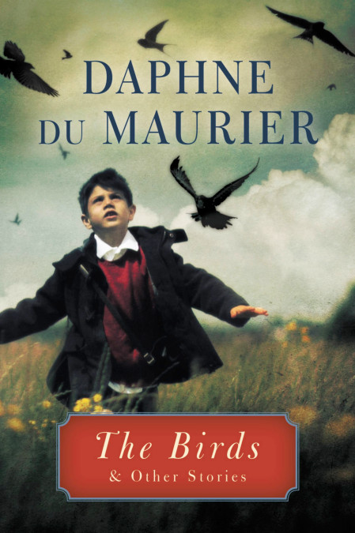
YOUR TASK: READ THE SOURCE
"The Birds" is a horror story by British writer Daphne du Maurier, first published in her 1952 collection, The Apple Tree. It is the story of a farmhand, his family, and his community that are attacked by flocks of birds and seabirds in kamikaze fashion.

Slide 10
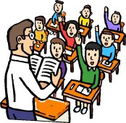
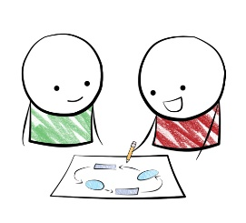

ORACY TASK: READING FOR MEANING
CLASS DISCUSSION:
1. Read the extract from ‘The Birds’ together as a class.
PAIRED DISCUSSION:
What do you think is happening in the extract? Which parts can you understand?
Is there any vocabulary you are unsure of?
TABLE DISCUSSION:
Discuss on the table what you think is happening in the extract.
Is there anything you are still unsure of? Discuss anything you find confusing as a table/
Thinking ahead to the requirements of each question, is there anything you have noticed in the extract that you could use in an answer?
CLASS DISCUSSION:
What is happening in this extract?
Is there anything we still don’t understand?
Thinking ahead to the requirements of each question, is there anything you have noticed in the extract that you could use in an answer?

Slide 11
YOUR TASK: IDENTIFYING EXPLICIT INFORMATION
Check your Horsforth revision grid. Where did you place your ability to identify and interpret explicit information?
Answer the question.
Q1. Read again the source from lines 4-7.
List four things you learn about the character, Nat Hocken.
1.
2.
3.
4.
Now mark your question with what you think you got.

Slide 12
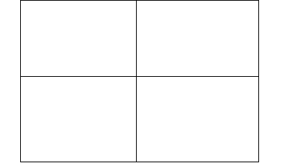
YOUR TASK: BE THE EXAMINER. MARK THE FOLLOWING ANSWERS
How many marks out of four would you give each candidate?
CANDIDATE 1
Nat Hocken has a wartime disability.
He had a pension.
He did not work full time at the farm.
He is married.
CANDIDATE 2
He has a wartime disability.
He works at a farm.
He has lighter jobs to do.
CANDIDATE 3
Nat Hocken, because of a wartime disability, had a pension and did not work full time at the farm. He worked three days a week, and they have him lighter jobs,
CANDIDATE 4
Nat Hocken has a wartime disability and has a pension.
He works three days a week.
He eats a pasty around noon.
He is married.

Slide 13


YOUR TASK: BE THE EXAMINER. MARK THE FOLLOWING ANSWERS
4 marks.
Candidate has correctly identified four things about the character, Nat Hocken.
CANDIDATE 1
Nat Hocken has a wartime disability.
He had a pension.
He did not work full time at the farm.
He is married.
CANDIDATE 2
He has a wartime disability.
He works at a farm.
He has lighter jobs to do.
3 marks.
Candidate has correctly identified three things about the character, Nat Hocken.
CANDIDATE 3
Nat Hocken, because of a wartime disability, had a pension and did not work full time at the farm. He worked three days a week, and they have him lighter jobs: hedging, thatching, repairs to the farm buildings. Although he was married, with children, his was a solitary disposition.
CANDIDATE 4
Nat Hocken has a wartime disability and has a pension.
He works three days a week.
He eats a pasty around noon.
He is married.
4 marks. Candidate includes a piece of information from outside the extract but because they have included TWO pieces of information in their first point, they receive a total of 4.
0 marks. Candidate has copied the extract out in full which is not allowed.

Slide 14
YOUR TASK: IDENTIFYING EXPLICIT INFORMATION
Answer the question.
Q1. Read again the source from lines 4-7.
List four things you learn about the character, Nat Hocken.
1.
2.
3.
4.
Can you add any more marks to your answer?

Slide 15
QUICK TERMINOLOGY TEST!
Imagery pertaining to
physical textures or the
sense of touch is called…
Tactile imagery
A word or utterance consisting
of one syllable is …
Monosyllabic.
Nouns you can physically
see or touch are called…
Concrete nouns

Slide 16


Slide 17
RESOURCES

Slide 18
CANDIDATE 2
He has a wartime disability.
He works at a farm.
He has lighter jobs to do.
CANDIDATE 2
He has a wartime disability.
He works at a farm.
He has lighter jobs to do.
CANDIDATE 4
Nat Hocken has a wartime disability and has a pension.
He works three days a week.
He eats a pasty around noon.
He is married.
CANDIDATE 4
Nat Hocken has a wartime disability and has a pension.
He works three days a week.
He eats a pasty around noon.
He is married.
CANDIDATE 3
Nat Hocken, because of a wartime disability, had a pension and did not work full time at the farm. He worked three days a week, and they have him lighter jobs: hedging, thatching, repairs to the farm buildings. Although he was married, with children, his was a solitary disposition.
CANDIDATE 3
Nat Hocken, because of a wartime disability, had a pension and did not work full time at the farm. He worked three days a week, and they have him lighter jobs: hedging, thatching, repairs to the farm buildings. Although he was married, with children, his was a solitary disposition.
CANDIDATE 1
Nat Hocken has a wartime disability.
He had a pension.
He did not work full time at the farm.
He is married.
CANDIDATE 1
Nat Hocken has a wartime disability.
He had a pension.
He did not work full time at the farm.
He is married.
Notes:
To print

