Slide 1
Here’s an example exam-style question
’16 and 17 year olds should be allowed to vote and it is ridiculous that they cannot now.’
Write an article for a weekend magazine explaining your opinion on this statement.
(24 marks for content and organisation 16 marks for technical accuracy) [40 marks]
You are advised to plan your answer to Question 5 before you start to write.

Slide 2
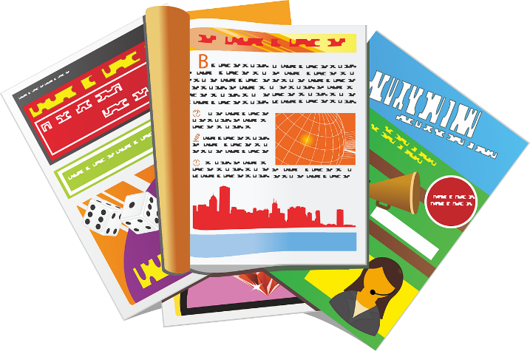

Form: Article
Here are the basic features the exam board are looking for:
a clear/apt/original title
a strapline (heading beneath the main headline)
subheadings
an introductory (overview) paragraph
effectively/fluently sequenced paragraphs.
Putting these elements into your article means you are showing the examiner you can write a specific form of writing and also that you think about the register, style and tone of your writing carefully, too!
Tone, style, register
The tone (sound of writing) is confident and changes dependent on the point being made.
The writing is appropriately formal or informal (register).
The pace (speed) of the writing changes depending on the point being made.

Slide 3

Purpose: Writing to Explain
Purpose: | WRITING TO EXPLAIN
What is it? | Explaining your opinion on a topic to your reader.
What does it involve? | You are not convincing people or advising.
What key features do you often find in this type of writing? | Facts Opinions A neutral and unbiased tone that gets across your opinions on a topic
When you are writing to explain, you are showing you understand what this purpose of writing involves.
It means you are presenting your opinions around a topic, but you do so in a neutral and factual way, rather than trying to show bias and persuade or argue a point.

Slide 4

Audience: The readers of a weekend magazine
In this exam question you are writing to the readers of a weekend magazine.
They are looking to be informed, interested and entertained, which means your article needs to explain your ideas clearly and carefully, but also be interesting to anyone reading it!
That means:
Extensive vocabulary
A carefully planned out structure that supports your ideas and how you get them across to your readers
Appealing to the readers of the magazine through your choice of writing to explain and article language techniques

Slide 5
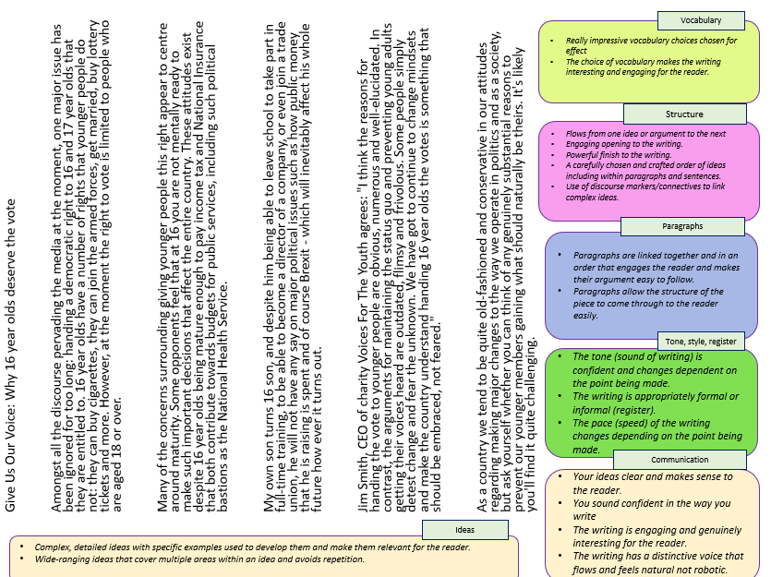
Look at the example answer to the question provided to you
Using the mark scheme boxes and ideas given to you, think about what really works well in this answer in terms of:
Vocabulary
Structure
Paragraphs
Tone, style, register
Communication
Ideas
Go through the answer and highlight sections that work well in your opinion.
Make notes on how this answer works well and meets the requirements of the mark scheme.
Having reflected on this example, what might you add or change to your own version and why?

Slide 6
Give Us Our Voice: Why 16 year olds deserve the vote
Amongst all the discourse pervading the media at the moment, one major issue has been ignored for too long: handing a democratic right to 16 and 17 year olds that they are entitled to. 16 year olds have a number of rights that younger people do not: they can buy cigarettes, they can join the armed forces, get married, buy lottery tickets and more. However, at the moment the right to vote is limited to people who are aged 18 or over.
Many of the concerns surrounding giving younger people this right appear to centre around maturity. Some opponents feel that at 16 you are not mentally ready to make such important decisions that affect the entire country. These attitudes exist despite 16 year olds being mature enough to pay income tax and National Insurance that both contribute towards budgets for public services, including such political bastions as the National Health Service.
My own son turns 16 son, and despite him being able to leave school to take part in full-time training, to be able to become a director of a company, or even join a trade union, he will not have any say on major political issues such as how public money that he is raising is spent and of course Brexit - which will inevitably affect his whole future how ever it turns out.
Jim Smith, CEO of charity Voices For The Youth agrees: "I think the reasons for handing the vote to younger people are obvious, numerous and well-elucidated. In contrast, the arguments for maintaining the status quo and preventing young adults getting their voices heard are outdated, flimsy and frivolous. Some people simply detest change and fear the unknown. We have got to continue to change mindsets and make the country understand handing 16 year olds the votes is something that should be embraced, not feared."
As a country we tend to be quite old-fashioned and conservative in our attitudes regarding making major changes to the way we operate in politics and as a society, but ask yourself whether you can think of any genuinely substantial reasons to prevent our younger members gaining what should naturally be theirs. It's likely you'll find it quite challenging.
Vocabulary
Really impressive vocabulary choices chosen for effect
The choice of vocabulary makes the writing interesting and engaging for the reader.
Structure
Flows from one idea or argument to the next
Engaging opening to the writing.
Powerful finish to the writing.
A carefully chosen and crafted order of ideas including within paragraphs and sentences.
Use of discourse markers/connectives to link complex ideas.
Paragraphs
Paragraphs are linked together and in an order that engages the reader and makes their argument easy to follow.
Paragraphs allow the structure of the piece to come through to the reader easily.
Tone, style, register
The tone (sound of writing) is confident and changes dependent on the point being made.
The writing is appropriately formal or informal (register).
The pace (speed) of the writing changes depending on the point being made.
Communication
Your ideas clear and makes sense to the reader.
You sound confident in the way you write
The writing is engaging and genuinely interesting for the reader.
The writing has a distinctive voice that flows and feels natural not robotic.
Ideas
Complex, detailed ideas with specific examples used to develop them and make them relevant for the reader.
Wide-ranging ideas that cover multiple areas within an idea and avoids repetition.
Notes:
Can be printed off. Word document version also included.

Slide 7
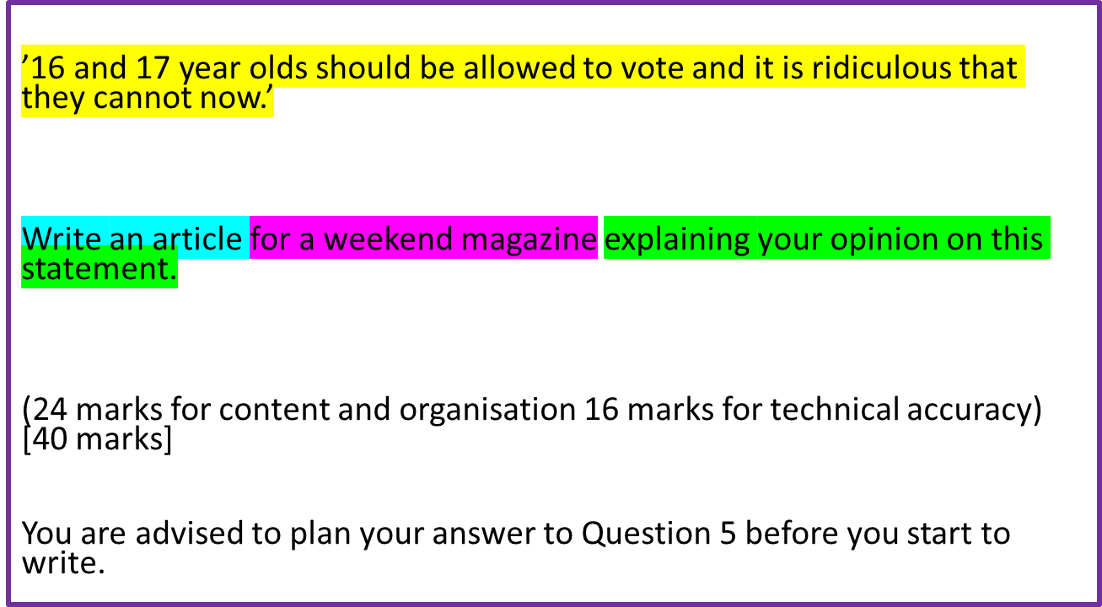
Now, give this a go yourself.
Go through all the steps we’ve looked at and plan out your answer carefully.
If you want to really make it like the exam, time yourself for 45 minutes (allow for any extra time if you are given it).
Remember to think about all the different requirements of the mark scheme.

Slide 8
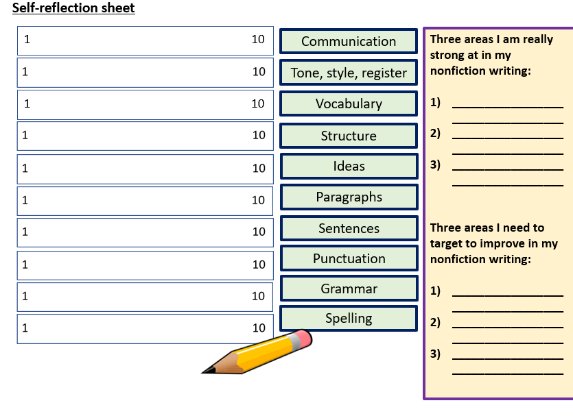
Complete your self-reflection sheet and make changes or additions to your own answer in red pen.
Communication
Tone, style, register
Vocabulary
Structure
Ideas
Paragraphs
Sentences
Punctuation
Grammar
Spelling

Slide 9


Self-reflection sheet
1 10
Communication
Three areas I am really strong at in my nonfiction writing:
__________________________________
__________________________________
__________________________________
Three areas I need to target to improve in my nonfiction writing:
__________________________________
__________________________________
__________________________________
Tone, style, register
1 10
Vocabulary
Structure
Ideas
Paragraphs
Sentences
Punctuation
Grammar
Spelling
Notes:
To print off

